Slide 1
Understanding Nutrition
Class 2
Chapters 3 & 4

Slide 2
Eating toward Digestion
Copyright Getty Images

Slide 3
Peristalsis
Copyright Wadsworth Cengage Learning

Slide 4
Absorption Small Intestine Villi Cengage Learning 2013

Slide 5
Circulatory- Vascular System copyright Wadsworth. Cengage Learning

Slide 6
Digestive Processes
Lymph System
+ Gastrointestinal Bacteria –
Hormones
Picture: copyright Google Images

Slide 7
Nourishing Foods and Pleasant Conversations Cengage Learning 2013

Slide 8
Glucose and Fructose copyright: Wadsworth-Cengage Learning

Slide 9
Hydrolosis copyright: Wadsworth-Cengage Learning

Slide 10
Complex Carbohydrates copyright: Wadsworth-Cengage Learning

Slide 11
Energy Carbs copyright: Wadsworth-Cengage Learning

Slide 12
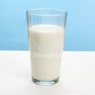
Carbohydrates left picture copyright: Wadsworth-Cengage Learning 2008 right pictures rights: Google Images

Slide 13
Sugars Excess Carbs Healthful Carbs copyrights: Wadsworth-Cengage Learning 2013

Slide 14
Alternative Sweeteners copyright: Wadsworth-Cengage Learning 2013

Slide 15
Carbohydrates and Nutrients in Some Foods copyright: Wadsworth-Cengage Learning 2013

Slide 16
Fiber in Foods copyright: Wadsworth – Cengage Learning 2013

Slide 17
Good Fiber Choices copyright: Wadsworth-Cengage Learning 2013

Slide 18
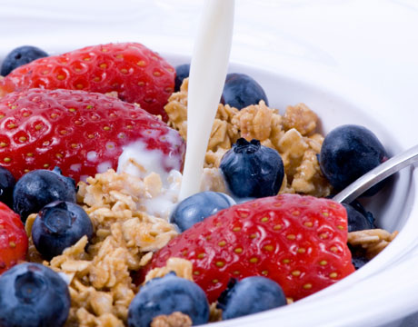
Other sugar Choices copyright: Google Images

Slide 19
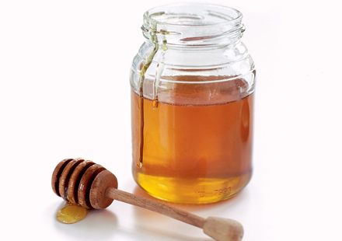
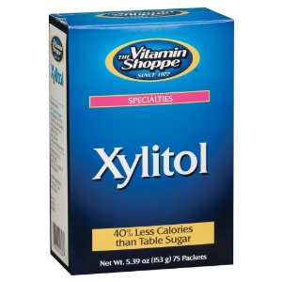
Sweeteners with some Nutrients copyright: Google Images

Slide 20
List of References
Whitney, E., Rolfes, S.,Understanding Nutrition 12th and 13th
editions, Wadsworth Cengage Learning US, 2008, 2013
Noble, R., MS, BA, Fundamentals of Nutrition, SCF Instructor,
Spring 2014
All Rights reserved: R. Noble

