Slide 1
ePortfolios State College of Florida
Less time. Less effort. More awesome.

Slide 2
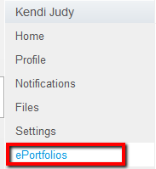
Open ePortfolios
ePortfolios are a place where you display the work you are proud of, ePortfolios can be public for everyone to see, or private so only those you allow can see.
To Open ePortfolios:
In the Help Corner, click the Settings link
In User Navigation, click the ePortfolio link to access all your ePortfolios

Slide 3
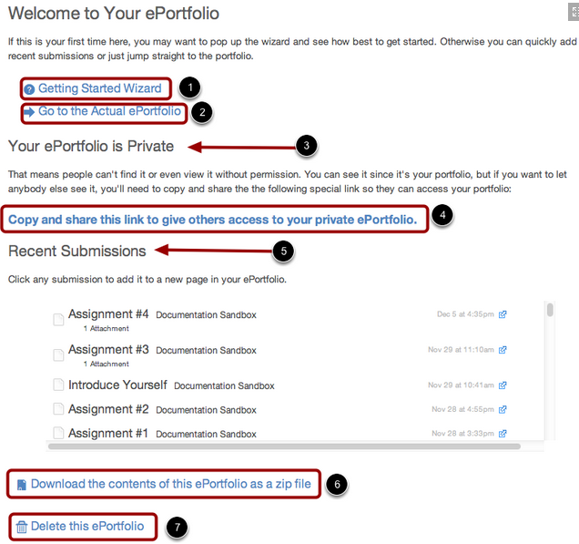
ePortfolio Dashboard
Getting Started Wizard
Go to the Actual ePortfolio (Preview)
Privacy Setting (Private vs. Public)
Copy and Share link
Recent Submissions : make any recently submitted coursework part of your ePortfolio
Download your ePortfolio as a zip file
Delete this ePortfolio

Slide 4
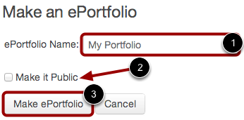
Create an ePortfolio
How To Create an ePortfolio:
In the Help Corner, click the Settings link
In User Navigation, click the ePortfolios link
Name your ePortfolio
Decide if you ePortfolio will be public (you can change this later)
Click Make ePortfolio

Slide 5
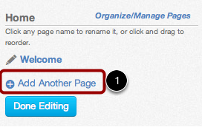
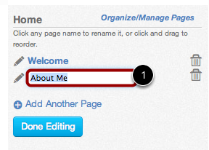
Create a new page in ePortfolio
To create or add new pages to your ePortfolio:
Click the Organize/Manage Pages link
Click Add Another Page link
Type the name of the new page in the name field (Press Enter on a PC or Press Return on a MAC)
Click Done Editing
Click the title of your new page to open it

Slide 6
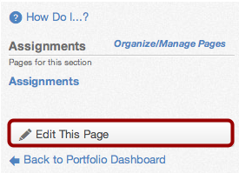
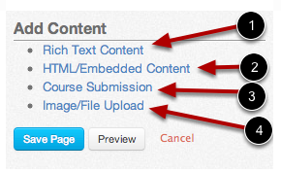
Edit ePortfolio Pages
To Edit Content on your ePortfolio pages:
Click on the Page you want to edit
Click Edit This Page button to add or change content
Add Content
You can add Rich Text Content Editor
HTML/Embedded Content (YouTube Videos, etc…)
Course Submissions
Image/File Uploads
Click Save Page

Slide 7
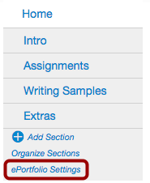
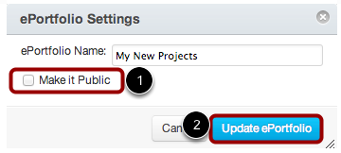
Make ePortfolio Public
To make a private ePortfolio public:
Click the title of the ePortfolio
Click the ePortfolio Settings link
Set Privacy Settings:
Click Make it Public checkbox
Click Update ePortfolio button
Note: by making your portfolio public anybody who has the URL address to your portfolio can view the contents as long as they have a Canvas log in

Slide 8
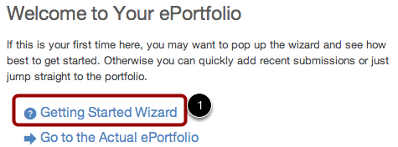
ePortfolio Getting Started Wizard
Once in the ePortfolio, I recommend using the Getting Started Wizard to walk you through your creation, step by step.
Each Link will provide instruction and tutorials for creating the ePortfolio.

Slide 9
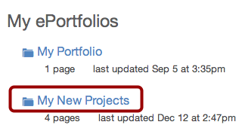
Delete an ePortfolio
To Delete an ePortfolio:
Click on the title of the ePortfolio you want to delete
Click Delete this ePortfolio
Click the Delete ePortfolio button to confirm deletion

Slide 10
Online Learning Staff
Gary Baker
Director Phone: 941-752-5431 Fax: 941-751-8185 Email: bakerg@scf.edu
Kendi Judy
Specialist, Instructional Designer Phone: 941-752-5437 Fax: 941-751-8185
Email: judyk@scf.edu
Melanie Wallace
Staff Assistant Phone: 941-752-5237 Fax: 941-751-8185
Email: wallacm@scf.edu
Dale Drees
Lead Instructional Designer
Phone: 941-752-5345 Fax: 941-751-8185 Email: dreesd@scf.edu
John Ewing LMS Administrator
Phone: 941-752-5254 Fax: 941-751-8185 Email: ewingj@scf.edu

