Slide 1
The Canvas Experience State College of Florida
Less time. Less effort. More awesome.

Slide 2
Student View : Update Profile
Students update their profile by:
Click the Settings link to :
View and edit personal settings
View or add a profile picture
Access links to notifications, files and ePortfolios
Edit profile information

Slide 3
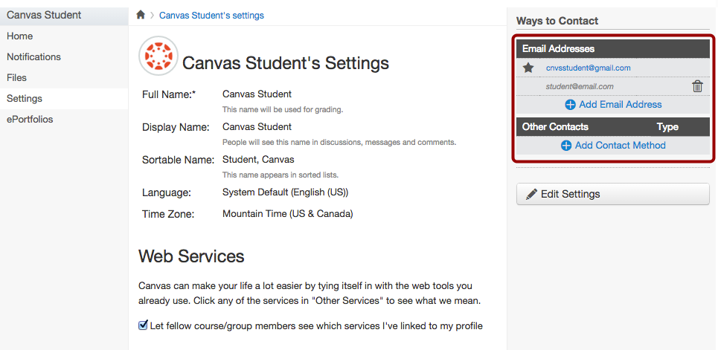
Student View: Notification Preferences
Students can update their notifications preferences by clicking on the Settings link.
Add ways to contact
Update notifications tab – update frequency of notifications

Slide 4
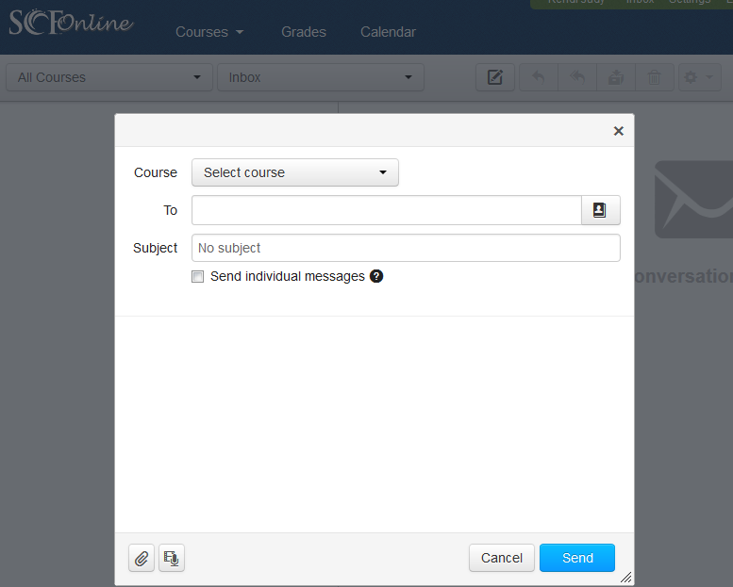
Student View: Communicate with Instructor and Peers
Students have three ways to communicate in Canvas:
Conversations Inbox (email)
Click the Inbox link in the Help Corner.
Enter a name, course, or group to send message to.
Write and send the message
Discussions
Click the discussion title
Click Reply and type reply
Announcements
Click the Announcement Tab
View the Announcement

Slide 5
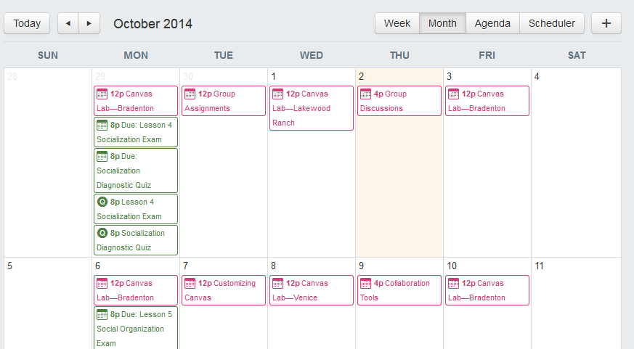
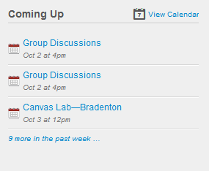
Student View: Keep track of your assignments due
Assignments are any online activity that is graded by the instructor.
Students can keep track of assignments by:
Recent Activity Feed on Main Dashboard
To-Do List on right sidebar
Coming Up Feed on right sidebar
View the Calendar

Slide 6
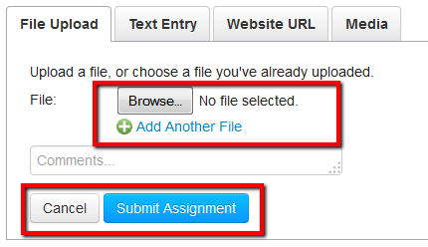
Student View: Submit your Assignments
Students submit assignments by:
Select the assignment to submit
Click the Submit Assignment button
Select the submission type
Upload the assignment
Click the submit button
Wait until you see the Submission ✓Turned In! message

Slide 7
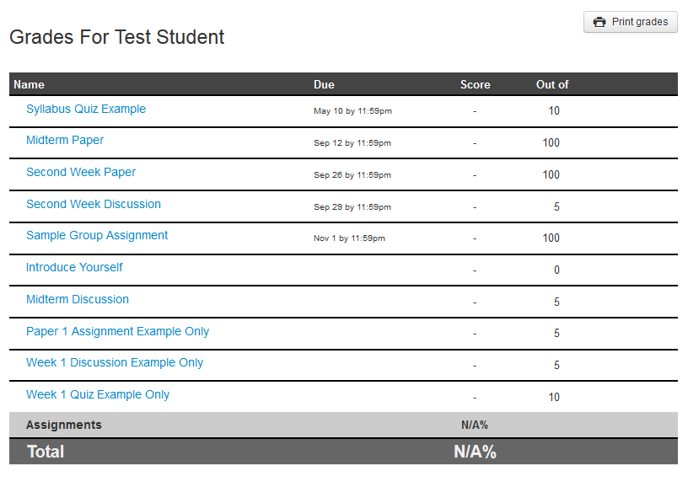
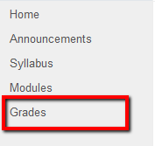
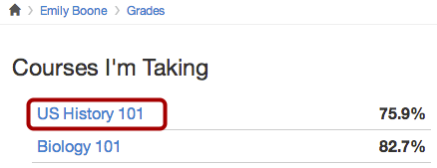
Student View: Check your Grades
Option 1:
View ALL overall grades
Click Grades on dashboard
View All courses
Option 2:
View individual course grades
Click Grades on left hand side
View Grade break down

Slide 8
Online Learning Staff
Gary Baker
Director Phone: 941-752-5431 Fax: 941-751-8185 Email: bakerg@scf.edu
Kendi Judy
Specialist, Instructional Designer Phone: 941-752-5437 Fax: 941-751-8185
Email: judyk@scf.edu
Melanie Wallace
Staff Assistant Phone: 941-752-5237 Fax: 941-751-8185
Email: wallacm@scf.edu
Dale Drees
Lead Instructional Designer
Phone: 941-752-5345 Fax: 941-751-8185 Email: dreesd@scf.edu
John Ewing LMS Administrator
Phone: 941-752-5254 Fax: 941-751-8185 Email: ewingj@scf.edu

