Slide 1
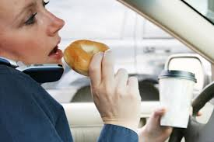
Distracted Driving
By. Frank Hoy
http://streetsblog.net/wp-content/uploads/2010/09/distracted-driver-1.jpg

Slide 2
http://justmesayingtwo.files.wordpress.com/2010/06/home-of-the-godley-wildcats1.jpg

Slide 3
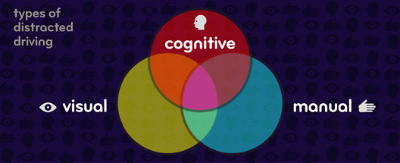
Definition:
any activity that could divert a person's
attention away from the primary task of driving
texting and taking calls on a cell phone
eating or drinking
talking to others in the car
grooming oneself
reading
using a GPS
watching a movie
http://www.esurance.com/safety/3-types-of-distracted-driving
United States. Dept. of Transportation. “What is Distracted Driving?” Distraction.gov. US Dept. of Transportation, n.d. Web. 12 Feb. 2013.

Slide 4
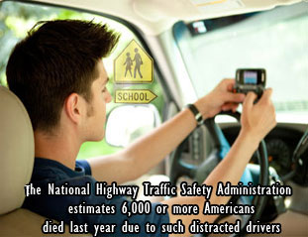
Statistics:
37% of people admit to texting and driving
13% of people have surfed
the web while driving.
86% of have admitted
to eating while driving
6000 deaths and
½ million injuries a year
http://www.jimadler.com/newsandviews
/images/distracted-driver.jpg
Cellphone and Texting Accident Statistics. Pittsburg: Edgar Snyder & Associates, 2012. Web

Slide 5
Alternatives:
Education
Time management
Realizing it’s not imperative
to answer calls or texts
Use a headset
Rosenberger, Robert. Phenomonology and the Cognitive Sciences. Atlanta, GA: Springer Science+Business Media, 2011. Print
United States. Dept. of Transportation. “What is Distracted Driving?” Distraction.gov. US Dept. of Transportation, n.d. Web. 12 Feb. 2013

Slide 6
Conclusion:
Distracted driving is the leading cause of vehicular deaths
Know the statistics
Understand what distracts you
Know preventative measures

Slide 7
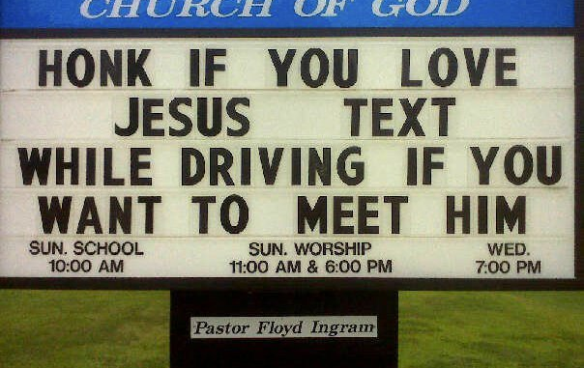
http://dc.streetsblog.org/wp-content/uploads/2012/06/texting-while-driving.jpg

