Slide 1
PowerPoint™ Presentation Prepared by
Diana M. Cooley, Ph.D.
Lone Star College – North Harris
Houston, Texas

Slide 2
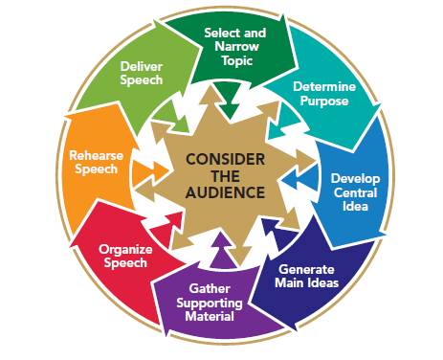
Chapter 1
Introduction to Public Speaking & the Audience-Centered Speaking Process
This multimedia product and its contents are protected under copyright law. The following are prohibited by law:
any public performance or display, including transmission of any image over a network;
preparation of any derivative work, including the extraction, in whole or in part, of any images;
any rental, lease, or lending of the program.
Notes:
Chapter Overview:
Why study public speaking
Public Speaking as a communication process
The rich heritage of public speaking
An overview of audience-centered public speaking

Slide 3
If all my talents and
powers were to be
taken from me by some
inscrutable Providence,
and I had my
choice of keeping but
one, I would unhesitatingly
ask to be
allowed to keep the
Power of Speaking, for
through it, I would
quickly recover all
the rest.
~Daniel Webster
Copyright © 2013, 2008, 2006 Pearson Education, Inc. All Rights Reserved.
Copyright © 2013, 2010, 2007, 2005 Pearson Education, Inc. All Rights Reserved.

Slide 4
Why Study Public Speaking?
Empowerment
Helps you achieve your goals
Gives you the “edge”
Helps you display confidence
Helps you express conviction
Employment
Leaders are needed to inform others
Leaders are needed to be organized
Leaders are needed to hold listeners attention
Notes:
NOTES:
Communication is the top skill that helps graduates land jobs.
Quick Check:
The ability to speak with competence & confidence will provide empowerment.
Being able to communicate effectively with others is key to success in any line of employment
Table 1.1 (next slide) demonstrates the top skills valued by employers

Slide 5
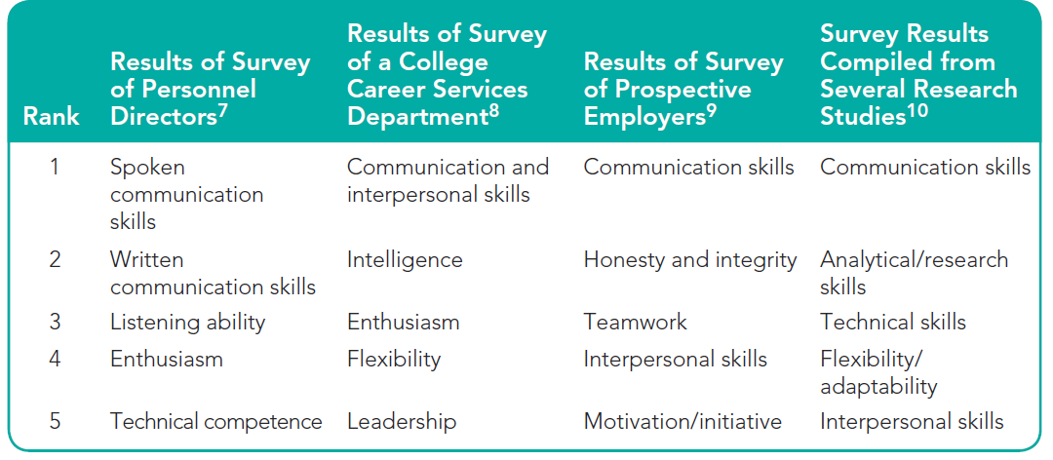
Table 1.1
Top Skills Valued by Employers
Notes:
NOTES:
The skills you learn in a public-speaking course, such as how to ethically adapt information to listeners, organize your ideas, persuade others, and hold listeners’ attention are among the skills that are most sought by employers. In a nationwide survey, prospective employers of college graduates said that they seek candidates with “public-speaking and presentation ability. Other surveys of personnel managers, both in the United States and internationally, have confirmed that they consider communication skills to be the top factor in helping graduating college students to obtain employment (p. -- ).

Slide 6
Public Speaking as a Communication Process
There three key differences between conversation and public speaking
Public speaking is more prepared than conversation
Public speaking is also more formal than conversation
Public speaking involves more clearly defined roles for the speaker & audience than conversation
Notes:
NOTES:
There are three key differences between conversation and public speaking:
• Public speaking is more prepared than conversation. Although there may be times when you are asked to speak on the spur of the moment, you will usually know in advance if you will be expected to give a talk on a specific occasion. A public speaker may spend hours or even days planning and practicing his or her speech.
• Public speaking is also more formal than conversation. The slang or casual language that we often use in conversation is not appropriate for most public speaking. Audiences expect speakers to use standard English grammar and vocabulary. The nonverbal communication of public speakers is also more formal than nonverbal behavior in ordinary conversation.
• Public speaking involves more clearly defined roles for the speaker and audience than conversation. During a conversation, there is typically interaction between speaker and listener. But in public speaking, the roles of speaker and audience are more
clearly defined and remain stable. Although in some cultures, a call-and-response speaker–audience interaction occurs (such as saying, “That’s right” or “Amen” in response to a preacher’s sermon), audience members rarely interrupt or talk back to speakers during most speeches.

Slide 7
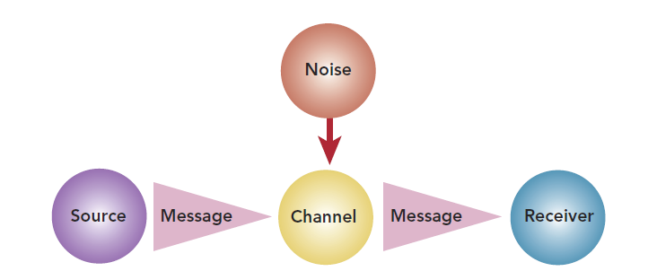
Communication as Action
Source
Message
Channels
Receiver
Noise
Notes:
NOTES:
Communication as Action:
The earliest models that communication theorists formulated were linear, suggesting a simple transfer of meaning from a sender to a receiver, as shown in Figure 1.1. Although theorists later realized that these ideas were too simplistic, early models did identify most of the elements of the communication process. We will explain each element as it relates to public speaking.
Source A public speaker is a source of information and ideas for an audience. The job of the source or speaker is to encode, or translate, the ideas and images in his or her mind into verbal or nonverbal symbols (a code) that an audience can recognize. The speaker may encode into words (for example, saying, “The fabric should be 2 inches square”) or into gestures (showing the size with his or her hands).
Message The message in public speaking is the speech itself—both what is said and how it is said. If a speaker has trouble finding words to convey his or her ideas or sends contradictory nonverbal symbols, listeners might not be able to decode the speaker’s verbal and nonverbal symbols into a message.
Channels A message is usually transmitted from sender to receiver via two channels: visual and auditory. Audience members see the speaker and decode his or her nonverbal symbols—eye contact (or lack of it), facial expressions, posture, gestures, and dress. If the speaker uses any visual aids, such as graphs or models, these too are transmitted along the visual channel. The auditory channel opens as the speaker speaks. Then the audience members hear words and such vocal cues as inflection, rate, and voice quality.
Receiver The receiver of the message is the individual audience member, whose decoding of the message will depend on his or her own particular blend of past experiences, attitudes, beliefs, and values. An effective public speaker should be receiver or audience-centered.
Noise Anything that interferes with the communication of a message is called noise. Noise may be physical and external. If your 8 a.m. public-speaking class is frequently interrupted by the roar of a lawn mower running back and forth under the window, it may be difficult to concentrate on what your instructor is saying. A noisy air conditioner, a crying baby, or incessant coughing can make it difficult for audience members
to hear or concentrate on a speech. Noise can also be internal. This type of noise may stem from either physiological or psychological causes and may directly affect either the source or the receiver. A bad cold (physiological noise) may cloud a speaker’s memory or subdue his or her delivery. An audience member who is worried about an upcoming exam (psychological noise) is unlikely to remember much of what the speaker says. Whether it is internal or external.

Slide 8
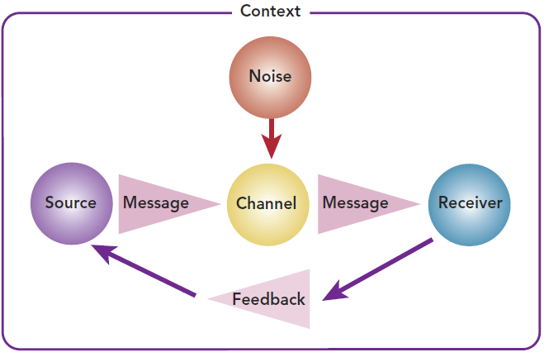
Communication as Interaction
Feedback
Context
Notes:
NOTES:
Communication as Interaction: Realizing that linear models were overly simplistic, later communication theorists designed models that depicted communication as a more complex process (see Figure 1.2). These models were circular, or interactive, and added two important new elements: feedback and context.
Feedback One way in which public speaking differs from casual conversation is that the public speaker does most or all of the talking. But public speaking is still interactive. Without an audience to hear and provide feedback, public speaking serves little purpose. Skillful public speakers are audience-centered. They depend on the nods, facial expressions, and murmurings of the audience to signal them to adjust their rate of speaking, volume, vocabulary, type and amount of supporting material, and other variables to communicate their message successfully.
Context The context of a public-speaking experience is the environment or situation in which the speech occurs. It includes such elements as the time, the place, and the speaker’s and audience’s cultural traditions and expectations. To paraphrase John Donne, no speech is an island—no speech occurs in a vacuum. Rather, each speech is a blend of circumstances that can never be replicated exactly again. The person whose job it is to deliver an identical message to a number of different audiences at different times and in different places can attest to the uniqueness of each
speaking context. If the room is hot, crowded, or poorly lit, these conditions affect both speaker and audience. The audience that hears a speaker at 10 a.m. is likely to be fresher and more receptive than a 4:30 p.m. audience. A speaker who fought rush-hour traffic for ninety minutes to arrive at his or her destination may find it difficult to muster much enthusiasm for delivering the speech. Many of the skills that you will learn from this book relate not only to the preparation of effective speeches (messages), but also to the elements of feedback and context in the communication process. Our audience-centered approach focuses on “reading” your listeners’ responses and adjusting to them as you speak.

Slide 9
Communication as Transaction
Notes:
NOTES:
The most recent communication models do not label individual components. Transactive models focus instead on communication as a simultaneous process. As the model in Figure 1.3 suggests, we send and receive messages concurrently. In a two-person communication
transaction, both individuals are sending and receiving at the same time. When you are listening, you are also expressing your thoughts and feelings nonverbally. An effective public speaker should not only be focused on the message he or she is expressing, but also be tuned in to how the audience is responding to the message. A good public speaker shouldn’t wait until a speech is over to gauge its effectiveness but, because of the transactive nature of communication, should be scanning the audience during the speech for nonverbal clues to the audience’s reaction. Although communication models have been developed only recently, the elements of these models have long been recognized as the keys to successful public speaking. As you study public speaking, you will continue a tradition that goes back to the very beginnings of Western civilization.

Slide 10
The Rich Heritage of Public Speaking
Public Speaking Throughout Western History
Fourth Century B.C.
Medieval Europe
Public Speaking Throughout U.S. History
Eighteenth Century
Nineteenth Century
Twentieth Century
Twenty-First Century
Notes:
NOTES:
The fourth century B.C.E. was a golden age for rhetoric in the Greek Republic, where the philosopher Aristotle formulated guidelines for speakers that we still follow today. Several centuries later, as politicians and poets attracted large followings in ancient Rome, Cicero and Quintilian sought to define the qualities of the “true” orator. On a lighter note, it is said that Roman orators invented the necktie; fearing laryngitis, they
wore “chin cloths” to protect their throats.
By the 1400s in medieval Europe, the clergy were the most polished public speakers. People gathered eagerly to hear Martin Luther expound his Articles of Faith.
In the eighteenth century, British subjects in the American colonies listened to town criers and to the speeches of impassioned patriots of what was to become the United States. About a hundred years later, nineteenth-century audiences heard speakers such as Henry Clay and Daniel Webster debate states’ rights; they listened to Frederick Douglass, Angelina Grimke, and Sojourner Truth argue for the abolition of slavery and to Lucretia Mott plead for women’s suffrage; they gathered for an evening’s entertainment to hear Mark Twain as he traveled the lecture circuits of the frontier. Students of nineteenth-century public speaking spent very little time developing their own speeches. Instead, they practiced the art of declamation—the delivery of an already famous address. Favorite subjects for declamation included speeches by Americans such as Patrick Henry and William Jennings Bryan and British orator Edmund Burke. Collections of speeches, such as Bryan’s own ten-volume set of The World’s
Famous Orations, published in 1906, were extremely popular. Hand in hand with declamation went the study and practice of elocution, the expression of emotion through posture, movement, gestures, facial expression, and voice. From the mid-nineteenth century to the early twentieth century, elocution manuals, providing elaborate and specific prescriptions for effective delivery, were standard references not only in schools, but also in nearly every middle-class home in the United States. In the first half of the twentieth century, radio made it possible for people around the world to hear Franklin Delano Roosevelt decry December 7, 1941, as “a date which will live in infamy.” In the last half of the century, television was the medium through which audiences saw and heard the most stirring speeches:
With the twenty-first century dawned a new era of speechmaking. It was to be an era that would draw on age-old public-speaking traditions and an era in which U.S. soldiers serving in Iraq would watch their children’s commencement addresses live via streaming video. And it was to be an era that would summon public speakers to meet some of the most difficult challenges in history—an era in which a U.S. president would face a nation badly shocked by the events of September 11, 2001, and assure them that “terrorist attacks can shake the foundations of our biggest buildings, but they cannot touch the foundation of America. These acts shattered steel, but they cannot dent the steel of American resolve.” Speakers in the future will continue to draw on a long and rich heritage in addition to forging new frontiers in public speaking.

Slide 11
Figure 1.4
Model of the Speechmaking Process
Notes:
NOTES:
As you think about preparing your first speech, you might wonder, “What do I do first?” Your assignment might be to introduce yourself. Or your first assignment might be a brief informative talk—to describe something to your audience. Regardless of the specific assignment, you need some idea of how to begin. Figure 1.4 presents a diagram of the tasks involved in the speechmaking process, emphasizing the audience as the central concern at every step of the process.

Slide 12
Overview of Audience-Centered Public Speaking
Consider your audience
Gather & analyze information about your audience
Consider the culturally diverse backgrounds of your audience
Select & narrow your topic
Who is the audience?
What are my interests, talents, & experiences?
What is the occasion?
Notes:
NOTES:
Considering your audience: In designing and delivering your speech, always make choices with your audience in mind. Audience analysis is not something you do only at the beginning of preparing your speech. It is an ongoing activity. The needs, attitudes, beliefs, values, and other characteristics of your audience influence the choices you make about your speech at every step of the speech-preparation process. Your selection of topic, purpose, and even major ideas should be based on a thorough understanding of your listeners. In a very real sense, your audience “writes” the speech. Gather and analyze information about your audience Being audience-centered involves making decisions about the content and delivery of your speech before you speak, based on knowledge of your audience’s values, beliefs, and knowledge. It also means being aware of your audience’s responses during the speech so that you can make appropriate adjustments.

Slide 13
Overview of Audience-Centered Public Speaking
Determine your purpose
What is your general & specific purpose of speaking?
Determine your general purpose
Speaking to inform
Speaking to persuade
Speaking to entertain
Determine your specific purpose
Adds detail to your general purpose

Slide 14
Overview of Audience-Centered Public Speaking
Develop your central idea
What are your major divisions of your speech?
What are the key points you want to develop?
Generate the main ideas
Does the central idea have logical divisions?
Can you think of several reasons why the central idea is true?
Can you support the central idea with a series of steps?

Slide 15
Overview of Audience Centered Public Speaking
Gather supporting material
Personal
Concrete
Appealing to the senses
Develop your research skills
Gather visual supporting material
Organize your speech
Divide your speech
Outline your speech

