Slide 1
Creating a Positive World for the Youth of Today
By: Jennifer Brader

Slide 2
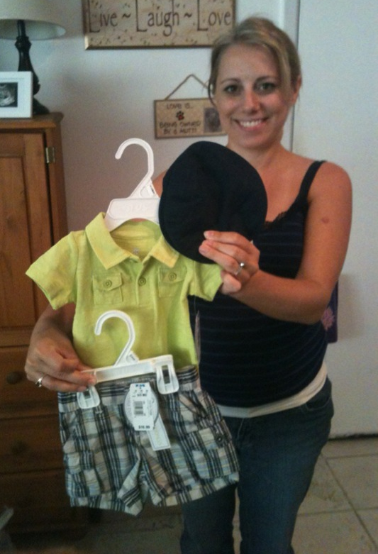
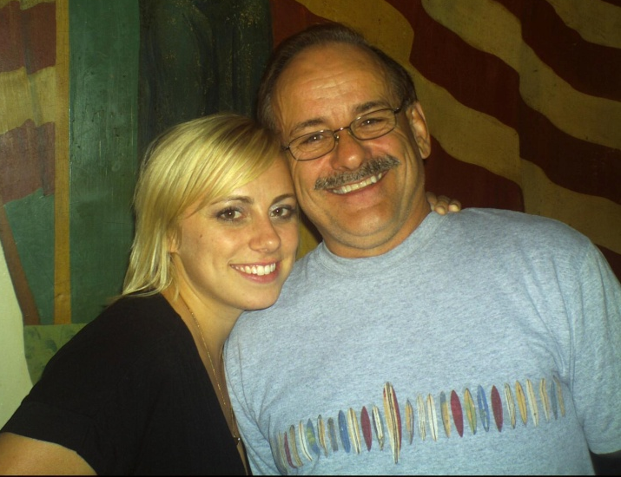
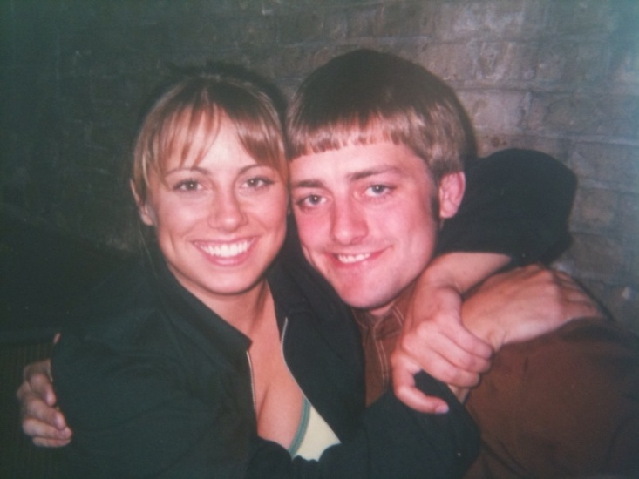
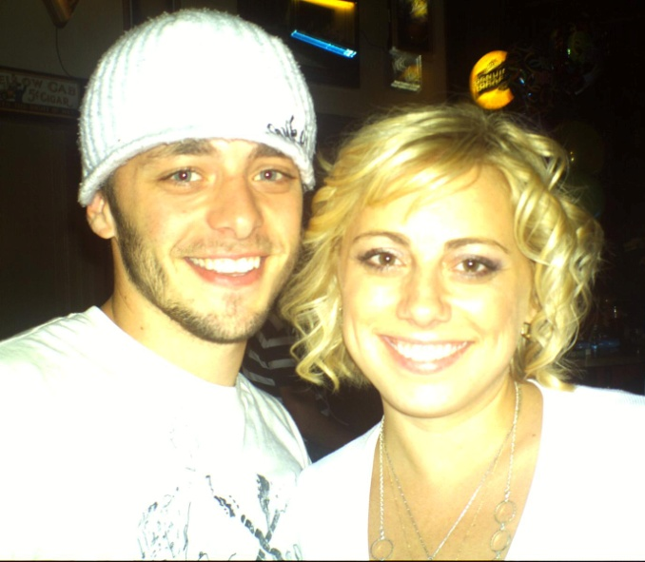
Left: Mom-to-Be
Below: Wife & Husband
Above: Daughter & Father
Above: Sister & Brother
Above: Brother & Sister
Left: Mother & Daughter

Slide 3
From “Picture Perfect” to a life at-risk

Slide 4
http://kellycaul.com/yahoo_site_admin/assets/images/Be_logo_final-_1.309133644_std.png

Slide 5
FACTORS & WARNING SIGNS
CAUSES
POSITIVE SOLUTION

Slide 6
FACTORS & WARNING SIGNS
SUBSTANCE ABUSE
FAMILY LIFE
VIOLENCE
IS THE TEEN…?

Slide 7
SUBSTANCE ABUSE
Marijuana use increased 32% to 39% from 2008 to 2010
45% of 2,500 high school students don’t see a “great risk” in drinking heavily everyday
http://www.acsh.org/factsfears/newsid.2515/news_detail.asp

Slide 8
FAMILY LIFE
Strongest socializing forces
Teach children to control unacceptable behavior
Teach children to delay gratification
Teach children to respect the rights of others
http://facstaff.elon.edu/ajones5/Anika’s%20paper.htm

Slide 9
VIOLENCE
11.1% of youth, grades 9-12, were in a physical fight in 2009
More than 656,000 young people, age 10 to 24, were treated in emergency departments for injuries sustained from violence, in 2008
http://www.cdc.gov/ViolencePrevention/pdf/YV-DataSheet-a/pdf

Slide 10
WARNING SIGNS
Does the teen sometimes lie regarding their activities?
Is the teen verbally abusive?
Does the teen lack self-worth and self-esteem?
Does the teen associate with a suspect peer group?
http://At-risk.org

Slide 11
CAUSES
PARENTS
ADOLESCENTS AND TEENS
PEERS

Slide 12
PARENTS
Children who are rejected
Children who grow up in homes with conflict
Children who are inadequately supervised
ARE AT THE GREATEST RISK OF BECOMING DELINQUENT
Wright, Kevin N. and Karen E. Wright. Family Life, Delinquency, and Crime: A Policymakers Guide.

Slide 13
ADOLESCENTS & TEENS
Believe themselves to be indestructible
Believe themselves to be untouchable
TO THEIR CONSEQUENCES OF TOMORROW
Wright, Kevin N. and Karen E. Wright. Family Life, Delinquency, and Crime: A Policymakers Guide.

Slide 14
PEERS
50% of teens feel pressured with regard to sex in relationships
30% of teens are offered drugs in middle school and high school
74.3% of high school students have tried alcohol
http://www.familyfirstaid.org/peer-pressure.html

Slide 15
SOLUTION
POSITIVE SOCIAL SUPPORT
COMMUNITY INVOLVEMENT

Slide 16
FRIENDS & FAMILY
Open lines of communication between themselves and their children
Get to know their child’s friends
Be involved
Encourage their child and be supportive
http://www.familyfirstaid.org/peer-pressure.html

Slide 17
COMMUNITY
POLICE ATHLETIC LEAGUE OF SARAOSTA (PAL)
PAL serves over 1,200 young people
PAL provides a safe environment
PAL allows youth to participate, learn, and achieve positive relationships
PAL teaches youth self-respect and self-worth
http://www.saraostapal.org/main.htm

Slide 18
CONCLUSION
FACTORS & WARNING SIGNS: Substance Abuse, Family Life, and Violence
CAUSES: Parents, Adolescents & Teens, and Peers
SOLUTION: Positive Social Support and Community Involvement

Slide 19
CHALLENGE
DONATE: TIME and/or MONEY to an organization
www.sarasotapal.org
BE A POSITIVE ROLE MODEL: to the youth in our community
http://www.saraostapal.org/main.htm

Slide 20
Forest witcraft from “Within my power” pronounced:
“A hundred years from now it will not matter what my bank account was, the sort of house I lived in, or the kind of car I drove… but the world may be different because I was important in the life of a child.”
http://www.saraostapal.org/main.htm

Slide 21
BE APART OF SOMETHING GREAT!
BE A POSITIVE ROLE MODEL TO A CHILD!
BE IMPORTANT IN THE LIFE OF A CHILD!
BE THE PERSON TO GIVE A CHILD A BRIGHTER FUTURE!
http://www.westkentpct.nhs.uk/images/ZZ_1212486843_childrengroup.jpg

