Slide 1
PowerPoint™ Presentation Prepared by
Diana M. Cooley, Ph.D.
Lone Star College – North Harris
Houston, Texas
Notes:
1

Slide 2
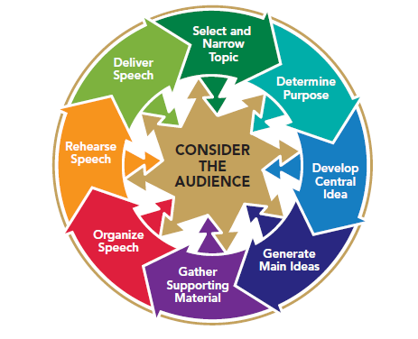
Chapter 14
Designing and Using Presentation Aids
This multimedia product and its contents are protected under copyright law. The following are prohibited by law:
any public performance or display, including transmission of any image over a network;
preparation of any derivative work, including the extraction, in whole or in part, of any images;
any rental, lease, or lending of the program.
Notes:
Chapter Overview:
The Value of Presentation Aids
Types of Presentation Aids
Guidelines for Developing Presentation Aids
Guidelines for Using Presentation Aids

Slide 3
The soul never thinks
without a picture.
~Aristotle
Copyright © 2013, 2010, 2007, 2005 Pearson Education, Inc. All Rights Reserved.

Slide 4
The Value of Presentation Aids
Presentation aids enhance understanding
Presentation aids enhance memory
Presentation aids help listeners to organize ideas
Presentation aids help to gain and maintain attention
Presentation aids help to illustrate a sequence of events or procedures
Notes:
NOTES:
Presentation aids are invaluable to an audience-centered speaker. They help your audience to understand and remember your message and help you to communicate the organization of your ideas, gain and maintain attention, and illustrate a sequence of events or procedures.
Presentation aids enhance understanding. Of your five senses, you learn more from sight than from all the others combined. In fact, it has been estimated that more than 80 percent of all information comes to you through sight.
Presentation aids enhance memory. Your audience will not only have an improved understanding of your speech but also better remember what you say as a result of visual reinforcement. There is evidence that high-tech presentation aids enhance learning. Researchers estimate that people remember 10 percent of what we read, 20 percent of what we hear, 30 percent of what we see, and 50 percent of what we simultaneously hear and see.
Presentation aids help listeners to organize ideas. Most listeners need help understanding the structure of a speech. Even if you lay out your major points clearly, use effective internal summaries, and make clear transition statements, your listeners will welcome additional help. Listing major ideas on a chart, a poster, or an overhead transparency can add clarity to your talk and help your audience grasp your main ideas.
Presentation aids help to gain and maintain attention. Presentation aids not only grab the attention of your listeners but also keep their interest when words alone might not.
Presentation aids help to illustrate a sequence of events or procedures. If your purpose is to inform an audience about a process—how to do something or how something functions—you can do this best through actual demonstrations or with a series of visuals.
Contemporary communicators understand the power of visual rhetoric in informing and persuading others. Visual rhetoric is the use of images as an integrated element in the total communication effort a speaker makes to achieve his or her speaking goal.

Slide 5
Types of Presentation Aids: Three-Dimensional Presentation Aids
Objects
Models
People
Notes:
NOTES:
The first question many students ask when they learn that they are required to use presentation aids is “What type of presentation aid should I use?” We will discuss three classes of presentation aids: three-dimensional, two-dimensional, and audiovisual.
Objects: Objects add interest because they are tangible. They can be touched, smelled, heard, and even tasted as well as seen. Objects are real, and audiences like the real thing. When you use an object to illustrate an idea, make sure that you can handle the object with ease.
Models: If you cannot bring the object that you would like to show your audience, consider showing a model of it. Make sure, however, that any model you use is large enough to be seen by all members of your audience.
People: People can serve as presentation aids, Using people to illustrate your message can be tricky, however. Utilize the following tips when using people as a visual (How To Box: Use People as Presentation Aids):
Choose models with care.
Plan & practice
Time your model’s appearance
Stay in control

Slide 6
Types of Presentation Aids: Two-Dimensional Presentation Aids
Drawings
Photographs
Slides
Maps
Graphs
Bar graph
Pie graph
Line graph
Picture graph
Notes:
NOTES: The most common presentation aids are two-dimensional: drawings, photographs, to use overhead transparencies. Although two-dimensional aids are the most common, you’ll more than likely incorporate them into PowerPoint slides to illustrate your message.
Drawings: Drawings are popular and often-used presentation aids because they are easy and inexpensive to make. Drawings can be tailored to your specific needs.
Photographs: Photographs can be used to show objects or places that cannot be illustrated with drawings or that an audience cannot view directly. The problem with photos printed on paper is that they are usually too small to be seen clearly from a distance. Passing a photograph among your listeners is not a good idea either; it creates competition for your audience’s attention. If you’re using PowerPoint, you can import your photos into PowerPoint slides to make them large enough for everyone to see.
Slides: slides have several disadvantages: The room has to be darkened, and slides require special projectors (with bulbs that all too often burn out just as the room lights are dimmed). In addition, slides need to be loaded properly or they could be projected upside down. Today, a speaker rarely uses slides because of the advantages of PowerPoint.
Maps: Most maps are designed to be read from a distance of no more than two feet.
Graphs: A graph is a pictorial representation of statistical data in an easy-to understand format. Most graphs that are used in speeches are prepared by using either Excel or Word and then displayed as PowerPoint slides. Why use a graph? Because statistics are abstract summaries of many examples, most listeners find that graphs help to make the data more concrete. Yet research suggests that in addition to presenting information in a graph, it’s important to narrate the information presented. A bar graph uses flat areas—bars—of various lengths to represent information. The bar graph in Figure 14.2 clearly shows the growth rates in the number of wireless subscribers. A pie graph shows the individual shares of whole. The pie graph in Figure 14.3 shows the top Internet search providers. Pie graphs are especially useful in helping your listeners to see quickly how data are distributed in a given category. Line graphs show relationships between two or more variables, using lines or curves. Like bar graphs, line graphs organize statistical data to show overall trends (Figure 14.4). pictures to represent the data you are summarizing (Figure 14.5). Picture graphs look somewhat less formal and less intimidating than other kinds of graphs. One of the advantages of picture graphs is that they use few words or labels, which makes them easier for your audience to read.

Slide 7
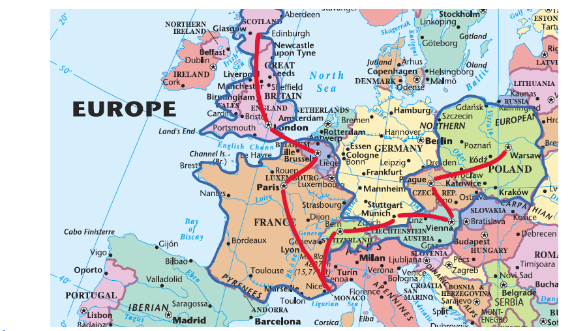
Figure 14.1
Two-Dimensional Presentation Aid: Map
Notes:
NOTES:
Figure 14.1 A map can be an effective visual aid, especially if the speaker personalizes it by highlighting the relevant information.

Slide 8
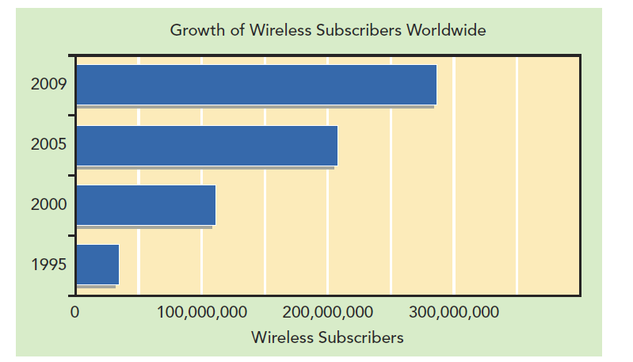
Two-Dimensional Presentation Aid: Bar Graph
Figure 14.2
Notes:
NOTES:
Figure 14.2 Bar graphs can help to summarize statistical information clearly so that the information is immediately visible to the audience.

Slide 9
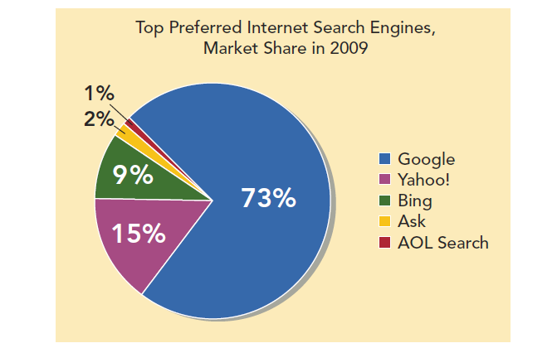
Figure 14.3
Two-Dimensional Presentation: Pie Graph
Notes:
NOTES:
Figure 14.3 A pie graph shows the percentage of a whole contributed by each part.

Slide 10
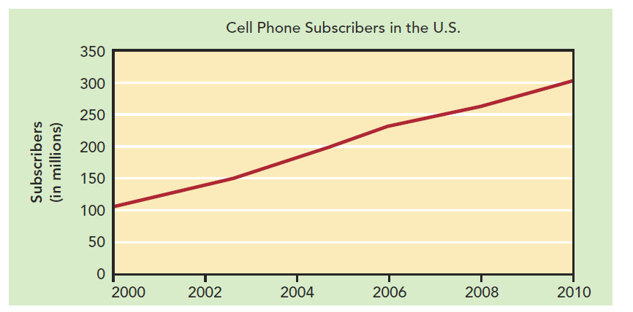
Figure 14.4
Two Dimensional Presentation Aid: Line Graph
Notes:
NOTES:
Figure 14.4 Line graphs show relationships between two or more variables.

Slide 11
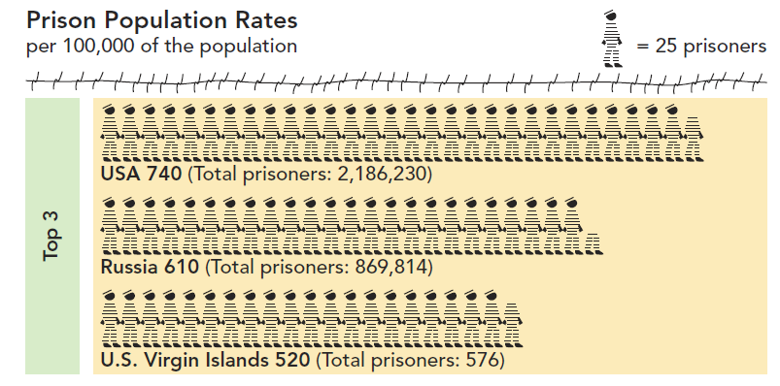
Figure 14.5
Two-Dimensional Presentation Aid: Visual Symbols
Notes:
NOTES:
Figure 14.5 Adding visual symbols, such as those in this picture graph can help your audience to maintain interest and understand complete information.

Slide 12
Types of Presentation Aids: Two-Dimensional Presentation Aids
Charts
Flipcharts
Chalkboards and whiteboards
Overhead transparencies
Notes:
NOTES:
Charts summarize and present a great deal of information in a small amount of space. They have several advantages. They are easy to use, reuse, and enlarge. They can also be displayed in a variety of ways: as a flipchart, a poster, or a PowerPoint slide. Like all other presentation aids, charts must be simple. Do not try to put too much information on one chart. several advantages. They are easy to use, reuse, and enlarge. They can also be displayed in a variety of ways: as a flipchart, a poster, or a PowerPoint slide. Like all other presentation aids, charts must be simple. Do not try to put too much information on one chart.
Flipcharts: A flipchart consist of a large pad of paper resting on an easel. Flipcharts are often used in business presentations and training sessions, although the prevalence of computer graphics software has reduced their use in corporate presentations. You can either prepare your visual aids before your speech or draw on the paper while speaking. Flipcharts are easy to use; during your presentation, you need only flip the page to reveal your next visual. Flipcharts are best used when you have brief information to display or when you want to summarize comments from audience members during a presentation.
Chalkboards & whiteboards: Chalkboards and whiteboards are often used to provide visual support for spoken words. Chalkboards and whiteboards have several advantages: They are inexpensive, simple to use, and low-tech, so you don’t need to worry about extension cords or special training. Use a board only for brief phrases or for very simple line diagrams that can be drawn in just a few seconds. For anything beyond that, it is usually better to prepare a chart, graph, or drawing on a poster or PowerPoint slide than to use a chalkboard or whiteboard.
Overhead transparencies: An overhead projector projects images drawn or printed on clear sheets of plastic, called transparencies, onto a screen so that the images can be seen by a large group. Overhead projectors allow you to maintain eye contact with your audience as you write on the transparency. In addition, the overhead doesn’t require that you turn off the lights in the room.

Slide 13
PowerPoint Presentation Aids
Make it simple
Keep your presentation professional
Unify visuals
Choose fonts carefully
Choose colors carefully
Allow plenty of time to create visuals
Control attention with PowerPoint slides
Notes:
NOTES: Most audiences, especially those in the corporate world, expect a speaker to use PowerPoint—a popular software program that helps you to create and present images photos, words, charts, and graphs. Although PowerPoint or any other computer generated graphics tool can be overused and, like any presentation aid, can distract from your message if used improperly, it nonetheless opens up professional-looking possibilities for illustrating your speech. One of the biggest problems with PowerPoint presentations is the fact that a speaker might be tempted to shovel vast amounts of information at listeners without regard for their attention span. Follow these simple rules when developing a PowerPoint presentation:
Make slides simple: Use no more than seven lines of text on a single slide; use bullets; use parallel structure. For example, start every bullet point with the same word. Use the heading to summarize the main point of the slide. Listeners should be able to follow the key points of the story your visuals tell by reading only the headings.
Keep your presentation professional: Use high-quality clip art, available free at many Web sites; Resist overusing sounds (such as zooming race cars) or distracting visual effects for transitions between slides.
Unify visuals: Use a common visual element on each slide, such as the same bullet or symbol; Use a common font in all your slides; Use a similar background or style for each slide.
Choose fonts carefully: Categories of fonts are shown in Figure 14.6; Make the words big. Use large font sizes. It’s better to use two or three slides than to cram too much information, in tiny print, onto a single slide; Limit yourself to one or two typefaces on a single visual. If you use two, choose them from different categories.
Choose colors carefully: Use red and orange to communicate warmth; use blue and green for calm coolness; Use no more than two colors of text; Be cautious about using red and green together; Use a light background with darker text to catch attention.
Allow plenty of time to create visuals: Spend the time to polish professional images; Carefully integrate your verbal and visual messages; Take time to get feedback, advice, or assistance from others; Practice using your visuals when you rehearse your speech.
Control attention with PowerPoint slides: Control the audience’s attention by timing when you show slides; Use a blank slide, turn off projector, or cover the lens to focus attention back to you.

Slide 14
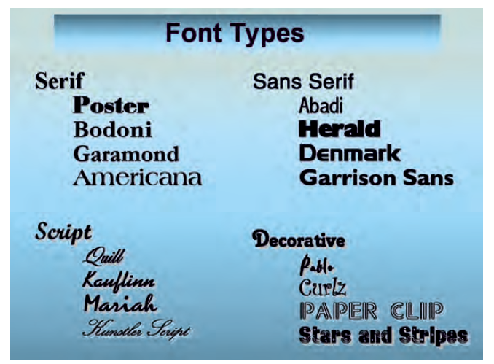
Figure 14.6
PowerPoint Typefaces
Notes:
NOTES:
Figure 14.6 – Several typefaces, grouped by font type. Serif fonts are generally easiest for audiences to read. We recommend using script and sans serif fonts sparingly and decorative fonts only for dramatic impact.

Slide 15
Audiovisual Aids
Video aids
DVD/videotape players
Computers and other electronic devices
The Internet
Audio aids
Notes:
NOTES: Audiovisual aids combine sound and images to communicate ideas. With audiovisual aids, you combine the power of visual rhetoric with a supporting audio rhetoric track. You are undoubtedly familiar with media that combine images and sound. If you are using video images to support your talk, you’ll likely get the images from prerecorded digital video disks (DVDs), video recordings you make yourself, or Internet sites such as YouTube or Hulu. Before you decide to use a video image, think about whether or not it will really enhance your speech. Showing a short clip from a movie or TV show may help you to make your point or can provide an attention-catching opening or a memorable closing to your talk.
DVD/videotape players. You might wish to play part of a prerecorded movie or TV show from a DVD or videotape. DVD players have several advantages over the older technology of videotapes. Not only does a DVD have excellent picture quality, but it can be started and stopped with precision.
Computers and other electronic devices. You can store and play your own videos and clips from other sources on your computer, your smartphone, your iPad, or your iPod or other MP3 player. Unless the audience is very small, all of these options will require you to hook your device to a monitor or a projection system. A 25-inch screen is generally visible to an audience of twenty-five to thirty people. For a larger audience, you will need several TV monitors or a large projection TV system. Make sure monitors are available and compatible with your device, or bring your own monitors.
The Internet. If the room in which you are delivering your speech has Internet access, you could play the video directly from YouTube or another Internet source. Playing video directly from the Internet does, however, carry the risk of losing an Internet connection before or during your speech. It will also involve having the technology to access the Internet—either your own equipment or whatever is available in the room. It would be wise to store your video on another device as part of a backup plan.
Audio Aids
Audio can be used to complement visual displays. As with video, you can either create your own audio content or use prerecorded sources. As with video, be sure to rehearse with and master any technology that is needed for your audio aids. Also be sure not to let your audio soundtrack distract from your own words.

Slide 16
Guidelines for Developing Presentation Aids
Make them easy to see
Keep them simple
Select the right presentation aid
Do not use dangerous or illegal presentation aids
Notes:
NOTES:
Make Them Easy to See: Without a doubt, the most violated principle of using presentation aids in public speaking is “Make it big!” Countless speeches have been accompanied by a chart or graph that contains writing that is too small to read, a PowerPoint image that is not large enough to be legible, or a graph on a flipchart that simply can’t be deciphered from the back row.
Keep them simple: Simple presentation aids usually communicate best. Some students think that the visuals accompanying a speech must be as fancy as a Broadway production, complete with lights and costumes. Resist trying to make your visuals complicated. Indeed, any complexity is too much complexity. Text should be limited to key words or phrases. Lengthy dissertations on poster board or PowerPoint usually do more harm than good. Don’t cram too much information on one chart or slide. If you have a great deal of information, it is better to use two or three simple charts or overhead transparencies than to attempt to put all your words on one visual. Don’t add music or visuals just for the sake of dressing up your presentation. Every part of your presentation must support the purpose of your speech.
Select the right presentation aid: Because there are so many choices, here are some suggestions: Consider your audience. Factors such as audience size dictate the size of the visual you select. If you have a large audience, do not choose a presentation aid unless everyone can see it clearly. The age, interests, and attitudes of your audience also affect your selection of audiovisual support. Think of your speech objective. Don’t select a presentation aid until you have decided on the purpose of your speech. Take into account your own skill and experience. Use only equipment with which you are comfortable or have had practical experience. Know the room in which you will speak. If the room has large windows with no shades and no other way to dim the lights, do not consider using visuals that require a darkened room.
Do not use dangerous or illegal presentation aids: Dangerous or illegal presentation aids may either shock your audience or physically endanger them. Such aids will also detract from your message. They are never worth the risk of a ruined speech or an injured audience member. If your speech seems to call for a dangerous or illegal object or substance, substitute a picture, a chart, or some other representation device.

Slide 17
Using Presentation Aids Effectively
Prepare carefully and practice with aids
Maintain eye contact with audience
Tell about the presentation aid
Don’t pass objects
Notes:
NOTES:
Prepare carefully & practice with aids: Your appearance before your audience should not be the first time you deliver your speech while holding up your chart, turning on the overhead projector, operating the slide projector, or using the flipchart. Practice with your presentation aids until you feel at ease with them.
Maintain eye contact with the audience: You might be tempted to talk to your presentation aid rather than to your audience. Your focus, however, should remain on your audience. You will need to glance at your visual to make sure that it isn’t upside down and that it is the proper one. But do not face it while giving your talk. Keep looking your audience in the eyes.
Tell about the aid: Some speakers believe that they do not need to explain a presentation aid. They think that it’s enough just to show it to their audience. Resist this approach. When you exhibit your graph or chart showing the overall decline in the stock market, tell your audience what point you are trying to make. Visual support performs the same function as verbal support. It helps you to communicate an idea. Make sure that your audience knows what that idea is.
Don’t pass objects: People will be more interested in seeing and touching your object than in hearing you talk about them. If your object is too small to be seen without passing it around and no other speaker follows your speech, you can invite audience members to come up and see your object when your speech is over. If your audience is only two or three rows deep, you can even hold up the object and move in close to the audience to show it while you maintain control.

Slide 18
Using Presentation Aids Effectively
Be careful with animals
Use handouts and technology effectively
Control your audience’s attention
Remember Murphy’s Law
Notes:
NOTES:
Be careful with animals: The risk of having an animal detract from your speech may be too great to make planning a speech around one worthwhile. Use animals with care, if at all.
Use handouts & technology effectively: Handing out papers in the middle of your presentation will only distract your audience. However, audiences in business and other types of organizations will often expect a summary of your key ideas in written form. If you do find it necessary to use written material to reinforce your presentation, keep the following suggestions in mind: Don’t distribute your handout during the presentation unless your listeners must refer to the material while you’re talking about it. Do not distribute handouts that have only marginal relevance to your verbal message. They will defeat your purpose. If you do need to distribute a handout and you see that your listeners are giving the written material more attention than they are giving you, tell them where in the handout you want them to focus. For example, you could say, “I see that many of you are interested in the second and third pages of the report. I’ll discuss those items in just a few moment. After distributing your handouts, tell audience members to keep the material face down until you’re ready to talk about the material. This will help to keep listeners from peeking at your handout rather than focusing on you and your message. Make sure you clearly number the pages on your handout material. This will make it easy for you to direct audience members to specific pages in your handouts. To make sure your listeners know what page of your handouts you want them to focus on, prepare images of each page. You’ll be able to display the specific page you’re talking about. Even if the displayed words are too small for audience members to read. If your listeners do not need the information in your handouts during your presentation, tell them that you will distribute a summary of the key ideas at the end of your talk.
Control listeners’ attention: Here are a few more suggestions for timing your presentation aids: If possible, use a remote control device to advance the PowerPoint images so that you do not have to stay anchored near the computer to advance each slide; Turn the PowerPoint image off or, if possible, cover the projector lens so that the audience’s focus returns to you if you are making a point or telling a story that is not related to a PowerPoint image. You don’t want an image or bulleted list of words unrelated to your message to compete for your listeners’ attention; Consider asking someone to help you hold your presentation aid or turn the pages of your flipchart. Make sure you rehearse with your assistant so that all goes smoothly during your presentation.
Remember Murphy’s Law: According to Murphy’s Law, if something can go wrong, it will. When you use presentation aids, you increase the chances that problems or snags will develop when you present your speech. We are not saying that you should be a pessimist, just that you should have backup supplies and a backup plan in case your best-laid plans go away. If something doesn’t go as you planned, do your best to keep your speech on track.

