Slide 1
Getting Involved
By:

Slide 2
Why causes some people not to work?
Bad reasons:
Lazy
Excuses
Legitimate Reasons
Higher minimum wage rates
University of Georgia Study (2008)
Clip Art
Sabia, Joseph J. "Effect On Minimum Wage." Employment Policies Institute: UG. 2008. Web. 31 Mar. 2012. <http://epionline.org/study_detail.cfm?sid=98>.

Slide 3
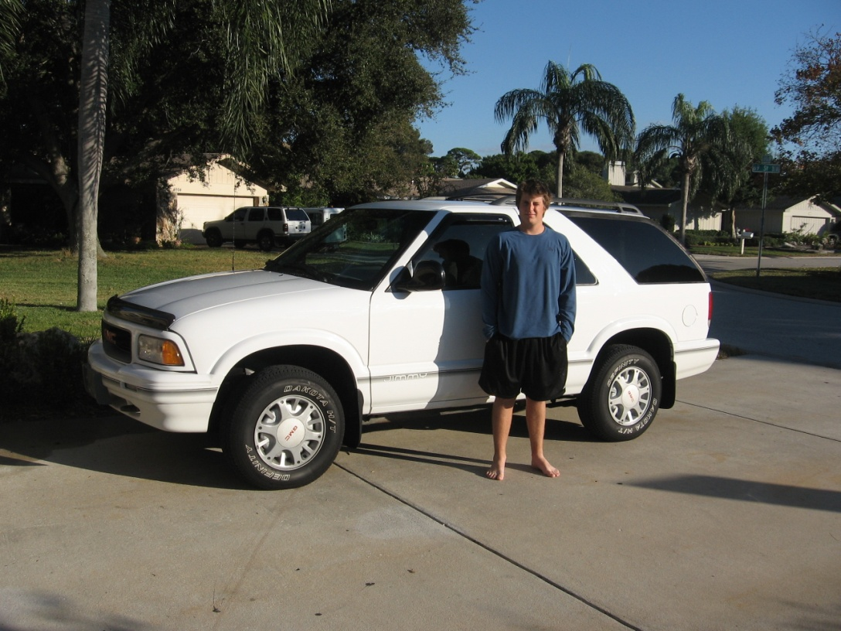
Effects of having a Job
Can teach valuable lessons
Example:
Earned vs. Unearned
http://www.autotraderuae.com/auto/carnews/large/532-1.jpg

Slide 4
Solutions
1. Find out if your state has a training wage law?
2. Show interest in the position you applied for
3. Network yourself
4. Schedule Flexibility

Slide 5
Why Volunteer?
Some volunteer because
An event in their life opens their mind
They have to
Some don’t volunteer because
Lack of motivation
No personal gain
Don’t have time
"Getting Involved." Involved in Volunteering Boosts Confidence, Improves Grades. May 2011. Web. 21 Mar. 2012. <http://www.about-underachieving-teens.com/AUT/teen-volunteering-improves-confidence-grades.htm>.

Slide 6
Effects of Volunteering
Said to:
Increase self-esteem and resilience
Makes you less likely to use drugs and alcohol
Build leadership, patience, and drive for
success
Give a person a new life perspective
Build a good resume for future
"Getting Involved." Involved in Volunteering Boosts Confidence, Improves Grades. May 2011. Web. 21 Mar. 2012. <http://www.about-underachieving-teens.com/AUT/teen-volunteering-improves-confidence-grades.htm>.

Slide 7
Solutions
Find some thing that interests you and a friend or family member
Don’t dwell on how much you can`t do but how you can do
Make it fun
http://palmsla.org/wp-content/uploads/2010/11/volunteer.jpg

Slide 8
Volunteer Now!
http://www.volunteerguide.org/

