Slide 1
PowerPoint™ Presentation Prepared by
Diana M. Cooley, Ph.D.
Lone Star College – North Harris
Houston, Texas
Notes:
1

Slide 2
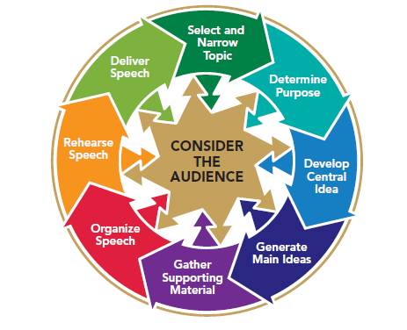
Chapter 4
Listening to Speeches
This multimedia product and its contents are protected under copyright law. The following are prohibited by law:
any public performance or display, including transmission of any image over a network;
preparation of any derivative work, including the extraction, in whole or in part, of any images;
any rental, lease, or lending of the program.
Notes:
Chapter Overview:
Effective Listening: Select, Attend, Understand, Remember, Respond
Overcoming barriers to effective listening
How to become a better listener
Listening & critical thinking
Analyzing and evaluating speeches

Slide 3
Learn how to listen and you
will prosper – even
from those who
talk badly.
~Plutarch
Copyright © 2013, 2008, 2006 Pearson Education, Inc. All Rights Reserved.
Copyright © 2013, 2010, 2007, 2005 Pearson Education, Inc. All Rights Reserved.

Slide 4
Effective Listening
The process:
Selecting
Attending to
Creating meaning from
Remembering
Responding
Notes:
NOTES:
Listening is a complex process of selecting, attending to, creating meaning from, remembering, and responding to verbal and nonverbal messages. Understanding these components of listening can help you to retain more, and it can help you to be a better speaker and a better listener.
Select: To select a sound, the first stage of listening, is to single out a message from several competing messages. As a public speaker, your job is to develop a message that motivates listeners to focus on your message.
Attending to: The sequel to selecting is attending. To attend to a sound is to focus on it. Most people’s average attention span while listening to someone talk is about 8 seconds. One of your key challenges as a public speaker is to capture and then hold your audience’s attention. Your choice of supporting material is often the key to gaining and maintaining attention.
Creating meaning from: Boiled down to its essence, communication is the process of understanding, or making sense of our experiences and sharing that sense with others. As a speaker, your job is to facilitate listener understanding by making sure you clearly explain your ideas in terms and images to which your listeners can relate. Again, the challenge of being understood comes back to a focus on the audience.
Remembering: The next stage in the listening process is remembering. To remember is to recall ideas and information. You hear more than one billion words each year, but how much information do you retain? It depends on how well you listen. Most listening experts believe that the main way to determine whether audience members have been listening is to determine what they remember. (That’s the purpose of taking tests in school: to assess what you remember and understand from what you’ve heard and read).
Responding: The final stage in the listening process is responding. When listeners respond, they react with their behavior to what they have heard. That’s why it’s useful for public speakers to develop specific behavioral goals for their talks. As a speaker, you should identify what you would like listeners to be able to do after you speak.

Slide 5
Quick Check
Effective Listening
To listen effectively you need to:
Select a message
Attend to it
Understand the message
Remember it
Respond appropriately to it

Slide 6
Overcoming Barriers to Effective Listening
Managing information overload
Overcoming personal concerns
Reducing outside distractions
Counteracting prejudices
Using differences between speech rate and thought rate
Managing receiver apprehension
Notes:
NOTES:
Information Overload:
Turning out due to so much information
Speakers balance new information with supporting material
Listeners try to focus on the speaker
Personal Concerns:
Thoughts distract
Speakers should use wake up messages, intensify volume & eye-contact
Listeners should note distractions & redirect attention to the speaker
Outside Distractions:
People & sounds
Speakers should try to reduce or eliminate distractions
Listeners should try to stay focused & make adjustments
Prejudice:
Judging so soon that you bypass the speech
Speakers should avoid words that may be misinterpreted
Listeners should recognize “snap judgments”
Differences:
We process words faster than they are given
Speakers should summarize & build in redundant ideas
Listeners should channel energy to mentally summarize
Receiver Apprehension:
Fear of misunderstanding or misinterpreting spoken messages
Speakers should summarize & show visual aids
Listeners should visualize being successful in understanding & interpreting

Slide 7
How to Become a Better Listener
Listen with your eyes as well as your ears
Adapt to the speaker’s delivery
Listen mindfully
Listen skillfully
Listening style: people-oriented, action-oriented, content-oriented, time-oriented
Become an active listener
Listen ethically
Notes:
NOTES:
Listen with your eyes as well as your ears:
See if you are paying attention
Pay attention to nonverbal messages
Adapt to the Speaker’s Delivery:
Look beyond nonverbals
Look for several cues
Focus on the message, not the messenger
Don’t fall for fancy delivery
Listen Mindfully:
Be aware of whether you are listening or not. Put aside your own thoughts; be present mentally and physically; make a conscious & mindful effort to listen; invent time in listening, patiently letting the speaker make h/h point; be open-minded
Monitor your emotional reaction to a message
Be a selfish listener & ask: What is in this for me? & how can I use this information?
Listen Skillfully:
Identify your listening goal: listening for pleasure; listening to empathize, listening to evaluate; listening for information;
Listen for major ideas: summaries, transitions, previews
Practice listening
4. Listening style: people-oriented (feelings & emotions); action oriented (organized & brief); content-oriented (facts & details); time oriented (succinct messages)
Become an Active Listener:
Remain alert
Re-sort what you hear
Rephrase what you hear
Repeat key information you hear
Listen Ethically:
Communicate your expectations & feedback
Be sensitive to and tolerant of differences
Be aware that different cultures have different styles of speaking

Slide 8
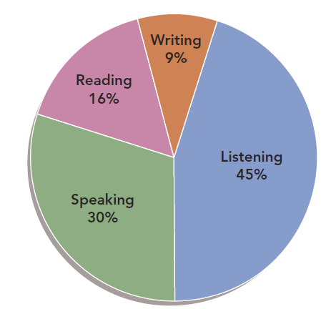
Figure 4.1
Involvement in Communication Activities
Notes:
NOTES:
Figure 4.1 You listen a lot. A typical student spends about 9% of his or her communication time writing, 16% reading, 30% speaking, and at least 45% listening.

Slide 9
Listening & Critical Thinking
Critical listening is listening to evaluate the quality of information
Critical thinking is make judgments about the conclusions observed
Notes:
NOTES:
Effective listening requires the ability to listen critically. Listening critically and thinking critically both involve a variety of skills that we reexamine throughout this text. Critical listening is the process of listening to evaluate the quality, appropriateness, value, or importance of the information you hear. Related to being a critical listener is being a critical thinker. Critical thinking is a mental process of making judgments about the conclusions that are presented in what you see, hear, and read. The goal of a critical listener or a critical thinker is to evaluate information to make a choice.

Slide 10
Quick Check
Critical Thinking and Listening
Separate facts from inferences:
Facts can be proven
Inferences are based on partial or unobserved
evidence
Evaluate evidence:
Facts
Examples
Opinions
Statistics
Evaluate the logic and reasoning of conclusions
Notes:
NOTES:
Separate facts from inferences - The ability to separate facts from inferences is one of the most basic critical thinking and listening skills. Facts are information that has been proven true by direct observation. An inference is a conclusion based on partial information or an evaluation that has not been directly observed. You infer that your favorite sports team will win the championship or that it will rain tomorrow.
Evaluate evidence - Evidence consists of the facts, examples, opinions, and statistics that a speaker uses to support a conclusion. The speaker has an obligation to provide evidence to support the statement that has been asserted.
Evaluating the underlying logic & reasoning - An effective critical listener listens not only for evidence, but also for the overall structure of the logic, or argument, a speaker uses to reach a conclusion. Logic is a formal system of rules applied to reach a rational conclusion. A speaker is logical if he or she offers appropriate evidence to reach a valid, well-reasoned conclusion. Reasoning is the process of drawing a conclusion from evidence within the logical framework of the arguments.

Slide 11
Analyzing & Evaluating Speeches
Rhetorical Criticism: evaluating a speech’s effectiveness & appropriateness
Criticism…is not fault-finding. It is not pointing out evils to be reformed. It is judgment engaged in discriminating among values. It is talking through as to what is better and worse…with some consciousness of why the worse is worse (John Dewey).
Notes:
NOTES:
Rhetorical criticism is the process of using a method or standards to evaluate the effectiveness and appropriateness of messages. Rhetoric can be defined as the process of using symbols to create meaning to achieve a goal. As a public speaker, you are a rhetorician in that you are using symbols (words, images, nonverbal cues) to create meaning in the minds of your listeners and achieve a goal (to inform, to persuade, to entertain). To be a rhetorical critic is to evaluate the effectiveness and appropriateness of the message and its delivery.

Slide 12
Understanding Criteria for Evaluating Speeches
Message should be effective
Is the message understood?
Does the message achieve its goal?
Message should be ethical
Identify and analyze rhetorical strategies
Give feedback to others
Give feedback to yourself
Notes:
NOTES:
Understanding criteria for evaluating a speech:
It should be effective
It should be appropriate
It should be ethical
Identifying & analyzing rhetorical strategies. Pay attention to:
Speech goal
Organization
Speaker’s role
Tone of speech
Intended audience
Speaker’s techniques
Giving feedback to others:
Be descriptive
Be specific
Be positive
Be constructive
Be sensitive
Be realistic
Giving feedback to yourself:
Look for & reinforce your skills & speaking abilities
Evaluate your effectiveness based on your speaking situation & audience
Identify one or two areas for improvement

Slide 13
Quick Check
Giving Good Feedback
Help your fellow speakers by making sure your evaluations are:
Descriptive
Specific
Positive
Constructive
Sensitive
Realistic

