Slide 1
PowerPoint™ Presentation Prepared by
Diana M. Cooley, Ph.D.
Lone Star College – North Harris
Houston, Texas
Notes:
1

Slide 2
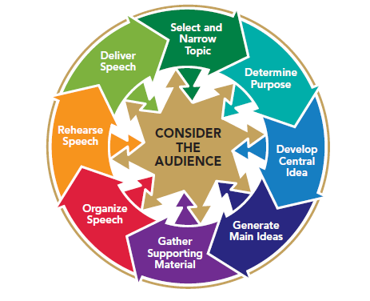
Chapter 10
Concluding Your Speech
This multimedia product and its contents are protected under copyright law. The following are prohibited by law:
any public performance or display, including transmission of any image over a network;
preparation of any derivative work, including the extraction, in whole or in part, of any images;
any rental, lease, or lending of the program.
Notes:
Chapter Overview:
Purpose of a conclusion
Effective Conclusions

Slide 3
A hard beginning maketh a good ending.
~John Heywood
Copyright © 2013, 2010, 2007, 2005 Pearson Education, Inc. All Rights Reserved.

Slide 4
Purposes of Conclusions
Summarize the speech
Reemphasize the central idea in a memorable way
Reinstate the main ideas
Provide closure
Use verbal or nonverbal cues to signal the end of the speech
Motivate the audience to respond
Notes:
NOTES:
An effective conclusion will serve two purposes: It will summarize the speech, and it will provide closure.
Summarize the speech: A conclusion is a speaker’s last chance to review his or her main ideas for the audience. The conclusions of a number of famous speeches are among the most memorable statements we have. The end of your speech is your last chance to impress the central idea on your audience members. Do it in such a way that they cannot help but remember it. In addition to reemphasizing the central idea of the speech, the conclusion is likely to restate the main ideas.
Provide closure: Probably the most obvious purpose of a conclusion is to bring closure—to cue the audience that the speech is coming to an end by making it “sound finished.” You can use both verbal and nonverbal clues to let your audience know your speech is coming to its end. Another way to provide closure to your speech is to motivate your audience to respond in some way. If your speech is persuasive you might want your audience to take some sort of appropriate action: write a letter, buy a product, make a telephone call, or get involved in a cause.

Slide 5
Effective Conclusions
Illustrations or anecdotes
Startling facts or statistics
Quotations
Humor
Questions
References to the introduction
Inspirational appeals or challenges
Notes:
NOTES:
Effective conclusions may employ any of the methods that are used for introductions:
Illustrations or anecdotes - An illustration or anecdote can provide the basis for an effective conclusion. It can help the audience to focus on the main point of your speech, and it can hold their attention. A personal illustration that is used in a conclusion will also reinforce your credibility.
Startling facts or statistics- Startling facts and statistics can help your audience to remember afterward what you had to say.
Quotations- Just as using an appropriate quotation to introduce a speech is a common practice, so too is using a quotation to conclude a speech.
Humor. A humorous conclusion puts the audience in a relaxed frame of mind so that they leave with a sense of enjoyment of what you have told them and goodwill toward you as the speaker.
Questions - Just as using a rhetorical question to open a speech focuses the audience’s attention, using a rhetorical question in your conclusion keeps your speech in the audience’s mind as they try to answer the question.
In addition, there are at least two other distinct ways of concluding a speech: with references to the introduction and with inspirational appeals or challenges.
Finishing a story, answering a rhetorical question, or reminding the audience of the startling fact or statistic you presented in the introduction is an excellent way to provide closure. Like bookends on either side of a group of books on your desk, a related introduction and conclusion provide unified support for the ideas in the middle.
Another way to end your speech is to issue an inspirational appeal or challenge to your listeners, rousing them to a high emotional pitch at the conclusion of the speech. The conclusion becomes the climax.

