Slide 1
SQL Implementation & Administration
Data Types, Tables and Views

Slide 2
Let’s talk Data Types, Tables and Views

Slide 3
DATA TYPES
SQL Server 2012: Data Types
Each column in a database table is required to have a name and a data type.
SQL developers have to decide what types of data will be stored inside each and every table column when creating a SQL table. The data type is a label and a guideline for SQL to understand what type of data is expected inside of each column, and it also identifies how SQL will interact with the stored data.
SQL Server contains four distinct data type categories:
Each of the four categories contains subcategories. All columns within a table, declared variables, and parameters must have a corresponding data type. A data type simply specifies what type of data can be placed into the object (column, variable, parameter, and so on). Database integrity depends heavily on appropriately scoped data types; therefore, you should not always depend or rely on an application to enforce data type usage.
Numeric
Date & Time
Strings
Other

Slide 4
DATA TYPES
SQL Server 2012 Data Types
Numeric Types:
The numeric data type has two subcategories: exact and approximate. Exact data types fit within a finite range of numbers.
Data Type | Description | Storage
Tinyint | Allows whole numbers from 0 to 255 | 1 byte
Smallint | Allows whole numbers between -32,768 and 32,767 | 2 bytes
Int | Allows whole numbers between -2,147,483,648 and 2,147,483,647 | 4 bytes
Bigint | Allows whole numbers between -9,223,372,036,854,775,808 and 9,223,372,036,854,775,807 | 8 bytes
Decimal(p,s) | Fixed precision and scale numbers. Allows numbers from -10^38 +1 to 10^38 –1. The p parameter indicates the maximum total number of digits that can be stored (both to the left and to the right of the decimal point). p must be a value from 1 to 38. Default is 18. The s parameter indicates the maximum number of digits stored to the right of the decimal point. s must be a value from 0 to p. Default value is 0 | 5-17 bytes
Numeric(p,s) | Fixed precision and scale numbers. Allows numbers from -10^38 +1 to 10^38 –1. The p parameter indicates the maximum total number of digits that can be stored (both to the left and to the right of the decimal point). p must be a value from 1 to 38. Default is 18. The s parameter indicates the maximum number of digits stored to the right of the decimal point. s must be a value from 0 to p. Default value is 0 | 5-17 bytes

Slide 5
DATA TYPES
SQL Server 2012 Data Types
Number Types (cont):
Data Type | Description | Storage
Smallmoney | Monetary data from -214,748.3648 to 214,748.3647 | 4 bytes
Money | Monetary data from -922,337,203,685,477.5808 to 922,337,203,685,477.5807 | 8 bytes
Float(n) | Floating precision number data from -1.79E + 308 to 1.79E + 308.The n parameter indicates whether the field should hold 4 or 8 bytes. float(24) holds a 4-byte field and float(53) holds an 8-byte field. Default value of n is 53. | 4 or 8 bytes
Real | Floating precision number data from -3.40E + 38 to 3.40E + 38 | 4 bytes
If you need a column in a table that stores only values between 1 and 10, you should use a tinyint.
Decimal and numeric are slightly different from the others in that they allow decimal places, which are restricted by two values: precision and scale. Essentially, they are very similar in what and how they store data. Precision is the total number of digits that can be stored on both sides of the decimal place. This value can only be between 1 and 38. Scale is the number of digits that can be stored to the right of the decimal place and is specified only when precision is provided. This value will be between 0 and the specified precision. Therefore, if you wanted to store a four-digit number with only two digits to the right of the decimal place, you would use decimal(4,2).

Slide 6
DATA TYPES
SQL Server 2012 Data Types
Date Types:
Date and time data types are used widely in SQL Server databases. They offer the convenience of storing the date and time in various ways. There are seven date and time data types.
Data Type | Description | Storage
Datetime | From January 1, 1753 to December 31, 9999 with an accuracy of 3.33 milliseconds | 8 bytes
Datetime2 | From January 1, 0001 to December 31, 9999 with an accuracy of 100 nanoseconds | 6-8 bytes
Smalldatetime | From January 1, 1900 to June 6, 2079 with an accuracy of 1 minute | 4 bytes
Date | Store a date only. From January 1, 0001 to December 31, 9999 | 3 bytes
Time | Store a time only to an accuracy of 100 nanoseconds | 3-5 bytes
Datetimeoffset | The same as datetime2 with the addition of a time zone offset | 8-10 bytes
Timestamp | Stores a unique number that gets updated every time a row gets created or modified. The timestamp value is based upon an internal clock and does not correspond to real time. Each table may have only one timestamp variable

Slide 7
DATA TYPES
SQL Server 2012 Data Types
String Types:
The string data type contains three subcategories: character, Unicode, and binary. Each contains three specific data types. The data types are similar in that each subcategory contains a fixed-length data type, a variable-length data type, and a data type that has been deprecated.
Data Type | Description | Storage
Char(n) | Fixed width character string. Maximum 8,000 characters | Defined width
Varchar(n) | Variable width character string. Maximum 8,000 characters | 2 bytes + number of chars
Varchar(max) | Variable width character string. Maximum 1,073,741,824 characters | 2 bytes + number of chars
Text | Variable width character string. Maximum 2GB of text data | 4 bytes + number of chars
Nchar | Fixed width Unicode string. Maximum 4,000 characters | Defined width x 2
Nvarchar | Variable width Unicode string. Maximum 4,000 characters
Nvarchar(max) | Variable width Unicode string. Maximum 536,870,912 characters
Ntext | Variable width Unicode string. Maximum 2GB of text data
Bit | Allows 0, 1, or NULL
Binary(n) | Fixed width binary string. Maximum 8,000 bytes

Slide 8
DATA TYPES
SQL Server 2012 Data Types
String Types (cont):
Data Type | Description | Storage
Varbinary | Variable width binary string. Maximum 8,000 bytes
Varbinary(max) | Variable width binary string. Maximum 2GB
Image | Variable width binary string. Maximum 2GB Deprecated data type. Replace with varbinary(max).
Note (n) defines the string length that can be stored. For variable-length data types, max
can be specified for n, which indicates that the maximum storage size is 2 GB.
As a best practice, you should use the fixed-length (char, nchar, binary) data types across all subcategories when the values being stored are a consistent size. When the values are not consistent, you should use the variable-length data types (varchar, nvarchar, varbinary).

Slide 9
DATA TYPES
SQL Server 2012 Data Types
Other Types:
In addition to the data types covered in the preceding sections, SQL Server includes several other data types.
Data Type | Description | Storage
Cursor | A temporary copy of data that will be used for recursive or iterative processes. Of all the data types, this is the only one that cannot be included as part of a table.
Rowversion (timestamp) | This data type automatically generates an 8-byte value similar to 0x0000000000000001. rowversion replaces the timestamp data type, which has been deprecated. This data type is typically used to detect changes in data.
Hierarchyid | This is a positional data type. It represents a position in a hierarchy. hierarchyid is used to organize data such as a bill of materials and organizational charts.
Sql_variant | Stores up to 8,000 bytes of data of various data types, except text, ntext, and timestamp
Uniqueidentifier | Stores a globally unique identifier (GUID)
Xml | Stores XML formatted data. Maximum 2GB
Table | Stores a result-set for later processing
Geospatial | SQL Server supports two geospatial data types: GEOGRAPHY and GEOMETRY. GEOGRAPHY represents data in a round-earth coordinate system. GEOMETRY is a flat or planar data type in which you can store points, lines, and other geometric figures.
Filestream | This data type allows you to store common unstructured data such as documents and images. SQL Server has been coupled with the NTFS file system, allowing the storage of varbinary(max) on the file system.

Slide 10
DATA TABLES
Data Tables
Creating Tables
You can create tables using both SSMS and T-SQL, but creating tables with SSMS is much easier than with T-SQL.
The CREATE TABLE statement is used to create a table in a database.
Tables are organized into rows and columns; and each table must have a name and a data type.
SQL CREATE TABLE Syntax
CREATE TABLE table_name ( column_name1 data_type(size), column_name2 data_type(size), column_name3 data_type(size), .... );
The column_name parameters specify the names of the columns of the table.
The data_type parameter specifies what type of data the column can hold (e.g. varchar, integer, decimal, date, etc.).
The size parameter specifies the maximum length of the column of the table.

Slide 11
DATA TABLES
Data Tables
Column properties
A table contains one or more columns, which make up the rows of a table. Each column stores very specific information. You can configure certain properties for a given column based on the selected data type, which is a property itself.
The most common property is “Allow Nulls”. This simply means that you can insert a row into
the table without supplying a value. For example, say you have a table that contains FirstName,
MiddleName, and LastName. Every person does not have a middle name; therefore, that value should be optional. When designing your table, consider the business logic behind the value when deciding nullability.
Note: NULL is a special value in the database world. It does not mean empty; rather, it rep-resents the absence of a value and is different from an empty string.
The second most common property is “Is Identity”. It is second because it is only available for most numeric data types. When you set this value for a column, SQL Server automatically generates a number as each row is inserted. You can customize or configure the starting point and how the number will increment using the properties that are available.

Slide 12
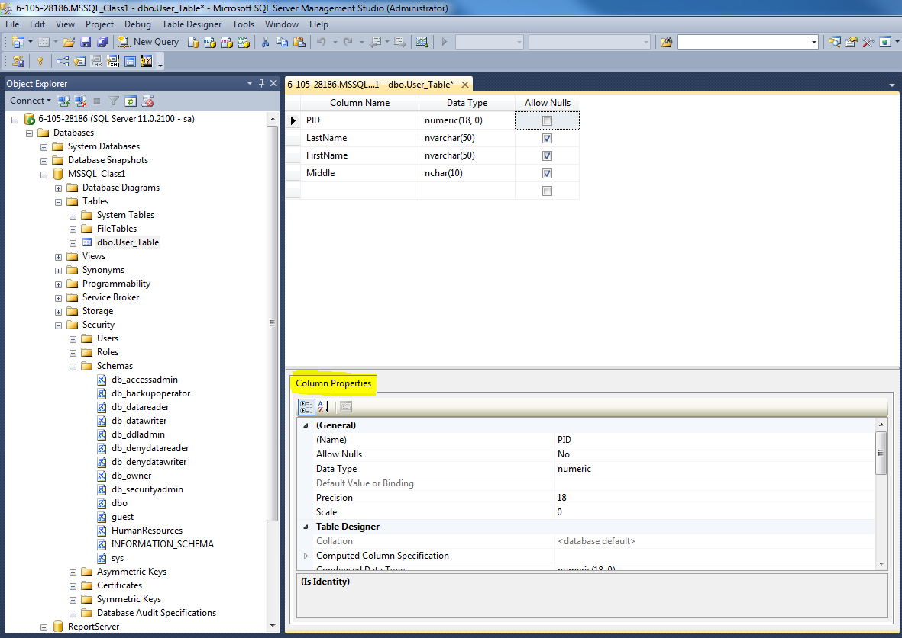
DATA TABLES
Data Tables
Column properties
To view column properties in SSMS, you can view the table design, and select the column that you want to edit. Below the table columns, you will see the Column Properties, once you’ve selected an individual column.

Slide 13
DATA TABLES
Data Tables
Column properties
Previously we created a Products table with the following columns: Product ID, Product Description and Product Cost, and while we set the Product ID as being an integer, we did not set the column properties for Identity Specifications.
Since we had saved our table prior to setting the Identity Specification, we can’t go back and add it afterwards. We have to drop the table and recreate it prior to saving.
To drop a table, right click on the table name and select Delete. Confirm deletion.
Note: You cannot drop a table that is reference by a foreign key constraint.
Recreate the Products Table by doing the following:
- Right click on Tables under your SQLClass_DB Database – Select New Table
- Enter the following:
Column Name Data Type Allow Nulls
ProdID int
ProdDesc nvarchar(100)
ProdCost money
InStock int
- Select the ProdID column, and view the Column Properties below
- Scroll down to Identity Specification and expand it
- Change (Is Identity) to ‘Yes’
- Click Save and Name Table Products

Slide 14
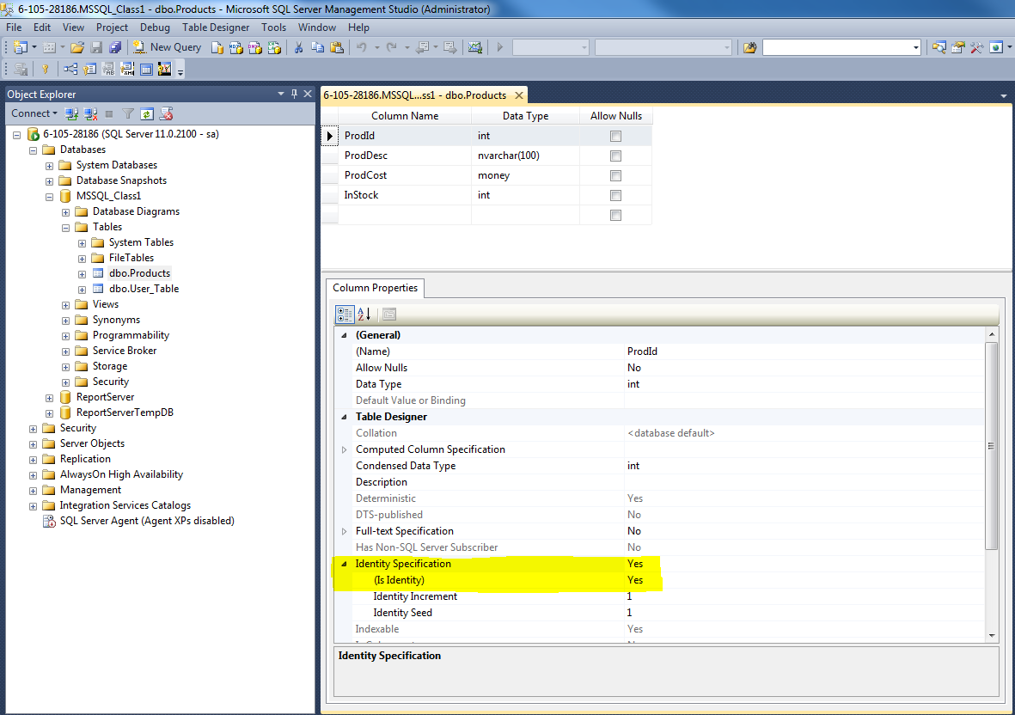
DATA TABLES
Data Tables

Slide 15
DATA TABLES
Data Tables
Column properties
If you close your table, and then script it to a New Query Editor Window, your code should look like the following:
USE [MSSQL_Class1]
GO
/****** Object: Table [dbo].[Products] Script Date: 2/08/2015 4:57:39 PM ******/
SET ANSI_NULLS ON
GO
SET QUOTED_IDENTIFIER ON
GO
CREATE TABLE [dbo].[Products](
[ProdId] [int] IDENTITY(1,1) NOT NULL,
[ProdDesc] [nvarchar](100) NOT NULL,
[ProdCost] [money] NOT NULL,
[InStock] [int] NOT NULL
) ON [PRIMARY]
GO

Slide 16
DATA TABLES
Data Tables
Updating a Table
You can add new columns to an existing table either through design mode in SSMS or through T-SQL.
ALTER TABLE [dbo].[Products]
ADD column_name DATATYPE NULL
GO
In most cases, you can modify an existing column as long as it isn’t part of the primary key or an identity.
ALTER TABLE [dbo].[Products]
ALTER COLUMN [ProdDesc] NVARCHAR(50)
GO
Considerations for altering a column
Reducing precision (example, going from CHAR(20) to CHAR(15)) can cause data truncation and should be avoided unless you are absolutely sure their will be no impact to the data.
Changing data types should typically be avoided. There are exceptions to this. For example, changing a CHAR(20) to a VARCHAR(20) on columns where the average storage length is 10 can save disk space.

Slide 17
DATA TABLES
Data Tables
Using Computed Columns
If you have columns in your SQL database tables such that their values depend on other columns, you may use computed columns. Using computed columns or calculated columns will enable you to save the calculation logic of such computed values in database. This will also save you from extra coding every time you have to do, when you require the computed item.
A computed column can be defined as an expression which can use other columns in the same table as well as using other table values via user-defined functions. The expression of the computation can be directly a name of a noncomputed column (*), constants, functions including SQL or user-defined functions or can contain all in the computed column definition. It is important that the computed column expression can not be a subquery which means you can not use SELECT statements in the expression. Even if you are selecting a constant value like "SELECT 1" .
To add a computed column, open your table in design mode in SSMS. Add you computed column name (ie. FullName, Age). In the column properties, under Computed Column Specification, enter your formula.
T-SQL
--Use this code to add the FullName column to the Users table
USE SQLClass_DB;
ALTER TABLE dbo.Users
ADD FullName AS LastName+', '+FirstName;

Slide 18
DATA TABLES
Data Tables
--Use this code to add the Gender column to the Employee table USE SBSChp4TSQL; ALTER TABLE HumanResources.Employee ADD FullName AS LastName+', '+FirstName;
--Use this code to add the Gender column to the Employee table USE SBSChp4TSQL; ALTER TABLE HumanResources.Employee ADD FullName AS LastName+', '+FirstName;

Slide 19
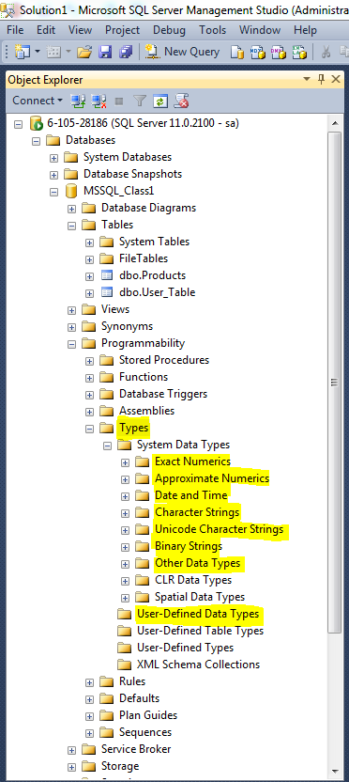
DATA TABLES
Data Tables
Using User-Defined Data Type (Alias)
Logic for the different data types is actually stored in the database, and you have the capability to create your own User-Defined data type as known as an alias.
This is useful in situations were you want to restrict the data for data integrity, for instance you want to store the SSN with the dashes, which would take up 11 characters.

Slide 20
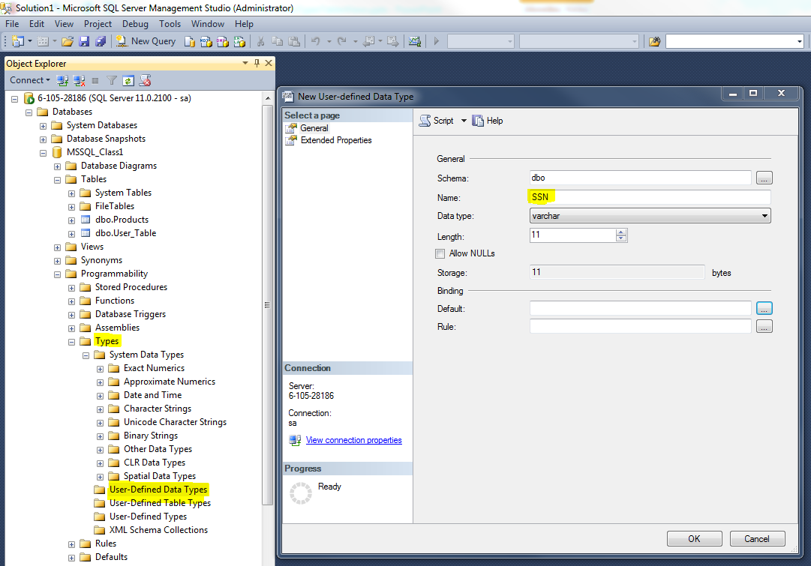
DATA TABLES
Data Tables
Using User-Defined Data Type (Alias)
To create a new data type:
Expand the MSQSQL_Class1 database, and then expand Programmability and the expand Types.
Right-click the User-Defined Data Types, and then click New User-Defined Data Type.

Slide 21
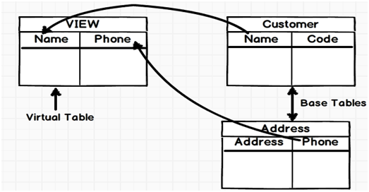
VIEWS
Views
In SQL, a view is a virtual table based on the result-set of a SQL statement.
A view contains rows and columns, just like a real table. The fields in a view are fields from one or more real tables in the database.
You can add SQL functions, WHERE, and JOIN statements to a view and present the data as if the data were coming from one single table.
You can think of a view as a lens looking at one or more tables. A view is really nothing more than a logical representation of one or more tables in a database. Views offer the following benefits and functionality:
Many different perspectives of the same table.
Can hide certain columns in a table. For example you may want to allow employees to see other employees to see the phone number column, but only certain employees to be able to access an employees salary column!
Can provide huge time savings in writing queries by already having a group of frequently accessed tables joined together in a view.
Views allow you to use functions and manipulate data in ways that meet your requirements. For example, you store a persons birth date, but you like to calculate this to determine their age.

Slide 22
VIEWS
Views
In general, you should adopt some naming standard for your views. This standard is vw_<name of view>. The name should be somewhat reflective of the purpose of the view. You can clearly see that I did not do such a good job with this. Sometimes coming up with a short descriptive name for your view is easier said than done.
The syntax for creating a view is...
CREATE OR REPLACE VIEW `<your_view_name>`
AS
...followed by a normal SQL SELECT statement. This SELECT can include a WHERE clause or anything else for that matter that can be put into a SELECT statement. The scenarios are endless. It really depends on the purpose of the view.
Views don’t actually store physical data. To view the data in a view, you would execute it by running a select statement.
Simple syntax for executing a view is…
SELECT TOP 100
lastname,
firstname,
Fullname_fl,
Fullname_lf,
birth_dttm , Age
From vw_Users (NOLOCK)
WHERE Age is not null
GO

Slide 23
VIEWS
Views
Updating a View
You can update a view by using the following syntax:
CREATE OR REPLACE VIEW vw_view_name AS SELECT column_name(s) FROM table_name WHERE condition
Dropping a View
DROP VIEW vw_view_name

Slide 24
SQL SERVER
Summary
A data type defines what kind of value a column can contain.
MS SQL Server uses the IDENTITY keyword to perform an auto-increment feature.
In the INDENTITY(1,1), the starting value for IDENTITY is 1, and it will increment by 1 for each new record.
Tip: To specify that the "ID" column should start at value 10 and increment by 5, change it to IDENTITY(10,5).
Identity columns can be used for generating key values. The identity property on a column guarantees the following:
Each new value is generated based on the current seed & increment.
Each new value for a particular transaction is different from other concurrent transactions on the table.
Not only can you insert data directly into columns, but you can also derive columns from other columns. Typically, computed columns will extend or enhance the data that is stored in traditional columns.
A view always shows up-to-date data! The database engine recreates the data, using the view's SQL statement, every time a user queries a view.

Slide 25
SQL SERVER
Summary
MSDN – Reference Listing on Data Types
https://msdn.microsoft.com/en-us/library/ms187752.aspx

