Slide 1
SQL Implementation & Administration
Data Integrity, Constraints, Relationships & Joins

Slide 2
Let’s talk Data INTEGRITY

Slide 3
DATA INTEGRITY
SQL Server 2012: Data Integrity
Data integrity refers to maintaining and assuring the accuracy and consistency of data over its entire life-cycle and is a critical aspect to the design, implementation and usage of any system which stores, processes, or retrieves data.
Any unintended changes to data as the result of a storage, retrieval or processing operation, including malicious intent, unexpected hardware failure, and human error, is failure of data integrity.
Data integrity can be roughly divided into two overlapping categories:
Physical integrity - deals with challenges associated with correctly storing and fetching the data itself.
Logical integrity - concerned with the correctness or rationality of a piece of data, given a particular context. This includes topics such as referential integrity and entity integrity in a relational database or correctly ignoring impossible sensor data in robotic systems. These concerns involve making certain the data "makes sense" given its environment.

Slide 4
DATA INTEGRITY
SQL Server 2012: Data Integrity
Data integrity contains guidelines for data retention, specifying or guaranteeing the length of time data can be retained in a particular database. It specifies what can be done with data values when their validity or usefulness expires.
SQL Server 2012 allows you to add several constraints to a table. The primary goal of most constraints is data integrity. In other words, their purpose is to improve the validity and consistency of your data.
Analyze
Data
Normalize
Events/Data
Reduce
Events
Tune
Thresholds
Trigger
Alerts

Slide 5
DATA INTEGRITY
SQL Server 2012: Data Integrity
Data integrity is normally enforced in a database system by a series of integrity constraints or rules. Three types of integrity constraints are an inherent part of the relational data model: entity integrity, referential integrity and domain integrity:
Entity integrity concerns the concept of a primary key. Entity integrity is an integrity rule which states that every table must have a primary key and that the column or columns chosen to be the primary key should be unique and not null.
Referential integrity concerns the concept of a foreign key. The referential integrity rule states that any foreign-key value can only be in one of two states. The usual state of affairs is that the foreign-key value refers to a primary key value of some table in the database. Occasionally, and this will depend on the rules of the data owner, a foreign-key value can be null. In this case we are explicitly saying that either there is no relationship between the objects represented in the database or that this relationship is unknown.
Domain integrity specifies that all columns in a relational database must be declared upon a defined domain. The primary unit of data in the relational data model is the data item. Such data items are said to be non-decomposable or atomic. A domain is a set of values of the same type. Domains are therefore pools of values from which actual values appearing in the columns of a table are drawn.
User-defined integrity refers to a set of rules specified by a user, which do not belong to the entity, domain and referential integrity categories.

Slide 6
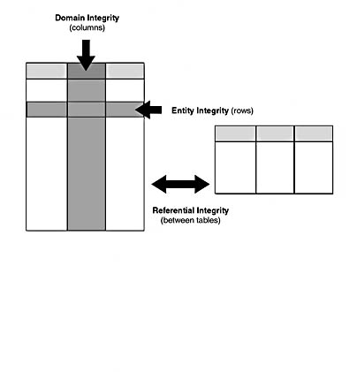
DATA INTEGRITY
SQL Server 2012: Data Integrity

Slide 7
DATA INTEGRITY
SQL Server 2012: Data Integrity
Primary Key Constraints:
A primary key is a column that contains a unique list of values. Often an integer column is added to a table with the identity property and is used as the primary key. However, you can create a primary key from almost any column or combination of columns. The main limitations are that the column cannot allow nulls, the values must be unique, and you can have only one primary key per table.
Default Constraints:
Default constraints are perfect when you have a column that typically contains a specific value. A really good candidate for this is a column that has a data type of bit. The bit data type only accepts 1 or 0 (true or false). If you add an Active column to the Employee table that specifies whether an employee is currently working for the company, the default value will probably be true or 1. Therefore, you should set the default value for that column accordingly.
Unique Constraints:
Unique constraints are sometimes confused with primary keys. These constraints simply ensure that duplicate values cannot be inserted into the corresponding column. For example, assume that you add a column for Social Security numbers to the Employee table. Since Social Security numbers are truly unique values, you should add a unique constraint to ensure that a given Social Security number is entered only once.

Slide 8
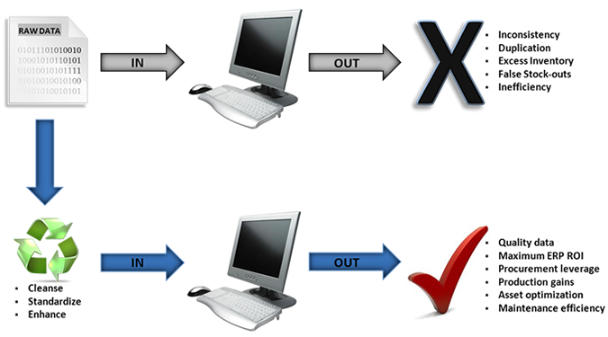
DATA INTEGRITY
SQL Server 2012: Data Integrity
The final constraint, check, allows you to check the value that is being inserted against logical expressions. This constraint is similar to the foreign key column in that it controls what values are inserted. The foreign key column gets its values from another table, while check constraints use expressions.
The integrity of data is the most important concern in a database. If you allow the insertion of bad data, then that is what is going to come out. Foreign keys play a vital role in enforcing the referential integrity of the database.

Slide 9
DATA INTEGRITY
SQL Server 2012: Data Integrity
Enforcing Data Integrity:
Data integrity is enforced through two methods: declarative data integrity and procedural data integrity.
With declarative integrity, you define the criteria that the data must meet as part of an object definition, and then Microsoft SQL Server automatically ensures that the data conforms to the criteria. The preferred method of implementing basic data integrity is to use declarative integrity. Consider the following facts about the declarative method:
Declarative integrity is part of the database definition created by using declared constraints that are defined directly on tables and columns.
You can implement declarative integrity by using constraints.
With procedural integrity, you write scripts that both define the criteria that data must meet and enforce the criteria. You should limit your use of procedural integrity to more complicated business logic and exceptions. For example, use procedural integrity when you want to have a cascading delete. The following facts apply to procedural integrity:
You can implement procedural integrity on the client or the server by using other programming languages and tools.
You can implement procedural integrity on SQL Server with defaults, rules, triggers, and stored procedures.

Slide 10
DATA INTEGRITY
SQL Server 2012: Data Integrity
If a database supports these features it is the responsibility of the database to insure data integrity as well as the consistency model for the data storage and retrieval. If a database does not support these features it is the responsibility of the applications to ensure data integrity while the database supports the consistency model for the data storage and retrieval.
Having a single, well-controlled, and well-defined data-integrity system increases
stability (one centralized system performs all data integrity operations)
performance (all data integrity operations are performed in the same tier as the consistency model) re-usability (all applications benefit from a single centralized data integrity system) maintainability (one centralized system for all data integrity administration).
The primary key of a relational table uniquely identifies each record in the table. It can either be a normal attribute that is guaranteed to be unique (such as Social Security Number in a table with no more than one record per person) or it can be generated by the DBMS (such as a globally unique identifier, or GUID). Primary keys may consist of a single attribute or multiple attributes in combination.
A foreign key is a field (or collection of fields) in one table that uniquely identifies a row of another table. In simpler words, the foreign key is defined in a second table, but it refers to the primary key in the first table.

Slide 11
DATA INTEGRITY
Views – Additional Information
Views are virtual tables that are compiled at run time. The data associated with views are not physically stored in the view, but it is stored in the base tables of the view. A view can be made over one or more database tables. Generally we put those columns in view that we need to retrieve/query again and again. Once you have created the view, you can query view like as table. We can make index, trigger on view.
Views are a very useful feature of relational technology in general, and Microsoft SQL Server specifically. They are wonderful tools that ease data access and system development when used prudently. Furthermore, views are simple to create and implement. But unfortunately most users do not adhere to a systematic and logical approach to view creation. This causes the advantages of views to become muddled and misunderstood.
The basics of views: All operations on a SQL Server table result in another table. This is a requirement of the relational model and is referred to as relational closure. A view is basically the relational model's way of turning a SELECT statement into a "table" that is accessible using SQL. Therefore, a view can be considered a logical table. No physical structure is required of a view; it is a representation of data that is stored in other tables. The data "in the view" is not stored anywhere and only physically exists in the underlying tables. Views can also be based on other views.
In SQL Server we make views for security purpose since it restricts the user to view some columns/fields of the table(s). Views show only those columns that are present in the query which is used to make the view. One more advantage of Views is, data abstraction since the end user is not aware of all the data present in database table.

Slide 12
DATA INTEGRITY
Views – Additional Information
In SQL Server, we have (2) types of views:
System Designed Views - System defined Views are predefined Views that already exist in the Master database of SQL Server. These are also used as template Views for all newly created databases. These system Views will be automatically attached to any user defined database.
Information Schema View
Catalog View
Dynamic Management View
User Designed Views - These types of view are defined by users. We have two types of user defined views.
Simple
Complex

Slide 13
DATA INTEGRITY
Views – Additional Information
User Defined Views:
Simple View:
When we create a view on a single table, it is called simple view. In simple view we can insert, update, delete data. We can only insert data in simple view if we have a primary key and all not null fields in the view.
Complex View:
When we create a view on more than one table, it is called complex view. We can only update data in complex view. We can't insert data in complex view.
We make views for security purpose since it restricts the user to view some columns/fields of the table(s).
One more advantage of Views is, data abstraction since the end user is not aware of all the data present in database table

Slide 14
DATA INTEGRITY
Views – Additional Information
Views and Data Integrity:
Rules of thumb for when it is wise to create views. Guidelines such as these should be instituted within your organization to reduce the amount of time and effort required to implement effective views. The following rules will ensure that views are created in a responsible and useful manner at your shop. These rules were developed over a number of years as a result of implementing large relational databases in many different environments. There may be more uses for views than are presented here, so do not needlessly fret if you do not see your favorite use for views covered in this article—unless you blindly use base table views. There is no adequate rationale for enforcing a strict rule of one—view per base table for SQL Server application systems. In fact, the evidence supports not using views in this manner. There are three basic view implementation rules:
The View Usage Rule - Views should be created only when they achieve a specific, reasonable goal.
The Proliferation Avoidance Rule - Do not needlessly create SQL Server objects that are not necessary.
The View Synchronization Rule - Ensure that views are kept in sync with the base tables upon which they are based.

Slide 15
DATA INTEGRITY
Views – Additional Information
Additional Rules of thumb:
Do not Create One View Per Base Table
Always specify column names
Code SQL Statements in Block Style
Do Not Encrypt Views

Slide 16
DATA INTEGRITY
Summary
Data integrity is the accuracy and consistency of stored data, indicated by an absence of any alteration in data between two updates of a data record. Data integrity is imposed within a system at its design stage through the use of standard rules and procedures, and is maintained through the use of error checking and validation routines.
It has become the de facto responsibility of the database to ensure data integrity.
In a relational database, each table should have at least one primary key.
Views are practical and helpful when implemented in a systematic and thoughtful manner. The view definition is stored by SQL Server so that it can be used as a virtual table to simplify queries and add a layer of security to your base tables; however, it does not take up any space in the database. In fact, a view really doesn't do anything until you query it.

Slide 17
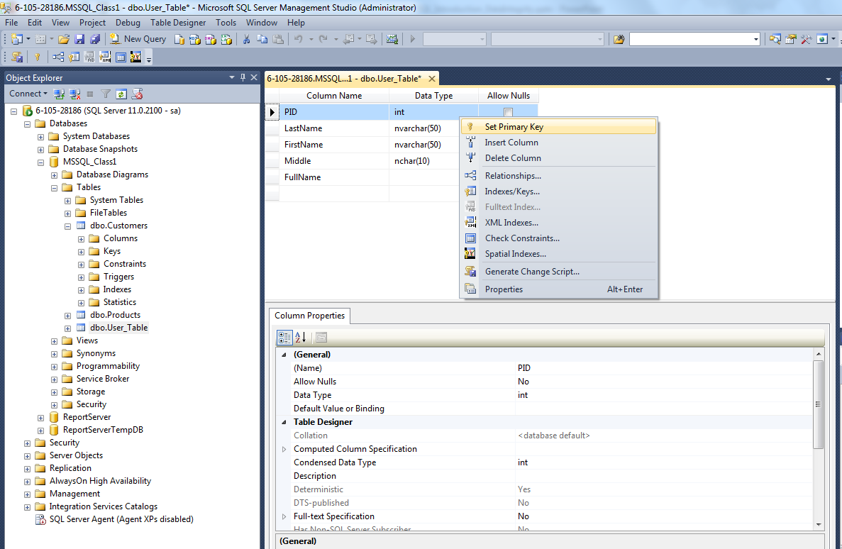
DATA INTEGRITY
Summary
To make a column a primary key, you would highlight the column, and then right-click and select Set Primary Key.

Slide 18
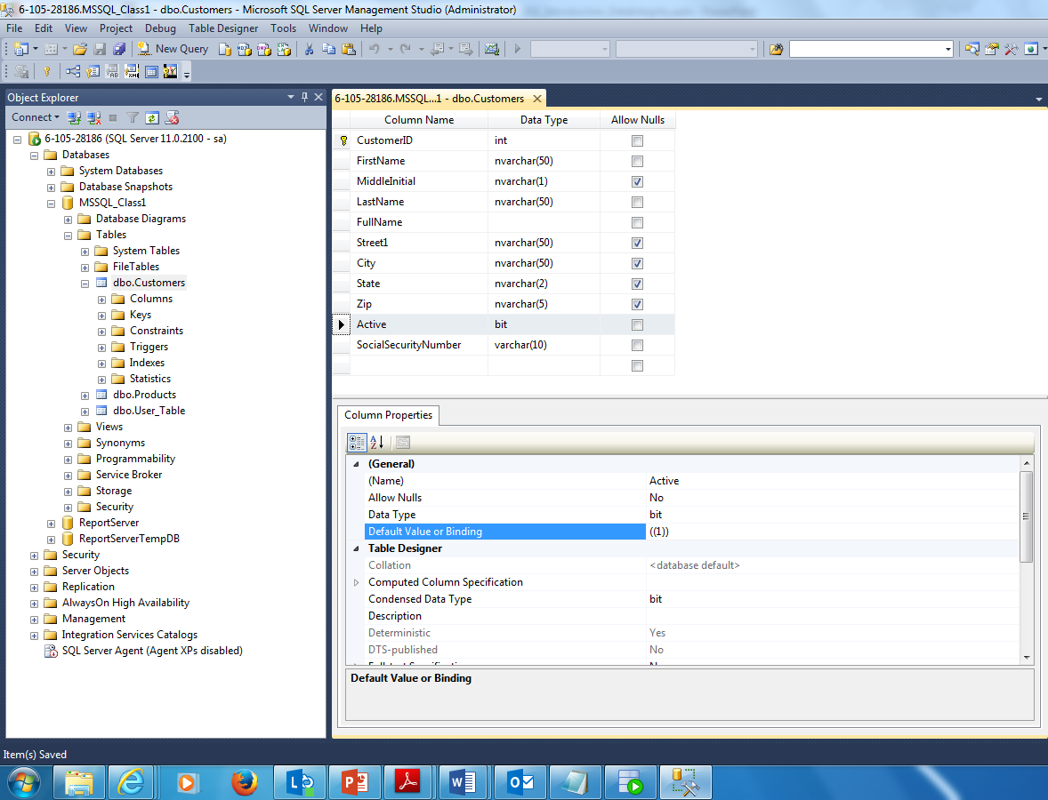
DATA INTEGRITY
Summary
To set a default key:

Slide 19
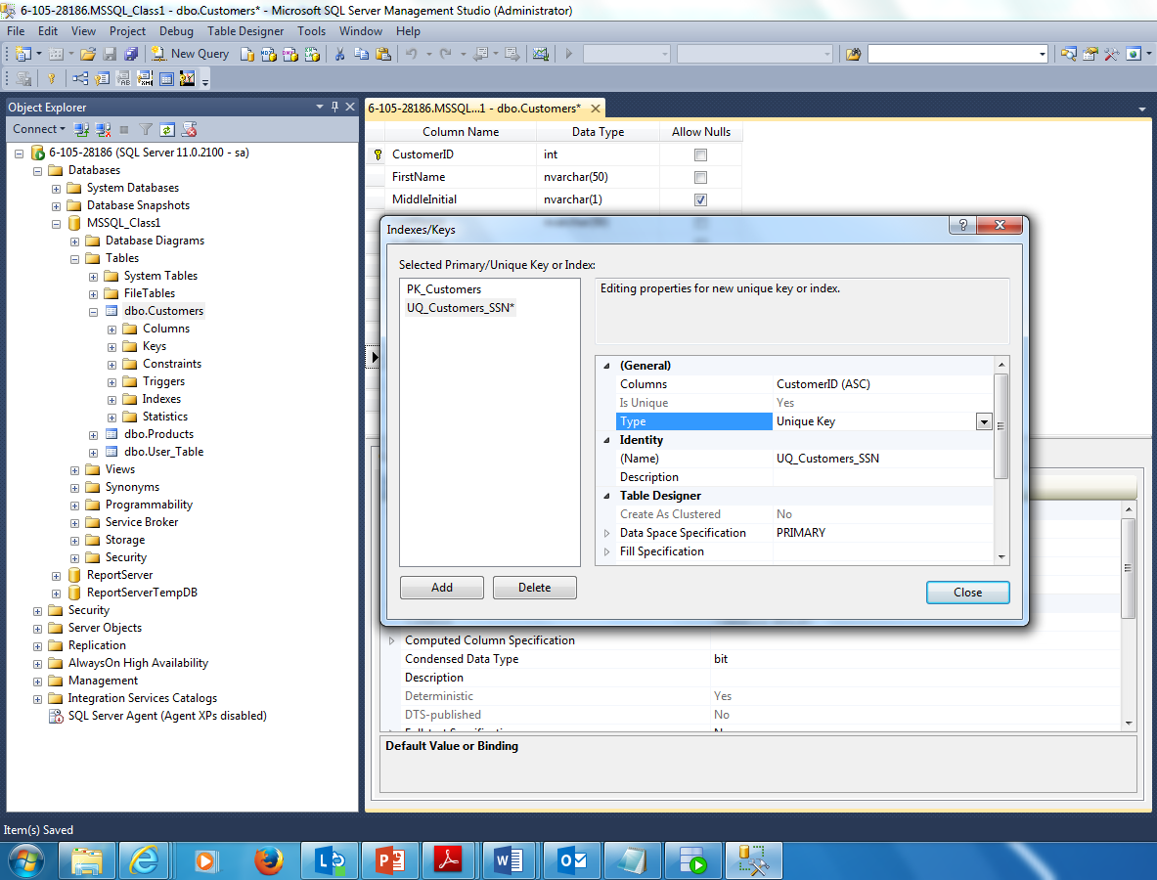
DATA INTEGRITY
Summary
To indexes or unique keys:

Slide 20
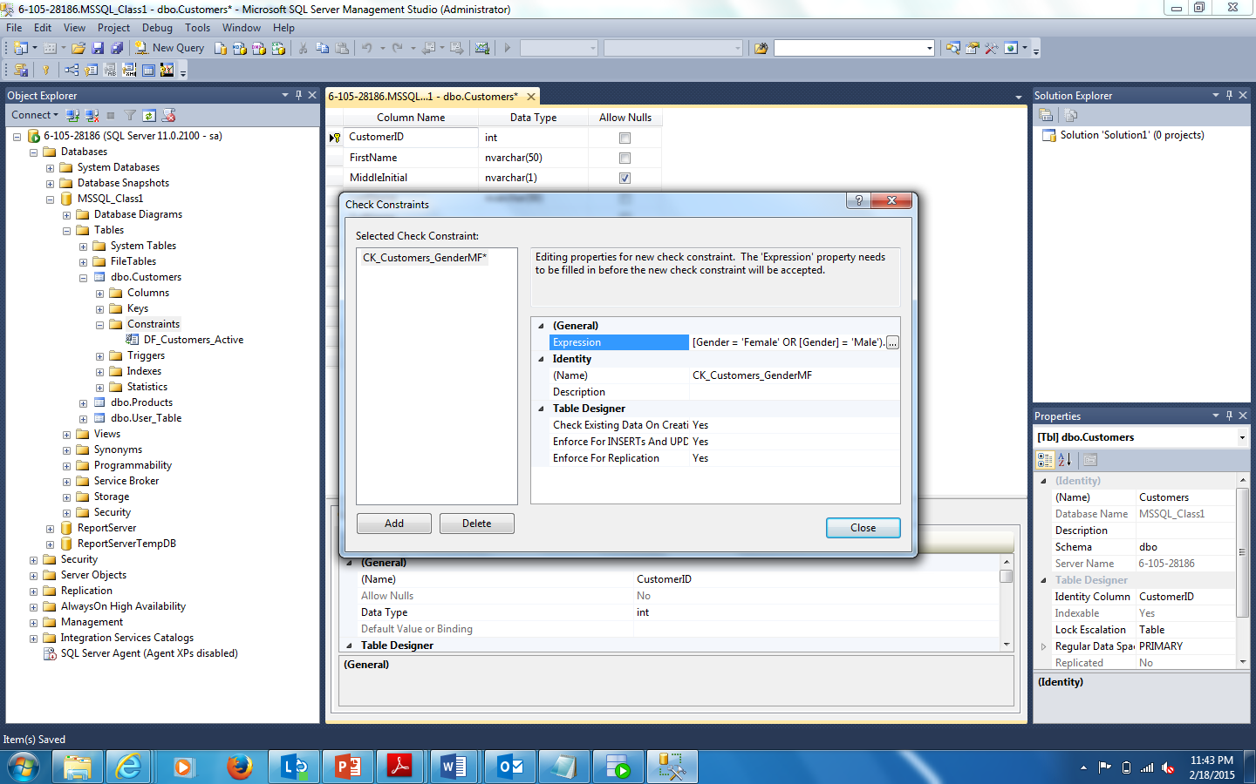
DATA INTEGRITY
Summary
To add a constraint, expand the table properties to view the constraints folder, right-click and select “Add Constraint”:

