Slide 1
SQL Implementation & Administration
Securing the Database

Slide 2
Let’s talk SECURITY

Slide 3
SECURITY
SECURITY
No matter if you work for a university, a bank, or a retail store, securing data is always a database administrator’s (DBA’s) top priority. Who can access the data, what data they can access, and how to access the data are often main topics of conversation inside and outside the information technology (IT) department. Data access needs will vary across applications, departments, and individuals, but the underlying requirement of governing permissions persists for every aspect of the data.
Microsoft SQL Server provides a very robust security structure that allows DBAs to control access from the server down to a specific object within the database. For example, a DBA could be given server-level permission without being granted any data-level access. Or an application or individual could be given access to a database or database objects without being granted any server-level permissions.
Having a good security plan is part of maintaining data integrity. Like anything in SQL Server, you need to plan and design your permissions to provide the maximum protection for your data and server, while balancing the need for people and processes to access the data to do their jobs. This really is a balancing act, but is critical to implementing Least Privilege in SQL Server.

Slide 4
SECURITY
SECURITY

Slide 5
SECURITY
SECURITY
Starting with SQL Server 2005, Microsoft introduced the concepts of working with principals, securables and permissions.
Principal: An entity (such as a login, user, group, or role) that can be granted access to a securable resource.
Securable: Entities that can be secured with permissions.
Permissions: A rule associated with an object to regulate which users can gain access to the object and in what manner.

Slide 6
SECURITY
SECURITY
One of the most striking changes in 2005 was the new permissions infrastructure component of server authorization. Finally gone were the days of having to assign users to system roles to grant them a single permission, along with other serious security shortcomings. Now, the permissions system is highly granular, letting you assign the minimum permissions necessary for a principal to do the job they need to do, which is the idea behind the security principle of Least Privilege.
Principals are entities that can request SQL Server resources.
Principals are arranged in a hierarchy.
The scope of influence of a principal depends on the scope of the definition of the principal: Windows, Server, Database, or whether the principal is indivisible or a collection
Every principal has a security identifier (SID).

Slide 7
SECURITY
SECURITY
Principals
SQL Server has a variety of types of principals that can be granted a permission on an object. The list of available principals, shown below, ranges from real users authenticated either by Windows or SQL Server, various mappings of principals at different scopes, as well as applications, asymmetric keys, and even security certificates.
Like Windows, a principal can be a single user or a collection of users, called a group in Windows and a role in SQL Server. You'll generally want to assign users to groups in Windows (which is then mapped to a role in SQL Server) or roles within SQL Server, then assign permissions to a role.

Slide 8
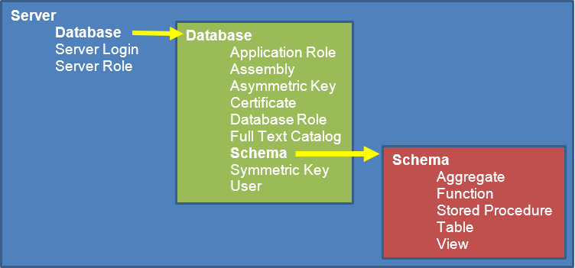
SECURITY
SECURITY
The Object of the Permission
Just about every user-definable object in SQL Server is a securable object, something that you can control access to using permissions granted to a principal. There are three scopes of securable objects—server, database, and schema—that form a hierarchy of securable objects in an instance of SQL Server, as shown in Figure 1. The figure shows the most common objects you'll need to secure in each scope (but not all of them). It also shows how two of the objects—database and schema—are containers for other objects.

Slide 9
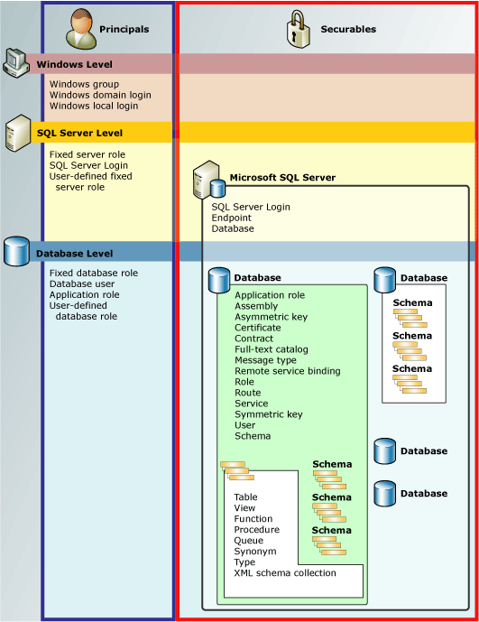
SECURITY
SECURITY
The Object of the Permission

Slide 10
SECURITY
SECURITY
The Object of the Permission
You can secure every object shown in the figure separately with permissions. That makes sense for individual objects like server roles, certificates, and tables. But it has enormous significance for the container objects, database and schema. Each of those objects contain other objects. The cool security implication is that you can set permissions on the container that then apply to all the contained objects. For example, you could grant the SELECT permission on a schema, and the principal would receive that permission on all the tables in the schema. So just like roles aggregate permissions on potentially many principals, the container objects aggregate permissions on objects.

Slide 11
SECURITY
SECURITY
Fully Qualified Names
Every object in a database has a unique four part fully qualified name in the form InstanceName.DatabaseName.SchemaName.ObjectName.
This implies a server level, database level, schema level, and object level hierarchy.
Permissions can be granted at the different levels.
Table Name in SQL: A table name in SQL is unique and it is a good practice to use table names which are relevant to the table.
Qualified table name: A qualified table name is used to describe the owner of a table and the name of the table.
Syntax:
OWNER.TABLE
For Example: A user can access the table PHONE, for which Max is the owner by:
MAX.PHONE
Qualified table names can also be used with a schema. A schema is a collection of tables.
For Example:
ADDRESS.PHONE

Slide 12
SECURITY
SECURITY
Fully Qualified Names
Column Name in SQL: A column name is used to describe a particular column in SQL.
Qualified column name: A qualified column name is used to describe the table name where the column is, and the column name.
Syntax:
For Example: For a table name PHONE and column name AREA_CODE, can be described by:
PHONE.AREA_CODE
A user can access the table PHONE, column AREA_CODE for which Max is the owner by:
MAX.PHONE.AREA_CODE

Slide 13
SECURITY
SECURITY
Fully Qualified Names
The four part SQL Server security architecture begins with the InstanceName.
SQL Server can be installed into multiple instances on a single Windows operating system (OS) and hardware platform.
The default SQL Server installation assumes the name of the OS platform and thus this four part naming convention has been traditionally expressed as
ServerName.DatabaseName.SchemaName.ObjectName
Within each of these four scopes exist securables.

Slide 14
SECURITY
SECURITY
Securables
Securables are the resources to which the SQL Server Database Engine authorization system regulates access. For example, a table is a securable. Some securables can be contained within others, creating nested hierarchies called "scopes" that can
themselves be secured.
The securable scopes
are server, database,
and schema.
Securable scope: Server

Slide 15
SECURITY
SECURITY
Permissions
Every SQL Server securable has associated permissions that can be granted to a principal. This topic provides the following information:
Within each of these scopes exist permissions.
Permissions complete the security architecture model.
The permissions available for data manipulation language (DML) securables.
Credentials
A credential is a record that contains the authentication information (credentials) required to connect to a resource outside SQL Server. This information is used internally by SQL Server. Most credentials contain a Windows user name and password.
The information stored in a credential enables a user who has connected to SQL Server by way of SQL Server Authentication to access resources outside the server instance. When the external resource is Windows, the user is authenticated as the Windows user specified in the credential. A single credential can be mapped to multiple SQL Server logins. However, a SQL Server login can be mapped to only one credential.

Slide 16
Let’s talk PERMISSIONS

Slide 17
SECURITY
PERMISSIONS
Permissions
Maintaining data integrity involves creating users, controlling their access and limiting their ability to read, change, add or delete data.
SQL Server processes user names and passwords according to an authentication mode. SQL Server provides two such modes:
Windows Authentication.
Mixed.

Slide 18
SECURITY
PERMISSIONS
Windows Authentication Mode
With this mode, users can sit down at their computers, log in to the Windows domain, and gain access to SQL Server using the Kerberos security protocol.
Use Windows Authentication mode so users don’t have to remember multiple usernames and passwords.
Only users with Windows accounts can open a trusted connection to SQL Server.
This means others, such as Apple or Linux clients, can’t use Windows Authentication mode because they don’t have a Windows user account.
Windows Authentication is more secure than Mixed Mode Authentication and, when enabled, Windows credentials (that is Kerberos or Windows NT LAN Manager [NTLM] authentication credentials) are trusted to log on to SQL Server.

Slide 19
SECURITY
PERMISSIONS
Mixed Mode
Mixed mode allows both Windows Authentication and SQL Server Authentication (or Standard Authentication).
Anyone can gain access to SQL Server using Mixed mode. Mac users, Novell users, Unix users, and the like, can gain access using SQL Server authentication.
Assigning Permissions
Now that you’ve created user accounts for everyone, you need to restrict what those users can do with the database.
You do so by assigning permissions directly to the users or adding the users to a database role with a predefined set of permissions.

Slide 20
SECURITY
PERMISSIONS
Object Permissions
Alter
Control
Create
Delete
Execute
Impersonate
Insert
References
Select
Take Ownership
Update
View Definition

Slide 21
SECURITY
PERMISSIONS
Assigning Permissions
These permissions control create, alter and drop actions on:
Databases
Tables
Views
Procedures
Indexes
Rules
Defaults
Once the structure exists to hold the data, you need to give users permission to start working with the data in the databases.
You accomplish this by granting object permissions to your users.
Using object permissions, you can control who may read from, write to, or otherwise manipulate your data.

Slide 22
SECURITY
PERMISSIONS
Permission States
All the permissions in SQL Server can exist in one of three states:
Granted - A GRANT statement grants a permission on a securable object to a principal.
Revoked - A REVOKE statement undoes what the GRANT statement does: it removes a permission on an object previously granted to a principal.
Denied - A DENY statement also revokes a permission, but does it in such a way that the principal cannot inherit the permission through role membership.

Slide 23
SECURITY
PERMISSIONS
Applying Permissions
SSMS
Begin with a principal
Begin with a securable
T-SQL statements
GRANT
REVOKE
DENY
Security model anomaly (prior to SQL Server 2012)
Column-level GRANT override Table-level DENY

Slide 24
Let’s talk LOGINS, ROLES and CREDENTIALS

Slide 25
SECURITY
Logins, Roles and Credentials
Logins
A SQL Server key—a login—gives your users access to SQL Server as a whole, not to the resources (such as databases) inside.
If you’re a member of the sysadmin or securityadmin fixed server, you can create one of two types of logins:
Standard logins:
Only clients with a Windows account can make trusted connections to SQL Server (where SQL Server trusts Windows to validate the user’s password).
If the user (such as a Macintosh or Linux client) for whom you’re creating a login can’t make a trusted connection, you must create a standard login for him or her.
Windows logins:
A Windows login can be mapped to one of the following:
A single user
A Windows group that an administrator has created
A Windows built-in group (for example, Administrators)

Slide 26
SECURITY
Logins, Roles and Credentials
Logins
When users first log in to SQL Server, they connect to the default database.
In all types of logins, you can grant database access at create time.
If you create a Windows login using sp_grantlogin, you can’t set the default database or language.
In addition, you can add users to a fixed server role at the time you create them
You do this on the Server Roles tab in SQL Server Management Studio.

Slide 27
SECURITY
Logins, Roles and Credentials
Database User Accounts
In much the same way, you need to give users access to databases once they have logged in to SQL Server.
You do so by creating database user accounts and then assigning permissions to those user accounts.
Once this process completes, your SQL Server users also have more than one key: one for the front door (the login) and one for each file cabinet (database) to which they need access.
You may have noticed that two user accounts already exist in your databases when they are first created:
DBO
Guest
Members of the sysadmin fixed server role automatically become the database owner (DBO) user in every database on the system.

Slide 28
SECURITY
Logins, Roles and Credentials
Roles
Roles are analogous to groups in the operating system.
A user can be added to a role to inherit the permissions of the role.
In this manner you can simplify your administrative load: create a role and design the necessary security protocol.
Users can then be added or removed easily maintaining your security plan.
Fixed Server Roles
Bulkadmin - Granted: ADMINISTER BULK OPERATIONS
Dbcreator - Granted: CREATE ANY DATABASE
Diskadmin - Granted: ALTER RESOURCES
Processadmin - Granted: ALTER ANY CONNECTION, ALTER SERVER STATE
Public
Securityadmin - Granted: ALTER ANY LOGIN (Assign most server perms)
Serveradmin - Granted: ALTER ANY ENDPOINT, ALTER RESOURCES, ALTER SERVER STATE, ALTER SETTINGS, SHUTDOWN, VIEW SERVER STATE
Setupadmin - Granted: ALTER ANY LINKED SERVER
Sysadmin - Granted with GRANT option: CONTROL SERVER

Slide 29
SECURITY
Logins, Roles and Credentials
Sysadmin Role
Members of the sysadmin role have the authority to perform any task in SQL Server.
SQL Server automatically makes operating system BUILTIN\Administrators a member of the sysadmin server role, giving SQL Server administrative rights to all of your Windows administrators
Although granting permissions to single users proves useful from time to time, it’s better, faster, and easier to apply permissions via roles.
You have three types of database roles to consider:
Fixed
Custom
Application
The sysadmin (sa) account is vulnerable when it exits unchanged. Potential SQL Server attackers are aware of this, and it makes hacking one step easier if they take control of this powerful account. To prevent attacks on the sa account by name, rename the sa account to a different account name.

Slide 30
SECURITY
Logins, Roles and Credentials
Fixed Database Role
Fixed database roles have permissions already applied; that is, you need only add users to these roles and the users inherit the associated permissions
db_accessadmin - Granted: ALTER ANY USER, CREATE SCHEMA
Granted with GRANT option: CONNECT
db_backupoperator - Granted: BACKUP DATABASE, BACKUP LOG, CHECKPOINT
db_datareader - Granted: SELECT
db_datawriter - Granted: DELETE, INSERT, UPDATE
db_ddladmin
db_denydatareader - Denied: SELECT
db_denydatawriter - Denied: DELETE, INSERT, UPDATE
db_owner - Granted with GRANT option: CONTROL
db_securityadmin - Granted: ALTER ANY APPLICATION ROLE, ALTER ANY ROLE, CREATE SCHEMA, VIEW DEFINITION
Public

Slide 31
SECURITY
Logins, Roles and Credentials
Fixed Database Roles
Fixed database roles cover many—but not all—of the situations that require permissions to be assigned to users.
Custom Database Role
Custom database roles can be created when fixed database roles don’t meet the permissions needs.
When you create this new role, you assign permissions to it and then assign users to the role
The users inherit whatever permissions you assign to that role.
You can make your custom database roles members of other database roles. This refers to nesting roles.

Slide 32
SECURITY
Logins, Roles and Credentials
Application Database Role
The application role—grants you a great deal of authority over which applications can be used to work with the data in your databases.
To enable the application role, the application executes the sp_setapprole stored procedure (which writes to the application at design time).
Once the application role has been enabled, SQL Server no longer sees users as themselves.
it sees them as the application and grants them application role permissions.

Slide 33
SECURITY
Logins, Roles and Credentials
Complex Passwords
When Mixed Mode Authentication is used, ensure that complex passwords are used for sa and all other SQL-Server-specific logins on SQL Server. First, check the "Enforce password expiration" and "Enforce password policy" options for sa and all other SQL logins.
Credentials
A credential record contains the authentication information (credentials) required to connect to a resource outside SQL Server.
SQL Server uses this information internally.
Most credentials contain a Windows user name and password.
Guest Access
By default, guest user exists in every user and system database, which is a potential security risk in a lock down environment because it allows database access to logins who don’t have associated users in the database. Because of this potential security risk, disable guest user access from all user and system databases (excluding msdb). This ensures that public server role members are not able to access user databases on SQL Server instance unless they have been assigned explicit access to these databases.

Slide 34
SUMMARY
Summary
SQL Server has a sophisticated security system that allows you to carefully implement your security plan.
Understand SQL Server’s security architecture.
Understand the concepts of permissions, securables and principles.
SQL Server can operate in Mixed security mode, which means Windows users and groups can be given access directly to SQL Server; or you can create separate, unique accounts that reside only in SQL Server.
If SQL Server runs in Windows Authentication mode, every user must first connect with a preauthorized Windows account.
Each database in SQL Server has its own independent permissions.
You looked at the two types of user permissions: statement permissions, which are used to create or change the data structure, and object permissions, which manipulate data.
Remember that statement permissions can’t be granted to other users.
Don’t forget that two types of permissions exist, object and statement.
Object permissions control a user’s ability to create or modify database objects, such as tables and views.
Statement permissions control a user’s ability to manipulate data using statements such as SELECT or INSERT.

Slide 35
SUMMARY
Summary
Summary of MsSQL Security Best Practices
SQL Server should be hardened after the installation.
After the installation, use the SQL Server Configuration Manager tool in order to disable unnecessary features and services.
Install only required components.
Recent service packs and critical fixes should be installed for SQL Server and Windows.
Windows Authentication mode is more secure than SQL Authentication.
If there is still a need to use SQL Authentication – enforce strong password policy.
Disable the SA account and rename it. Do not use this account for SQL server management.
Change default SQL Server ports associated with the SQL Server installation to keep hackers from port scanning the server.
Hide SQL Server instances or disable the SQL Server Browser service.
Remove BUILDIN\Administrators group from the SQL Server Logins.
Enable logging SQL Server login attempts (failed & successful).
Additional Information
http://www.sql-server-performance.com/2002/sql-security/

