Slide 1
SQL Implementation & Administration
Introduction to Databases & SQL

Slide 2
Let’s talk databases

Slide 3
Databases
What is a Database?
A database is a structured collection of records or data that is stored in a computer system. In order for a database to be truly functional, it must not only store large amounts of records well, but be accessed easily. In addition, new information and changes should also be fairly easy to input. In order to have a highly efficient database system, a program that manages the queries and information stored on the system must be incorporated. This is usually referred to as DBMS or a Database Management System. Besides these features, all databases that are created should be built with high data integrity and the ability to recover data if hardware fails.
There are several common types of databases. Each type of database has its own data model (how the data is structured). The different types are Flat Model, Hierarchical Model, Relational Model and Network Model.
Our class will focus mostly on the Relational Model, which is the most popular type of database and extremely powerful. Relational database are organized as tables. The beauty of a table is that the information can be accessed or added without reorganizing the table. A table can have many records and each record can have multiple fields.
Sales
UserID
ProductID
Customer
CustomerID
Customer_LastName
Products
ProductID
ProductType
ProductDesc

Slide 4
Databases
DBMS
A database management system (DBMS) is a software package with computer programs that controls the creation, maintenance, and use of a database. It allows organizations to conveniently develop databases for various applications. A database is an integrated collection of data records, files, and other objects. A DBMS allows different user application programs to concurrently access the same database. DBMSs may use a variety of database models, such as the relational model or object model, to conveniently describe and support applications. It typically supports query languages, which are in fact high-level programming languages, dedicated database languages that considerably simplify writing database application programs. Database languages also simplify the database organization as well as retrieving and presenting information from it. A DBMS provides facilities for controlling data access, enforcing data integrity, managing concurrency control, and recovering the database after failures and restoring it from backup files, as well as maintaining database security.
Important things to note:
A DBMS is a very large, integrated collection of data describing business activities of organizations.
Models real-word
Entities (e.g., students, teachers, courses)
Relationships (e.g. Student1 is taking CET2433)
Designed to store and manage multiple databases.

Slide 5
Databases
History
The history of database management systems begins around the time that computers began taking off. In the 1960’s, the concept of the database was put in use and also began to grow in commercial use and because of that a man named Charles W. Bachman became interested. Bachman invented the first database management system. He was an industrial researcher at Dow Chemical where he became the data processing manager in the 1950s before leaving to go General Electric in 1960. It was in 1960 that he came up with the Integrated Database System, the very first DBMS.
The first database system was not easy to use, so Edgar Codd working for IBM at the time, proposed replacing the current system with that of tables and rows, which would then become the concept of relational DBMS.
First DBMS: Bachman at General Electric, early 60’s (Network Data Model). Standardized by CODASYL.
Late 60’s : IBM’s IMS (Inf. Mgmt.Sys.) (Hierarchical Data Model).
1970: Edgar Codd (at IBM) proposed the Relational Data Model. Strong theoretical basis.
1980’s -90’s: Relational model consolidated. Research on query languages and data models => logic-based languages, OO DBMSs => Object-relational data model (extend DBMSs with new data types)

Slide 6
Databases
Why Use a DBMS?
Some of us want to compute, but all us want information….
Data independence and efficient access.
Reduced application development time.
Data integrity and security (different users may access different data subsets).
Uniform data administration.
Concurrent access, recovery from crashes.
Once you know how to create databases, you will use them to your personal advantage.
Improves global thinking and processing.

Slide 7
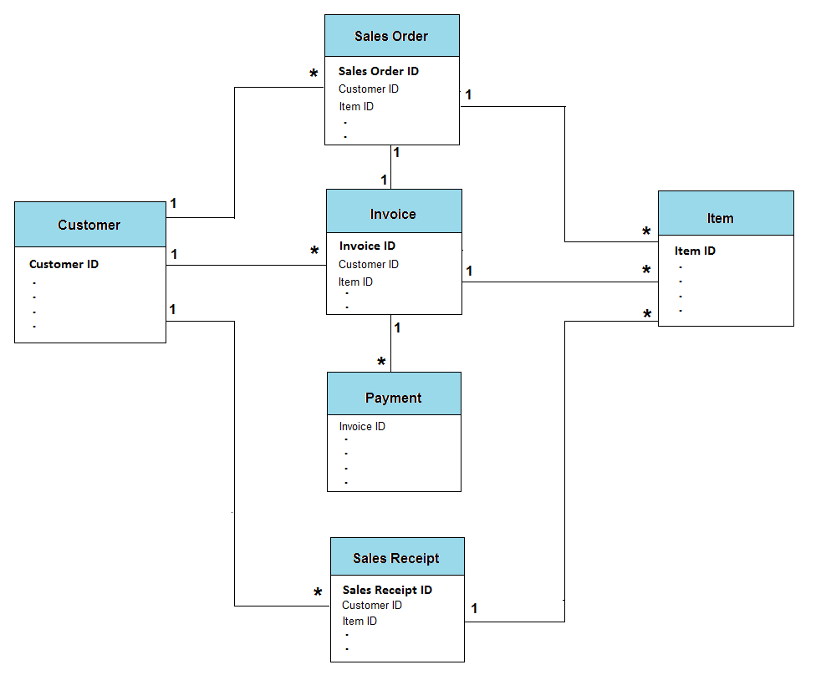
Databases
Describing Data: Data Models
A data model organizes data elements and standardizes how the data elements relate to one another. Since data elements document real life people, places and things and the events between them, the data model represents reality, for example a house has many windows or a cat has two eyes. Computer’s are used for the accounting of these real life things and events and therefore the data model is a necessary standard to ensure exact communication between human beings.

Slide 8
Databases
Describing Data: Data Models
A data model is a collection of concepts and constructs for describing data.
A schema is a description of a particular collection of data, using the a given data model.
The relational model of data is the most widely used model today.
Main concept: relation, basically a table with rows and columns.
Every relation has a schema, which describes the columns, or fields.
The data model of the DBMS hides details - Semantic Models assist in the DB design process.
Semantic Models allow an initial description of data in the “real world”.
A DBMS does not support directly all the features in a semantic model.
Most widely used: Entity-Relationship model (E/R).

Slide 9
DATABASES
Relational Database Management System (RDBMS)
A relational database management system is based on the relational model developed by E.F. Codd. A relational database allows the definition of data structures, storage and retrieval operations and integrity constraints. In such a database the data and relations between them are organized into tables. A table is a collection of records and each record in a table contains the same fields.[1] The contents of a table can be permanently saved for future use.
Properties of Relational Tables:
1. Data is presented as a collection of relations.
2. Each relation is depicted as a table.
3. Columns are attributes that belong to the entity modeled by the table (ex. In a student table, you could have name, address, student ID, major, etc.).
4. Each row ("tuple") represents a single entity (ex. In a student table, John Smith, 14 Oak St, 9002342, Accounting, would represent one student entity).
5. Every table has a set of attributes that taken together as a "key" (technically, a "superkey") uniquely identifies each entity (Ex. In the student table, “student ID” would uniquely identify each student – no two students would have the same student ID).
Rules
In the relational database model, there are five, very important rules. When followed, these rules help to ensure data integrity.
1. The order of tuples and attributes is not important. (Ex. Attribute order not important…if you have name before address, is the same as address before name).
2. Every tuple is unique. This means that for every record in a table there is something that uniquely identifies it from any other tuple.
3. Cells contain single values. This means that each cell in a table can contain only one value.
4. All values within an attribute are from the same domain. This means that however the attribute is defined, the values for each tuple fall into that definition. For example, if the attribute is labeled as Date, you would not enter a dollar amount, shirt size, or model number in that column, only dates.
5. Table names in the database must be unique and attribute names in tables must be unique. No two tables can have the same name in a database. Attributes (columns) cannot have the same name in a table. You can have two different tables that have similar attribute names.

Slide 10
DATABASES
Levels of Abstraction
Data are actually stored as bits, or numbers and strings, but it is difficult to work with data at this level.
It is necessary to view data at different levels of abstraction.
Schema
Description of data at some level. Each level has its own schema.
We will be concerned with three forms of schemas:
Physical – Describes the files and indexes used.
Conceptual (Logical) – Defines logical structure.
External (Views) – Views describe how users
see the data (data tailored to
different user groups)
View 1
View 2
View 3
Conceptual Schema
Physical Schema

Slide 11
DATABASES
Enterprise Resource Planning (ERP)
Enterprise Resource Planning (ERP) is a business management software—usually a suite of integrated applications—that a company can use to collect, store, manage and interpret data from many business activities. An ERP is a collection of DBMSs.
An excellent example of an ERP is the college’s main Student Database System. It is a collection of different DBMS that supply different functions. For example you have the student registration DBMS, an Employee DBMS, a Payroll DBMS, etc.
The levels of Abstraction of the College Student System
Conceptual schema:
Students(sid: string, name: string, login: string, age: integer)
Courses(cid: string, cname:string, credits:integer)
Enrolled(sid:string, cid:string, grade:string)
describes data in terms of the data model of the DBMS
Physical schema:
Relations stored as unordered files.
Index on first column of Students.
External Schema (View):
Course_info(cid:string,enrollment:integer)

Slide 12
DATABASES
Data Independence
Data independence is a form of database management that keeps data separated from all programs that make use of it. As a cornerstone for the idea of a DBMS or database management system, this independence ensures that the data cannot be redefined or reorganized by any of the programs that make use of it. In this manner, the data remains accessible, but it is also stable and cannot be corrupted by the applications.
Techniques that allow data to be changed without affecting the applications that process it. There are two kinds of data independence. The first type is data independence for data, which is accomplished in a database management system (DBMS). It allows the database to be structurally changed without affecting most existing programs. The second type of data independence relates to processing and refers to miscellaneous data used in programs that might change in the future, such as discount rates, product descriptions and error messages.
Advantage of using a DBMS: applications are (not totally) isolated from changes in the way data is structured and stored.
Logical data independence: Protection from changes in logical structure of data (if the CS is changed, views can be redefined in terms of the new relations).
Physical data independence: Protection from changes in physical structure of data.

Slide 13
DATABASES
Structured Query Language
A specialized language for requesting information from a database. For example, the query SELECT * FROM Users WHERE age > 30 AND name = "Smith"
requests all records in which the name-field is "Smith" and the Age field has a value greater than 30. The de factor standard for query languages is SQL.
SQL stands for "Structured Query Language," and can be pronounced as either "sequel" or "S-Q-L." It is a query language used for accessing and modifying information in a database. Some common SQL commands include "insert," "update," and "delete." The language was first created by IBM in 1975 and was called SEQUEL for "Structured English Query Language."
Employee
Department
Name
Dept
Dept
Manager
SELECT Manager FROM Employee, Department WHERE Employee.name = "Clark Kent” AND Employee.Dept = Department.Dept

Slide 14
DATABASES
Querying a Database
Queries are one of the things that make databases so powerful. A "query" refers to the action of retrieving data from your database. Usually, you will be selective with how much data you want returned. If you have a lot of data in your database, you probably don't want to see everything. More likely, you'll only want to see data that fits a certain criteria.
A DBMS provides a Query Language.
Query languages allow querying and updating a DMBS in a simple way.
Most popular:
DML (Data Manipulation Language) - A data manipulation language (DML) is a family of syntax elements similar to a computer programming language used for selecting, inserting, deleting and updating data in a database. Performing read-only queries of data is sometimes also considered a component of DML.
SQL (Structured Query Language)

Slide 15
DATABASES
Structure of a DBMS
A typical DBMS has a layered architecture.
The figure does not show the concurrency control and recovery components.
This is one of several possible architectures; each system has its own variations.
These layers
must consider
concurrency
control and
recovery
Query Optimization
and Execution
Relational Operators
Files and Access Methods
Buffer Management
Disk Space Management
DB

Slide 16
DATABASES
Structure of DBMS
Web Forms
Application Front Ends
SQL Interface
SQL Commands
Query evaluation engine
Parser + Optimizer +
Plan Execution
Transaction
Manager
Files and Access Methods
Recovery
Manager
Buffer Management
Lock
Manager
Disk Space Management
Index files + data files+ system catalog
DB

Slide 17
DATABASES
Summary
DBMS are used to maintain and query large datasets.
Benefits include recovery from system crashes, concurrent access, quick application development, data integrity and security.
Levels of abstraction give data independence.
A DBMS typically has a layered architecture.
DBAs hold responsible jobs and are well-paid!
DBMS R&D is one of the broadest, most exciting areas in CS.

