Slide 1
SQL Implementation & Administration
Introduction to Relational Databases and Database Management Systems

Slide 2
Let’s talk databases

Slide 3
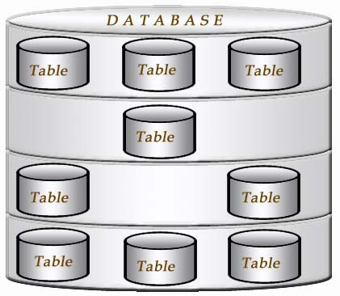
Databases
What is a Database?
An organized electronic collection of data.
Data is usually organized to model business processes that require information.
Data is organized so that it can easily be accessed, managed, and updated.
What are some
Examples of databases?

Slide 4
Databases
What is a Database Table?
A table is a collection of related data held in a structured format within a database.
Tables are uniquely identified by their names
Tables are comprised of columns and rows.
Columns contain the column name, data type, and any other attributes.
Rows contain the records or data for the columns.
Last Name | First Name | Address | City
Jones | Sarah | 123 Main Street | Orlando
Smith | Penny | 567 First Street | Tampa
Reed | Gary | 890 Third Street | Jacksonville

Slide 5
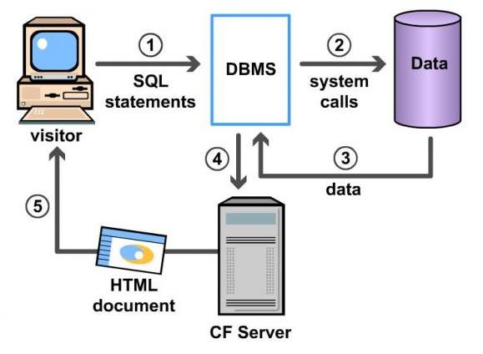
Databases
What is a Database Management System?
A database management system (DBMS) is a software tool that makes it possible
to organize data in a database.
The standard acronym for database management system is DBMS, so you will often
see this instead of the full name. The ultimate purpose of a database management
system is to store and transform data into information to support making decisions.
A DBMS consists of the following three elements:
The physical database: the collection of files that contain the data
The database engine: the software that makes it possible to access and modify the contents of the database
The database scheme: the specification of the logical structure of the data stored in the database

Slide 6
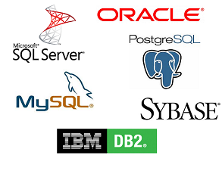
Databases
What is a Database Management System?
As the tool that is employed in the broad practice of managing databases, the DBMS is marketed in many forms. Some of the more popular examples of these solutions include Microsoft Access, FileMaker, DB2, Microsoft SQL and Oracle.
All these products provide for the creation of a series of rights or privileges that can be associated with a specific user. This means that it is possible to designate one or more database administrators who may control each function, as well as provide other users with various levels of administration rights. This flexibility makes the task of using DBMS methods to oversee a system something that can be centrally controlled, or allocated to several different people.

Slide 7
Databases
What is a Database Management System?
There are four essential elements that are found with just about every example of DBMS currently on the market.
The first is the implementation of a modeling language that serves to define the language of each database that is hosted via the system. There are several approaches currently in use, with hierarchical, network, relational, and object examples. Essentially, the modeling language ensures the ability of the databases to communicate with the DBMS and thus operate on the system.
Second, data structures also are administered by the DBMS. Examples of data that are organized by this function are individual profiles or records, files, fields and their definitions, and objects such as visual media. Data structures are what allows these systems to interact with the data without causing damage to the integrity of the data itself.
A third component of DBMS software is the data query language. This element is involved in maintaining the security of the database, by monitoring the use of login data, the assignment of access rights and privileges, and the definition of the criteria that must be employed to add data to the system. The data query language works with the data structures to make sure it is harder to input irrelevant data into any of the databases in use on the system.
Last, a mechanism that allows for transactions is an essential basic for any DBMS. This helps to allow multiple and concurrent access to the database by multiple users, prevents the manipulation of one record by two users at the same time, and preventing the creation of duplicate records.

Slide 8
Databases
What is a Database Management System?
There are several functions that a DBMS performs to ensure data integrity and consistency of data in the database. The ten functions in the DBMS are:
data dictionary management
data storage management
data transformation and presentation
security management
multiuser access control
backup and recovery management
data integrity management
database access languages and application programming interfaces
database communication interfaces
transaction management

Slide 9
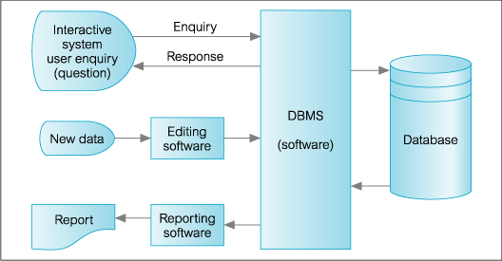
Databases
What is a Database Management System?
Microsoft's SQL Server is a relational database management system (DBMS) that initially was targeted at small and medium sized businesses. Today, many large corporation are using it for their enterprise information needs. The first version of SQL Server was launched in 1989.
The current version of this DBMS is Microsoft SQL Server 2014. In addition to providing database management functionality, the toolset includes ETL (extra, transform, load) functionality for data warehousing applications and an OLAP tool (Online Analytics).

Slide 10
Databases
What is a Relational Database Management System?
The data in a RDBMS connects the tables, by using a common data element that is followed between the tables.
DBMS | RDBMS
Database Management System | DBMS with referential integrity between the tables
No normalization technique | Normalization technique adopted
Inclusion of flat file data in its system | Non-acceptance of flat file design
Used for simple business applications | Huge database applications
Foreign key support | Relationship established through foreign key & primary key
Supported Languages: Programming Language, Data Manipulation Language, Data Definition Language, Schema Description Language, Sub-Schema Description Language | SQL (Structured Query Language) supported
Structured into three major categories: network, hierarchical and relational | Follows relational model only
No relation between tables | Relation between the tables can be established

Slide 11
Databases
What is Normalization?
The relational databases comprises of indexes, key elements, and tables. The rows of the tables are called ‘Tuples’. The normalization technique is adopted when it comes to designing of data tables. The term ‘Normalization’ refers to certain methods to be followed for organization of data in the database and when these standards are met through your designed data tables; they are called ‘Data normalization’. This technique helps in removal of unnecessary data’s and a cleaner organization of data and its tables.
Database normalization is the process of organizing the fields and tables of a relational database to minimize redundancy and dependency. Normalization usually involves dividing large tables into smaller (and less redundant) tables and defining relationships between them. The objective is to isolate data so that additions, deletions, and modifications of a field can be made in just one table and then propagated through the rest of the database via the defined relationships.
Why perform Normalization?
Reduce errors
Reduce Data Redundancy
Data Integrity

Slide 12
Databases
What is Normalization?
Normalization can be broken down into (5) levels or 5 Normal Forms (NF)
The first normal form (1NF) emphasizes on the need to organize the larger data into smaller logical units in the form of ‘tables’, provide one unique identity to a column in each row (Primary key) and to avoid any multiplicity in values (no repetitive values). For example, you have customer purchase record table, which would have columns such as customer id, customer name, items bought and the cost of the item. Now the ‘products bought’ and the ‘price of the products’ could have multiple entries in the column field in case the customer has purchased more than one item and which would actually clutter the data. In order to avoid this, the data should be divided into two tables namely ‘Customer details’ and ‘Customer purchase record’. The first table could have customer id, customer name and the second table could have items bought, customer id and the cost of the item. No Repeating Elements or Groups of Elements
The second normal form (2NF) reiterates on meeting of the requirements of the first normal form and also states that each non-key column should be related to primary key. No Partial Dependencies on a Concatenated Key
The third normal form (3NF) is one of the most common forms, and what most database administrators strive to achieve. No Dependencies on Non-Key Attributes

Slide 13
Databases
What is Normalization?
Normalization can be broken down into (5) levels or 5 Normal Forms (NF)
The fourth normal form (4NF) has one additional dependency. A relation is in (4NF) if it has no multi-valued dependencies.
The fifth normal form (5NF) is very rarely seen, but basically exists when every non-trivial join dependency in it is implied by the candidate keys.

Slide 14
Databases
What is Data Integrity?
One of the main reasons that we normalize databases is to ensure data integrity.
Definition - What does Data Integrity mean?
Data integrity refers to the overall completeness, accuracy and consistency of data. Data integrity is usually imposed during the database design phase through the use of standard procedures and rules. Data integrity can be maintained through the use of various error checking methods and validation procedures.
The following three integrity constraints are used in a relational database structure to achieve data integrity:
Entity Integrity: This is concerned with the concept of primary keys. The rule states that every table must have its own primary key and that each has to be unique and not null
Referential Integrity: This is the concept of foreign keys. The rule states that the foreign key value can be in two states. The first state is that the foreign key value would refer to a primary key value of another table, or it can be null. Being null could simply mean that there are no relationships, or that the relationship is unknown.
Domain Integrity: This states that all columns in a relational database are in a defined domain.
The concept of data integrity ensures that all data in a database can be traced and connected to other data. This ensures that everything is recoverable and searchable.

Slide 15
DATABASES
Relationships
To get rid of the redundant data, we take larger tables and break them into small tables. To create relations between tables, you add additional columns that reference the data in the corresponding table. A relationship between 2 tables is established when the data in one of the columns in the first table matches the data in a column in the second table.
To explain this further we have to understand SQL relational concepts – Primary Key and Foreign Key. Primary Key is a column or a combination of columns that uniquely identifies each row in a table. Foreign Key is a column or a combination of columns whose values match a Primary Key in a different table. In the most common scenario the relationship between 2 tables matches the Primary Key in one of the tables with a Foreign Key in the second table.
There are 3 types of relations between tables –
One-To-Many (Most Common) - a row in one of the tables can have many matching rows in the second table, but a row the second table can match only one row in the first table
Many-To-Many - many rows from the first table can match many rows in the second and the other way around
One-To-One - each row in the first table may match only one row in the second and the other way around

Slide 16
DATABASES
Examples:
Users Table
Last Name | First Name | DOB | Street1 | Street2 | City | State | Zip
King | Sam | 05/25/85 | 56 Main Street |  | Florence | GA | 31506
Smith | Jane | 02/20/86 | 223 White St. |  | Freedom | KS | 42589
Waters | Mary | 06/10/87 | 78 Michigan Ave. |  | Chicago | IL | 78452

Slide 17
DATABASES
Examples:
Users Table
Users_PIDM | LastName | FirstName | DOB
1 | King | Sam | 05/25/85
2 | Smith | Jane | 02/20/86
3 | Waters | Mary | 06/10/87
Address Table
Address_PIDM | Street1 | Street2 | City
1 | 56 Main St |  | Florence
2 | 223 White St |  | Freedom
3 | 78 Michigan Ave |  | Chicago

Slide 18
DATABASES
Summary
The relationships in a RDBMS ensure that there is no redundant data
Normalization ensures data integrity

