Slide 1
Creating Databases and Database Objects
Getting started with Data Types

Slide 2
Objectives
Recognize the need to develop Naming Standards and to consistently use them throughout your database.
Identify the (4) main data types:
Numeric
String
Date / Time
Other

Slide 3
Data Types – Naming Standards
One of the first things that you have to do before designing your database tables, is to decide what kind of data is going to be stored, and as equally important developing a naming standard to be used throughout your database.
In programming, we have many naming conventions like camelCase, PascalCase, under_scores etc. But each and every organization typically uses its own naming conventions. The main key is to stick to what you use.
Tables are used to store data in the database. The naming conventions for a table may have a "tbl" prefix, followed by the table name. Moreover, TableName should be plural. The syntax should be "tbl<TableName>".
Examples:
tblEmployees
tblOrders
tblProducts

Slide 4
Data Types – Naming Standards
Primary Key is a field or a set of fields in the database table that uniquely identify records in the database table. A table can have only one primary key. The naming conventions for a primary key constraints should have a "PK_" prefix, followed by the table name. The syntax should be "PK_<TableName>".
Examples:
PK_Employees
PK_Orders
PK_Products
Foreign Key is a field in the database table that is primary key in other table. The naming conventions for a foreign key constraint should have a "FK_" prefix, followed by the target table name, followed by the source table name. The syntax should be "FK_<TargetTable>_<SourceTable>".
Examples:
FK_Orders_Employees
FK_Items_Products

Slide 5
Data Types – Naming Standards
Functions are a set of SQL statements that accepts only input parameters, perform actions and return the result.Function can return only single value or a table. The naming conventions for user defined functions may have a "fn_" prefix, followed by it's action. The syntax should be "fn_<Action>". Examples:
fn_CalulateTax
fn_CalculateAge
Views are like a virtual table that can be made over one or more database tables. Generally we put those columns in view that we need to retrieve/query again and again. The naming conventions for a view should have a "vw_" prefix, followed by the namespace, results. The syntax should be "vw_<Result>".
Examples:
vw_EmpOrderDetails
vw_SalesProductDetails

Slide 6
SQL Server Schemas
In SQL Server, a database schema facilitates security management. A schema assists in defining who can access each database object.
A database schema can also act as a namespace. This prevents name clashes of objects from different schemas.
A database schema is a way to logically group objects such as tables, views, stored procedures etc. Think of a schema as a container of objects.
You can assign a user login permissions to a single schema so that the user can only access the objects they are authorized to access.
Schemas can be created and altered in a database, and users can be granted access to a schema. A schema can be owned by any user, and schema ownership is transferable.

Slide 7
SQL Server Schemas
User
Owns
Schema
Which Contains
Tables
Views
Stored Procs
Functions

Slide 8
Data Types
A data type is simply a declaration of what kinds of information a database will allow and how much disk space or resources you want to allocate to the storage of that information. A data type is an attribute that specifies the type of data that an object can hold as well as the number of bytes of information that can be stored in the object.
Microsoft SQL Server features many built-in data types that can be grouped into the following categories; exact numbers, approximate numbers, dates and times, strings of text characters, unicode character strings, binary data such as images and other files, and spatial data.
If you have similar data types to choose from but they only differ in byte size, use the data type that has a larger range of values and/or has increased precision.

Slide 9
Data Types
Exact numeric data types (int, tinyint) are the most common SQL Server data types used to store numeric information.
Approximate Numerics include precision (p) which is the total number of decimal digits that could be stored, both to the left and right of the decimal point.

Slide 10
Data Types
Unicode data types provide storage of international characters, such as Japanese and Chineses, to allow worldwide businesses to use big vendor database products to store their data.
Unicode data types require more bytes to store the data in the database.
If you have a similar data type to choose from but they only differ in byte size, use the data type that has a larger range of values and/or has increased precision.

Slide 11
Data Types
SQL Server built-in data types are organized into the following categories:
Exact numeric – (bigint, bit, decimal, int, money, numeric, smallint)
Approximate numeric (float, real)
Date and time (date, datetime2, datetime, datetimeoffset, time)
Character strings (char, varchar, text)
Unicode character strings (nchar, ntext, nvarchar)
Binary strings (binary, varbinary, iamge)
Other data types (cursor, timestamp, uniqueidentified, table)
Large valued data types (varchar(max), nvarchar(max))
Large object data types (text, ntext, image, xml)

Slide 12
Data Types
Money – used where you’ll store money or currency values
Int – used to store whole numbers and when performing mathematical computations
Float – commonly used in the scientific community and is considered and approximate-number data type
Datetime – used to store date and tie values in one of many different formats
Char – fixed length non-unicode string data type where n defines the string length
Varchar – variable length non-unicode string datat type that indicates the actual storage size of the data
Bit (Boolean) – integer that can have a null, 0 (false) or 1 (true) value
Datetimeoffset – a date combined with time of day that has time zone awareness

Slide 13
Data Types - Conversions
Implicit data types conversions occurs when the SQL Server expression evaluator automatically converts data from one data type to another to complete an operation like a comparison of two values
Explicit data type conversions require the use of the CONVERT or CAST function to convert the data from one data type to another before an operation like a comparison can be completed
To convert a numeric value into a character string: CAST ($157.27 as varchar(10))
Not all data types conversions are supported (nchar() cannot be converted to image)
Use CAST instead of CONVERT to adhere to ISO
Use CONVERT instead of CAST to take advantage of the style functionality

Slide 14
Data Types - Collation
Because SQL Server supports many different kinds of data types special rules have been created to control sorting order. For instance, do capital letters come before lowercase? What about accented characters? Do numbers sort before letters or after?
Collation is the term that defines the various rules for how all of these data types would land if you threw them all into a big pile and had the server put them in order. The default collation type follows Latin character rules, is case insensitive, but accent mark sensitive.

Slide 15
SQL Server – NULL Values
NULL values represent missing unknown data.
By default, a table column can hold NULL values.
If a column in a table is optional, we can insert a new record or update an existing record without adding a value to this column. This means that the field will be saved with a NULL value.
NULL values are treated differently from other values.
NULL is used as a placeholder for unknown or inapplicable values.
When creating your tables, you’ll want to decide which columns will allow for NULL data.

Slide 16
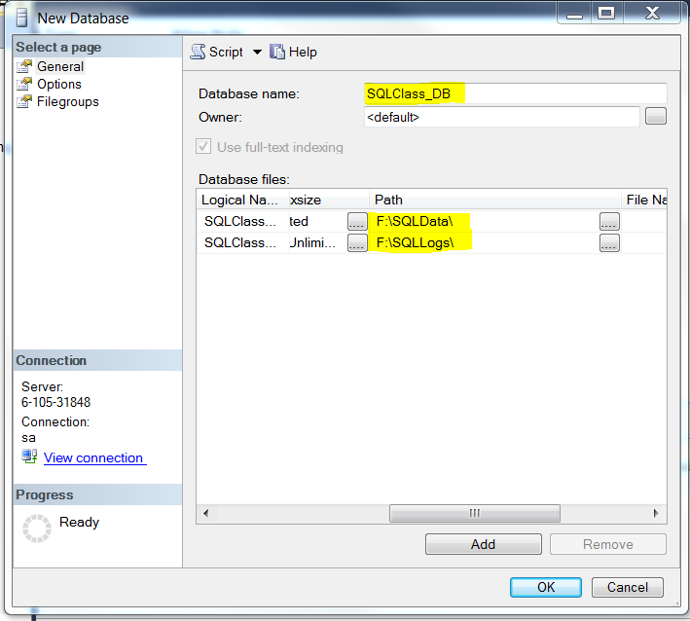
Create a Database
To Create A Database in SSMS:
Right-Click on Databases
Select New Database

Slide 17
Create a Database
To Script your database:
Right-Click on Database
Script Database as
Create to
New Query Editor Window

Slide 18
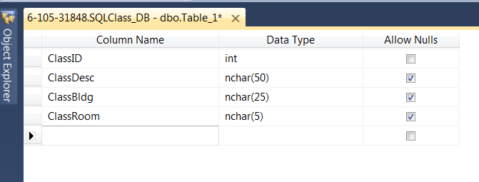
Create a Table
To Create A Table in SSMS:
Click on New Database
Right-Click on Table
Select New Table
Enter Column Name
Enter/Select Data Type
Select Allow Nulls as needed
Click Save

Slide 19
Create a Table
To Script your table:
Right-Click on Table
Script Table as
Create to
New Query Editor Window

Slide 20
Summary
A data type is an attribute that specifies the type of data that an object can hold
The built-in data types fall into the following categories:
Exact numeric
Approximate numeric
Date and time
Character strings
Unicode character strings
Binary strings
Other data types
Large valued data types
Large object data types

