Slide 1
SQL Security
Securing and Administering the Data

Slide 2
Objectives
Understand the security architecture of SQL Server
Manage logins, users and roles
Manage permissions
Control access with database objects and ownership chains
Audit SQL Server

Slide 3
SQL Server Administrator’s Duties
Install and configure SQL Server
Plan and create databases
Back up the databases
Restore the databases when necessary
Set up and manage users for SQL Server
Manage security for new users and existing users
Import and export data
Set up and manage tasks, alerts, and operators
Manage the replication environment
Tune the SQL Server system for the optimal performance
Troubleshoot any SQL Server problems

Slide 4
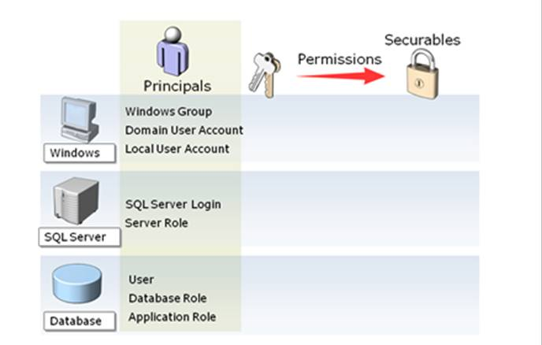
Security Architecture
A Securable is a resource that someone might want to access (like the Financial Folder).
A Principal is anything that might want to gain access to the securable (like Tom).
A Permission is the level of access a principal has to a securable (like Read).
The Securable can be the entire SQL Server itself.
The Principal is a user named either Tom, Murray or Sara.
The Permission(s) will either be ‘Control Server’
or ‘Alter Any Database’.

Slide 5
Security Architecture
Authentication
First stage of security
Identifies users based on login information they provide
Only verifies that users can connect to a SQL Server instance
Does not provide access to databases and their objects
Authorization
Second stage of security
Occurs when database permissions are checked to determine which actions a particular user can perform within a database

Slide 6
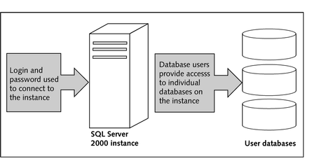
Security Architecture
Logins provide access to an instance and are, in turn, mapped to database users to provide access to various databases housed within the instance

Slide 7
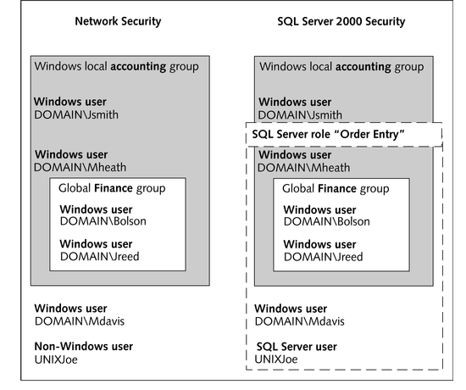
Security Architecture

Slide 8
Security Authentication Modes
Windows Authentication Mode
The user logs on to a Windows domain; the user name and password are verified by Windows
The user then opens a trusted connection with SQL Server
Since this is a trusted connection, SQL does not need to verify the user password
Mixed Mode (SQL Server and Windows)
The user logs on to their network, Windows or otherwise
Next, the user opens a non-trusted connection to SQL Server using a separate user name and password
The user name and password should be verified by SQL Server

Slide 9
Windows Authentication Mode
When using Windows authentication, SQL Server calls out to the Windows domain to validate the account
When a user tries to connect to an instance of SQL Server without specifying a user name or password, Windows Authentication Mode is used
If the Windows credentials of the user are flagged as a valid login for a SQL Server, then the user is allowed to connect to the instance

Slide 10
Windows Authentication Mode
Along with limiting administration of a user to a single location (within a Windows domain), Windows authentication provides the following benefits:
Secure validation of credentials through Windows and encryption of passwords passed over the network
Windows password requirements
Automatic locking out of accounts that repeatedly fail to connect
Native auditing capabilities of Windows accounts

Slide 11
Mixed Authentication Mode
In Mixed Authentication Mode, either a Windows-based account or a SQL Server-based login can be used to connect to an instance
Mixed Authentication Mode is provided for backward compatibility with older applications designed to utilize SQL Server-based logins
Mixed Authentication Mode is also necessary for situations where users connecting to an instance of SQL Server do not have a Windows domain account

Slide 12
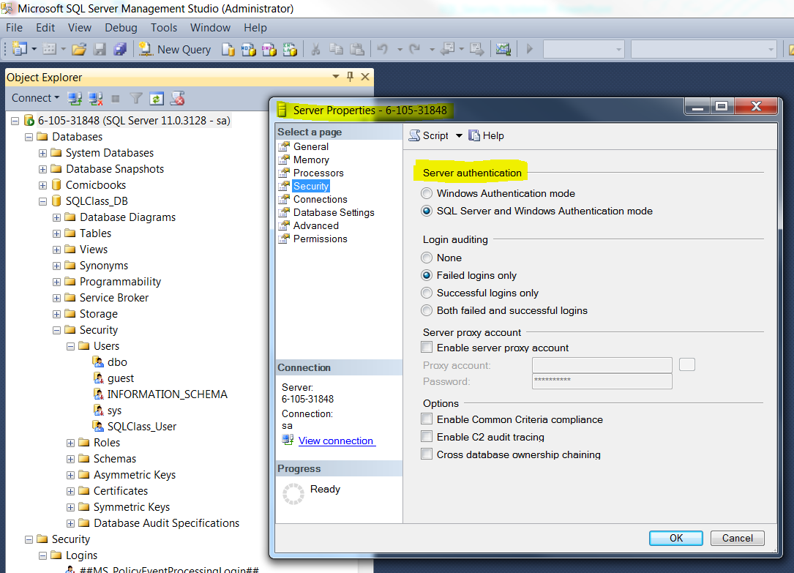
Changing Authentication Mode
Once an authentication mode is specified for a SQL Server 2000 instance, it can be modified easily through Enterprise Manager

Slide 13
Logins
Authentication is implemented using logins in SQL Server
Logins
SQL Server object that provides connection access to an instance of SQL Server (authentication)
Logins can be based on Windows users and groups defined natively in SQL Server

Slide 14
Create A Standard Login
Open Management Studio and expand your server
Expand Security and then click Logins
Right-click Logins and select New Login from the context menu
In the Logic name box, type “SQLClass_User”
Select SQL Server Authentication mode
In the Password text box, type a complex string and confirm it
Uncheck “User must change password at next login”
Under Default database, select your target database as the default database
Click the OK button

Slide 15
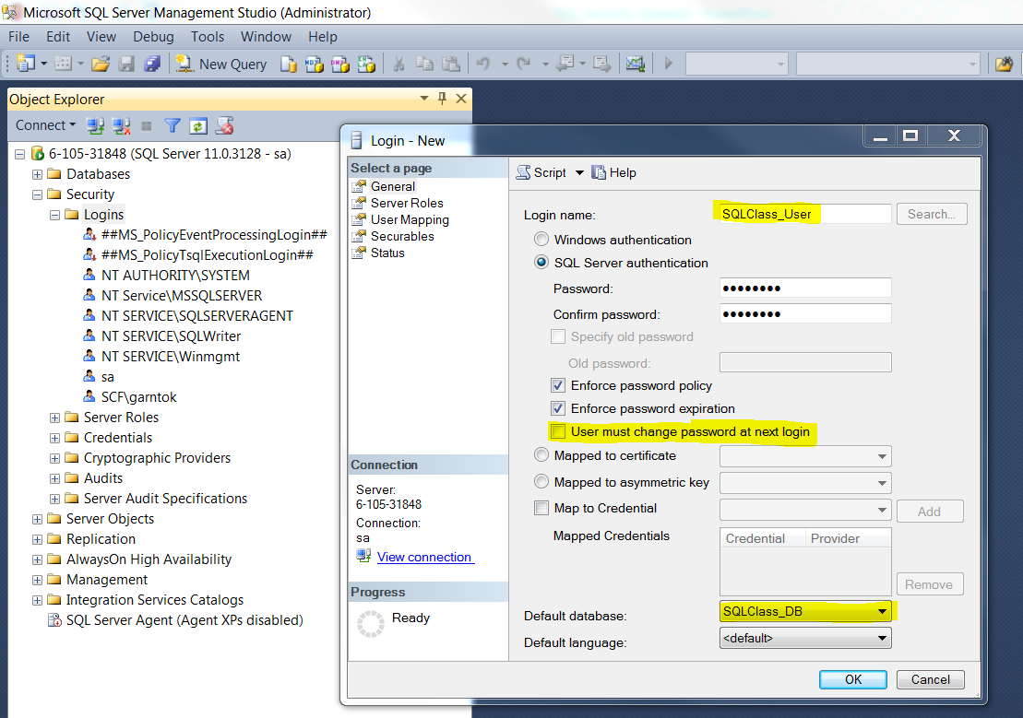

Slide 16
Managing Logins with T-SQL
Windows-based logins
The sp_grantlogin system-stored procedure is used to add Windows users and groups to a SQL Server instance
The sp_denylogin system-stored procedure is used to deny access to a particular Windows user or group, without removing its SQL Server login entries
The sp_revokelogin system-stored procedure is used to remove a login for a Windows user or group

Slide 17
Managing Logins with T-SQL
SQL Server-based logins
The system-stored procedures used to add and remove logins for SQL Server authentication are:
The sp_addlogin system-stored procedure
The sp_droplogin system-stored procedure
EXEC sp_addlogin 'Albert', ‘SQLCLass_DB', 'corporate'; GO

Slide 18
Other Stored Procedures for working with Logins
As seen in the Enterprise Manager interface for creating new logins, both a default database and default language can be set for each new or existing login
The sp_defaultdb and sp_defaultlanguage stored procedures are used to specify a default database and language for a login
Stored procedure | Description
sp_grantlogin | Adds a Windows user or group.
sp_password | Changes the password of a user.
sp_defaultdb | Changes the default database of a user.
sp_defaultlanguage | Changes the default language of a user.

Slide 19
Database Users
Database users
Individual accounts stored within each database that control access to database objects through permissions
Database users are mapped to Windows users, Windows groups and SQL Server logins

Slide 20
Roles
Roles
Allow you to group database users (and even logins) who perform similar functions and to apply permissions for the group instead of the individual users
Allow both Windows and SQL Server logins to be grouped together, which eases administration in diverse network environments

Slide 21
Fixed Server Roles
Fixed Server Roles
Associated with Windows and SQL Server logins defined for an instance
Used to provide special permissions, like configuring instance-wide settings and creating databases that cannot be explicitly provided to individual logins

Slide 22
Fixed Server Roles
Fixed Server Role | Description
Sysadmin | Allowed to perform any action in SQL Server
Serveradmin | Allowed to configure instance-wide settings and shut down the instance
Setupadmin | Allowed to manage linked servers and startup procedures
Securityadmin | Allowed to manage logins and provide CREATE DATABASE permissions to them, read error logs, and change passwords
Processadmin | Allowed to manage running processes in SQL Server
Dbcreator | Allowed to create, modify, and delete databases
Diskadmin | Allowed to manage disk files
Bulkadmin | Allowed to use the BULD INSERT statement to perform mass imports of data

Slide 23
Fixed Server Roles
The sysadmin role is the most important of all the server roles. Quite simply, if a login is a member of this role, it can do anything within the SQL Server. Moreover, it bypasses all security checks. So even if you are able to set up a scenario that should block a login from doing something, by nature of the login being a member of this role, it will ignore that restriction. As a result, membership in this role should be carefully controlled. In typical production environments you would only see DBAs being a member of this role. In very strict environments, you'll even see it restricted so that only particular DBAs within an organization have this level of access.
This role can do anything within SQL Server.
This role completely bypasses all security checks.
This role can do everything any other role can do and more.
This is the most powerful role in SQL Server. Limit its access to only those who absolutely need it.

Slide 24
Fixed Server Roles
The dbcreator role allows a login the ability to create databases. Again, this is typically not something a normal user is a member of. In environments where you might have junior DBAs who aren't given full sysadmin rights, this is typically one of the roles which are used.
This role allows creation of databases within SQL Server.
This is another role that should be rarely used.
It is an ideal role for a junior DBA to give him/her some control over SQL Server, but not the level of permission sysadmin grants.
Some applications will need to be a member of this role if they "roll over" databases as part of their operations.

Slide 25
Fixed Server Roles
The processadmin server role has the ability to alter any connection. That basically means it can disconnect folks from SQL Server. Because it doesn't have much more than this capability, it's also a server role that's typically not used. However, because it can terminate a connection to SQL Server, it's a powerful server role. Therefore, if you do use it, make sure the logins which are members of this role are trustworthy. Someone with this role could effectively create a denial of service attack on your SQL Server by terminating connections as they come in.
This is a powerful role because it can kill connections to SQL Server.
This is another role that should be rarely used.
I have never seen this role used in practice because typically if connections are to be killed off, you want a fully trained DBA handling this, who are typically members of the sysadmin role.

Slide 26
Fixed Server Roles
The securityadmin role controls security for the SQL Server... to a point. This role allows a login to manage logins to SQL Server as far as granting/revoking, enabling/disabling, and determining what databases logins have access to. But once you cross that database boundary, a login without additional rights on the specific database can't manage permissions within the database. However, due to the fact that it can manage logins, it is a powerful role. I should also point out that a member of securityadmin can manage the other server roles with the exception of the sysadmin role. Therefore, membership in this role should be carefully controlled. This is another role you might see be given to junior DBAs where sysadmin rights aren't appropriate.
This role controls logins for SQL Server.
This role can grant access to databases within SQL Server.
This role, by itself, cannot define any further security within a database.
This is another good role for junior DBAs when sysadmin is too much.
Because it is a security related role, membership in it should be carefully restricted, especially in production.

Slide 27
Fixed Server Roles
A member of serveradmin can control the SQL Server configuration and even shutdown SQL Server by issuing the SHUTDOWN command if connected. Because of this, you should rarely see anyone be a member of this role. Typically DBAs control SQL Server configuration and they are usually in the sysadmin fixed server role, which already has such permissions. There are occasions where you might want junior DBAs to have this level of access, but typically you want your SQL Server configurations standardized and changed rarely, and even then, only intentionally. So you'd typically see senior DBAs with such access.
This role manages the SQL Server configuration.
This is another role I've not seen used in practice very much because typically you want DBAs who are members of sysadmin handing configuration.
This is possibly a role you would hand to a junior DBA, but I wouldn't, especially on a production system.

Slide 28
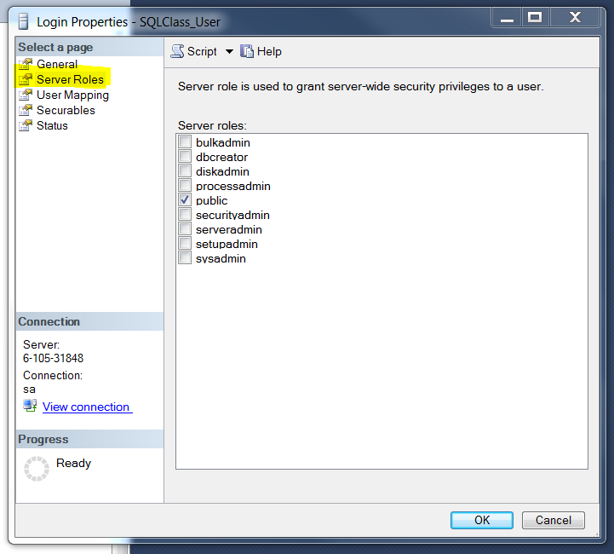
Fixed Database Roles
There are several predefined roles in each database that provide sets of permissions for the database users who belongs to them

Slide 29
Fixed Database Roles
Fixed Database Role | Description
db_owner | Allowed to perform all of the operations permitted to the other roles, as well as activities to maintain and configure the database
db_accessadmin | Allowed to manage database users mapped from Windows users, Windows Groups, and SQL Server Logins
db_datareader | Allowed to see (read access) all data in all of the user-defined tables in a database
db_datawriter | Allowed to insert, update, and delete data from all user-defined tables
db_ddladmin | Allowed to create, modify, and remove all database objects, like tables and views
db_securityadmin | Allowed to manage roles and role membership, as well as to apply permissions to database users and roles
db_backupoperator | Allowed to back up the database
db_denydatereader | Not allowed to view data in the database
db-denydatawriter | Not allowed to modify data in the database
public | The default role of which every database user is a member. If a user does not have permission to access an object like a table, then the permissions of the public role are checked as last resort

Slide 30
Creating a Database User Account
Open Management Studio and expand your server
Expand Databases by clicking the plus sign next to the icon
Expand the target database, then expand Security
Right-click the Users icon and from the context menu, select New User
Input a User name
Click the button at the right of Login name box, then browse all the available names
Select the target name (SQLClass_User, the one you just created)
Click OK

Slide 31
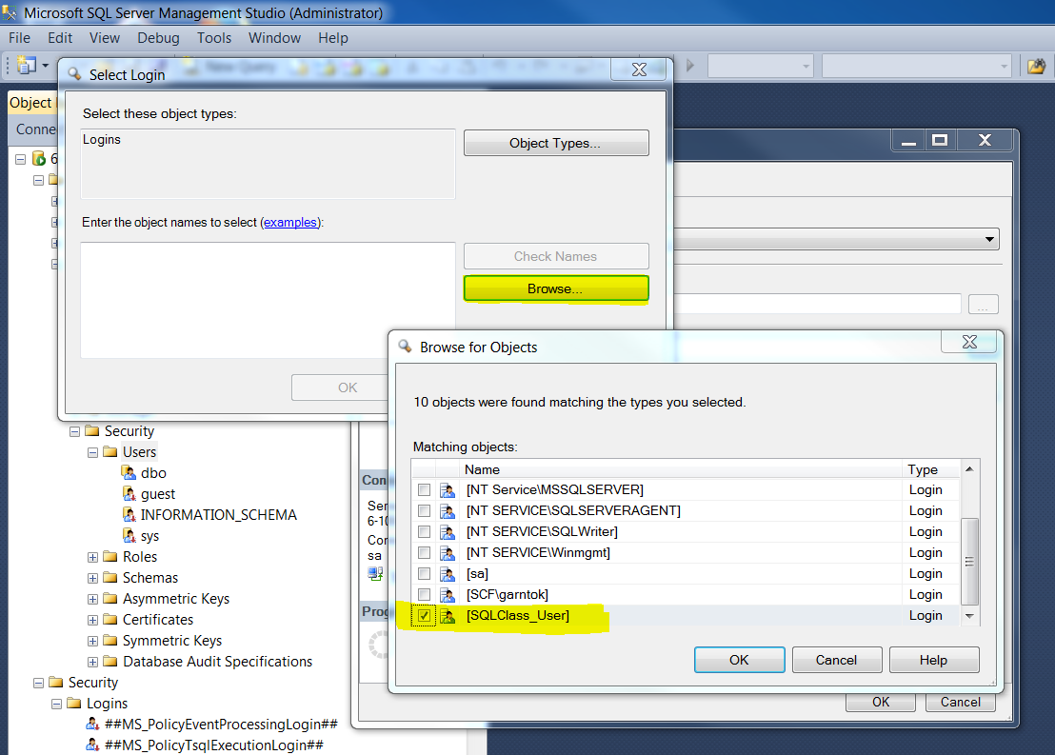

Slide 32
DBO and the Guest Database User
Every database in an instance of SQL Server 2000 can have two special users:
Database owner
Special user that has permissions to perform all database activities
Guest user
Special account that allows database access to a login without a mapped database user

Slide 33
Object Permissions
The three types of permissions that can be used to control user access within a database:
Object permissions
Allow access/modification to data as well as execution of stored procedures and user-defined functions
Statement permissions
Allow access to certain object-creation T-SQL statements like CREATE DATABASE and CREATE TABLE
Implied permissions
Permissions only available through predefined roles

Slide 34
Object Permissions
Object permissions
Allow users to work with objects and they can be granted to users or roles for database objects
Allow users to insert, update, delete and select data from tables and views

Slide 35
Object Permissions
Statement permissions
Used to allow users to create databases and database objects
Access to the following statements are controlled through the statement permissions
CREATE DATABASE
BACKUP DATABASE
BACKUP LOG
CREATE TABLE

Slide 36
Object Permissions
Implied permissions
Special privileges that are provided through membership to a user-defined role
These are often permissions that cannot be explicitly provided to individual users

Slide 37
Granting, Revoking and Denying Rights
Permissions within databases are hierarchical and, consequently, are inherited through group and role membership
Since a database role can contain users, groups and other roles, permissions could be applied to a high-level role and all of the users and groups associated with that role would receive the rights assigned to it
Both statement and object permissions can be assigned to users, groups and roles within a database
Each permission can be granted, denied or revoked
When a permission is granted to a user, the user is able to perform the operation in the database

Slide 38
Granting, Revoking and Denying Rights
The GRANT keyword is a DCL statement that creates permissions on a securable and grants these permissions to a principal. With the GRANT keyword, you can tell the SQL Server (securable) to allow the ‘Alter Any Database’ (permission level) to Murray (principal), while also allowing the ‘Control Server’ (permission level) to Murray and Sara (principal).
With the DENY keyword, you can tell the SQL Server to explicitly deny the ‘Alter Any Database’ to Sara, without affecting any of the permissions already given to Murray. However; this action will prevent Sara from having the ability to modify or create any databases on the SQL Server securable.
The REVOKE keyword will simply remove an existing GRANT or DENY permission from the SQL Server access list.

Slide 39
Granting, Revoking and Denying Rights
Open Management Studio, expand your server and Databases, then select the target database
Expand the database, then expand Security and Users
Double-Click the target user, and select the Securables page from the dialog window
In Securables section, click Search, and in the Add Objects window click OK
In the Select Objects window, click Object Types, then check Tables and click OK
Browse available table and check the target table, then click OK
If necessary, define more detailed permissions on the target table
Click OK to return to Enterprise Manager

Slide 40
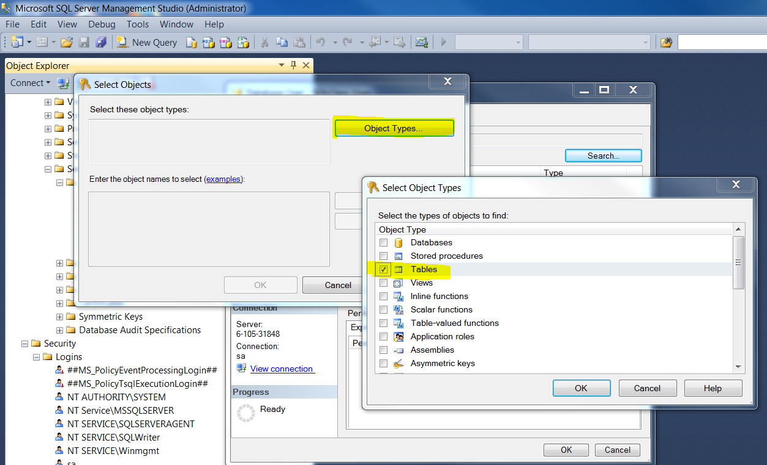

Slide 41
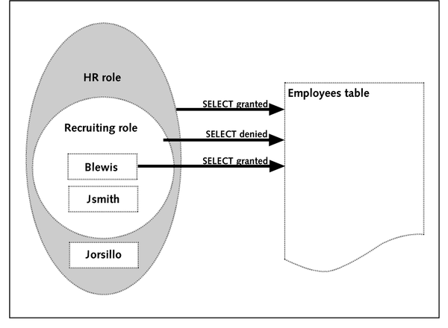
Resolving Permission Conflicts
SQL Server always applies deny permissions first when evaluating a particular action for authorization
Denied permissions always take precedence over conflicting granted permissions at the user or role level
When permissions are revoked, SQL Server simply removes the previous granted or denied permission

Slide 42
Implementing Security through Database Objects
Securing data with views
Views can be defined to provide either a filtered set of table columns or a limited set of data rows from underlying tables
A common use of a view is to create a special representation of a table that does not contain certain sensitive information
Securing data with stored procedures and user-defined functions
Stored procedures and user-defined functions allow sets of T-SQL statements to be stored and executed as a single unit
They are typically used to enforce business rules or perform logic

Slide 43
Implementing Security through Database Objects
Controlling access with triggers
Triggers are similar to stored procedures in that they contain saved groups of T-SQL statements
However, triggers are not called directly, so permissions cannot be granted directly to use them
They are controlled by insert, update and delete permissions on the table with which they are defined

Slide 44
Summary
SQL Server has a flexible and scalable security architecture capable of supporting the full spectrum of requirements from 10 users to 10,000 users
Validating user activity is implemented as a two-part process consisting of authentication and authorization
Logins require a separate database user account in each database to gain access
Objects and statement permissions are assigned at the database level to users
Roles are an organizational unit in databases that allows users to be grouped together and share a set of permissions
SQL Server is capable of meeting rigorous C2 certification standards for security and auditing

