Slide 1
SQL Disaster Recovery
Performing Disaster Recovery Operations

Slide 2
Objectives
Understand backup operations and recovery models
Create database devices
Create full database, differential database and transaction log backups
Use backups to restore a database
Configure log shipping
Use the Database Maintenance Plan Wizard to create a disaster recovery plan
Ensure the consistency of databases using DBCC T-SQL statements
Understand the different types of replication.
Understand the different replication agents.
Configure and monitor replication.

Slide 3
SQL Server Administrator’s Duties
Install and configure SQL Server
Plan and create databases
Back up the databases
Restore the databases when necessary
Set up and manage users for SQL Server
Manage security for new users and existing users
Import and export data
Set up and manage tasks, alerts, and operators
Manage the replication environment
Tune the SQL Server system for the optimal performance
Troubleshoot any SQL Server problems

Slide 4
Planning for Disaster
In most organizations, data is the most valuable asset, and keeping that data secure is a major concern
With improvements in reliability of hardware and software, system meltdowns are less frequent
Still, hardware will fail and users will make mistakes like deleting important information by accident
Only recourse is to plan for such events and minimize the effects on an organization using SQL Server 2012
SQL Server 2012 offers a flexible backup architecture that allows database administrators to execute backup operations that meet the data availability requirements of any database

Slide 5
Recovery Models
One of the most important aspects for a database environment is ensuring reliable backups are being executed and a dependable recovery plan is established in the event of a system failure or data corruption.
Which recovery model is best for the databases in your environment? This setting depends on the critically of the data and the acceptable data loss in the event of a system failure.
SQL Server offers three recovery models that can be implemented for your databases. The appropriate choice depends on your applications and the criticality of your data.

Slide 6
Recovery Models
The three database recovery model options are:
1. Simple - With the Simple Recovery model, data is recoverable only to the most recent full database or differential backup. Transaction log (or incremental changes) backups are not available. The Simple Recovery model is easier to manage than the Full or Bulk-Logged models, but at the expense of higher data loss because the contents of the database transaction log are truncated each time a checkpoint is issued for the database.
2. Full - The Full Recovery model uses database backups and transaction log backups to provide complete protection against failure. If one or more data files are damaged, restoring the backups permits recovery of all committed transactions using a combination of the database and transaction log backups. Full Recovery provides the ability to recover the database to the point of failure or to a specific point in time. All operations, including bulk operations such as SELECT INTO, CREATE INDEX, and bulk loading data, are fully logged and recoverable.

Slide 7
Recovery Models
3. Bulk Logged - The Bulk-Logged Recovery model provides protection against failure combined with the best performance. In order to get better performance, the following operations are minimally logged and not fully recoverable: SELECT INTO, Bulk load operations, CREATE INDEX as well as text and image operations. Under the Bulk-Logged Recovery model, a damaged data file can result in having to redo work manually based on the operations above that are not fully logged. In addition, the Bulk-Logged Recovery model only allows the database to be recovered to the end of a transaction log backup when the log backup contains bulk changes.
Each model addresses different needs, including:
Minimizing data loss in the event of a failure
Amount of disk space available to stored backups
Impacting performance of the system

Slide 8
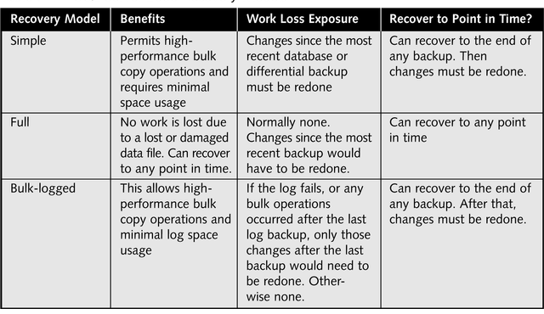
Recovery Models

Slide 9
Recovery Models
Simple Recovery Model requires the least amount of administration.
Simple Recovery Model performing backups each day.

Slide 10
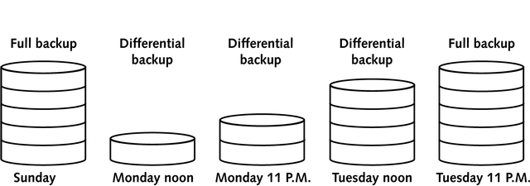
Recovery Models
Simple Recovery Model requires the least amount of administration.
Simple Recovery Model performing full and differential backups each day.

Slide 11
Recovery Models
Full recovery model is regarded as the model of choice to restore a database to an earlier point in time
Full recovery model uses full backups, differential backups and transaction logs to restore a database to a point in time very close to when a system failure occurred
Location of the transaction log
It is strongly recommended that the transaction log for a mission-critical database be placed on a separate physical disk than the data
Transaction logs in bulk-logged recovery model
Like full recovery model, bulk-logged provides optimal performance and limited exposure to data loss
Differentiating factor between the two models is how operations are logged

Slide 12
Recovery Models
Full recovery model performing both full and transaction log backups
Full recovery model performing full, differential and transaction logs

Slide 13
Recovery Models
SQL Server Enterprise Manager directions to configure the database Recovery Model: In SQL Server Enterprise Manager, open the 'Databases' folder. Once the database folder is expanded, right click on the database and select the 'Properties' option. The 'Database Properties' window will open. Click on the 'Options' tab and the recovery model will be listed in the middle of the screen. Click on the drop down box to select the needed recovery model. On the bottom of the screen click 'OK' to save the Recovery Model.
SQL Server Transact-SQL directions for ALTER DATABASE commands to configure the database Recovery Model:
ALTER DATABASE AdventureWorks_2012 SET RECOVERY FULL GO

Slide 14
Database Consistency
System and software errors can cause low-level errors in data and page allocations of a database
DBCC CHECKDB validates consistency of everything in a database
For each table in a database (including its indexes), DBCC CHECKDB checks that:
Indexes and data pages are linked correctly on a hard drive
Indexes are arranged in their proper sort order
All pointers are valid
Data is spread out evenly across pages

Slide 15
Backup Operations
Once the database recovery model has been identified, it is necessary to decide which backup method needs to be instituted for your backup and recovery procedures. There are several options and each has advantages and disadvantages. The backup options can be configured with either the Maintenance Plan Wizard, Enterprise Manager or through the use of T-SQL commands.
Databases can be backed up to disk, to tape, or to a network path. Regardless of the destination, database backups should be executed regularly to protect the database from data loss and downtime. Using database backups, a DBA can restore from the last backup or to a specific point in time. In this chapter, you will learn how to back up and restore a database.

Slide 16
Backup Operations
Issues to consider when deciding how to use the backup operation provided with SQL Server:
The time it takes to perform the operation (especially when the operation is executed while users are accessing the database)
The amount of data loss that is acceptable within the system
The time it would take to restore the database to an operational status in the event of a failure
Backing up databases is the second most important task that a DBA should perform. So what is the most important task? Recovering databases. This is why it is important that a DBA regularly take backups. However, coupled with taking the backups, the DBA should regularly test those backups.
Databases can be restored from a backup or set of backups using both Enterprise Manager and T-SQL statements

Slide 17
Backup Operations
Below outlines the available backup options:
Database This option creates a full copy of the database. A complete snapshot of your database is created at the time the backup occurs.
Transaction This option provides a copy of the active transaction log. Transaction log backups operate in conjunction with database backups to allow you to append transactions that have occurred since the last database backup. If successive logs are created, each log creates a set of the new transactions since the last transaction log backup.

Slide 18
Backup Operations
Below outlines the available backup options:
Database This option creates a full copy of the database. A complete snapshot of your database is created at the time the backup occurs.
Transaction This option provides a copy of the active transaction log. Transaction log backups operate in conjunction with database backups to allow you to append transactions that have occurred since the last database backup. If successive logs are created, each log creates a set of the new transactions since the last transaction log backup.
Differential This option copies only the database pages which have been modified after the last database backup. If successive differential backups are created, only the most recent differential backup is required for the recovery process. Differential backups are leveraged in combination with full backups. It is necessary to execute a full backup first and then execute the Differential backups on the needed interval. In addition, it is possible to use transaction log backups with differential backups based on the backup schedule.

Slide 19
Backup Operations
Below outlines the available backup options:
File or Filegroup For very large databases, an option is available for executing database file or filegroup backups. These backups allow you to backup a single data file at a time. One of the drawbacks with this option is that it requires more effort in planning the backup and recovery process as well as your overall database design. In most instances you only have one data file and one log file for each database and therefore this option does not make sense. Also, in order to use filegroup backups you must use transaction log backups in conjunction with this backup method.
Snapshot Backups Using third party tools, such as Storage Area Network (SAN) solutions, you have the ability to capture file level snapshots of the database to replicate the complete database files to other disk drives on the SAN. Unfortunately, this method is expensive and not an option for most database installations.

Slide 20
Backup Operations
Backup Commands:
There are primarily two options when constructing backup commands, either backing up the database or the transaction log.
Database
BACKUP DATABASE {databasename} TO {device}.
Differential
BACKUP DATABASE {databasename} TO {device}.WITH DIFFERENTIAL
Filegroup
BACKUP DATABASE {databasename} FILE = {filename}, FILEGROUP = {filegroup} TO {device}
Log
BACKUP LOG {databasename} TO {device

Slide 21
Maintenance Plans
The only way to be ready for a disaster is to plan ahead and ensure that the SQL Server maintenance plan and disaster recovery measures you have in place will work.
A good maintenance plan can do wonders if planned correctly, implemented successfully and managed appropriately and properly.
SQL Server provides a maintenance plan that help to implement appropriate measures to ensure that your database is safe and properly maintained.
So what is a database maintenance plan and how can you configure a good SQL Server maintenance plan?
A maintenance plan is a set of measures taken to ensure that a database is properly maintained and that routine backups are scheduled and handled.
Within SQL Server, a database maintenance plan can include tasks such as backups of the database, backups of the transaction log, recomputing statistics on the database, managing indexes and taking care of internal data storage issues.
A nice feature of SQL Server is that the maintenance plan can be configured by a wizard, which can help alleviate some of the burden of creating the plan. It can also ensure that the common features of the maintenance plan are taken care of.

Slide 22
Maintenance Plans
Maintenance Plan Tasks Overview
Check Database Integrity
The Check Database Integrity task runs DBCC CHECKDB against selected databases and performs an internal consistency check on them to see if there are any problems with their integrity. While this task is very resource intensive, it is critical that you perform it on a regular basis, to ensure that your databases aren't damaged.
Shrink Database
Never use the Shrink Database task. Is that clear enough advice? While we will discuss why it is not a good idea to automatically shrink a database in Chapter 6, the point to keep in mind is that, if you ever need to shrink a database, it should be done manually.
Rebuild Index
The Rebuild Index task runs the ALTER INDEX statement with the REBUILD option on indexes in the selected databases, by physically rebuilding indexes from scratch.

Slide 23
Maintenance Plans
Maintenance Plan Tasks Overview (Continued)
Execute SQL Server Agent Job
The Execute SQL Server Agent Job task allows you to select SQL Server Agent jobs (ones you have previously created), and to execute them as part of a Maintenance Plan. This feature offers you additional flexibility when performing database maintenance using the Maintenance Plan Wizard.
History Cleanup
The History Cleanup task deletes historical data from the msdb database, including historical data regarding backup and restore, SQL Server Agent and Maintenance Plans.
Back Up Database (Full, Differential, Log)
The Back Up Database (Full) task executes the BACKUP DATABASE statement and creates a full backup of the database. You will probably want to run this task daily against your system and production databases. In most cases, the databases you will be backing up with this task use the Full Recovery model, and you will also want to run the Backup Database (Transaction Log) task as part of your Maintenance Plan.

Slide 24
Summary
This first step in taking a database backup is to determine where you will store the files. As mentioned in the chapter introduction, backups can be stored to disk, to tape, or to a network path.
SQL Server provides a robust backup and recovery architecture that allows operations to be tailored to meet individual needs of different systems
Transaction log backups can be used to recover a failed database all the way up to a specific time or even a specific transaction
Backups are not the only tool for ensuring the integrity and consistency of data
The DBCC CHECKDB T-SQL statement is used to detect and repair small errors that occur within a database
SQL Server Database Maintenance Plan Wizard provides a time-saving interface for configuring recurring backup and consistency checking operations
Log shipping is a powerful feature of SQL Server that maintains a warm standby server by automatically copying transaction log backups from a production database to a remote SQL Server instance and applying each log backup to a database that is kept in sync with the production system

