Slide 1
SQL Database Management
Managing the System

Slide 2
Objectives
Understand the importance of maintenance plans.
Check for database consistency.
Understand how and when to use SQL Server Profiler.
Understand the components of SQL Server Agent.
View SQL Server Agent Configuration Manager options.
Configure SQL Server Agent properties.
Configure SQL Server Agent to automate the administration of SQL Server
Create and configure jobs, alerts and operators by using SQL Server Agent
Monitor hardware resource usage and SQL Server activity by using the Windows System Monitor

Slide 3
SQL Server Administrator’s Duties
Install and configure SQL Server
Plan and create databases
Back up the databases
Restore the databases when necessary
Set up and manage users for SQL Server
Manage security for new users and existing users
Import and export data
Set up and manage tasks, alerts, and operators
Manage the replication environment
Tune the SQL Server system for the optimal performance
Troubleshoot any SQL Server problems

Slide 4
SQL Profiler
Microsoft SQL Server comes with a host of development and administrator features that warrant a separate IDE – the SQL Server Management Studio (SSMS). While the SSMS allows a developer or an administrator to write and debug T-SQL code and manage and maintain SQL Server instance(s), there is a requirement for a diagnostic tool that can be used for:
Troubleshooting
Debugging T-SQL code
Performance monitoring & analysis
Audit and review activities occurring against an instance of the Microsoft SQL Server
Correlate performance counters for advanced troubleshooting

Slide 5
SQL Profiler
SQL Profiler is a handy tool that enables you to monitor events within your SQL Server (or more specifically, a SQL Server instance). For example, you could use SQL Profiler to check the performance of a stored procedure. You could also use SQL Profiler to troubleshoot a problem that's occurring in your production environment.
When using SQL Profiler, you can save the output to a "trace file" so that you can later analyze the events that occurred during your trace.
A SQL Trace is most commonly described by using the following terms. We will be using these as we talk more about the SQL Server Profiler
Trace = A collection of events & data returned by the SQL Server database engine
Events = An Event is the occurrence of an event within the SQL Server Database engine
Event Class = A type of event that can be traced. The event class contains all of the data columns that can be reported by an event
Event Category = A group of related Event Classes
Data column = An attribute of an event
Filter = Criteria that limit the events collected on a trace

Slide 6
SQL Profiler
Any user requiring to run a SQL Trace using SQL Server Profiler must have the ALTER TRACE permissions on the SQL Server instance. Talking about permissions, it is important to remember that such users will be able to see sensitive information and therefore such access must be restricted to members of the db_owner fixed database role, or members of sysadmin fixed server role.
SQL Profiler won’t be included in future releases of SQL Server, but it still remains a valuable tool.

Slide 7
SQL Server Automation
Automated administration
Refers to a programmed response to a predictable administrative task or event on the server
Leveraging this functionality in SQL Server frees database administrators to focus on tasks that cannot be predicted

Slide 8
SQL Server Agent
The SQL Server Agent is a separate service that lets you configure scheduled tasks and system alerts. SQL Server Agent runs continuously in the background as a Windows Service.
The SQL Server Agent is made up of the following components:
Component | Description
Jobs | SQL jobs consist of one or more steps to be executed. Each step consists of a SQL statement. SQL Agent Jobs can be scheduled to run at specified times or at specified intervals.
Alerts | SQL Alerts consist of a set of actions to occur when a specific event occurs (such as when a particular error occurs, or the database reaches a defined size). Alerts can include sending an email to the administrator, paging the administrator, or running a job to fix the problem.
Operators | Operators are people who can address problems with SQL Server. Operators can be identified through their network account or their email identifier. These are usually the people who alerts are sent to.

Slide 9
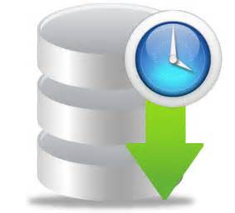
SQL Server Agent
Events
Schedule
Alerts
Jobs
Operators

Slide 10
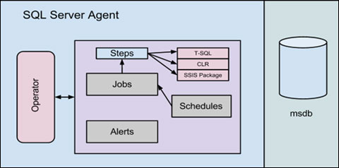
SQL Server Agent - Jobs
Jobs
Administrative tasks defined once and executed as many times as necessary

Slide 11
SQL Server Agent - Alerts
Alerts
Actions on an instance of SQL Server in response to a particular event or performance condition
Commonly used to trigger notification of a problem to administrative users of a database known as operators

Slide 12
SQL Server Agent - Operators
Operators
Users who are often configured within an instance of SQL Server to receive notification of particular jobs and alerts
Operators can receive notification in one of three ways:
E-mail
Pager
The NET SEND command

Slide 13
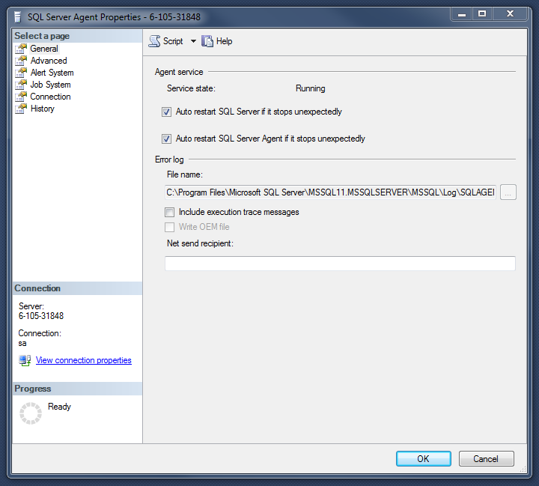
Configuring SQL Server Agent
Right-Click on SQL Server Agent, and select
Properties

Slide 14
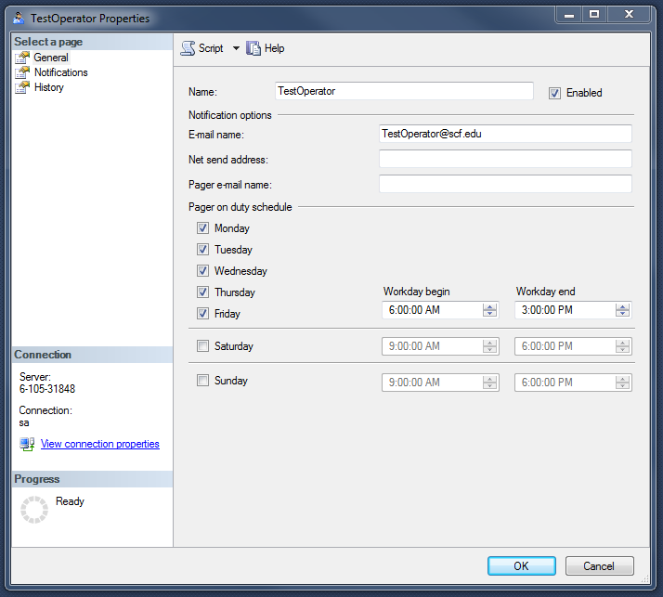
Configuring SQL Server Agent
Creating operators
To create operators in Enterprise Manager, expand Management folder, expand SQL Server Agent node, right-click on operators node and click New Operators option from context-sensitive menu

Slide 15
Configuring SQL Server Agent
SQL Server provides several system-stored procedures for managing operators in the SQL Server Agent notification system
Since the msdb database stores all of the information about operators, alerts and jobs, all of these procedures must be run from the msdb database
The sp_operator system-stored procedure is used to add new operators
The pagers_days parameter specifies the days on which the operators can receive pager notification

Slide 16
Configuring SQL Server Agent
The sp_update_operator system-stored procedure is used to modify the properties of existing operators
Accepts the same parameters as the sp_add_operator procedure but requires that the name parameter be a valid existing operator
The sp_help_operator system-stored procedure is used to return information about all of one of the operators defined in the msdb database for an instance of SQL Server
When called without any parameters, the procedure returns a result set containing the configurations for all operators in the system
If the operator_name parameter is specified, only the information of that particular operator is returned
To delete and existing operator, you would use the sp_delete_operator system-stored procedure

Slide 17
Summary
SQL Server Agent service provides a robust and flexible facility for automating and monitoring SQL Server instances
Using jobs, recurring operations can be configured and scheduled to run automatically by the SQL Server Agent service
Alerts are a powerful component of the SQL Server Agent architecture that allow different events and performance conditions to trigger notifications to administrative personnel
Alerts can be based on events that SQL Server writes to Windows application log or they can be defined for certain SQL Server performance counters
Performance counters are added to the server when you install SQL Server
These counters can be used in conjunction with the Windows System Monitor to identify performance bottlenecks involving the CPU, memory and I/O subsystems

