Slide 1
SQL Server - Review
Managing the System

Slide 2
Objectives
Understand the importance of maintenance plans.
Check for database consistency.
Understand how and when to use SQL Server Profiler.
Understand the components of SQL Server Agent.
View SQL Server Agent Configuration Manager options.
Configure SQL Server Agent properties.
Configure SQL Server Agent to automate the administration of SQL Server
Create and configure jobs, alerts and operators by using SQL Server Agent
Monitor hardware resource usage and SQL Server activity by using the Windows System Monitor

Slide 3
SQL Server Administrator’s Duties
Install and configure SQL Server
Plan and create databases
Back up the databases
Restore the databases when necessary
Set up and manage users for SQL Server
Manage security for new users and existing users
Import and export data
Set up and manage tasks, alerts, and operators
Manage the replication environment
Tune the SQL Server system for the optimal performance
Troubleshoot any SQL Server problems

Slide 4
SQL Server Administrative Duties
User Mgmt
Tuning
Auditing
Data
Mgmt
DR - Backup
Security
DR - Recovery
Archiving

Slide 5
SQL Server Administrator’s Duties (Defined)
Installation, Administration and Maintenance of SQL Server Instances. (Installing SQL Server)
Setup Test, Dev, Staging and Production Environments. (Installing SQL Server)
Create Users and assign permissions based on the level of database access the user would need. (Security)
Create Linked Servers to SQL Servers and other databases such as Oracle, Access, Informix etc. (Security and General Administration)
Design database Backup and Restoration Strategy. (Database Backups and SQL Server Agent)
Once created the database Backups, monitor those backups are being performed regularly. (SQL Server Agent)

Slide 6
SQL Server Administrator’s Duties (Defined)
From time to time recover the databases to a specific point of time, as per the requests. (Database Backups and Recovery)
Setup High-Availability as part Disaster Recovery Strategy for the Databases. (Failover Clustering, Database Mirroring, Log Shipping and Replication)
Troubleshoot various problems that arise in a day-to-day work and fix the issues. (Monitoring SQL Server Error Logs and checking your email alert (if there is one configured))
Monitoring and Performance Tuning; Physical Server Level, Database level (Database settings and options) and query tuning. (Creating and maintaining those Indexes, not performing database shrinking, memory settings, monitoring CPU usage and Disk I/O activity etc)
Documenting major changes to the SQL Servers. (General)
Apply Service Packs. (General)

Slide 7
Relational Database Management System (RDBMS)
RDBMS stands for Relational Database Management System. RDBMS data is structured in database tables, fields and records. Each RDBMS table consists of database table rows. Each database table row consists of one or more database table fields.
RDBMS store the data into collection of tables, which might be related by common fields (database table columns). RDBMS also provide relational operators to manipulate the data stored into the database tables. Most RDBMS use SQL as database query language.
Edgar Codd introduced the relational database model. Many modern DBMS do not conform to the Codd’s definition of a RDBMS, but nonetheless they are still considered to be RDBMS.
The most popular RDBMS are MS SQL Server, DB2, Oracle and MySQL.

Slide 8
RDBMS Objects - Tables
You already know that the table is the central RDBMS object. In a perfect world you would never have to change anything in a table's structure after it was created. In real life though you need to modify table definitions quite often. Changing business rules are usually the main reason; incorrect initial design is also not uncommon, especially in test environments. The whole idea behind the ALTER TABLE statement is to make the table definition changes as fast and as painless as possible. The DROP TABLE statement is used to remove a table (both its data and definition) from the database.

Slide 9
Planning Your Database
Designing a database requires an understanding of both the business functions you want to model and the database concepts and features used to represent those business functions.
It is important to accurately design a database to model the business because it can be time consuming to change the design of a database significantly once implemented. A well-designed database also performs better. When designing a database, consider: The purpose of the database and how it affects the design. Create a database plan to fit your purpose.
Database normalization rules that prevent mistakes in the database design
Protection of your data integrity
Security requirements of the database and user permissions
Performance needs of the application

Slide 10
Software Development Life Cycle (SDLC)
Software life cycle models describe phases of the software cycle and the order in which those phases are executed. Each phase produces deliverables required by the next phase in the life cycle. Requirements are translated into design. Code is produced according to the design which is called development phase. After coding and development the testing verifies the deliverable of the implementation phase against requirements.
There are following six phases in every Software Development Life Cycle model:
Requirement gathering and analysis
Design
Implementation or coding
Testing
Deployment - Evolution
Maintenance

Slide 11
Software Development Life Cycle

Slide 12
SCF Administrative Services – Software Development Lifecycle (SLDC)
1 – Project Initiation
Banner Project Request Form Filled out and submitted
Initial Requirements gathered
Data Custodian Meetings established
Resources Estimated
Step 1: Project Planning
Step 2: Present Project to BUG
Step 3: Project Specifications
Step 7: DBA Deploy to Production
Step 4: Development & Coding
Step 5: Testing
Step 6: Final Approval Process
6 – Project Completion
User approval for Production
Request submitted to Change Management Meeting (Wednesdays)
Coordination of push to Production
2 – Project Approval
Present Project to BUG
Further define requirements based on BUG feedback
3 – Project Documentation
Helpdesk Ticket Open with Initial Requirements (Project Classification)
Requirements completely defined
Software Design Specifications
Requirements Traceability Matrix
Requirements
Design
Development
Test
Deployment
5 – Project Testing
Deployment Instructions
Deployed to BIWK for testing and user feedback

Slide 13
SDLC – Database Design

Slide 14
Normalization
The logical design of the database, including the tables and the relationships between them, is the core of an optimized relational database. A good logical database design can lay the foundation for optimal database and application performance. A poor logical database design can impair the performance of the entire system.
Normalizing a logical database design involves using formal methods to separate the data into multiple, related tables. A greater number of narrow tables (with fewer columns) is characteristic of a normalized database. A few wide tables (with more columns) are characteristics of an non-normalized database.
In relational-database design theory, normalization rules identify certain attributes that must be present or absent in a well-designed database. A complete discussion of normalization rules goes well beyond the scope of this topic. However, there are a few rules that can help you achieve a sound database design: A table should have a numeric or uniqueidentifier (GUID) primary key
A table should store only data for a single type of entity (all fields should relate directly to the key) For example: Avoid storing information about a student and his/her test scores in the same table
A table should avoid nullable columns
A table should use default values where appropriate
A table should not have repeating values or columns For example: TEST_SCORE_1, TEST_SCORE_2 and so on
As normalization increases, so do the number and complexity of joins required to retrieve data. Too many complex relational joins between too many tables can hinder performance. Reasonable normalization often includes few regularly executed queries that use joins involving more than four tables.

Slide 15
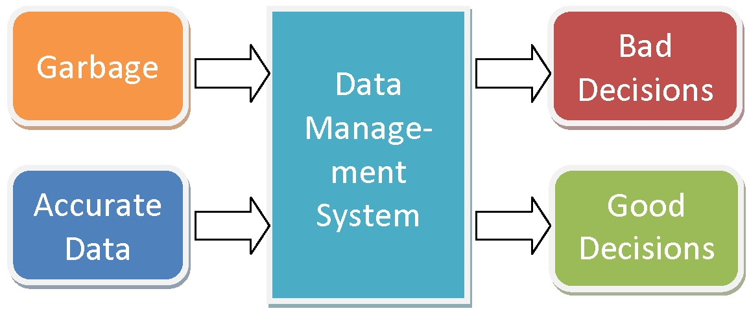
Data Integrity
Enforcing data integrity ensures the quality of the data in the database. One of the more common forms of data integrity is referential integrity.
Referential integrity preserves the defined relationships between tables when records are entered or deleted. In Microsoft SQL Server, referential integrity is based on relationships between foreign keys and primary keys or between foreign keys and unique keys. Referential integrity ensures that key values are consistent across tables. Such consistency requires that there be no references to nonexistent values and that if a key value changes, all references to it change consistently throughout the database.

Slide 16
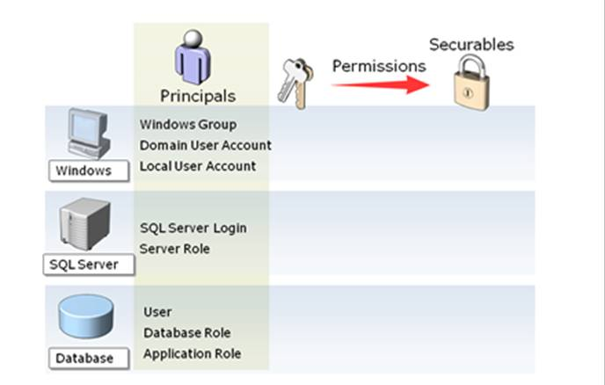
Data Security
One of the functions of a database is to protect the data by preventing certain users from seeing or changing highly sensitive data and preventing all users from making costly mistakes. For this reason, each application will use a separate user with specific permissions to only the data needed to provide a successful implementation.

Slide 17
Database Performance
When you design a database, you must ensure that the database performs all the important functions correctly and quickly. Some performance issues can be resolved after the database is in production, but other performance issues may be the result of a poor database design and can be addressed only by changing the structure and design of the database.
When you design and implement a database, you should identify the large tables in the database and the more complex processes that the database will perform, and give special consideration to performance when designing these tables. Also consider the effect on performance of increasing the number of users who can access the database.
In conjunction with correct database design, correct use of indexes is important for achieving good performance.
Indexes in databases are similar to indexes in books. In a book, an index allows you to find information quickly without reading the entire book. In a database, an index allows the database program to find data in a table without scanning the entire table. An index in a book is a list of words with the page numbers that contain each word. An index in a database is a list of values in a table with the storage locations of rows in the table that contain each value. Indexes can be created on either a single column or a combination of columns in a table. An index contains an entry with one or more columns (the search key) from each row in a table.

Slide 18
SQL – Querying the Database

Slide 19
SQL – Querying the Database

Slide 20
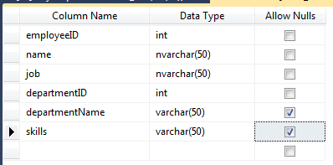
Example – Employee Table
What could be done better with this table design?

