Slide 1
Medication Administration
Adams Chapter 3
Notes:
A medication is a substance used in the diagnosis, treatment, cure, relief, or prevention of health problems.
Nurses play an essential role in safe medication preparation and administration, and in evaluation of medication effects.
In all settings, nurses are responsible for evaluating the effects of medications on patients’ ongoing health status, teaching them about their medications and side effects, ensuring adherence to the medication regimen, and evaluating the patient’s and family caregiver’s ability to self-administer medications.

Slide 2
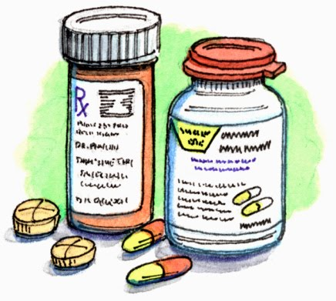
Medication Knowledge
Nurses Responsibilities:
Drug name
Purpose
Effects
Contraindications
Special considerations
Side effects
Purpose for THIS patient
Form supplied, route, dose range

Slide 3
Patient Assessment
Medical history
Physical assessment
Growth and development
Current medical/disease processes

Slide 4
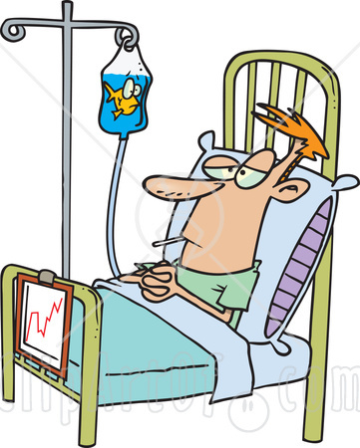
Adverse Effects
Side effect
Expected drug reaction
Allergic reaction
Hyperresponse
Anaphylaxis
Massive systemic response

Slide 5
The Rights of Drug Administration
1. Right patient
2. Right medication
3. Right dose
4. Right route
5. Right time
THE THREE CHECKS OF DRUG ADMINISTRATION

Slide 6
Nursing Knowledge Base
Safe administration is imperative.
Nursing process provides a framework for medication administration.
Clinical calculations must be handled without error.
Conversions within and between systems
Dose calculations
Pediatric calculations require special caution.
Notes:
[Encourage students to take a Math for Meds and/or Pharmacology course and to review information from their math course.]
In 2003, the Institutes of Medicine published the book To Err Is Human: Building a Safer Health System. This book created a new national awareness of problems within the health care system. It estimated that up to 98,000 people die in any given year from medical errors that occur in hospitals. This means that more people die from medical errors than from motor vehicle accidents, breast cancer, acquired immunodeficiency
syndrome (AIDS), or workplace injuries. Health care experts estimate that medication-related errors for hospitalized patients cost more than $3.5 billion annually.
Nurses play an important role in patient safety, especially in the area of medication administration. Nurses need to know how to calculate medication doses accurately and must understand the different roles that members of the health care team play in prescribing and administering medications.
To administer medications safely, you need to have an understanding of basic mathematics skills to calculate medication doses, mix solutions, and perform a variety of other activities.
Medications are not always dispensed in the unit of measure in which they are ordered. Medication companies package and bottle medications in standard dosages. Nurses frequently convert available units of volume and weight to desired doses. Therefore, be aware of equivalents in all major measurement systems. You use equivalents when performing other nursing actions, such as when calculating patients’ intake and output and IV flow rates.
[See also Box 31-2 Evidence-Based Practice: Reducing Errors During Medication Administration.]

Slide 7
Maintaining Patients’ Rights
To be informed about a medication
To refuse a medication
To have a medication history
To be properly advised about experimental nature of medication
To receive labeled medications safely
To receive appropriate supportive therapy
To not receive unnecessary medications
To be informed if medications are part of a research study
Notes:
In accordance with The Patient Care Partnership (American Hospital Association, 2003) and because of the potential risks related to medication administration, a patient has the following rights:
To be informed of the name, purpose, action, and potential undesired effects of a medication
To refuse a medication regardless of the consequences
To have qualified nurses or physicians assess a medication history, including allergies and use of herbals
To be properly advised of the experimental nature of medication therapy and to give written consent for its use
To receive labeled medications safely without discomfort in accordance with the six rights of medication administration
To receive appropriate supportive therapy in relation to medication therapy
To not receive unnecessary medications
To be informed if medications are part of a research study
[Ask students if they have questions about these rights. Discuss any concerns.]
Know these rights and handle all inquiries by patients and families courteously and professionally. Do not become defensive if a patient refuses medication therapy, recognizing that every person of consenting age has a right to refusal.

Slide 8
Types of Drug Orders
Routine: Administered until the dosage is changed or another medication is prescribed | prn: Given when the patient requires it
Single (one-time): Given one time only for a specific reason | STAT: Given immediately in an emergency
Now/ASAP: When a medication is needed right away, but not STAT
Notes:
Types of medication orders depend on the urgency, or how frequently they are needed.
A standing order is carried out until the prescriber cancels it by another order, or the prescribed number of days elapses. It often indicates a final date or number of treatments or doses.
A prn order indicates that the prescriber ordered a medication to be given only when a patient requires it.
A STAT order signifies that a single dose of a medication is to be given immediately and only once.

Slide 9
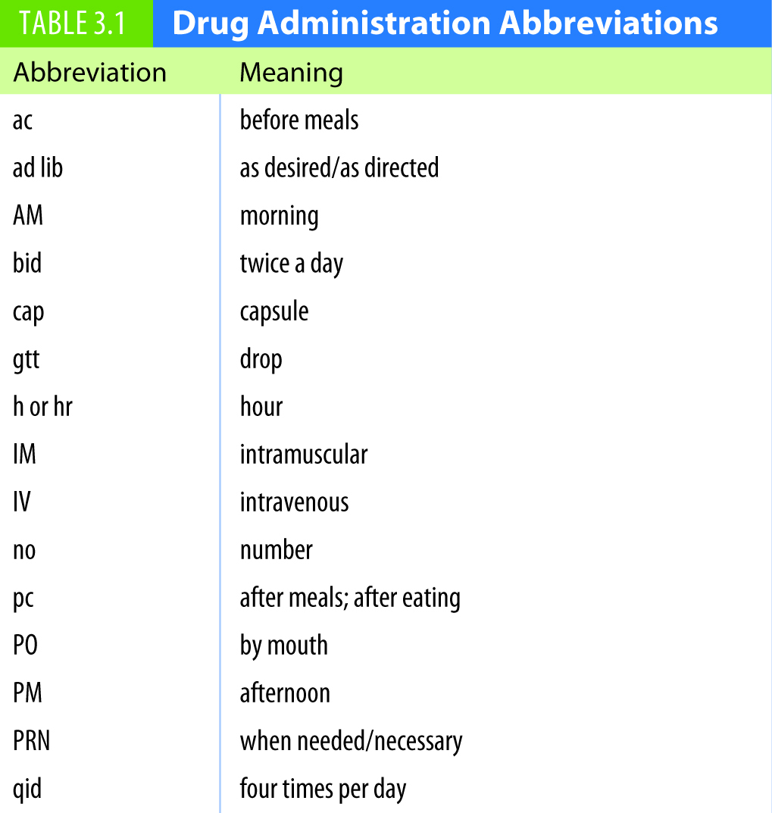
Table 3.1 Drug Administration Abbreviations
continued on next slide

Slide 10
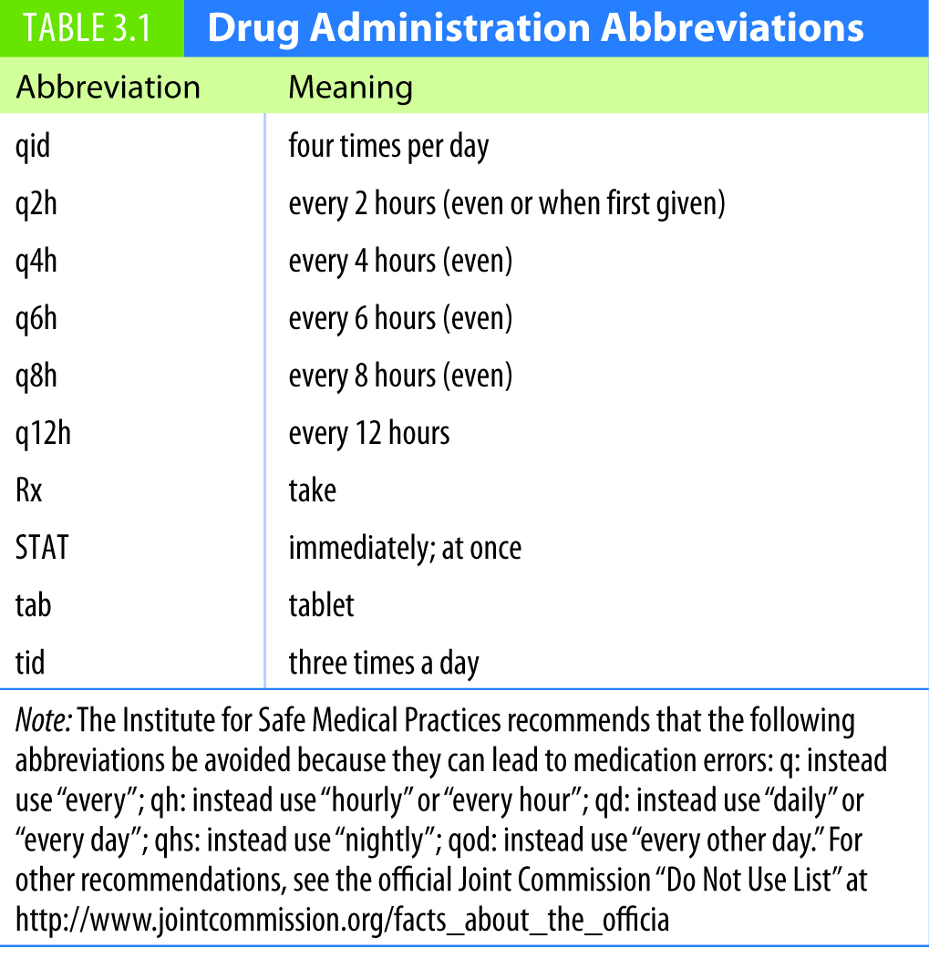
Table 3.1 (continued) Drug Administration Abbreviations

Slide 11
Do Not Use List

Slide 12
Systems of Medication Measurement
Require the ability to compute medication doses accurately and measure medications correctly
Metric system (0 before the decimal only)
Most logically organized
Meter, liter, gram
Household system
Most familiar to individuals
Disadvantage: inaccuracy
Solution
Notes:
The metric system is organized into units of 10. Metric units are easy to convert and compute through simple multiplication and division. However, this system must be used with great care because moving a decimal to the right or the left will greatly affect the dose. This is why a zero (0) must always be placed before a decimal (0.1 mg) but never after a decimal (1 mg, not 1.0 mg).
Household measurements are familiar to most people. Medications ordered by this method include drops, teaspoons, and tablespoons.
Solutions are used for irrigations, injections, and infusions. A solution is defined as a given mass of solid substance dissolved in a known volume of fluid, or as a given volume of liquid dissolved in a known volume of another fluid.
[See also Table 31-6 on text p. 573 Equivalents of Measurement.]

Slide 13
Metric Specifics
Gram = g or gm
Liter = l or L
Use lowercase letters for abbreviations for other units:
Milligram = mg
Milliliter = mL
Convert fractions to decimals:
500 mg or 0.5 g, but NOT ½ g
10 mL or 0.01 L, but NOT 1/100 L
Notes:
Specific abbreviations are used for metric units.
Abbreviations for grams and liters can be shown in uppercase or lowercase, but milligrams and milliliter abbreviations are always lowercase.
Many actual and potential medication errors happen with the use of fractions and decimal points. Convert fractions to decimals carefully!

Slide 14
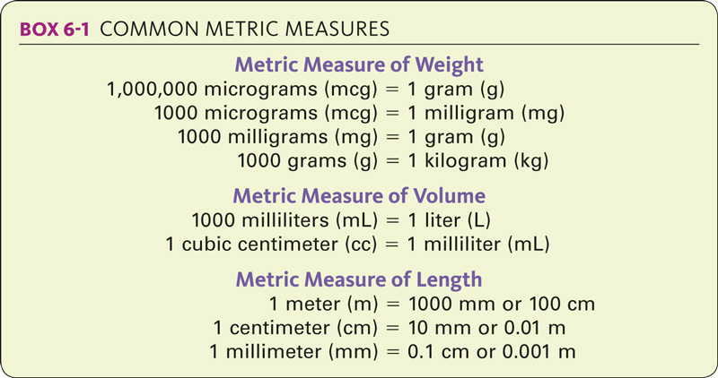
Common Metric Measures

Slide 15
Converting within the Metric System
To convert a quantity from one unit of metric measurement to another:
1. Move the decimal point to the right if you are converting from a larger unit to a smaller unit.
2. Move the decimal point to the left if you are converting from a smaller unit to a larger unit.

Slide 16
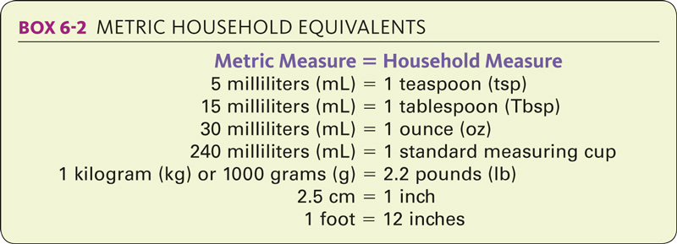
Metric Household Equivalents

Slide 17
Apothecary/Metric Equivalents
Notes:
What types of measures are included in this table? Are weight measures included? What about length and volume measures?
Volume and weight measures are included in this table, but length measures are not.

Slide 18
Apothecary System
ERROR ALERT!
The basic unit of weight is the grain (gr).
Do not confuse grains and grams.
grains (gr)
grams (g)
1 gr = 60 mg = 0.06 g OR
1 gr = 65 mg = 0.065 g

Slide 19
Apothecary System
Apothecary ounce is used in the United States.
8 ounces to a cup is commonly used in the home to measure liquids.
The dram is most frequently used to abbreviate a teaspoonful which is nearly the same volume.

Slide 20
Converting Celsius and Fahrenheit Temperatures
BOX 8-2 n CONVERTING CELSIUS AND FAHRENHEIT TEMPERATURES
Fahrenheit to Celsius Celsius to Fahrenheit
Subtract 32 Multiply by 1.8
Divide by 1.8 Add 32
Notes:
What is the freezing point of water in degrees Fahrenheit? What is the freezing point of water in degrees Celsius?
The freezing point of water is 32º F on the Fahrenheit scale and 0º C on the Celsius scale.

Slide 21
METHODS of DOSAGE CALCULATIONS
To calculate medication dosages you must know:
Desired Dose:
The amount of the drug to be administered at a single time.
Its unit of measurement must be the same as the dosage unit.
Dose on hand:
The amount of drug contained within a dosage unit of medication.

Slide 22
Dose Calculation Methods
Verify medication calculations with another nurse to ensure accuracy.
The ratio and proportion method
Desired dose= _____X_____
Dose on hand Amount on hand
Formula method
Desired dose × Amount on hand = Amount to
Dose on hand administer
Dimensional analysis
Factor-label or unit factor method
Notes:
In a proportion, the first and last numbers are called the extremes, and the second and third numbers are called the means. When multiplying the extremes, the answer is the same as when multiplying the means. Because of this relationship, if you know three of the numbers in the proportion, calculating the unknown fourth number is easy. In the example, 1 and 8 are the extremes, and 2 and 4 are the means.
The formula method requires you to first memorize the formula. Estimate the answer, and then place all the information from the medication order into the formula. Label all parts of the formula, and ensure that all measures in the formula are in the same units and system of measurement before calculating the dosage.
Current evidence shows that nursing students who use dimensional analysis often calculate medications more accurately than when they use the formula method.

Slide 23
Decimals
Always write a zero to the left of the decimal point when the decimal number has no whole number part.
Using zero makes the decimal more noticeable and helps to prevent errors caused by illegible handwriting.

Slide 24
Converting Measures
Example:
A physician ordered amoxicillin 0.5 g po four times a day. The drug is supplied in 500-mg capsules.
Notes:
Why is it necessary to convert oral drug measurements from one system to another?
Physicians can order a drug in one system of measurement when it is supplied in another. It is then necessary to convert between measures so that both measurements are in the same system.
Convert the measurements in the example.
Because the drug is supplied in milligrams, convert the measurement in the order to milligrams.
1000 mg : 1 g :: x mg : 0.5 g
1x = 1000 × 0.5
x = 500 mg

Slide 25
Using Proportions to Solve Tablet and Capsule Medication Problems (cont’d)
Example:
The physician orders minocycline 200 mg po daily. Minocycline 50 mg is available. How many capsules will the nurse administer?
Notes:
How many tablets will the nurse administer?
Because the order and the available drug are already listed in the same metric measurement, a proportion can be written to calculate the amount of the drug to be administered.
50 mg : 1 capsule :: 200 mg : x capsules
50 : 1 :: 200 : x
50x = 200
x = 200 ÷ 50
x = 4
The nurse will administer 4 capsules.

Slide 26
Using Proportions to Solve Liquid Medication Problems (cont’d)
Example:
The physician ordered atovaquone 750 mg twice daily pc. Atovaquone is available 150 mg/mL. How many milliliters will the nurse administer?
Notes:
How many milliliters will the nurse administer?
Because the order and available drug are in the same metric measurement, the proportion can be written.
150 mg : 1 mL :: 750 mg : x mL
150 : 1 :: 750 : x
150x = 750
x = 750 ÷ 150
x = 5
The nurse will administer 5 mL of atovaquone.

Slide 27
Using Proportions to Solve Problems Involving Milliequivalents
Example:
The physician ordered Slow-K 20 mEq four times a day with meals. The drug is available 10 mEq/5 mL. How many milliliters will the nurse administer?
Notes:
A milliequivalent is the number of grams of a solute contained in 1 mL of a normal solution.
How many milliliters will the nurse administer?
10 mEq : 5 mL :: 20 mEq : x mL
10 : 5 :: 20 : x
10x = 100
x = 100 ÷ 10
x = 10
The nurse will administer 10 mL of Slow-K.

