Slide 1
Medication Administration
Adams Chapter 3
Notes:
A medication is a substance used in the diagnosis, treatment, cure, relief, or prevention of health problems.
Nurses play an essential role in safe medication preparation and administration, and in evaluation of medication effects.
In all settings, nurses are responsible for evaluating the effects of medications on patients’ ongoing health status, teaching them about their medications and side effects, ensuring adherence to the medication regimen, and evaluating the patient’s and family caregiver’s ability to self-administer medications.

Slide 2
Drug Name
Generic name = official name
  By law this name must appear on the label.
Trade name = brand name used to market the drug
Levothyroxine Sodium = Synthroid
(generic name) (trade name)

Slide 3
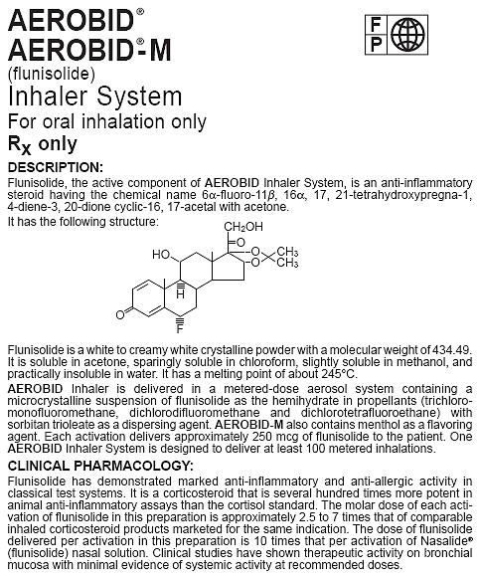
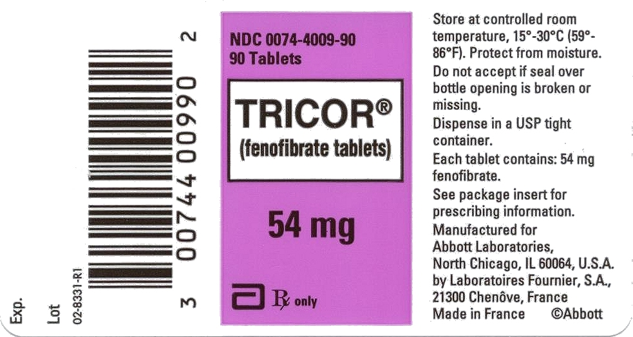
Drug Labels and Package Inserts

Slide 4
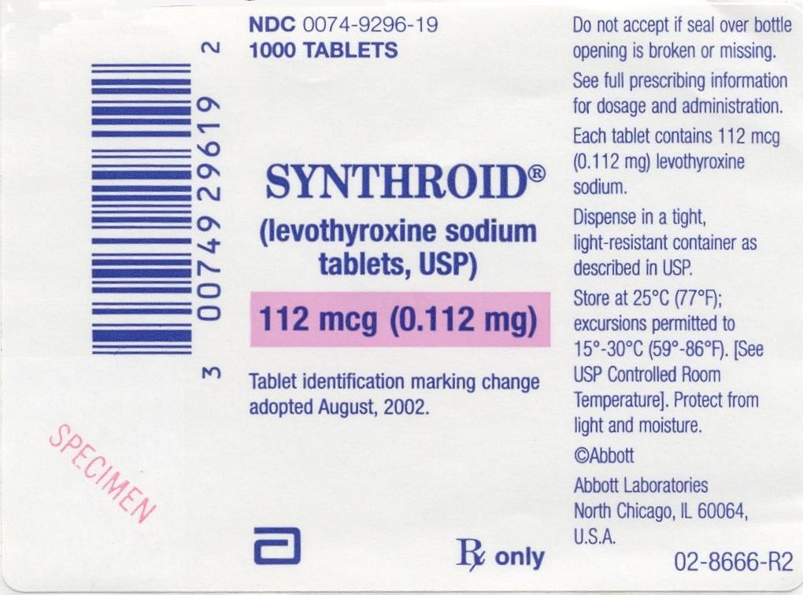
Locating Information on Drug Labels and Package Inserts
Drug name
Form of the drug
Dosage strength
Total amount in the container
Warnings
Route of administration
Storage requirements
Manufacturing information

Slide 5
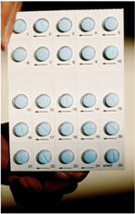
Controlled Substances
Kept under lock
Special inventory forms
Documentation requirements
Counts of controlled substances
Procedures for discarding

Slide 6
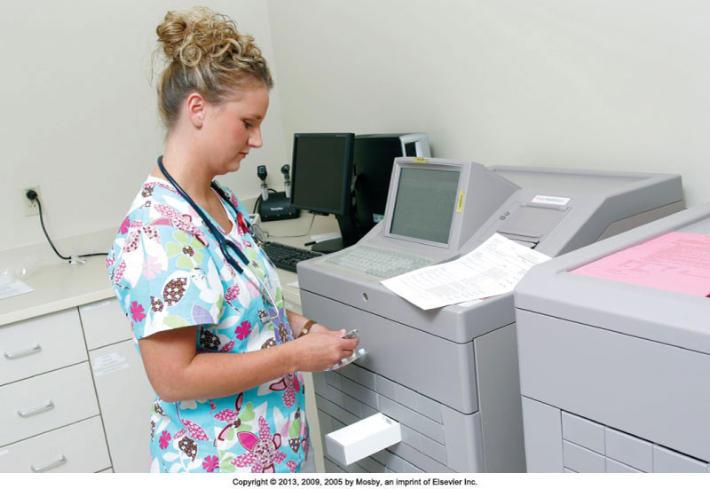
Automated Medication Dispensing System
Notes:
Shown is an automated medication dispensing system (AMDS).
AMDSs control the dispensing of all medications, including narcotics. Each nurse accesses the system by entering a security code. Some systems require bioidentification as well. With these systems, you place your finger on a screen to access the computer. You select the patient’s name and his or her drug profile before the AMDS dispenses a medication. With these systems, you are allowed to select the desired medication, dosage, and route from a list displayed on the computer screen.
The system causes the drawer containing medication to open, records it, and charges it to the patient. Systems that are connected to the patient’s computerized medical record then record information about the medication (e.g., medication name, dose, time) and the nurse’s name in the patient’s medical record. Some systems require nurses to scan bar codes to identify the patient, the medication, and the nurse administering the medication before recording this information in the patient’s computerized medical record. Agencies that implement AMDS with bar-code scanning often reduce the incidence of medication errors.
[Shown is Figure 31-7 from text p. 582.]

Slide 7
Automated Medication-Dispensing System
A machine containing a combination of medications frequently used on a unit, as needed medications, controlled drugs, and emergency medications
Delivered in a unit-dose package
An account is kept of all medications used for billing and record keeping

Slide 8
Medication Errors
Report all medication errors.
Patient safety is top priority when an error occurs.
Documentation is required.
The nurse is responsible for preparing a written occurrence or incident report: an accurate, factual description of what occurred and what was done.
Nurses play an essential role in medication reconciliation.
Notes:
A medication error can cause or lead to inappropriate medication use or patient harm. Errors include inaccurate prescribing or administration, or giving a drug via the wrong route or frequency.
It is important to feel comfortable in reporting an error and not fear repercussions from managerial staff. Even when a patient suffers no harm from a medication error, the institution can still learn why the mistake occurred and what can be done to avoid similar errors in the future.
When an error occurs, the nurse first assesses and examines the patient’s condition and notifies the health care provider of the incident as soon as possible. Once the patient is stable, the nurse reports the incident to the appropriate person in the institution (e.g., manager, supervisor).
The nurse is responsible for preparing a written occurrence or incident report that usually needs to be filed within 24 hours of the error. The report includes patient identification information; the location and time of the incident; an accurate, factual description of what occurred and what was done; and the signature of the nurse involved. The occurrence report is not a permanent part of the medical record and is not referred to anywhere in the record. This legally protects the nurse and the institution. Agencies use occurrence reports to track incident patterns and initiate quality improvement programs as needed.
Nurses play an essential role in medication reconciliation. Whenever a nurse admits a patient to a health care setting, he or she compares the medications that the patient took in the previous setting (e.g., home, another nursing unit) with his or her current medication orders. When the patient leaves that setting for another setting (e.g., skilled care facility, intensive care unit), the nurse communicates the patient’s current medications to the health care providers in the new setting. The nurse also reconciles the patient’s medications when he or she is discharged from an agency or is seen in an outpatient setting.
Many agencies have computerized or written forms to facilitate the process of medication reconciliation.
Advances in technology have helped to decrease the occurrence of medication errors.
[Refer to Box 31-4 Steps to Take to Prevent Medication Errors and Box 31-5 Informatics and Medication Safety) on text p. 583 for medication safety information.]
[See also Box 31-6 on text p. 584 Process for Medication Reconciliation.]

Slide 9
Critical Thinking and Medication Administration
Knowledge
Experience
  Psychomotor skills (how to)
Attitudes
  Be disciplined; take your time.
  Be responsible and accountable.
Standards
  Ensure safe nursing practice.
Notes:
You will use knowledge from many disciplines when administering medications to understand why a particular medication is prescribed for a patient and how the medication will alter the patient’s physiology to have a therapeutic effect.
Experience will be gained as students learn to administer medications on a weekly basis. Medication administration requires both knowledge and psychomotor skills. Students will practice medication administration in skills laboratory.
Every step of safe medication administration requires a disciplined attitude and a comprehensive, systematic approach.
The attitude nurses need to possess when administering medications to patients includes responsibility and accountability.
The American Nurses Association’s Scope and Standards of Nursing Practice addresses medication administration.

Slide 10
Medication Administration
Keys to accuracy
  Avoid distractions and follow the same routine.
  Administer only medications you prepare, and never leave prepared medications unattended.
  Document medications immediately after administration.
  Use clinical judgment in determining the best time to administer prn medications.
  When preparing medications, check the medication container label against the medication administration record (MAR) three times.
Notes:
To reduce medication errors, nurses need to avoid distractions and follow the same routine when preparing medications.

Slide 11
Administering Oral Medications
1. Review medication order
2. Utilize drug resource
3. Assess allergies
4. Assess ability to take medication
5. Perform medication specific assessments
6. Utilize MAR or EMAR
7. Pull medications; scan if using EMAR
8. Check “five rights” three times (next slide)
9. Identify client with two identifiers; scan client if using EMAR
10. Explain medications
11. Unwrap medications and place in medication cup
12. Administer to client
13. Document as appropriate

Slide 12
The Six “Rights”
The six rights of medication administration contribute to accurate preparation and administration of medication doses:
  1. Right medication
  2. Right dose
  3. Right patient
  4. Right route
  5. Right time
  6. Right documentation
Notes:
Because nurses play an essential role in preparing and administering medications, they need to be vigilant in preventing errors.
Regardless of how the nurse receives a medication order, he or she compares the prescriber’s written orders with the medication administration record (MAR) or the electronic medication administration record (eMAR) when medication is initially ordered.
When performing medication calculations or conversions, have another qualified nurse check the calculated doses.
An important step in safe medication administration is making sure that you give the right medication to the right patient. Before administering a medication, use at least two patient identifiers.
Always consult the prescriber if an order does not designate a route of administration. Likewise, if the specified route is not the recommended route, alert the prescriber immediately.
You need to know why a medication is ordered for certain times of the day, and whether you are able to alter the time schedule.
A medication order is required for every medication that you administer to a patient. If any question arises about a medication order because it is incomplete, illegible, vague, or not understood, contact the prescribing health care provider before administering the medication.
Never document that you have given a medication until you have actually given it.

Slide 13
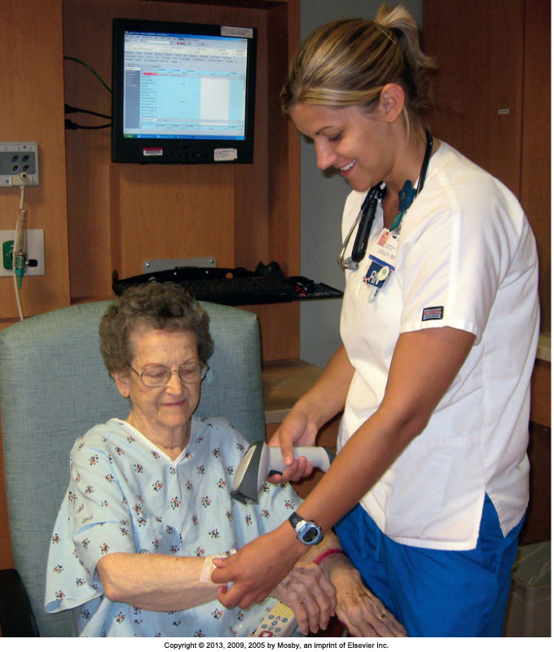
Right Patient
Notes:
Nurse using bar-code scanner to identify patient during medication administration.
[Shown is Figure 31-8 from text p. 586.]

Slide 14
Bar Code Medication Administration
Involves a hand-held laser scanner, a lap-top computer attached to a medication cart, and bar codes
Client wears bar-coded identification bracelet
Will warn of potential error if five rights are not met

Slide 15
Maintaining Patients’ Rights
To be informed about a medication
To refuse a medication
To have a medication history
To be properly advised about experimental nature of medication
To receive labeled medications safely
To receive appropriate supportive therapy
To not receive unnecessary medications
To be informed if medications are part of a research study
Notes:
In accordance with The Patient Care Partnership (American Hospital Association, 2003) and because of the potential risks related to medication administration, a patient has the following rights:
To be informed of the name, purpose, action, and potential undesired effects of a medication
To refuse a medication regardless of the consequences
To have qualified nurses or physicians assess a medication history, including allergies and use of herbals
To be properly advised of the experimental nature of medication therapy and to give written consent for its use
To receive labeled medications safely without discomfort in accordance with the six rights of medication administration
To receive appropriate supportive therapy in relation to medication therapy
To not receive unnecessary medications
To be informed if medications are part of a research study
[Ask students if they have questions about these rights. Discuss any concerns.]
Know these rights and handle all inquiries by patients and families courteously and professionally. Do not become defensive if a patient refuses medication therapy, recognizing that every person of consenting age has a right to refusal.

Slide 16
Routes of Administration
Oral Sublingual, buccal | Parenteral ID, Sub-Q, IM, IV (epidural, intrathecal, intraosseous, intraperitoneal, intrapleural, intra-arterial)
Topical Direct, body cavity
Inhalation | Intraocular
Notes:
The route prescribed for administering a medication depends on the properties and desired effect of the medication and the patient’s physical and mental condition.
[Table 31-5 on text p. 571 presents factors influencing administration routes.]
Each of these administration routes has pros and cons. As a nurse, you can help the prescriber decide which route will be most beneficial given the patient’s individual needs.
The oral route is the easiest and the most commonly used route. Oral medications have a slower onset of action and a more prolonged effect than parenteral medications. Patients generally prefer the oral route. (Sublingual and buccal routes are shown on the next slide.)
Parenteral administration involves injecting a medication into body tissues. The following are the four major sites of injection:
1. Intradermal (ID): injection into the dermis just under the epidermis.
2. Subcutaneous: injection into tissues just below the dermis of the skin.
3. Intramuscular (IM): injection into a muscle.
4. Intravenous (IV): injection into a vein.
Some medications are administered into other body cavities: epidural, intrathecal, intraosseous, intraperitoneal, intrapleural, and intra-arterial, as well as intracardiac and intra-articular.
Nurses usually are not responsible for administration of medications through these advanced techniques. Whether or not you actually administer the medication, you remain responsible for monitoring the integrity of the medication delivery system, understanding the therapeutic value of the medication, and evaluating the patient’s response to the therapy.
Medications applied to the skin and mucous membranes generally have local effects. You apply topical medications to the skin by painting or spreading the medication over an area, applying moist dressings, soaking body parts in a solution, or giving medicated baths. Systemic effects often occur if a patient’s skin is thin or broken down, if the medication concentration is high, or if contact with the skin is prolonged. A transdermal
disk or patch has systemic effects. The disk secures the medicated ointment to the skin. These topical applications are left in place for as little as 12 hours or as long as 7 days.
[Ask the class to name some common transdermal medications: nitroglycerin, scopolamine, estrogen.]
Nurses administer medications to mucous membranes in a variety of ways: (1) directly applying a liquid or ointment; (2) inserting a medication into a body cavity; (3) instilling fluid into a body cavity (instillation [fluid is retained]); (4) irrigating a body cavity (fluid is not retained); and (5) spraying a medication into a body cavity.
The deeper passages of the respiratory tract provide a large surface area for medication absorption. Nurses administer inhaled medications through the nasal and oral passages or through endotracheal or tracheostomy tubes. Inhaled medications are readily absorbed and work rapidly because of the rich vascular alveolar capillary network present in the pulmonary tissue. Many inhaled medications have local or systemic effects.
Intraocular medication delivery involves inserting a medication similar to a contact lens into the patient’s eye. The eye medication disk has two soft outer layers that have medication enclosed in them. The nurse inserts the disk into the patient’s eye, much like a contact lens, and it can remain there for up to 1 week.

Slide 17
Oral Administration
Easiest and most desirable route
Food may decrease therapeutic effect.
Aspiration precautions
Enteral or small-bore feedings:
  Verify that the tube location is compatible with medication absorption.
  Follow American Society for Parenteral and Enteral Nutrition (ASPEN) guidelines.
  Use liquids when possible.
  If medication is to be given on an empty stomach, allow at least 30 minutes before or after feeding.
  Risk of drug-drug interactions is higher.
Notes:
Patients usually are able to ingest or self-administer oral medications with a minimum of problems.
Food delays stomach emptying, which may decrease the therapeutic effects of oral medications.
Protect the patient from aspiration by assessing his or her ability to swallow.
[See also Box 31-14 on text p. 593 Protecting the Patient from Aspiration.]
Special consideration is needed when administering medications to patients with enteral or small-bore feeding tubes.
Failing to follow current evidence-based recommendations from the American Society for Parenteral and Enteral Nutrition (ASPEN) can result in tube obstruction, reduced medication effectiveness, and increased risk of medication toxicity.
When liquid medications are not available, crush simple tablets or open gelatin capsules and dilute in sterile water. Do not use tap water. Tap water often contains contaminants (e.g., pathogens, heavy metals) that can interact with a medication and affect its bioavailability.
If a medication needs to be given on an empty stomach or is not compatible with the feeding, it needs to be held at least 30 minutes before or 30 minutes after medication administration.
Before giving a medication by this route, verify that the location of the tube (e.g., stomach, jejunum) is compatible with medication absorption.
Monitor the patient closely for adverse reactions. The risk for drug-drug interactions is high when two or more medications are given by this route because they can interact as soon as they are administered.
[See also Box 31-15 on text p. 594 Procedural Guidelines: Giving Medications Through an Enteral Tube (Nasogastric Tube, G-Tube, J-Tube, or Small-Bore Feeding Tube.]

Slide 18
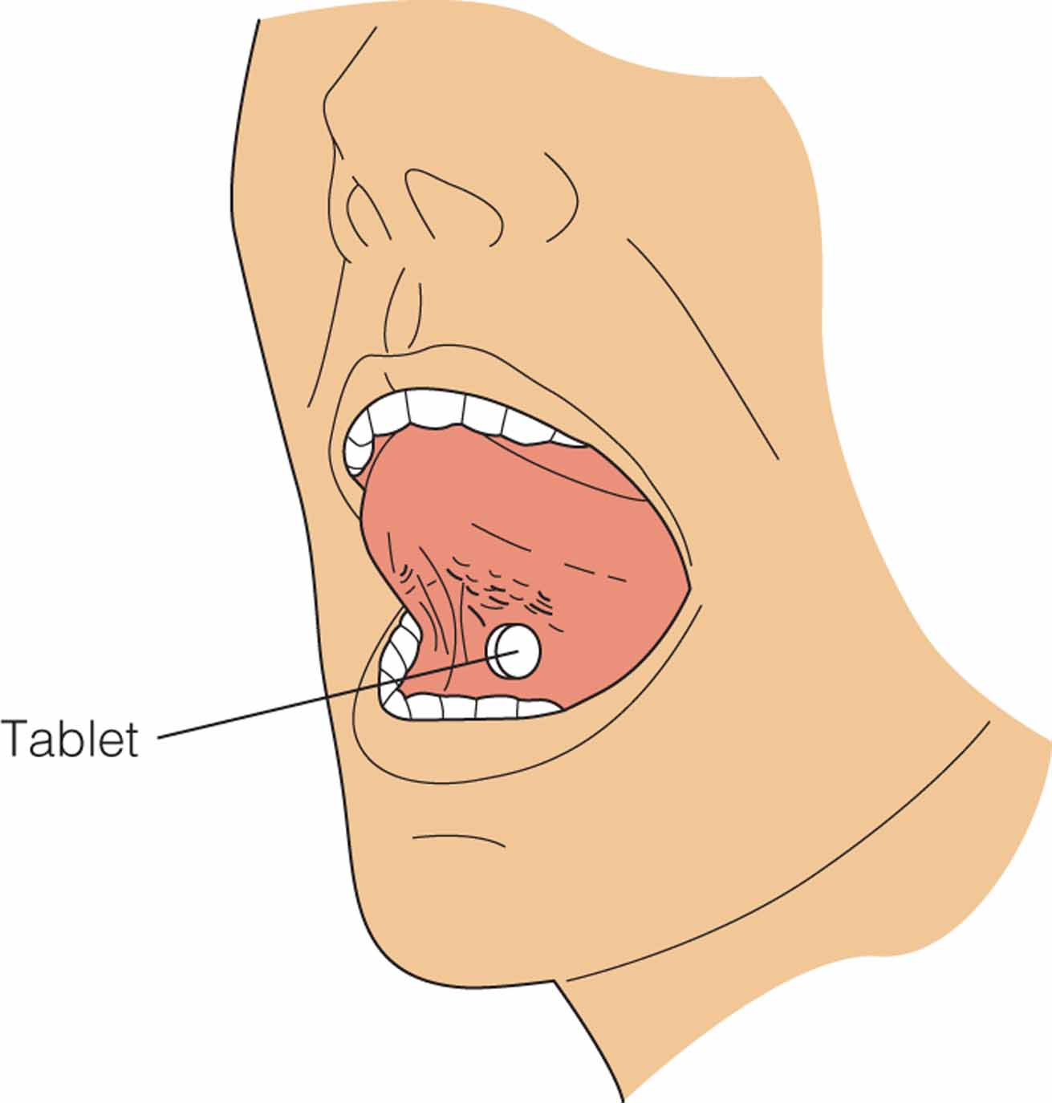
Sublingual Administration
Place tablet under tongue and allow to dissolve

Slide 19
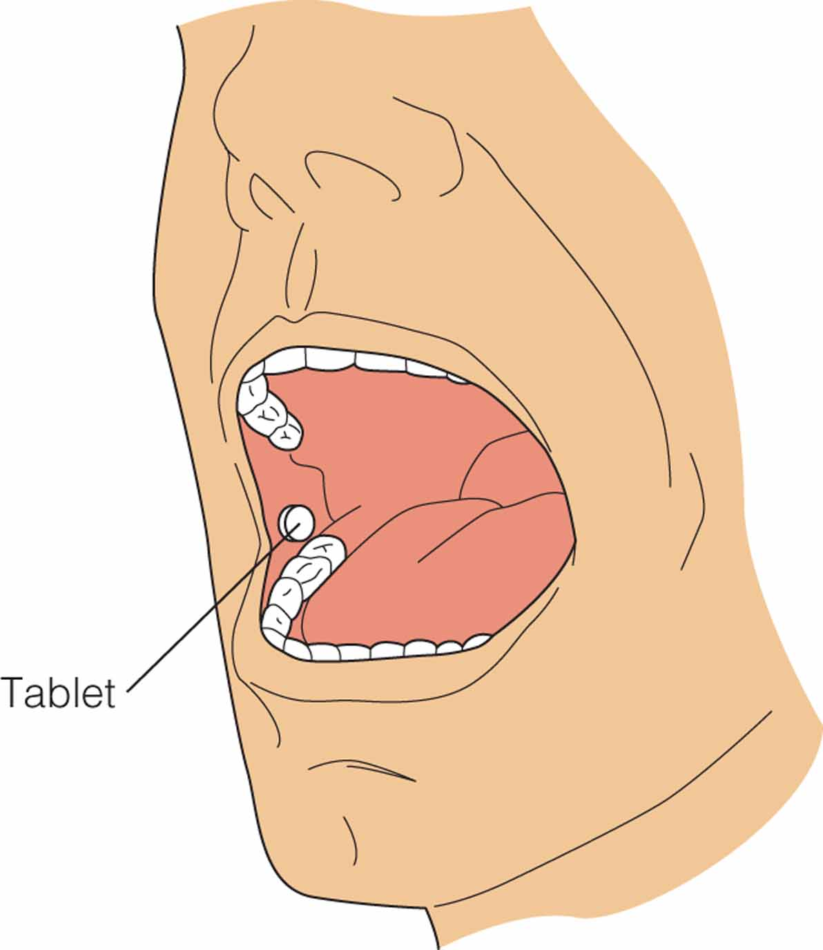
Buccal Administration
Place in side of mouth between cheek and gums

Slide 20
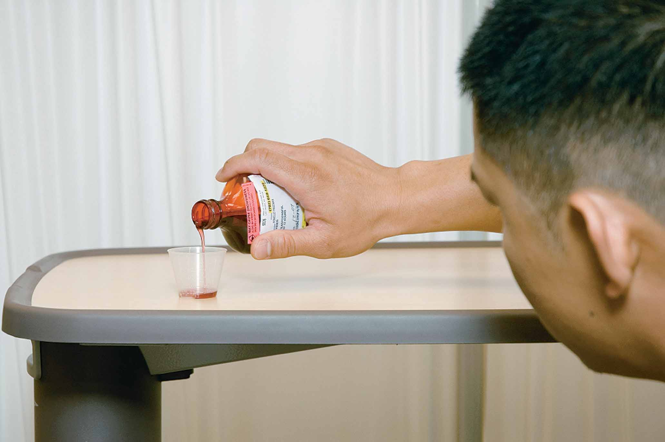
Administering Oral Medications Pouring a liquid medication from a bottle.
Notes:
20

Slide 21
Nasogastric and Gastronomy Drug Administration
Nasogastric (NG) tube is a soft, flexible tube inserted by way of the nasopharynx with the tip lying in the stomach.
  Generally for short-term treatment

Slide 22
Nasogastric and Gastronomy Drug Administration
Gastrostomy (G) tube is surgically placed directly into the patient's stomach.
  Longer-term treatment
Both methods generally use liquid drugs.

Slide 23
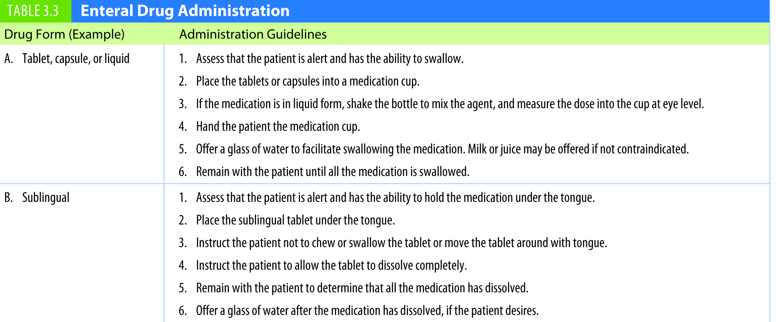
Table 3.3 Enteral Drug Administration
continued on next slide

Slide 24
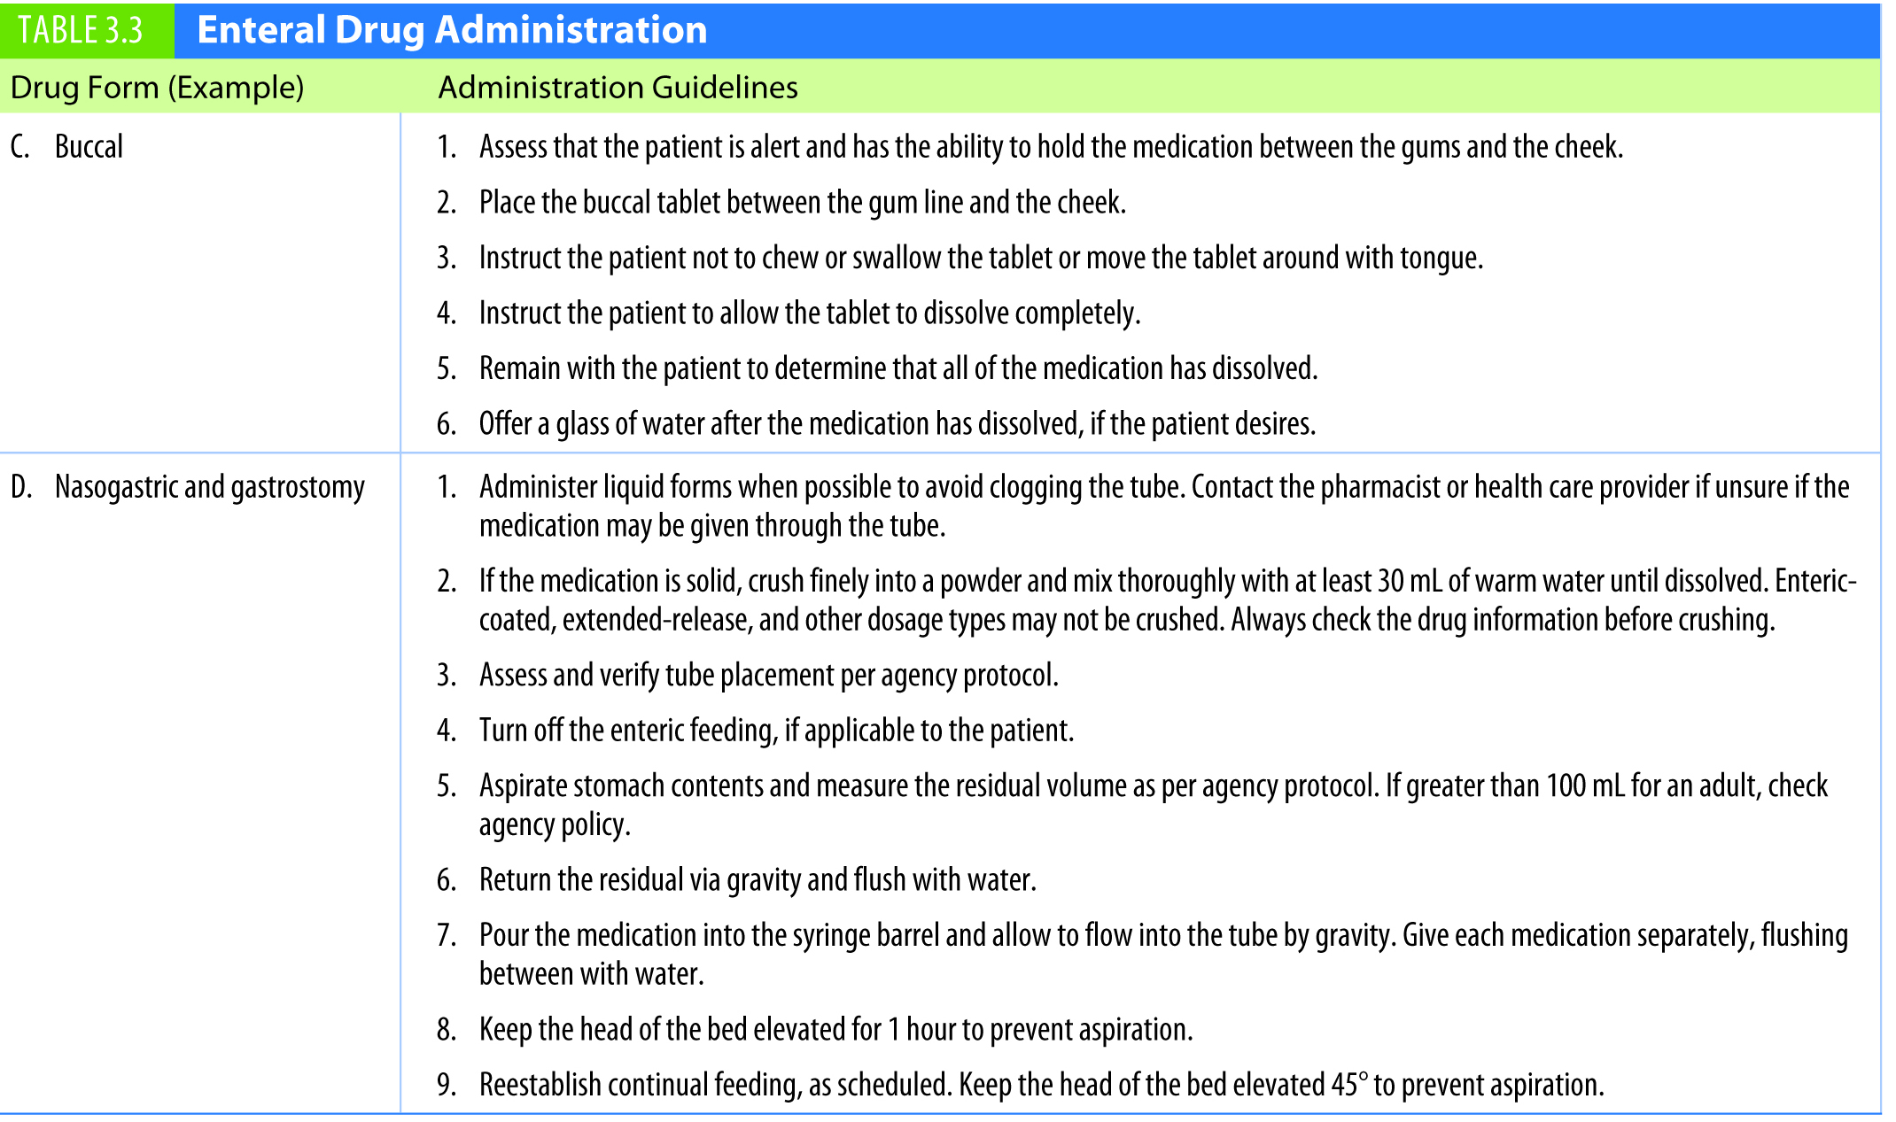
Table 3.3 (continued) Enteral Drug Administration

Slide 25
Topical Medications
Skin
  Use gloves.
  Use sterile technique if the patient has an open wound.
  Clean skin first.
  Follow directions for each type of medication.
  Transdermal patches:
    Remove old patch before applying new.
    Document the location of the new patch.
    Ask about patches during the medication history.
    Apply a label to the patch if it is difficult to see.
    Document removal of the patch as well.
Notes:
Topical medications are medications that are applied locally, usually to skin, but also to mucous membranes.
Apply each type of medication according to directions to ensure proper penetration and absorption.

Slide 26
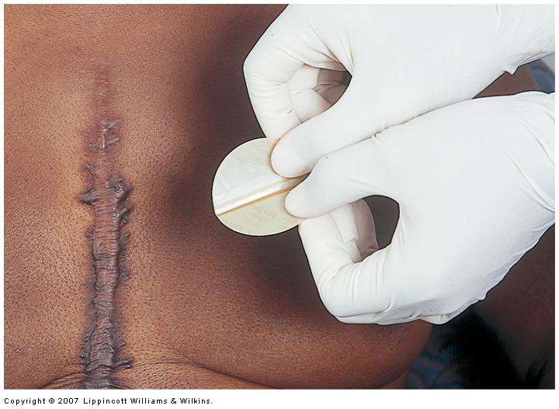
Topical

Slide 27
Ophthalmic Medications
The solution or ointment is placed in the lower conjunctival sac by gently retracting the lower eyelid
Avoid touching the eye with the tip of the ointment tube or dropper

Slide 28
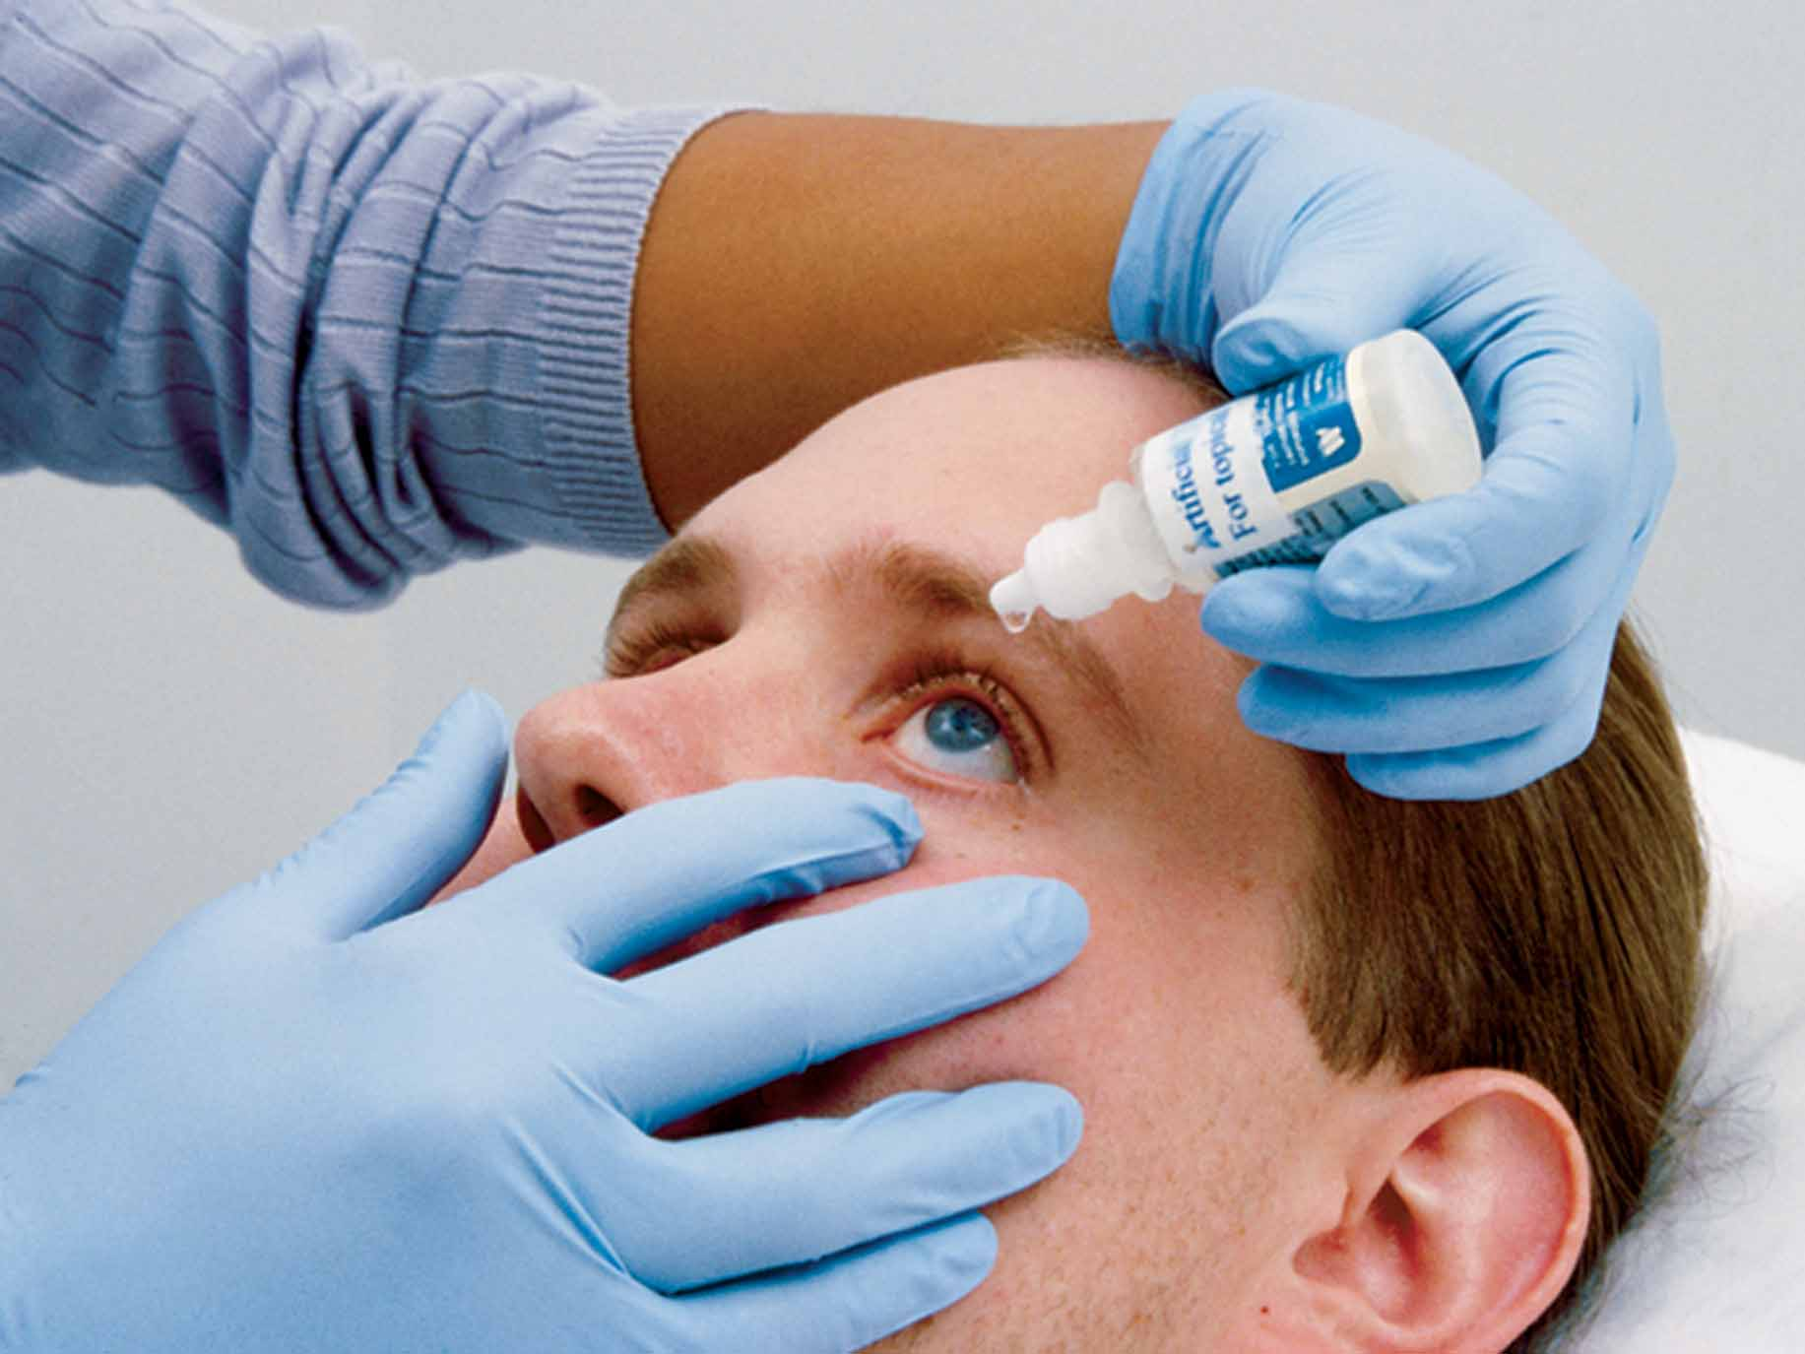
Administering Ophthalmic Instillations
Notes:
28

Slide 29

Pressing On The Nasolacrimal Duct
Notes:
29

Slide 30
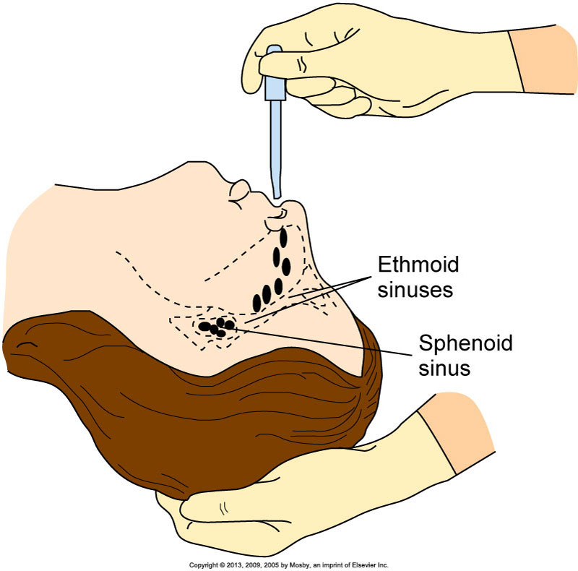
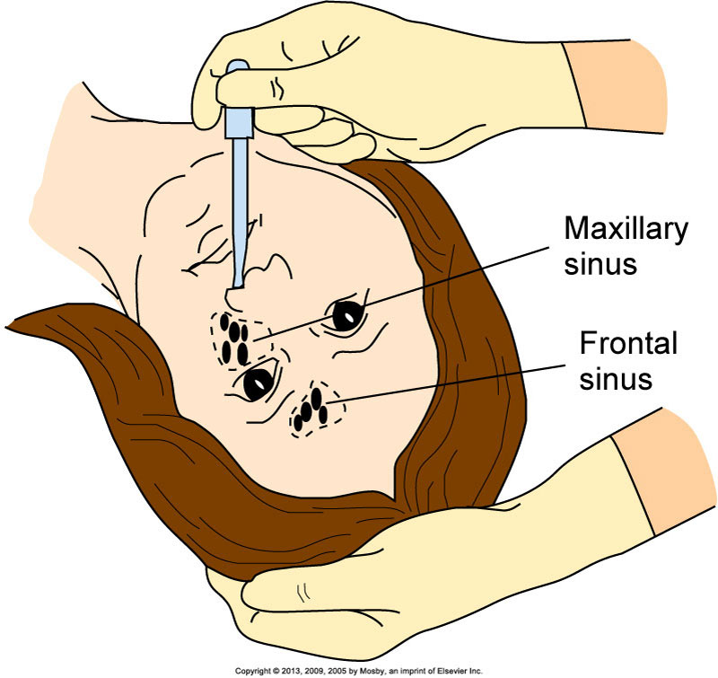
Nasal Instillation
Notes:
Patients with nasal sinus alterations sometimes receive medications by spray, drops, or tampons.
The most commonly administered form of nasal instillation is decongestant spray or drops, which are used to relieve symptoms of sinus congestion and colds.
Caution patients to avoid abuse of medications because overuse leads to a rebound effect in which nasal congestion worsens.
Saline drops are safer as a decongestant for children than nasal preparations that contain sympathomimetics.
It is easier to have the patient self-administer sprays because he or she is able to control the spray and inhale as it enters the nasal passages. For patients who use nasal sprays repeatedly, check the nares for irritation.
Nasal drops are effective in treating sinus infections.
Position patients to permit the medication to reach the affected sinus.
The left drawing shows positioning to reach the sphenoid and ethmoid sinuses.
The right drawing shows positioning to reach the frontal and maxillary sinuses.
Severe nosebleeds are usually treated with packing or nasal tampons, which are treated with epinephrine, to reduce blood flow. Usually a physician or an advanced practice clinician places nasal tampons.
[See Box 31-16 on text pp. 595-596 Procedural Guidelines: Administering Nasal Instillations, for step-by-step guidelines. Drawings shown are from the procedural guidelines on text p. 596.]

Slide 31
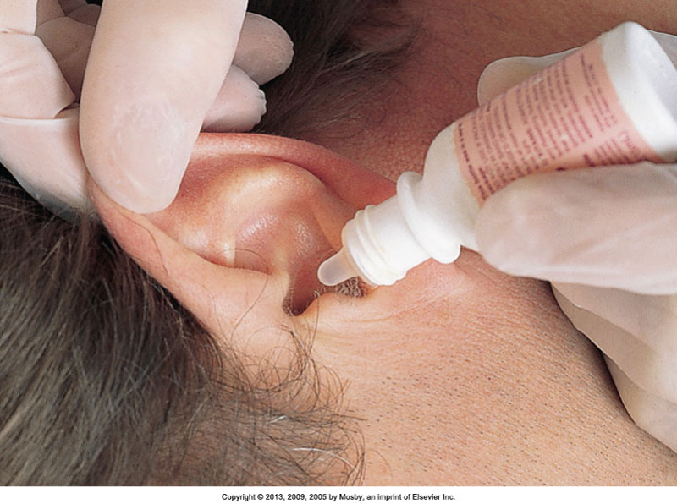
Topical Medications (cont’d)
Ear instillation
  Structures are very sensitive to temperature.
  Use sterile solutions.
Straighten the ear canal by gently pulling the pinna up and back for adults
Instill drops on the side of the canal to allow drops to flow in
Notes:
Internal ear structures are very sensitive to temperature extremes. Instill eardrops at room temperature to prevent vertigo, dizziness, or nausea.
Although the structures of the outer ear are not sterile, sterile solutions are used in case the eardrum is ruptured. The entry of nonsterile solutions into middle ear structures can result in infection.
If a patient has ear drainage, be sure that the eardrum has not ruptured. Never occlude or block the ear canal with the dropper or irrigating syringe. Forcing medication into an occluded ear canal creates pressure that injures the eardrum.
The figure shows placement of an eardrop.
[See step-by-step guidelines on p. 597 in the text Box 31-17 Procedural Guidelines: Administering Ear Medications.]
[Shown is the figure from p. 597 in the procedural guidelines.]

Slide 32
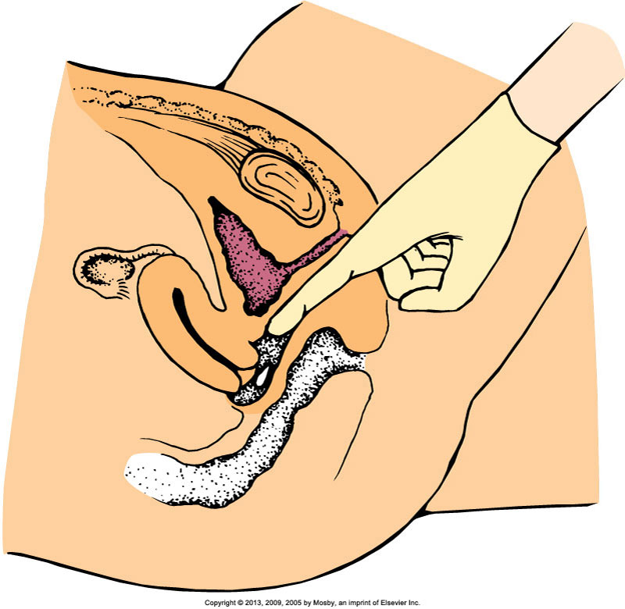
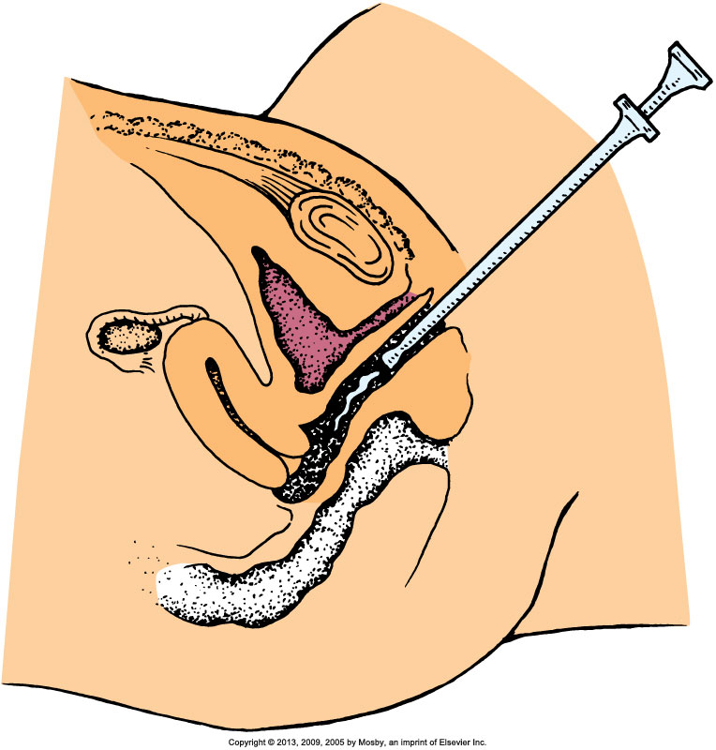
Topical Medications: Vaginal Instillation
Notes:
Vaginal medications are available as suppositories, foam, jellies, or creams.
Because vaginal medications are often given to treat infection, discharge is usually foul smelling. Follow aseptic technique, and offer the patient frequent opportunities to maintain perineal hygiene.
Shown on the left is insertion of a suppository into the vaginal canal.
Solid, oval suppositories come individually packaged in foil wrappers and sometimes are stored in the refrigerator to prevent them from melting. After a suppository is inserted into the vaginal cavity, body temperature causes it to melt and be distributed and absorbed.
Give a suppository with a gloved hand in accordance with standard precautions. Patients often prefer administering their own vaginal medications and need privacy.
The diagram on the right shows instillation of medication into the vaginal canal.
Foam, jellies, and creams are administered with an applicator inserter.
[See step-by-step guidelines in Box 31-18 on text p. 598 Procedural Guidelines: Administering Vaginal Suppositories.]
[Shown are the figures from p. 598 in the procedural guidelines.]

Slide 33
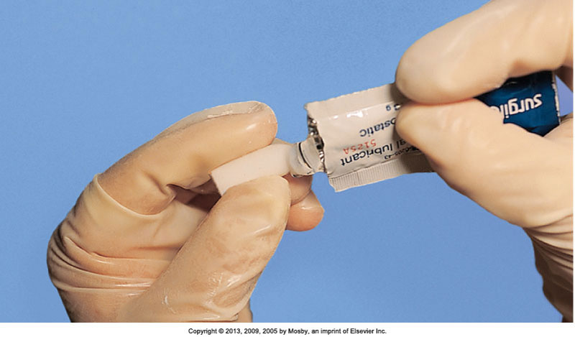
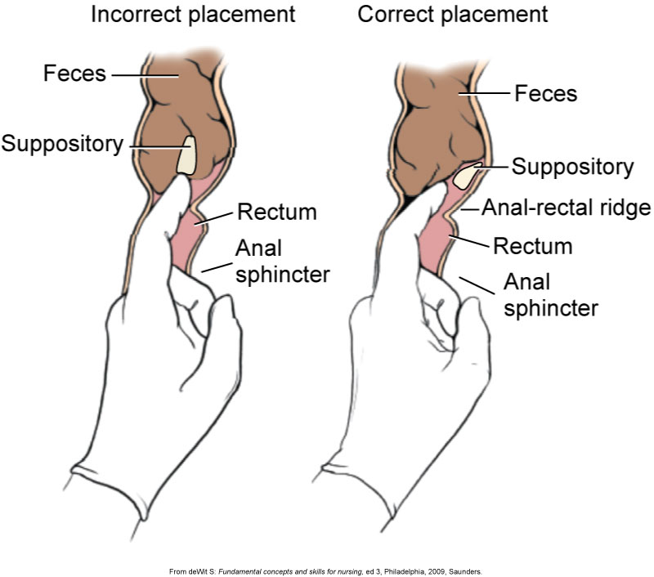
Topical Medications: Rectal Instillation
Notes:
The photo on the left shows removal of a rectal suppository from its wrapper.
Rectal suppositories are thinner and more bullet-shaped than vaginal suppositories. The rounded end prevents anal trauma during insertion.
Rectal suppositories contain medications that exert local effects such as promoting defecation, or systemic effects such as reducing nausea.
Rectal suppositories are often stored in the refrigerator until administered. Sometimes it is necessary to clear the rectum with a small cleansing enema before inserting a suppository.
The diagram shows insertion of a rectal suppository.
[See step-by-step guidelines in Box 31-19 on text p. 599 Procedural Guidelines: Administering Rectal Suppositories.]
[Shown are the figures from p. 599 in the procedural guidelines.]

Slide 34
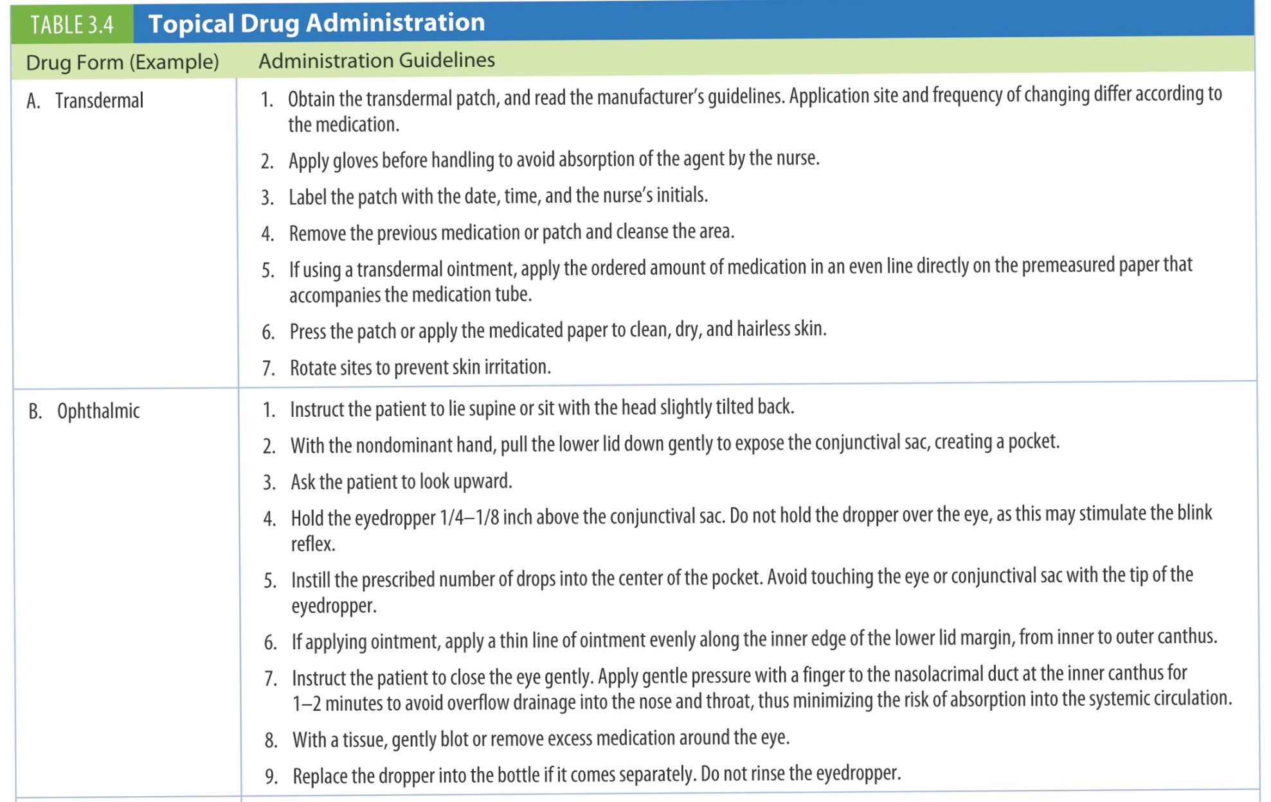
Table 3.4 Topical Drug Administration
continued on next slide

Slide 35
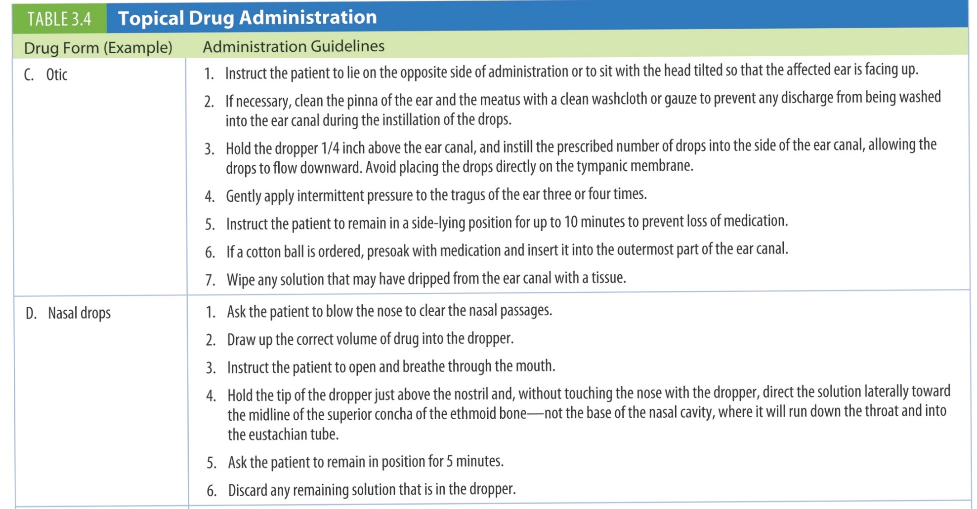
Table 3.4 (continued) Topical Drug Administration
continued on next slide

Slide 36
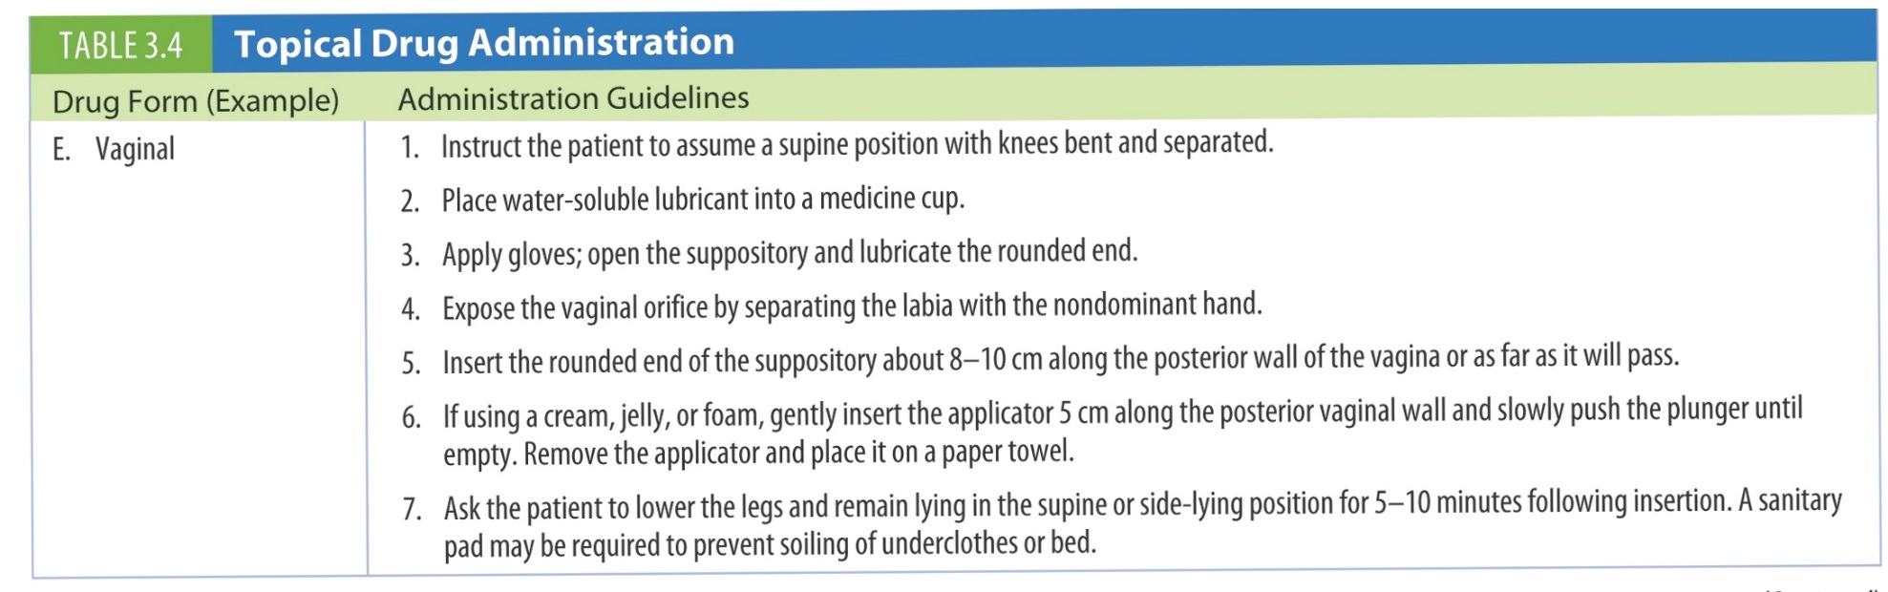
Table 3.4 (continued) Topical Drug Administration
continued on next slide

Slide 37
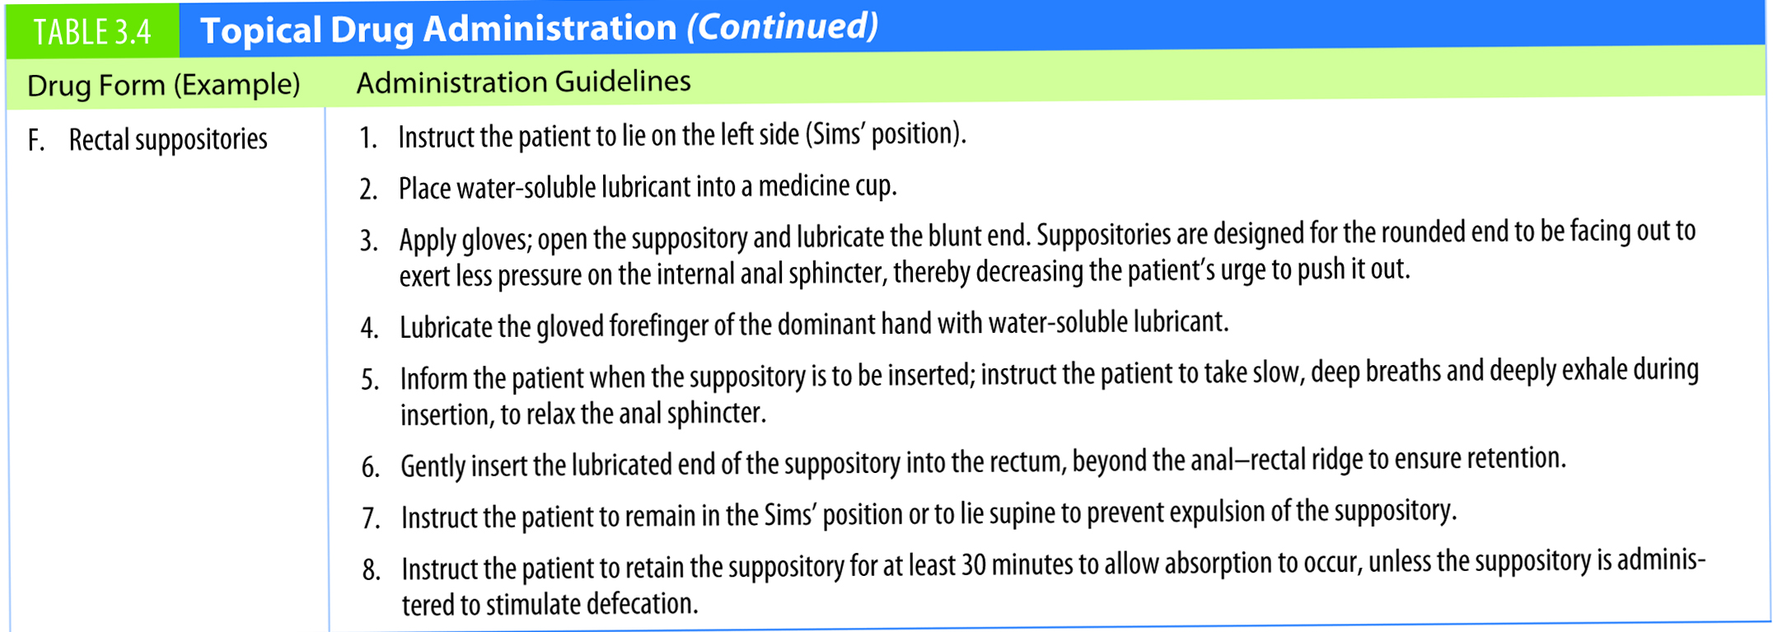
Table 3.4 (continued) Topical Drug Administration

Slide 38
Administering via Inhalation
Aerosol spray, mist, or powder via handheld inhalers; used for respiratory “rescue” and “maintenance”
Some medications create serious systemic side effects.
Notes:
Patients who receive medications by inhalation frequently suffer chronic respiratory disease such as chronic asthma, emphysema, or bronchitis.
Inhaled medications are often described as “rescue” or “maintenance” medications.
Rescue medications are short-acting and are taken for immediate relief of acute respiratory distress.
Maintenance medications are used on a daily schedule to prevent acute respiratory distress. The effects of maintenance medications start within hours of administration and last for a longer time than those of rescue medications.
Because patients depend on inhaled medications for disease control, and current evidence shows that many patients do not use their inhalers correctly, patients need to learn how to self-administer inhalers safely and effectively.
Some patients use a spacer with the pressurized metered-dose inhaler (pMDI). (Breath-actuated metered-dose inhalers [BAIs] and dry powder inhalers [DPIs] do not use spacers.) The spacer is a 4- to 8-inch (10.16- to 20.32-cm)-long tube that attaches to the pMDI and allows the particles of medication to slow down and break into smaller pieces, which improves drug absorption in the patient’s airway. Spacers have a face mask for infants and children younger than 4 years of age. They are especially helpful when the patient has difficulty coordinating the steps involved in self-administering inhaled medications. When patients do not use their inhalers and spacers correctly, they do not receive the full effect of the medication. Therefore, patient education is essential.
One important aspect of patient teaching is to help the patient determine when the MDI, BAI, or DPI is empty and needs to be replaced.
To calculate how long medication in an inhaler will last, divide the number of doses in the container by the number of doses the patient takes per day.

Slide 39
Using a Metered Dose Inhaler (MDI)
Client teaching a client to use an MDI
Remove the mouthpiece cap
Exhale comfortably
Hold canister upside down
Press down once and inhale slowly and deeply through the mouth
Hold your breath for 10 seconds or as long as you can

Slide 40
Using a Metered Dose Inhaler (MDI) (cont'd)
Remove inhaler away from mouth
Exhale slowly through pursed lips
Repeat the inhalation if ordered
Rinse mouth with tap water
Clean MDI mouthpiece after each use

Slide 41
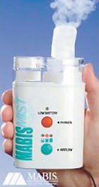
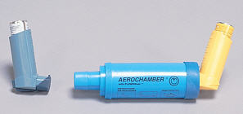
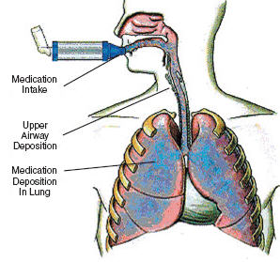
Respiratory Inhalation
Notes:
Figure 35-55. Ultrasonic nebulizer. (Courtesy of Mabis Healthcare, Inc.)
Figure 35-56. Metered-dose inhaler.
Figure 35-57. Delivery of medication to the lungs using a metered-dose inhaler extender. (Courtesy of Trudell Medical International).

Slide 42
Medication Administration
Parenteral
Parenteral = Injection into body tissues
Invasive procedure that requires aseptic technique
Risk of infection
Skills needed for each type of injection
Effects develop rapidly, depending on the rate of medication absorption.
Notes:
Parenteral administration entails injecting into body tissues and involves several components revolving around medication preparation.
Medication equipment includes syringe, ampule, or vial.
Upon completing medication preparation, administration occurs via various routes.
When preparing medications, the nurse checks the medication container label against the medication administration record (MAR) three times.
After a needle pierces the skin, risk for infection is present.
Each type of injection requires certain skills to ensure that the medication reaches the proper location.
[See Box 31-20 on text p. 600 Preventing Infection During an Injection.]

Slide 43
Medication Administration
Parenteral (cont’d)
Syringes
  Luer-Lok
  Non–Luer-Lok
  Sizes from 0.5 to 60 mL
    Larger sizes to administer IV medications and to irrigate wounds or drainage tubes
  May be prepackaged with a needle attached, or—
    You may need to change a needle
Notes:
A variety of syringes and needles are available, each designed to deliver a certain volume of a medication to a specific type of tissue.
Syringes consist of a cylindrical barrel with a tip designed to fit the hub of a hypodermic needle and a close-fitting plunger. Luer-Lok syringes have needles that are twisted onto the tip and lock themselves in place. This design prevents inadvertent removal of the needle.
A larger volume of a syringe creates discomfort. You sometimes change a needle based on the route of administration and the size of the patient.

Slide 44
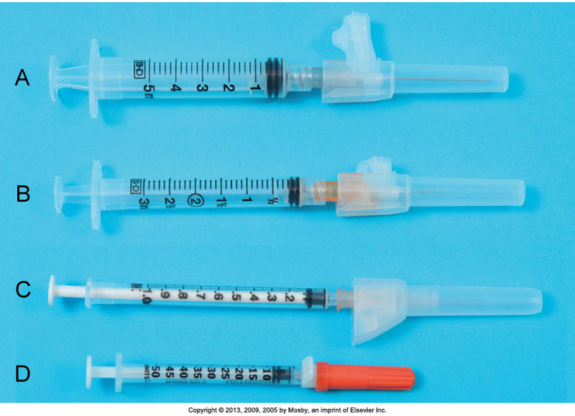
Types of Syringes
Notes:
Types of syringes are shown: A, 5-mL syringe. B, 3-mL syringe. C, Tuberculin syringe marked in 0.01 (hundredths) for doses less than 1 mL. D, Insulin syringe marked in units (50).
The tuberculin syringe (C) is calibrated in sixteenths of a minim and hundredths of a milliliter and has a capacity of 1 mL. Use a tuberculin syringe to prepare small amounts of medications (e.g., intradermal, subcutaneous injections). A tuberculin syringe is useful when small, precise doses are prepared for infants or young children.
Insulin syringes (D) are available in sizes that hold 0.3 to 1 mL and are calibrated in units. Most insulin syringes are U-100s, designed to be used with U-100 strength insulin. Each milliliter of U-100 insulin contains 100 units of insulin.
[Shown is Figure 31-10 from text p. 601.]

Slide 45
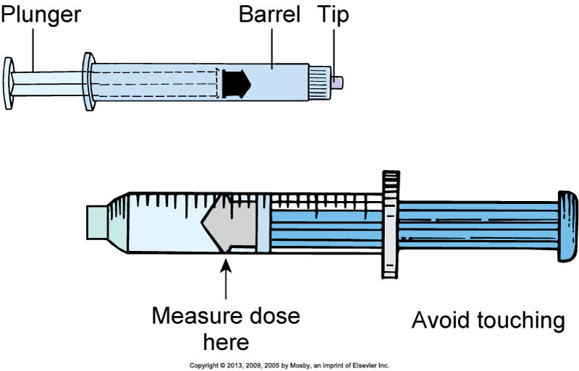
Parts of a Syringe
Notes:
The parts of a syringe are the plunger, barrel, and tip.
Fill a syringe by pulling the plunger outward while the needle tip remains immersed in the prepared solution. Touch only the outside of the syringe barrel and the handle of the plunger to maintain sterility. Avoid letting any unsterile object touch the tip or inside of the barrel, the hub, the shaft of the plunger, or the needle.
[Shown is Figure 31-11 from text p. 601.]

Slide 46
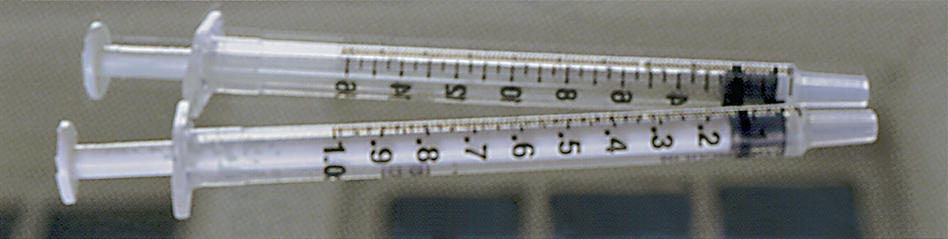
Tuberculin Syringes
0.10 0.20 0.30 0.40 0.50 0.60 0.70 0.80 0.90 1.00 mL
4 8 12
16
FIGURE 14-10 BD tuberculin syringes. (From Becton, Dickinson and Company, Franklin Lakes, NJ.)
Notes:
A tuberculin syringe is a 1-mL syringe that has markings for milliliters and minims.
In what situations are tuberculin syringes used?
Tuberculin syringes are commonly used in pediatrics and to measure medications administered in very small amounts.
What is the smallest division that can be read in millimeters on this syringe?
The smallest division that can be read on the syringe is 0.01 mL. Each shorter line represents 0.01 mL, and each longer line represents 0.5 mL.

Slide 47
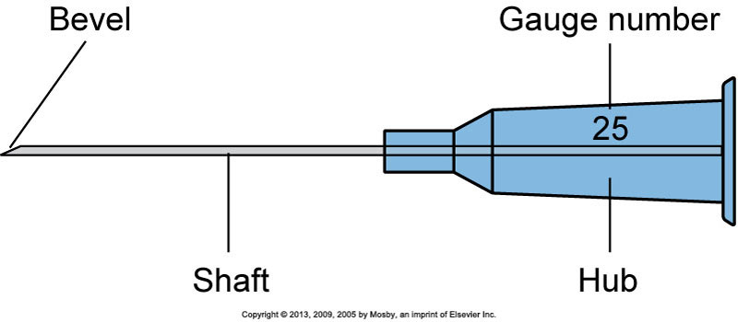
Parts of the Needle
Notes:
A needle has three parts: the hub, which fits onto the tip of a syringe; the shaft, which connects to the hub; and the bevel, or slanted tip.
The tip of a needle, or the bevel, is always slanted. The bevel creates a narrow slit when injected into tissue that quickly closes when the needle is removed to prevent leakage of medication, blood, or serum.
Long beveled tips are sharper and narrower, minimizing discomfort when entering tissue used for subcutaneous or IM injection.
Some needles come packaged in individual sheaths to allow flexibility in choosing the right needle for a patient, whereas others are preattached to standard-sized syringes.
Most needles are made of stainless steel, and all are disposable.
[Shown is Figure 31-12 from text p. 601.]

Slide 48
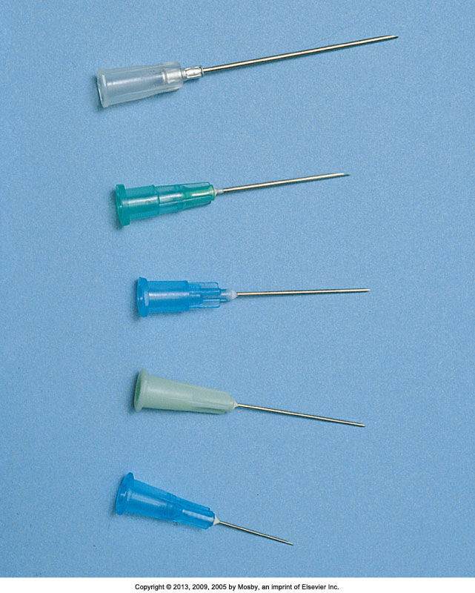
Types of Needles
Notes:
Most needles vary in length from 1/4 to 3 inches.
Top to bottom:
19 gauge, 1 1/2-inch length
20 gauge, 1-inch length
21 gauge, 1-inch length
23 gauge, 1-inch length
25 gauge, 5/8-inch length
Choose needle length according to the patient’s size and weight and the type of tissue into which the medication is to be injected. A child or a slender adult generally requires a shorter needle. Use longer needles (1 to 1 1/2 inches) for IM injections and shorter needles (3/8 to 5/8 inch) for subcutaneous injections.
As the needle gauge becomes smaller, the needle diameter becomes larger. The selection of a gauge depends on the viscosity of fluid to be injected or infused.
[Shown is Figure 31-13 from text p. 601.]

Slide 49
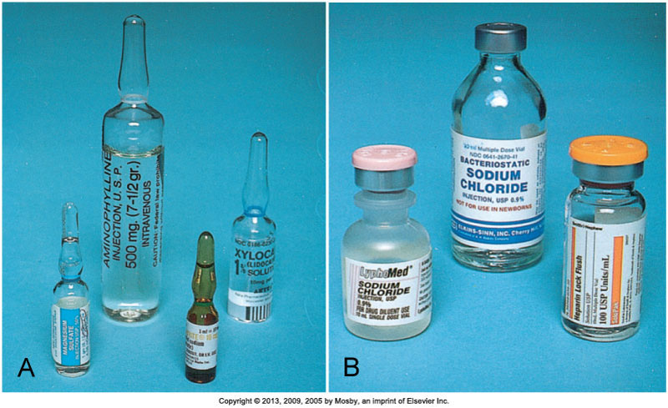
Medication Administration
Parenteral
Notes:
On the left (A) are medications in ampules. Ampules contain single doses of medication in a liquid. Ampules are available in several sizes, from 1 mL to 10 mL or more.
An ampule is made of glass and has a constricted neck that must be snapped off to allow access to the medication. A colored ring around the neck indicates where the ampule is prescored, so you can break it easily.
Carefully aspirate the medication into a syringe with a filter needle. Use of a filter needle prevents particulate matter such as small glass fragments or rubber from entering the syringe.
Replace the filter needle with a needle of appropriate size or a needleless access device before administering the injection.
******************************************
On the right (B) are medications in vials. A vial is a single-dose or multidose container with a rubber seal at the top. A metal cap protects the seal until it is ready for use. Vials contain liquid or dry forms of medications. Medications that are unstable in solution are packaged dry. The vial label specifies the solvent or diluent used to dissolve the medication and the amount of diluent needed to prepare a desired medication concentration. Normal saline and sterile distilled water are commonly used to dissolve medications.
Unlike the ampule, the vial is a closed system, and air needs to be injected into it to permit easy withdrawal of the solution. Failure to inject air when withdrawing creates a vacuum within the vial that makes withdrawal difficult. If concerned about drawing up parts of the rubber stopper or other particles into the syringe, use a filter needle when preparing medications from vials.
Some vials contain powder, which is mixed with a diluent during preparation and before injection.
After mixing multidose vials, make a label that includes the date and time of mixing and the concentration of medication per milliliter.
Some multidose vials require refrigeration after the contents are reconstituted.
[Shown is Figure 31-15 from text p. 602.]

Slide 50
Information About Reconstituting Drugs
Powder forms of drugs must be reconstituted by adding a liquid for administration before you can give the drug.
Directions for reconstituting are on the label.
Label indicates the time period within which they can be safely administered.

Slide 51
Medication Administration
Parenteral
If two medications are compatible, they can be mixed in one injection if the total dose is within accepted limits, so the patient receives only one injection at a time.
Mixing medications
  Mixing medications from a vial and an ampule
    Prepare medication from the vial first.
    Use the same syringe and filter needle to withdraw medication from the ampule.
  Mixing medications from two vials
Notes:
Most nursing units have charts that list common compatible medications. If any uncertainty exists about medication compatibilities, consult a pharmacist or a medication reference.
When mixing medication from both a vial and a ampule, prepare medication from the vial first. Using the same syringe and filter needle, withdraw medication from the ampule. Nurses prepare the combination in this order because it is not necessary to add air to withdraw medication from an ampule.
Apply these principles when mixing medications from two vials:
1. Do not contaminate one medication with another.
2. Ensure that the final dose is accurate.
3. Maintain aseptic technique.

Slide 52
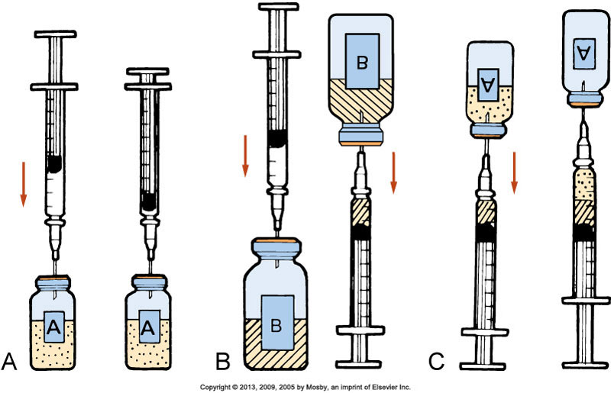
Mixing Medications from Two Vials
Notes:
In (A), the diagram shows injecting air into vial A.
B shows injecting air into vial B and withdrawing dose.
C diagrams withdrawing medication from vial A.
The medications are now mixed.
Use only one syringe with a needle or needleless access device attached to mix medications from two vials.
Aspirate the volume of air equivalent to the dose of the first medication (vial A) (A).
Inject the air into vial A, making sure that the needle does not touch the solution. Withdraw the needle and aspirate air equivalent to the dose of the second medication (vial B) (B).
Inject the volume of air into vial B. Immediately withdraw the medication from vial B into the syringe and insert the needle back into vial A, being careful not to push the plunger and expel the medication within the syringe into the vial.
Withdraw the desired amount of medication from vial A into the syringe (C).
After withdrawing the necessary amount, withdraw the needle and apply a new safety needle or needleless access device suitable for injection.
[Shown is Figure 31-16 from text p. 603.]

Slide 53
Administering Injections
Each injection route differs based on the types of tissues the medication enters.
Before injecting, know:
  The volume of medication to administer
  The characteristics and viscosity of the medication
  The location of anatomical structures underlying the injection site
If a nurse does not administer injections correctly, negative patient outcomes may result.
Notes:
The characteristics of the tissues influence the rate of medication absorption and thus the onset of medication action.
Failure to select an injection site in relation to anatomical landmarks results in nerve or bone damage during needle insertion.
Inability to maintain stability of the needle and syringe unit can result in pain and tissue damage.
If you fail to aspirate the syringe before injecting an IM medication, the medication may accidentally be injected directly into an artery or vein.
Injecting too large a volume of medication for the site selected causes extreme pain and results in local tissue damage.

Slide 54
Minimizing Patient Discomfort
Use a sharp-beveled needle in the smallest suitable length and gauge.
Select the proper injection site, using anatomical landmarks.
Apply a vapocoolant spray or topical anesthetic to the injection site before giving the medication, when possible.
Divert the patient’s attention from the injection through conversation using open-ended questioning.
Insert the needle quickly and smoothly to minimize tissue pulling.
Hold the syringe steady while the needle remains in tissues.
Inject the medication slowly and steadily.
Notes:
Many patients, particularly children, fear injections. Patients with serious or chronic illness often are given several injections daily.
Thus it is important to minimize patient discomfort by following the guidelines listed.
Be sure to position the patient as comfortably as possible to reduce muscular tension.
[This list is from text p. 604.]

Slide 55
Medication Administration
Injections: Subcutaneous
Medication is placed in loose connective tissue under the dermis.
Absorption is slower than with IM injections.
Administering low-molecular-weight heparin requires special considerations.
A patient’s body weight indicates the depth of the subcutaneous layer.
Choose the needle length and angle of insertion based on the patient’s weight and estimated amount of subcutaneous tissue.
Notes:
The subcutaneous route provides medication delivery under loose connective tissue, with minimal vascular supply and increased pain receptor presence. Small needle width and length are required, and administration is best in outer aspects of the deltoids and thighs, as well as in the abdomen. The angle can be 45 or 90 degrees (shown later).
Because subcutaneous tissue is not as richly supplied with blood as the muscles, medication absorption is somewhat slower than with IM injections. Because subcutaneous tissue contains pain receptors, the patient often experiences slight discomfort.
Administration of low-molecular-weight heparin (LMWH) requires special considerations. When injecting the medication, use the right or left side of the abdomen at least 2 inches from the umbilicus (the patient’s “love handles”) and pinch the injection site as you insert the needle. Administer LMWH in its prefilled syringe with the attached needle, and do not expel the air bubble in the syringe before giving the medication. Use U-100 insulin syringes with preattached 25- to 31-gauge needles when giving U-100 insulin, and 1-mL tuberculin syringes when giving U-500 insulin. Recommended sites for insulin injections include the upper arm and the anterior and lateral portions of the thigh, buttocks, and abdomen. Rotating injections within the same body part (intrasite rotation) provides greater consistency in the absorption of insulin. Injections are to be given at least an inch (2.5 cm) away from the previous site. No injection site should be used again for at least 1 month. The rate of insulin absorption varies based on the site; the abdomen has the quickest absorption, followed by the arms, thighs, and buttocks.
Only small volumes (0.5 to 1.5 mL) of water-soluble medications are given subcutaneously because the tissue is sensitive to irritating solutions and large volumes of medications. In children, smaller volumes up to 0.5 mL are given. Collection of medications within the tissues causes sterile abscesses, which appear as hardened, painful lumps under the skin.
Choose the needle length and angle of insertion based on the patient’s weight and an estimation of the amount of subcutaneous tissue. Generally, a 25-gauge, 5/8-inch needle inserted at a 45-degree angle, or a 1/2-inch needle inserted at a 90-degree angle deposits medications into the subcutaneous tissue of a normal-sized patient. Some children require only a 1/2-inch needle. If the patient is obese, pinch the tissue and use a needle long enough to insert through fatty tissue at the base of the skinfold. Thin patients often do not have sufficient tissue for subcutaneous injections; the upper abdomen is usually the best site in this case. To ensure that a subcutaneous medication reaches the subcutaneous tissue, follow this rule: If you can grasp 2 inches (5 cm) of tissue, insert the needle at a 90-degree angle; if you can grasp 1 inch (2.5 cm) of tissue, insert the needle at a 45-degree angle.

Slide 56
Math Check
    Example:
    The physician orders heparin 5000 units subcutaneous stat. Heparin 10,000 units/mL is available. How many milliliters of heparin will be administered?
Notes:
How many milliliters of heparin will be administered?
10,000 units : 1 mL :: 5000 units : x mL
10,000x = 5000
x = 5000 ÷ 10,000
x = 0.5 mL
The nurse will administer 0.5 mL.

Slide 57
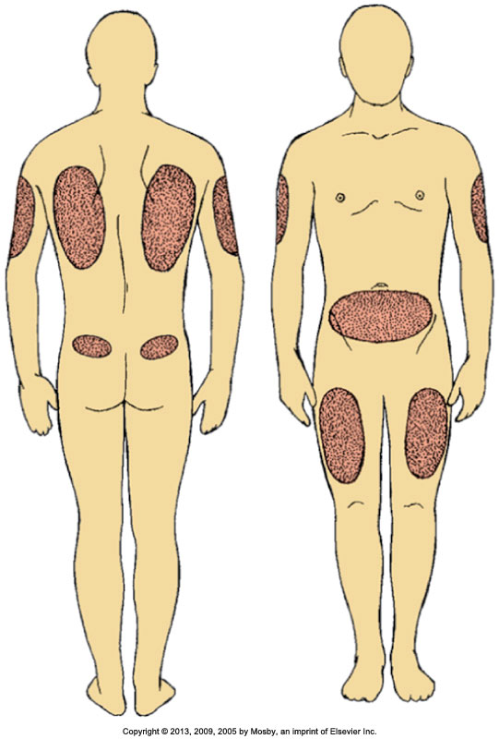
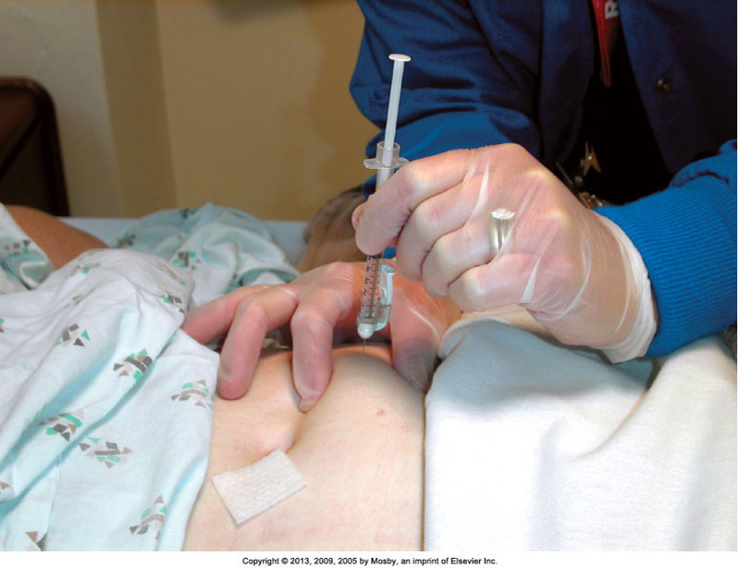
Subcutaneous Injections
Notes:
On the left, the diagram indicates sites recommended for subcutaneous injections.
The photo on the right shows subcutaneous heparin being administered in the abdomen.
The best subcutaneous injection sites include the outer posterior aspect of the upper arms, the abdomen from below the costal margins to the iliac crests, and the anterior aspects of the thighs.
The site most frequently recommended for heparin injection is the abdomen.
Alternative subcutaneous sites for other medications include the scapular areas of the upper back and the upper ventral or dorsal gluteal areas. The injection site chosen needs to be free of skin lesions, bony prominences, and large underlying muscles or nerves.
[Shown are Figures 31-17 and 31-18 from text p. 605.]

Slide 58
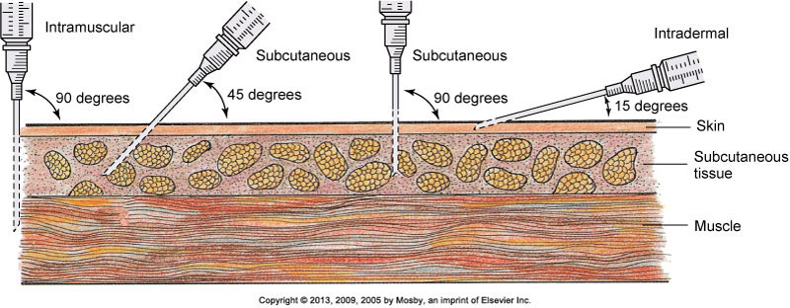
Comparison of Angles of Insertion for Injections
Notes:
Comparison of angles of insertion for intramuscular (90 degrees), subcutaneous (45 to 90 degrees), and intradermal (15 degrees) injections.
[Shown is Figure 31-19 from text p. 605.]

Slide 59
Injections: Intramuscular
Faster absorption than subcutaneous route
Many risks, so verify the injection is justified
Needles
  Very obese: 3 inches; use different route
  Thin: ½ to 1 inch
Amounts:
  Adults: 2 to 5 mL can be absorbed
  Children, older adults, thin patients: up to 2 mL
  Small children and older infants: up to 1 mL
  Smaller infants: up to 0.5 mL
Notes:
The IM route provides faster medication absorption than the subcutaneous route because of the greater vascularity of muscle. However, IM injections are associated with many risks. Therefore, whenever administering a medication by the IM route, first verify that the injection is justified, meaning that no alternative sites are available. The angle of administration is 90 degrees with larger needle width and length owing to muscle penetration.
Use a longer and heavier-gauge needle to pass through subcutaneous tissue and penetrate deep muscle tissue. Weight and amount of adipose tissue influence needle size selection. For example, a very obese patient often requires a needle 3 inches long, whereas a thin patient requires only a 1/2- to 1-inch needle. Because most agencies have needles that range in length from 3/8 to 1 1/2 inches, investigate different medication routes when IM injections are ordered for patients who are obese.
Muscle is less sensitive to irritating and viscous medications. A normal, well-developed adult patient tolerates 2 to 5 mL of medication into a larger muscle without severe muscle discomfort. However, larger volumes of medication (4 to 5 mL) are unlikely to be absorbed properly. Children, older adults, and thin patients tolerate only 2 mL of an IM injection. Do not give more than 1 mL to small children and older infants, and do not give more than 0.5 mL to smaller infants.

Slide 60
Injections: Intramuscular (cont’d)
Assess the muscle before giving the injection.
Properly identify the site by palpating bony landmarks.
Be aware of potential complications with each site.
The site needs to be free of tenderness.
Minimize discomfort.
Insertion angle is 90 degrees.
Notes:
Repeated injections in the same muscle cause severe discomfort. With the patient relaxed, palpate the muscle to rule out any hardened lesions. Minimize discomfort during an injection by helping the patient assume a position that helps to reduce muscle strain. Other interventions such as distraction and applying pressure to the IM site decrease pain during an IM injection.
When selecting an IM site, consider the following: Is the area free of infection or necrosis? Are local areas of bruising or abrasions evident? What is the location of underlying bones, nerves, and major blood vessels? What volume of medication is to be administered? Each site has different advantages and disadvantages.
Failure to select injection sites by anatomical landmarks leads to tissue, bone, or nerve damage.

Slide 61
Math Check
    Example:
    A physician orders atropine gr 0.01 IM stat. Atropine 0.4 mg/mL is available. Convert the physician’s order to milligrams.
Notes:
The physician’s order and the available drug must be in the same system of measurement before you can write a proportion for the actual amount of medication to be administered.
Convert measures into the same system before writing the proportion problem.
1 gr = 60 mg
1 gr : 60 mg :: 0.01 gr : x mg
x = 0.6 mg

Slide 62
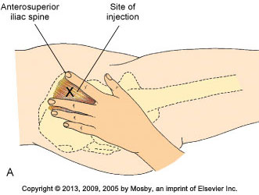

Landmarks: Ventrogluteal IM
Notes:
A, Landmarks for ventrogluteal site. B, Locating ventrogluteal site in patient.
The ventrogluteal muscle involves the gluteus medius; it is situated deep and away from major nerves and blood vessels. This site is the preferred and safest site for all adults, children, and infants, especially for medications that have larger volumes and are more viscous and irritating. The ventrogluteal site is recommended for volumes greater than 2 mL. Research shows that injuries such as fibrosis, nerve damage,
abscess, tissue necrosis, muscle contraction, gangrene, and pain are associated with all common IM sites except the ventrogluteal site.
Locate the ventrogluteal muscle by positioning the patient in a supine or lateral position. Flexing the knee and hip helps to relax this muscle. Place the palm of your hand over the greater trochanter of the patient’s hip with the wrist perpendicular to the femur. Use the right hand for the left hip, and use the left hand for the right hip. Point the thumb toward the patient’s groin and the index finger toward the anterior superior iliac spine; extend the middle finger back along the iliac crest toward the buttock. The index finger, the middle finger, and the iliac crest form a V-shaped triangle; the injection site is the center of the triangle.
[Shown is Figure 31-20A and B from text p. 606.]

Slide 63
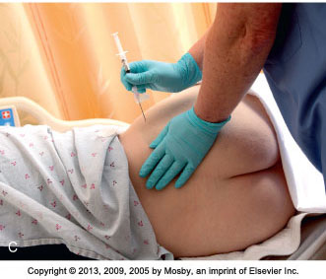
Ventrogluteal IM Injection
Notes:
C, Giving intramuscular injection in ventrogluteal muscle using the Z-track method.

Slide 64

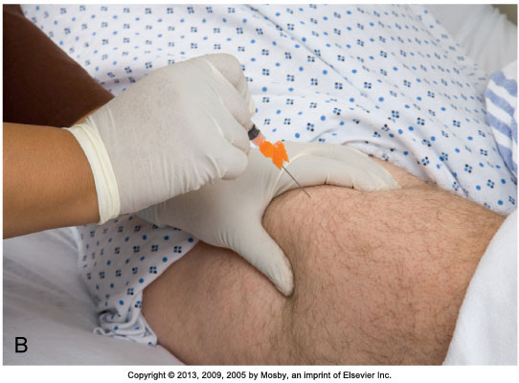
Vastus Lateralis Site for IM Injection
Notes:
A, Landmarks for vastus lateralis site. B, Giving intramuscular injection in vastus lateralis muscle.
The vastus lateralis muscle is another injection site for adults and children. The muscle is thick and well developed, is located on the anterior lateral aspect of the thigh, and extends in an adult from a handbreadth above the knee to a handbreadth below the greater trochanter of the femur.
Use the middle third of the muscle for injection. The width of the muscle usually extends from the midline of the thigh to the midline of the outer side of the thigh. With young children or cachectic patients, it helps to grasp the body of the muscle during injection to be sure that the medication is deposited in muscle tissue. To help relax the muscle, ask the patient to lie flat with the knee slightly flexed or in a sitting position. The vastus lateralis site is often used for infants, toddlers, and children receiving biologicals.
[Shown is Figure 31-21 from text p. 607.]

Slide 65
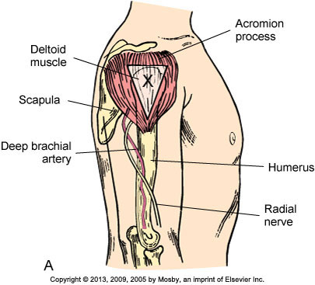
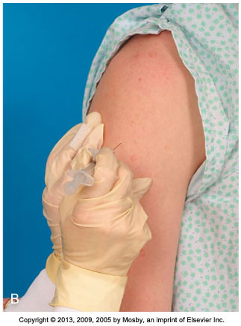
Deltoid Site for IM Injection
Notes:
A, Landmarks for deltoid site. B, Giving intramuscular injection in deltoid muscle.
Although the deltoid site is easily accessible, this muscle is not well developed in many adults. The potential for injury is present because the axillary, radial, brachial, and ulnar nerves, as well as the brachial artery, lie within the upper arm under the triceps and along the humerus. Use this site for small medication volumes (2 mL or less). Carefully assess the condition of the deltoid muscle, consult medication references for suitability of the medication, and carefully locate the injection site using anatomical landmarks.
Use this site only for small medication volumes, when giving immunizations, or when other sites are inaccessible because of dressings or casts. To locate the muscle, fully expose the patient’s upper arm and shoulder. Do not roll up a tight-fitting sleeve. Have the patient relax the arm at the side and flex the elbow. The patient may sit, stand, or lie down.
Palpate the lower edge of the acromion process, which forms the base of a triangle in line with the midpoint of the lateral aspect of the upper arm. The injection site is in the center of the triangle, about 3 to 5 cm (1 to 2 inches) below the acromion process. You can also locate the site by placing four fingers across the deltoid muscle, with the top finger along the acromion process. The injection site is then three fingerwidths below the acromion process.
[Shown is Figure 31-22 from text p. 607.]

Slide 66
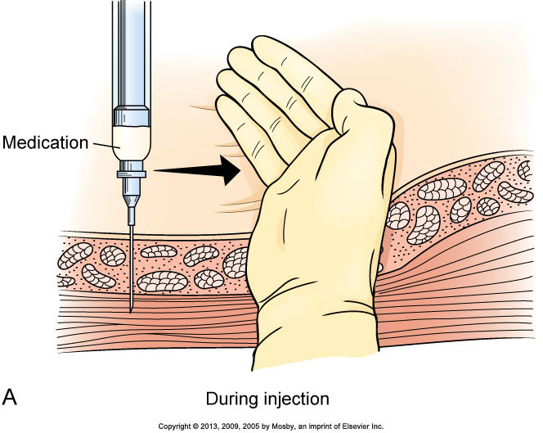

Z-Track Method in IM Injections
Notes:
A, Pulling on overlying skin during intramuscular injection moves tissue to prevent later tracking. B, Z-track method of injection prevents deposit of medication into sensitive tissue.
It is recommended that, when administering IM injections, the Z-track method be used to minimize local skin irritation by sealing the medication in muscle tissue. The Z-track method for IM injections protects subcutaneous tissues from irritating parenteral fluids.
To use the Z-track method, put a new needle on the syringe after preparing the medication, so no solution remains on the outside needle shaft.
Then select an IM site, preferably in a large, deep muscle such as the ventrogluteal muscle. Place the ulnar side of the nondominant hand just below the site, and pull the overlying skin and subcutaneous tissues approximately 2.5 to 3.5 cm (1 to 1 1/2 inches) laterally or downward. Hold the skin in this position until you administer the injection.
After preparing the site with an antiseptic swab, inject the needle deep into the muscle. Grasp the barrel of the syringe with the thumb and index finger of the nondominant hand, and slowly inject the medication at a rate of 10 seconds per milliliter if no blood return is noted on aspiration. The needle remains inserted for 10 seconds to allow the medication to disperse evenly rather than channeling back up the track of the needle.
Release the skin after withdrawing the needle. This leaves a zigzag path that seals the needle track where tissue planes slide across one another. The medication cannot escape from the muscle tissue. Injections using this technique result in less discomfort and decrease the occurrence of lesions at the injection site.
[Shown is Figure 31-23 from text p. 608.]

Slide 67
Injections: Intradermal
Used for skin testing (TB, allergies)
Slow absorption from dermis
Skin testing requires the nurse to be able to clearly see the injection site for changes.
Use a tuberculin or small hypodermic syringe for skin testing.
Angle of insertion is 5 to 15 degrees with bevel up.
A small bleb will form as you inject; if it does not form, it is likely the medication is in subcutaneous tissue, and the results will be invalid.
Notes:
Because these medications are potent, they are injected into the dermis, where blood supply is reduced and medication absorption occurs slowly. Sometimes patients have a severe anaphylactic reaction if the medications enter the circulation too rapidly.
Skin testing requires that the nurse be able to clearly see the injection sites for changes in color and tissue integrity. Intradermal sites need to be lightly pigmented, free of lesions, and relatively hairless. The inner forearm and the upper back are ideal locations.
Use a tuberculin or small hypodermic syringe for skin testing.
The angle of insertion for an intradermal injection is 5 to 15 degrees, and the bevel of the needle is pointed up.
As you inject the medication, a small bleb resembling a mosquito bite appears on the surface of the skin. If a bleb does not appear, or if the site bleeds after needle withdrawal, chances are good that the medication entered subcutaneous tissues. In this case, test results will not be valid.

Slide 68
Injections: Safety, Needleless Devices
600,000 to 1 million accidental needlesticks and sharps injuries annually in health care
Common when workers recap needles, mishandle IV lines and needles, or leave needles at a patient’s bedside
Exposure to bloodborne pathogens can be deadly.
Most needlestick injuries are preventable.
Needlestick Safety and Prevention Act
Notes:
Between 600,000 and 1 million accidental needlesticks and sharps injuries occur annually in health care settings.
Needlestick injuries commonly occur when health care workers recap needles, mishandle IV lines and needles, or leave needles at a patient’s bedside.
Exposure to bloodborne pathogens is one of the deadliest hazards to which nurses are exposed on a daily basis. Most needlestick injuries are preventable with the implementation of safe needle devices.
The Needlestick Safety and Prevention Act mandates the use of special needle safety devices to reduce the frequency of needlestick injuries.

Slide 69
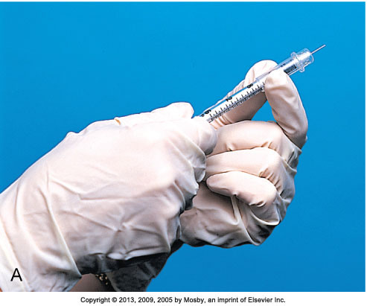
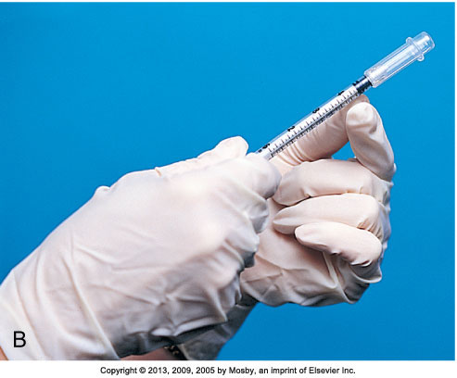
Needle With Plastic Guard
Notes:
Shown is a needle with a plastic guard to prevent needlesticks. A, Position of guard before injection. B, After injection, the guard locks in place, covering the needle.
Safety syringes have a sheath or guard that covers a needle after it is withdrawn from the skin. The needle is immediately covered, eliminating the chance for a needlestick injury. The syringe and the sheath are disposed of together in a receptacle. Use needleless devices whenever possible to reduce the risk of needlestick and sharps injuries.
Always dispose of needles and other instruments considered sharps into clearly marked, appropriate containers. Never place used needles and syringes in a wastebasket, in your pocket, on a patient’s meal tray, or at the patient’s bedside.
[Shown is Figure 31-24 from text p. 608.]

Slide 70
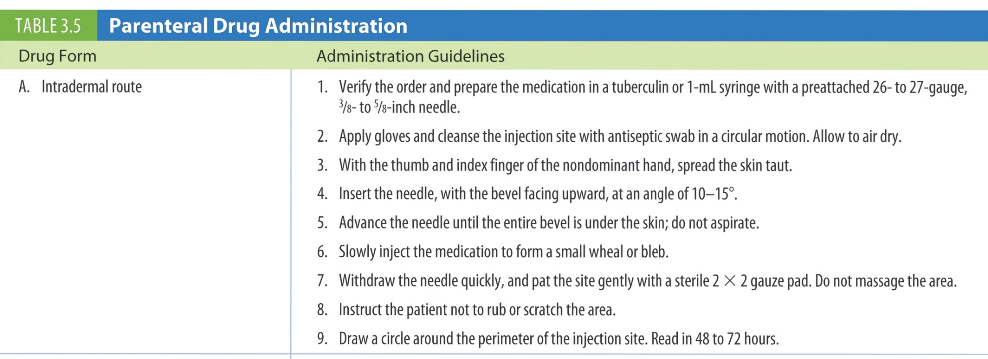
Table 3.5 Parenteral Drug Administration
continued on next slide

Slide 71
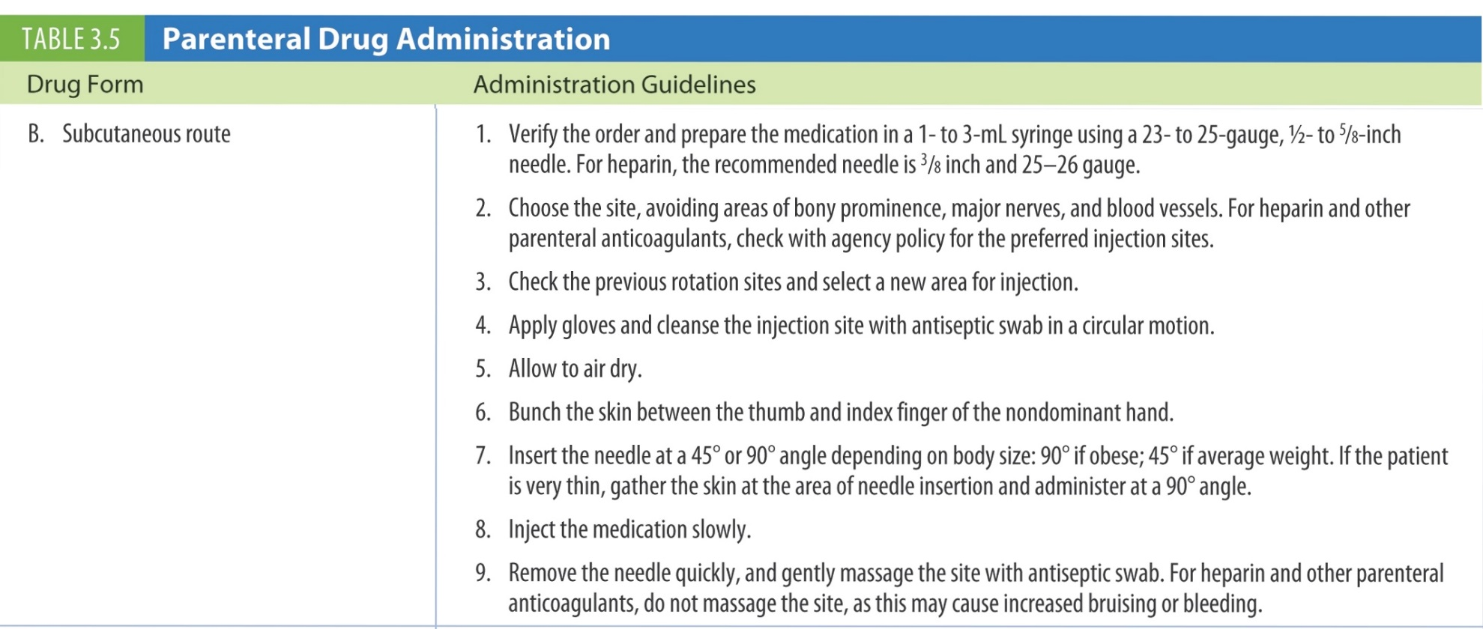
Table 3.5 (continued) Parenteral Drug Administration
continued on next slide

Slide 72
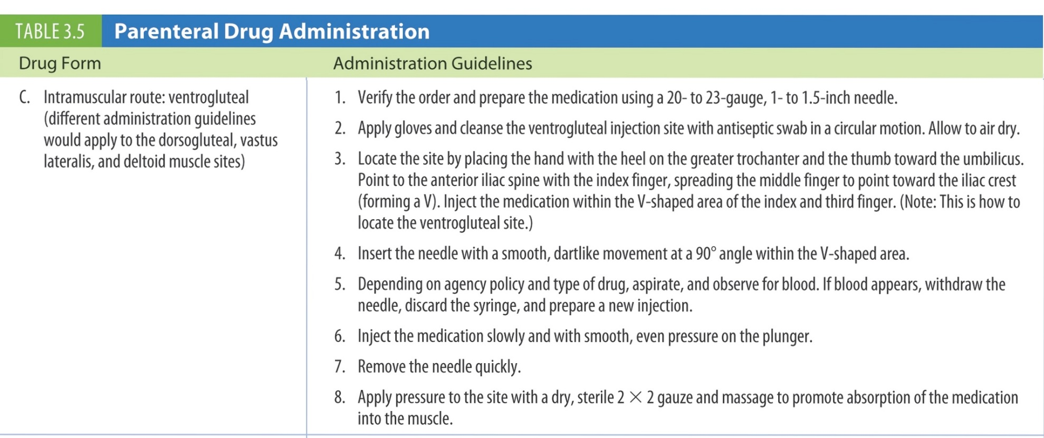
Table 3.5 (continued) Parenteral Drug Administration
continued on next slide

Slide 73
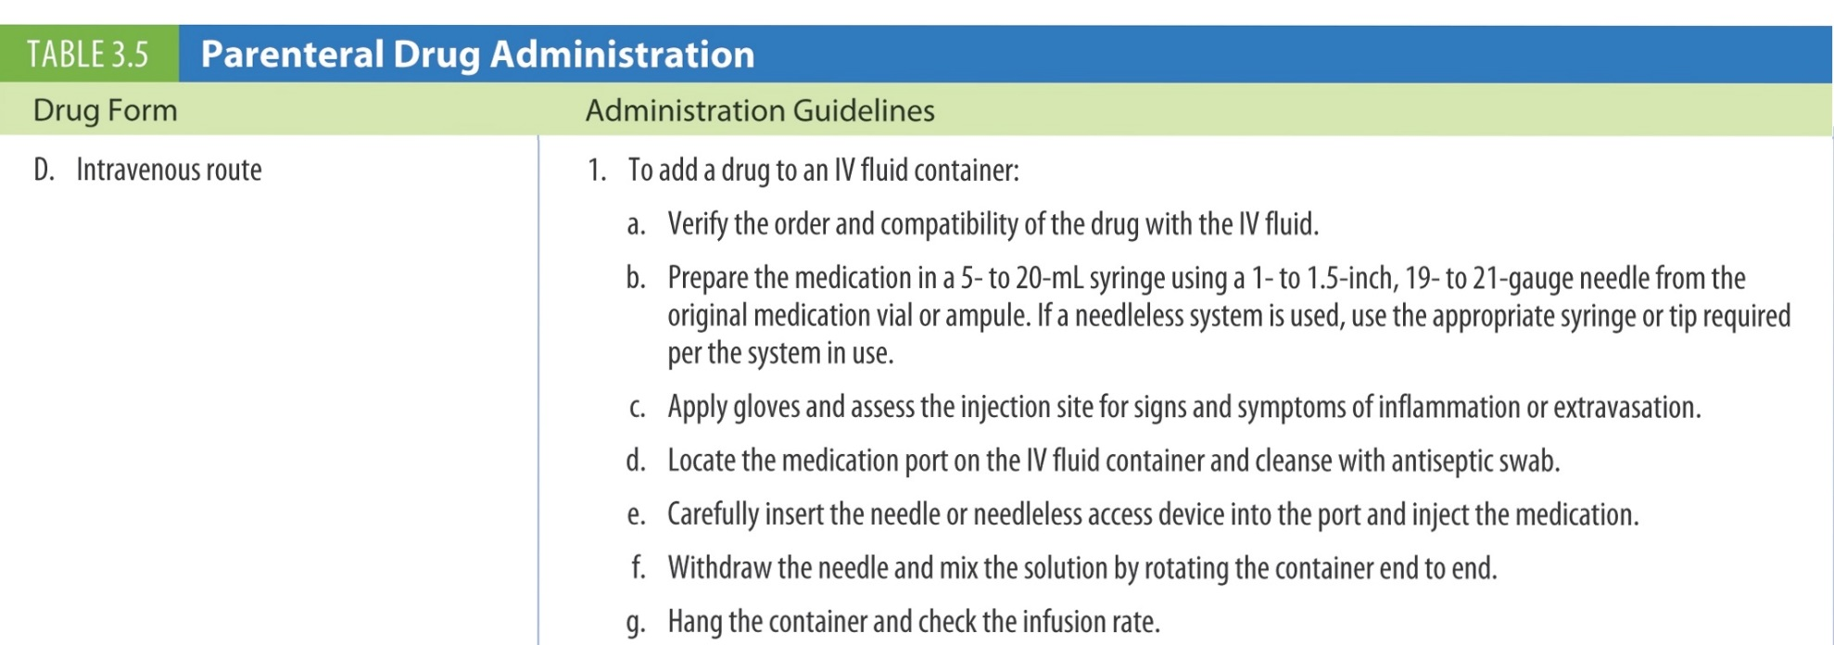
Table 3.5 (continued) Parenteral Drug Administration
continued on next slide

Slide 74
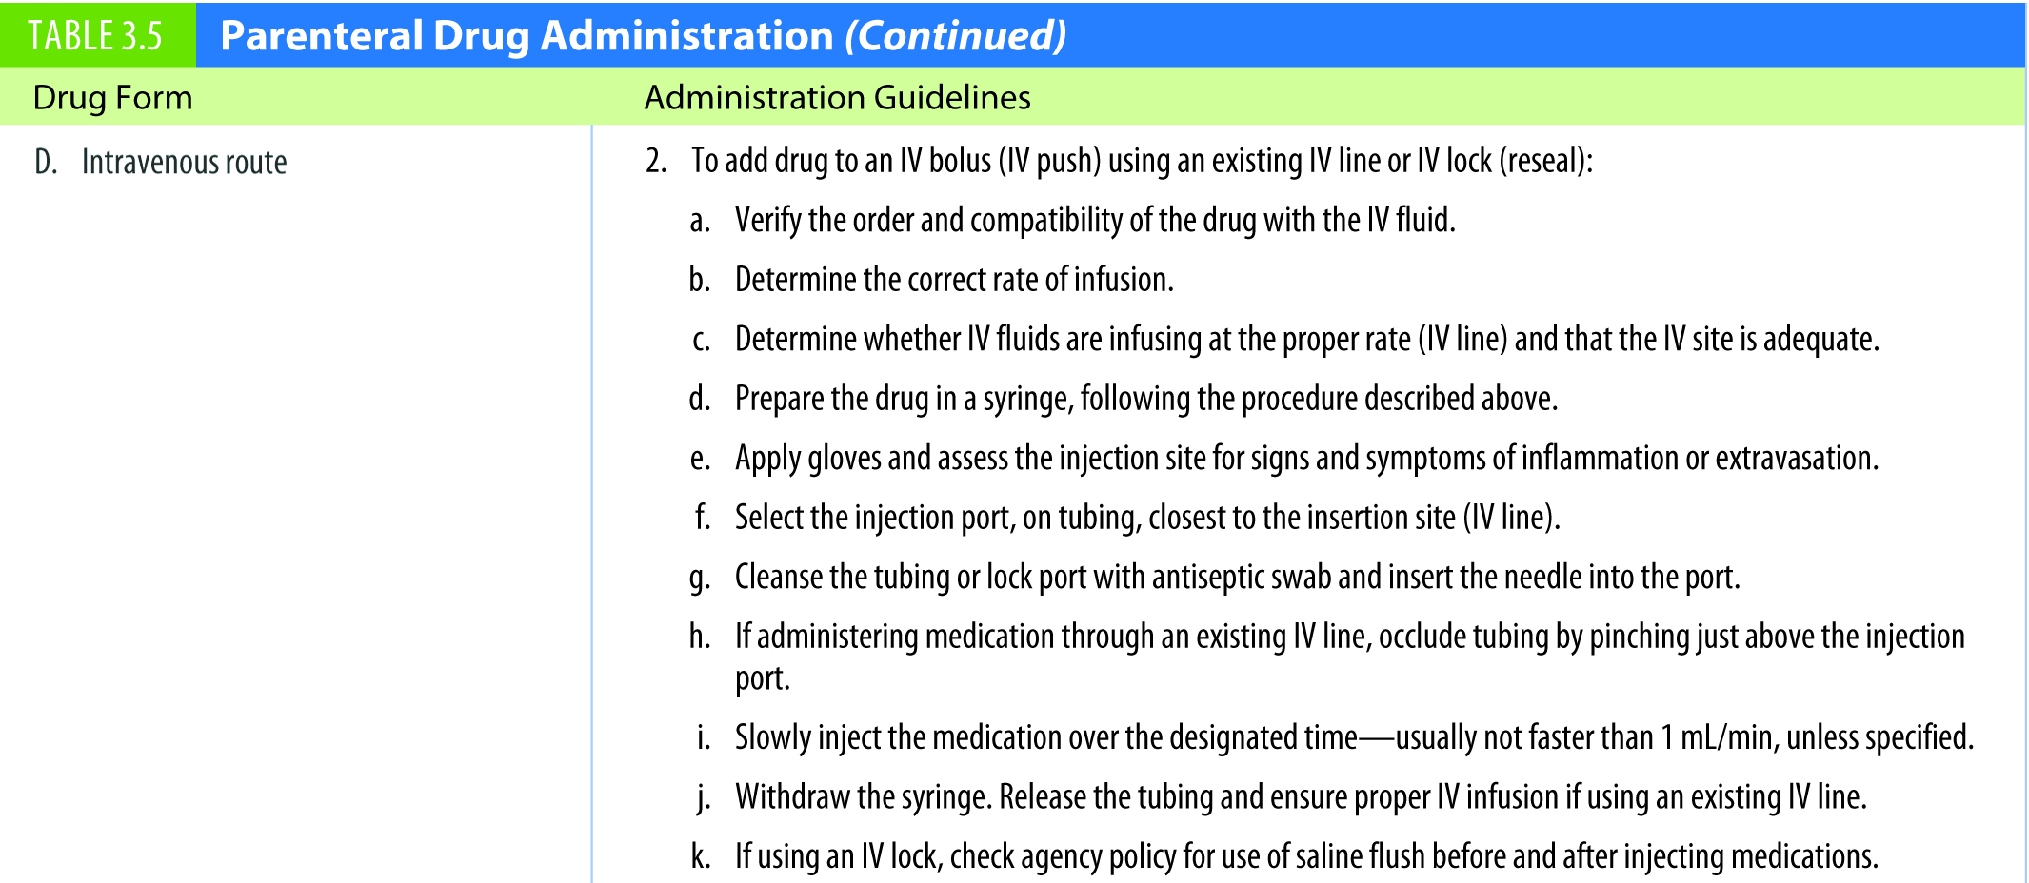
Table 3.5 (continued) Parenteral Drug Administration

Slide 75

Sharps Disposal
Notes:
This photo shows sharps disposal using only one hand.
Containers need to be puncture-proof and leak-proof. Never force a needle into a full needle disposal receptacle.
[See also Box 31-23 on text p. 609 Recommendations for Prevention of Needlestick Injuries.]
[Shown is Figure 31-25 from text p. 609.]

Slide 76

Table 3.1 Drug Administration Abbreviations
continued on next slide

Slide 77

Table 3.1 (continued) Drug Administration Abbreviations

