Slide 1
Tribute
Members names

Slide 2
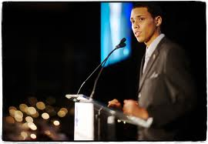
Description
Definition of tribute: A gift, testimonial, compliment, or the like, given as due or in acknowledgment of gratitude or esteem.
N/A. "Tribute." Dictionary.com. Dictionary.com, 2013. Web. 11 July 2013.
http://www.ryanbrenizer.com/2011/01/photo-of-the-day-focus-on-the-moment/

Slide 3
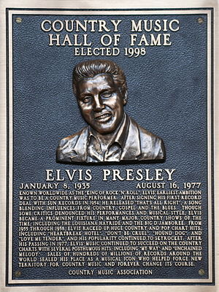
Description
An opportunity to pay tribute to a person, a group of people, or an institution.
The subject may be historical or contemporary, famous, or obscure.
Petrich, Kevin. "Impromptu and Tribute Speeches." Impromptu and Tribute Speeches. Broward College, 7 Sept. 2012. Web. 10 July 2013.
http://first-thoughts.org/on/Country+Music+Hall/

Slide 4
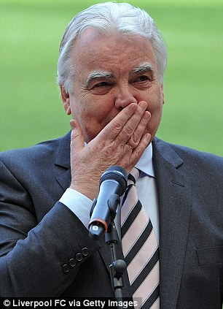
Descriptive
Guide lines for Tribute Speech:
1. Establish noble themes
2. Provide vivid examples
3. Express audience feelings
4. Great memorable images
5. Be genuine
Grice, G.L., and J.T. Skinner. Mastering Public Speaking. 5th ed. N.p.: Pearson, 2004. Print.
http://www.dailymail.co.uk

Slide 5
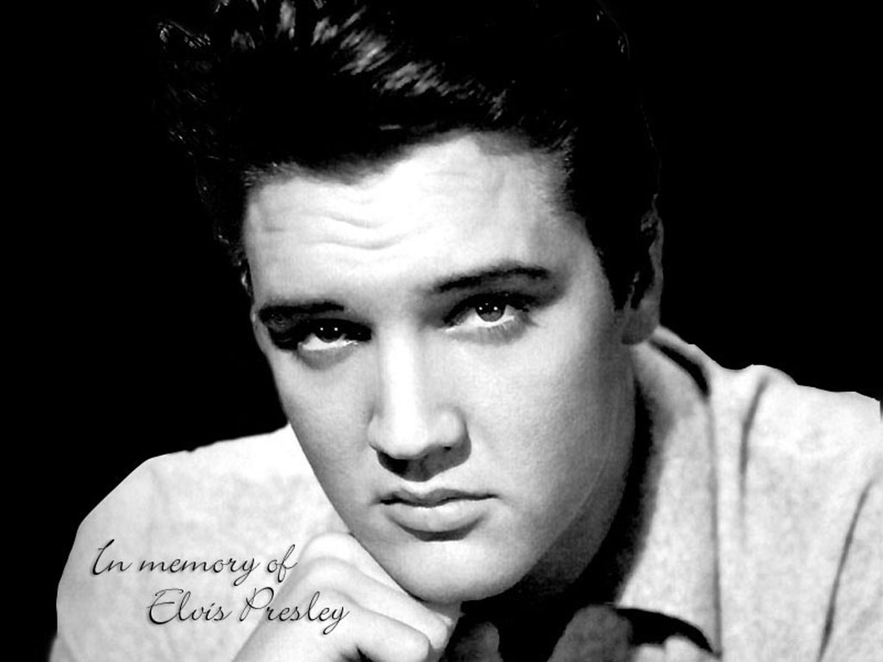
Elvis Presley
Presley, Elvis “Hound Dog” Rock and Roll Collection Vol. 1
http://images.search.yahoo.com

Slide 6
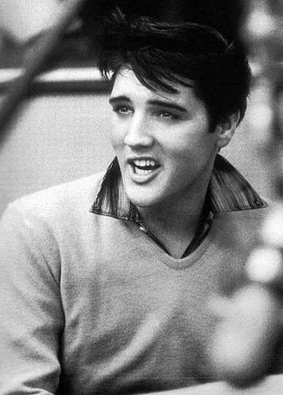
Early Life
Born in Tupelo Mississippi on 8 Jan 1935.
Started work as an usher in high school.
Moved on to being an delivery truck driver.
"Elvis Presley." Contemporary Musicians. Vol. 1. Detroit: Gale, 1989. Biography In Context. Web. 13 July 2013.
http://images.search.yahoo.com

Slide 7
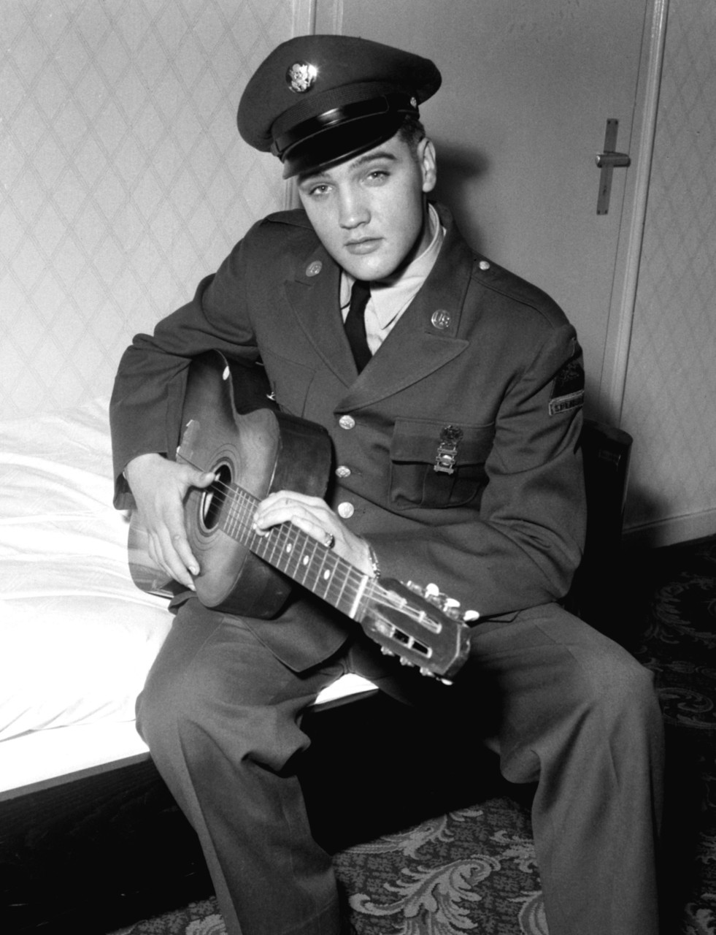
Military Career
24 Mar 1958 to 2 Mar 1960 Elvis served in the 2nd and 3rd Armored Division.
SGT Presley was honorably discharged from the reserves on 23 Mar 1964.
www.history.army.mil, 3 Oct 2003. (Web). 13 Jul 2013.
http://images.search.yahoo.com

Slide 8
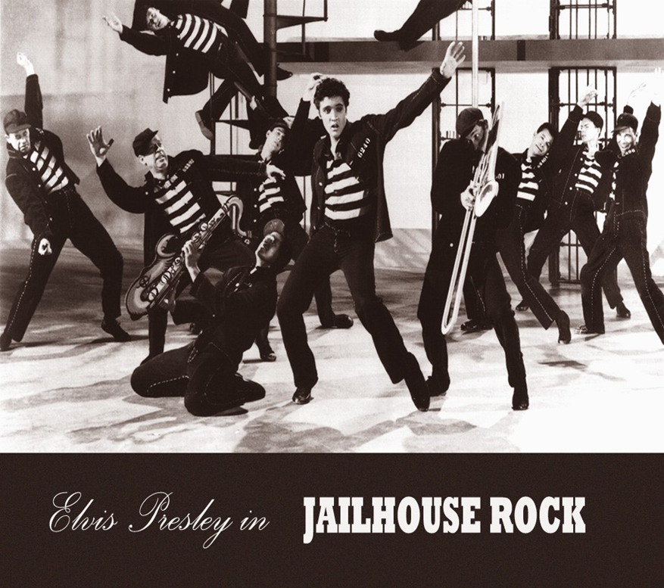
Life as the King
1953-1977 Elvis recorded music and appeared in movies like Jailhouse Rock in 1957.
Elvis’ “Heartbreak Hotel” was his first song to earn a golden record.
http://images.search.yahoo.com
"Elvis Presley." Contemporary Musicians. Vol. 1. Detroit: Gale, 1989. Biography In Context. Web. 13 July 2013.

Slide 9
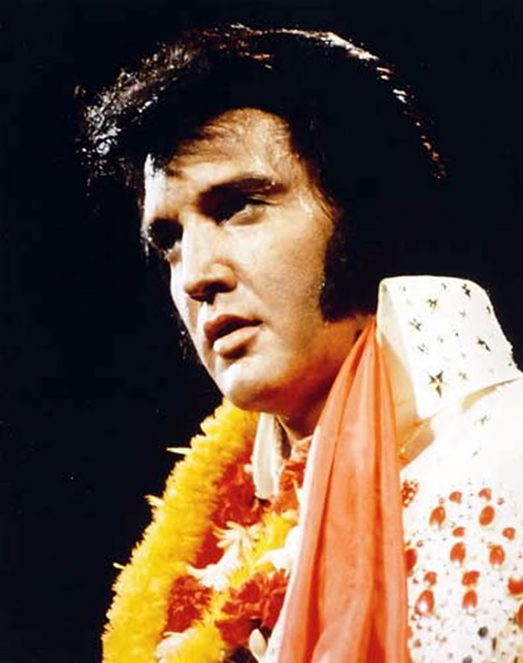
Achievements
His music topped the top 40 chart 100 times.
40+ golden records with over a billion records sold.
Earned 3 Grammy awards.
Appeared in 33+ movies.
"Elvis Presley." Contemporary Musicians. Vol. 1. Detroit: Gale, 1989. Biography In Context. Web. 13 July 2013.
http://images.search.yahoo.com

Slide 10
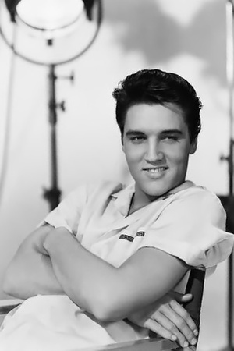
The End
Elvis died of heart failure in Memphis Tennessee on 16 Aug 1977.
Elvis led an amazing life and is still remembered to this day as the King of Rock and Roll.
"Elvis Presley." Contemporary Musicians. Vol. 1. Detroit: Gale, 1989. Biography In Context. Web. 13 July 2013.
http://images.search.yahoo.com

