Slide 1
Award Introduction, Award Presentations, and Acceptance Speech
Presented by:
Background photo:
www.backtoherroots.com

Slide 2
Award Introduction, Award Presentations, and Acceptance Speech
Speeches of Introduction
Awards Presentations
Acceptance Speeches
Demonstration
Background photo:
www.backtoherroots.com

Slide 3
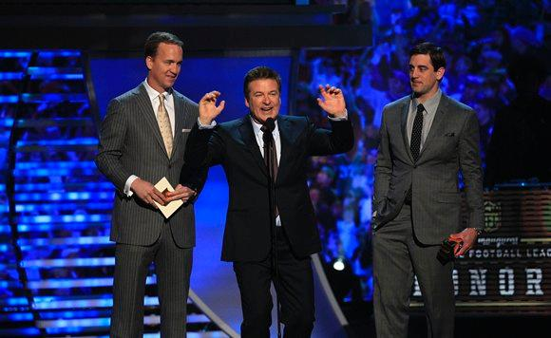
Introduction Speech
The introduction has 5 important responsibilities
- Get audience attention
- Introduce the topic
- Explain relevance to audience
- State a thesis or purpose
- Outline main points
http://www.packers.com/media-center/photo-gallery/Rodgers-wins-NFL-MVP-at-inaugural-NFL-Honors/40446f5d-4178-44e1-92d2-863088f2c4c6

Slide 4
Award Presentation
When presenting an award it is much like introducing a speaker or a guest.
There are three distinct components when preparing a presentation
Refer to the occasion:
Anniversary of a special event
Completion of a long-term task
Accomplishments of a lifetime
High achievement
Etc…
Beebe, Steven, and Susan Beebe. Public Speaking Handbook. 4th ed. Upper Saddle River: Pearson, 2013. 407. Print.

Slide 5
Award Presentation
2. Talk about the history and significance of the award:
If the audience doesn’t know much about the award it may be fairly long, but brief if the audience is already familiar with the history and purpose of the award.
The discussion of its significance adds to the meaning
3. Name the person:
Tell why the person won
Decide when to reveal the name
Beebe, Steven, and Susan Beebe. Public Speaking Handbook. 4th ed. Upper Saddle River: Pearson, 2013. 407. Print.

Slide 6
Acceptance Speech
Thank the presenter
First thank the presenter
Thank the organization
Thank your supporters
Thank a few contributors to your success
It’s best to resist making the list too long
Talk about the award
The meaning or significance of the award
Consider your audience
Relate the award to the audience
Beebe, Steven, and Susan Beebe. Public Speaking Handbook. 4th ed. Upper Saddle River: Pearson, 2013. 409. Print.

Slide 7
Mountain Dew
Lover Award

Slide 8
Mountain Dew
Lover Award

Slide 9
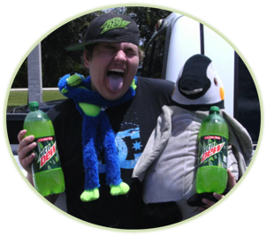
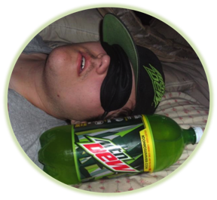
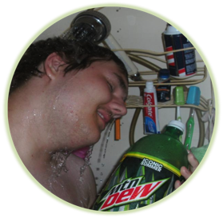
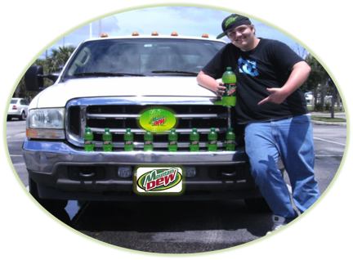
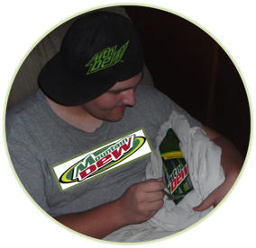
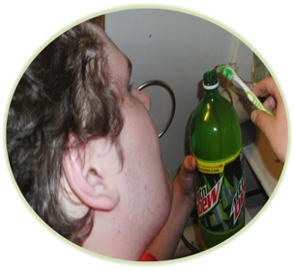
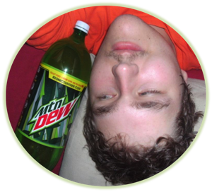
Deryck Thompson

Slide 10
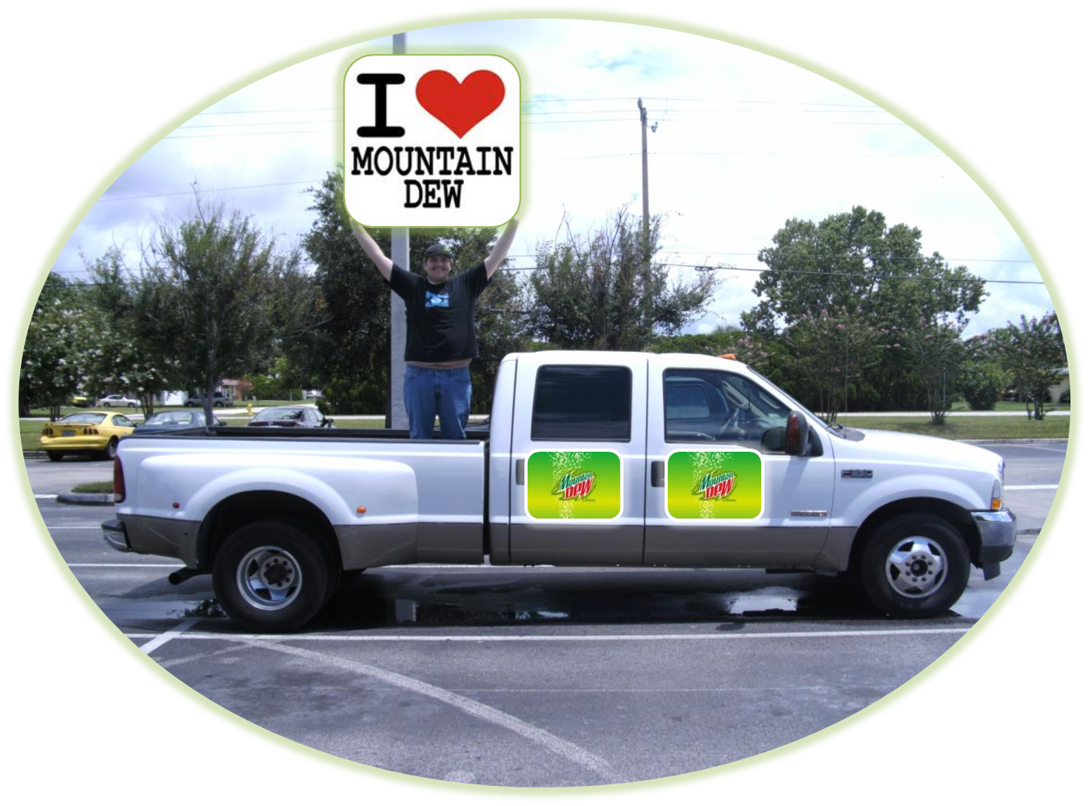
Conclusion

