Slide 1
PowerPoint™ Presentation Prepared by
Diana M. Cooley, Ph.D.
Lone Star College – North Harris
Houston, Texas
Notes:
1

Slide 2
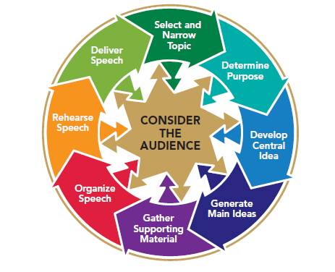
Chapter 11
Outlining & Editing Your Speech
This multimedia product and its contents are protected under copyright law. The following are prohibited by law:
any public performance or display, including transmission of any image over a network;
preparation of any derivative work, including the extraction, in whole or in part, of any images;
any rental, lease, or lending of the program.
Notes:
Chapter Overview:
Developing Your Preparation Outline
Revising Your Speech
Developing Your Delivery Outline and Speaking Notes

Slide 3
To be a living creature, having a body of
its own and head and feet; there should be a middle, a beginning, and end, adapted to one another and to the whole.
~Plato
Copyright © 2013, 2010, 2007, 2005 Pearson Education, Inc. All Rights Reserved.

Slide 4
Developing Your Preparation Outline
The preparation outline
Write your preparation outline in complete sentences
Use Standard outline form
Use standard outline numbers and letters
Use a least two subdivisions, if any, for each point
Indent main ideas, points, subpoints & supporting material
Write & label your specific purpose at the top of you preparation outline
Add the blueprint, key signposts & intro & conclusion
Notes:
NOTES: Although few speeches are written paragraph form, most speakers develop a detailed preparation outline that includes main ideas, subpoints, and supporting material. It may also include the specific purpose, introduction, blueprint, signposts, and conclusion. To begin your outlining task, you might try a technique known as mapping, or clustering. Write on a sheet of paper all the main ideas, subpoints, and supporting material for the speech. Then use geometric shapes and arrows to indicate the logical relationships among them, as shown in Figure 11.1 (next slide).
Unless you write complete sentences, you will have trouble judging the coherence of the speech. Moreover, complete sentences will help during your early rehearsals.
Although you did not have to use standard outline form when you began to outline your ideas, you need to do so now. Standard outline form lets you see at a glance the exact relationships among various main ideas, subpoints, and supporting material in your speech. It is an important tool for evaluating your speech as well as a requirement in many public-speaking courses. An instructor who requires speech outlines will generally expect standard outline form. To produce a correct outline, follow the instructions given here and summarized in Figure 11.2.
Unless your instructor directs you to do otherwise, do not work the specific purpose into the outline itself. Instead, label it and place it at the top of the outline. Your specific purpose can serve as a yardstick by which to measure the relevance of each main idea, sub-point, and piece of supporting material.
Add the Blueprint, Key Signposts, and an Introduction and Conclusion to Your Outline Place the introduction after the specific purpose, the blueprint immediately following the introduction, the conclusion after the outline of the body of the speech, and other signposts within the outline. Follow your instructor’s guidelines for incorporating these elements into your numbering system.

Slide 5
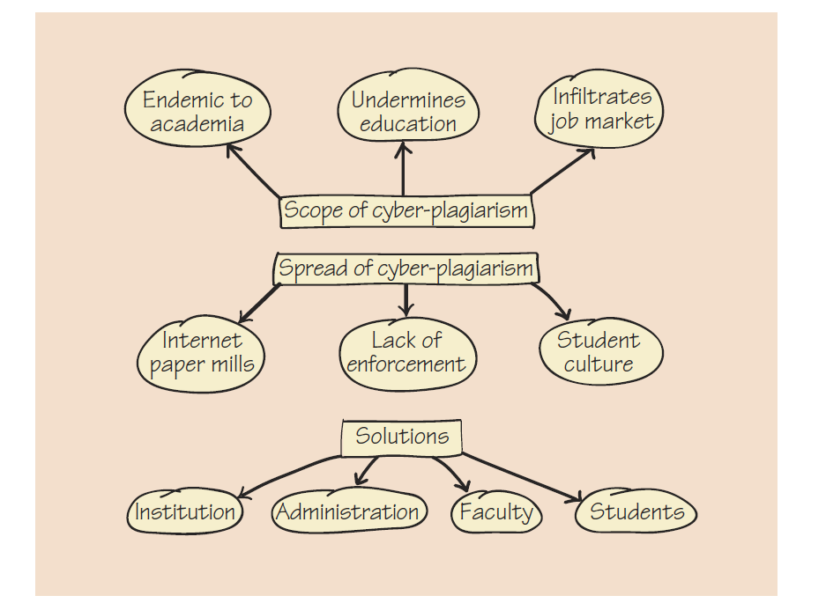
Figure 11.1
Mapping/Clustering Technique
Copyright © 2013, 2010, 2007, 2005 Pearson Education, Inc. All Rights Reserved.
Notes:
NOTES: Figure 11.1 A map that shows the relationships among each of a speaker’s three main ideas and their subpoints. Main ideas are enclosed by rectangles; subpoints, by ovals. Supporting material could be indicated by another shape and connected to the appropriate subpoints.

Slide 6
Figure 11.2
Correct Outline Format
Copyright © 2013, 2010, 2007, 2005 Pearson Education, Inc. All Rights Reserved.
Notes:
NOTES: Figure 11.2 Use this summary as a reminder of the rules of proper outlining when you write your preparation outline.

Slide 7
Revising Your Speech
Revising your preparation outline
Revising as you rehearse
Notes:
NOTES: Often, when you rehearse using your preparation outline, you discover that you’ve got too much information. You have to cut your speech. Here are a few tips to help you revise a speech that is too long:
Review your specific purpose.
Consider your audience.
Keep only the best supporting material.
Look at your introduction and conclusion. Your introduction should generally take up about 10 percent of your speaking time; another 10 percent should go to your conclusion.
Ask a listener to help you cut. It’s often easier to have someone else help you cut material.

Slide 8
Developing Your Delivery Outline
Delivery Outline:
Make the outline as brief as possible, and use single words or short phrases rather than complete sentences.
Include the introduction and conclusion in much shortened form.
Include supporting material and signposts.
Do not include your purpose statement in your delivery outline.
Use standard outline form
Notes:
NOTES: A delivery outline, as the name implies, is meant to give you all that you will need to present your speech in the way you have planned and rehearsed. However, it should not be so detailed that it encourages you to read the outline rather than speak to your audience.

Slide 9
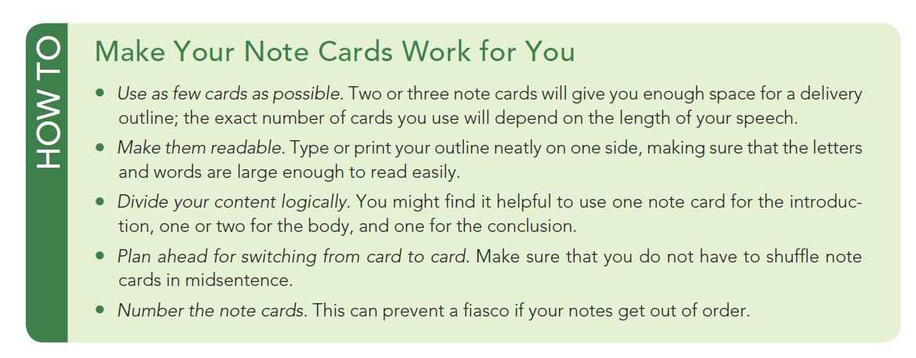
How To
Make Your Note Cards Work For You
Notes:
NOTES: Many speakers find paper difficult to handle quietly, so they transfer their delivery outlines to note cards. Note cards are small enough to hold in one hand, if necessary, and stiff enough not to rustle. The How To box tells you how to make the best use of note cards.

