Slide 1
PowerPoint™ Presentation Prepared by
Diana M. Cooley, Ph.D.
Lone Star College – North Harris
Houston, Texas
Notes:
1

Slide 2
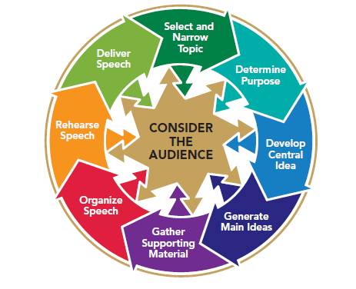
Chapter 8
Organizing Your Speech
This multimedia product and its contents are protected under copyright law. The following are prohibited by law:
any public performance or display, including transmission of any image over a network;
preparation of any derivative work, including the extraction, in whole or in part, of any images;
any rental, lease, or lending of the program.
Notes:
Chapter Overview:
Organizing Your Main Ideas
Subdividing Your Main Ideas
Integrating Your Supporting Material
Developing Signposts
Supplementing Signposts with Presentation Aids

Slide 3
Organized thought is the basis of organized action.
~ Alfred North Whitehead
Copyright © 2013, 2010, 2007, 2005 Pearson Education, Inc. All Rights Reserved.

Slide 4
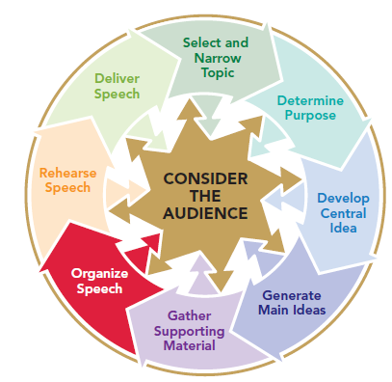
Organizing Your Main Ideas
Organizing ideas topically
Primacy
Recency
Complexity
Notes:
NOTES:
To generate a preliminary plan for your speech you need to determine whether your central idea had logical divisions, could be supported by several reasons, or could be explained by identifying specific steps. These divisions, reasons, or steps became the main ideas of the body of your speech and the basis for the organization task highlighted in Figure 8.1.
Topically: If your central idea has natural divisions, you can often organize your speech topically. You can simply arrange your main ideas as a matter of personal preference. At other times, you may organize your main points based on one of three principles: primacy, recency, or complexity.
Primacy: The principle of primacy suggests that you discuss your most important or convincing point first in your speech. The beginning of your speech can be the most important position if your listeners are either unfamiliar with your topic or hostile toward your central idea.
Recency: According to the principle of recency, the point that was discussed last is the one audiences will remember best. If your audience is at least somewhat knowledgeable about and generally favorable toward your topic and central idea, you should probably organize your main points according to recency.
Complexity: If your main ideas range from simple to complicated, it makes sense to arrange them in order of complexity, progressing from the simple to the more complex.

Slide 5
Organizing Your Main Ideas
Ordering ideas chronologically
Forward in time
How to explanations
Backward in time
Notes:
NOTES:
Chronological organization is organization by time; that is, your steps are ordered according to when each occurred or should occur. Historical speeches and how-to speeches are the two kinds of speeches that are usually organized chronologically.
Forward in time: Choosing to organize your main points either from earliest to most recent.
How to explanations: How-to explanations are also likely to follow a sequence or series of steps arranged from beginning to end, from the first step to the last—forward in time.
Backward in time: Choosing to organize your main points from recent events back into history.
The progression that you choose depends on your personal preference and on whether you want to emphasize the beginning or the end of the sequence.

Slide 6
Organizing Your Main Ideas
Organizing ideas spatially
Location
Direction
Notes:
NOTES:
When you choose to use spatial organization you arrange your ideas by natural divisions of the central idea—according to their location and direction. It does not matter whether you choose to progress up or down, east or west, forward or back, as long as you follow a logical progression. If you skip up, down, over, and back, you will only confuse your listeners rather than painting a distinct word picture.

Slide 7
Organizing Your Main Ideas
Organizing ideas to show cause –effect
Organizing ideas to show effect- cause
Notes:
NOTES:
If your central idea can be developed by discussing either steps or reasons, you might consider organizing your main ideas by cause and effect. A speech that is organized to show cause and effect may first identify a situation and then discuss the effects that result from it (cause → effect). Or the speech may present a situation and then seek its causes (effect → cause). As the recency principle would suggest, the cause–effect pattern emphasizes the effects; the effect–cause pattern emphasizes the causes.

Slide 8
Organizing Your Main Ideas
Organizing ideas by problem/solution
Organizing ideas by solution/problem
Notes:
NOTES:
If you want to discuss why a problem exists or what its effects are, you will probably organize your speech according to cause and effect, as discussed in the previous section. However, if you want to emphasize how best to solve the problem, you will probably use a problem–solution pattern of organization.

Slide 9
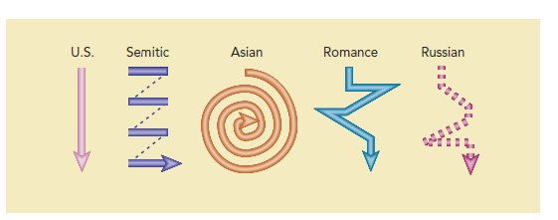
Organizing Your Main Ideas
Acknowledging cultural differences in organization
Notes:
NOTES:
Although the five patterns just discussed are typical of the way in which speakers in the United States are expected to organize and process information, they are not necessarily typical of all cultures. In fact, each culture teaches its members patterns of thought and organization that are considered appropriate for various occasions and audiences. Figure 8.2 illustrates these culturally diverse patterns of organization.
United States speakers tend to be more linear & direct
Semitic speakers support their main points by pursuing tangents that may be off-topic
Asians speakers may only allude to a main point through a circuitous route of illustration and parable
Romance & Russian speakers tend to begin with a basic principle and then move to facts & illustrations that they only gradually connect to a main point.
Of course, these are very broad generalizations. But as an audience member who recognizes the existence of cultural differences, you can better appreciate and understand the organization of a speaker from a culture other than your own.

Slide 10
Subdividing Your Main Ideas
Notes:
NOTES:
After you have decided how to organize your main ideas, you may need to subdivide at least some of them. Note that you can arrange your main ideas according to one pattern and your subpoints according to another. Your goal at this point is to get your ideas and information on paper.

Slide 11
Integrating Your Supporting Material
Prepare your supporting material
Organize your supporting material
Primacy/recency
Specificity
Complexity
Soft/hard evidence
Incorporate your supporting material into your speech
Notes:
NOTES:
Once you have organized your main ideas and subpoints, you are ready to flesh out the speech with your supporting material.
Preparing your supporting material: your records of supporting material may be in a variety of formats. Regardless of which strategy you use to integrate your supporting material, take care not to lose track of the source of the supporting material.
Organizing your supporting material: Once you have prepared your supporting material, you are ready to organize it. You might realize that in support of your second main idea, you have an illustration, two statistics, and an opinion. In what order should you present these items? You can sometimes use the five standard organizational patterns to arrange your supporting material as well as your main ideas and subpoints. Illustrations, for instance, may be organized chronologically. Can also utilize primacy or recency (which has all ready been discussed) or specificity where as your supporting material will range from very specific examples to more general overviews of a situation. Complexity moving from the simple to the complex. Soft evidence to hard evidence – soft rests on opinion or inference where as hard evidence includes factual examples and statistics
Incorporating your supporting material: When your supporting material has been logically placed into your plan, your next goal is to incorporate it smoothly into your speech so as to enhance the flow of ideas.

Slide 12
Developing Signposts
Transitions
Verbal transitions
Nonverbal transitions
Summaries
Final summary
Internal summary
Previews
Initial Previews
Internal Previews
Questions as internal
previews
Notes:
NOTES:
The next organizational task is to develop signposts—words and gestures that allow you to move smoothly from one idea to the next throughout your speech, showing relationships between ideas and emphasizing important points. Three types of signposts can serve as glue to hold your speech together: transitions, previews, and summaries.
Transitions - Transitions indicate that a speaker has finished discussing one idea and is moving to another. Transitions may be either verbal or nonverbal. Verbal transitions: A speaker can sometimes make a verbal transition simply by repeating a key word from an earlier statement or by using a synonym or a pronoun that refers to an earlier key word or idea. This type of transition is often used to make one sentence flow smoothly into the next. Nonverbal transitions: Nonverbal transitions can occur in several ways, sometimes alone and sometimes in combination with verbal transitions.
Previews – are a statement of what is to come. Initial preview is a statement of what the main ideas of the speech will be, and it is usually presented in conjunction with the central idea as a blueprint for the speech, at or near the end of the introduction. Internal previews introduce and outline ideas that will be developed as the speech progresses. Internal previews also serve as transitions. Questions as internal previews couch internal previews in the form of questions they plan to answer.
Summaries - Like previews, summaries provide additional exposure to a speaker’s ideas and can help to ensure that audience members will grasp and remember them. Final summary occurs just before the end of a speech, often doing double duty as a transition between the body and the conclusion. The final summary is the opposite of the preview statement. The preview statement gives audience members their first exposure to a speaker’s main ideas; the final summary gives them their last exposure to those ideas. Internal summary occur within and throughout a speech. They are often used after two or three points have been discussed.

