Slide 1
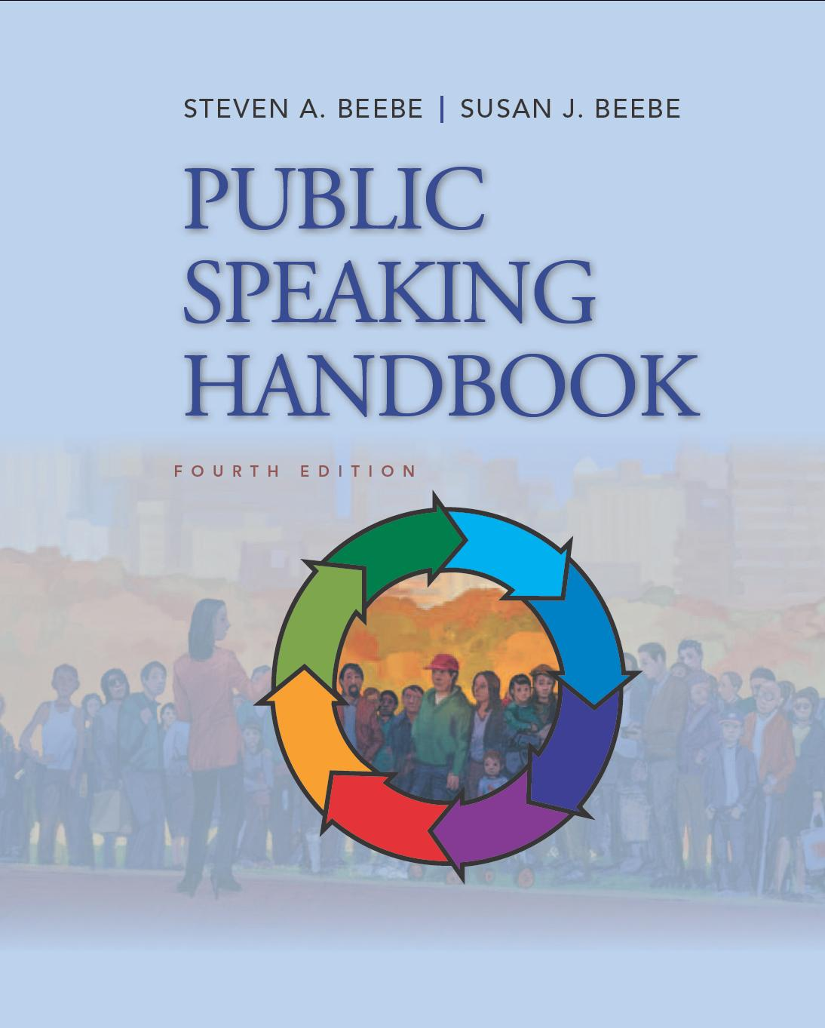
PowerPoint™ Presentation Prepared by
Diana M. Cooley, Ph.D.
Lone Star College – North Harris
Houston, Texas
Notes:
1

Slide 2
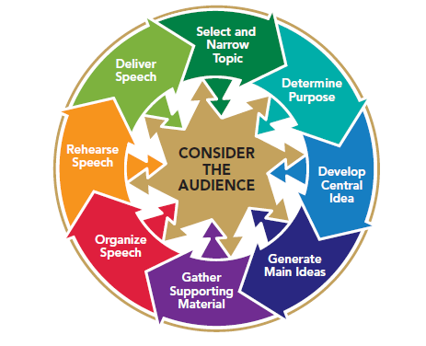
Chapter 3
Speaking Freely and Ethically
This multimedia product and its contents are protected under copyright law. The following are prohibited by law:
any public performance or display, including transmission of any image over a network;
preparation of any derivative work, including the extraction, in whole or in part, of any images;
any rental, lease, or lending of the program.
Notes:
Chapter Overview:
What are ethics?
Speaking Freely
Speaking ethically
Speaking credibly

Slide 3
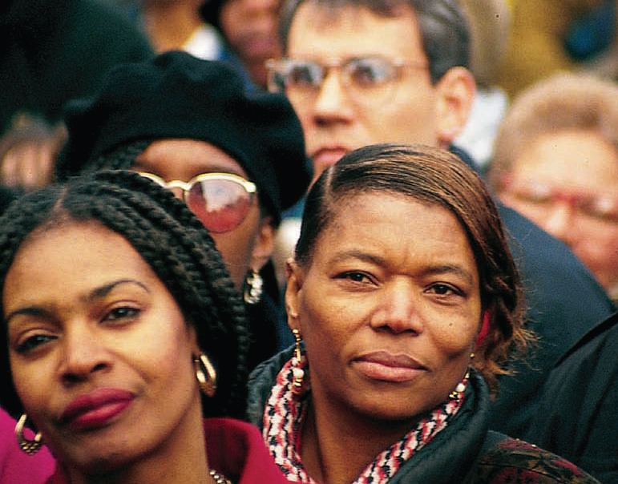
Free speech not only lives, it rocks!
~Oprah Winfrey
Copyright © 2013, 2008, 2006 Pearson Education, Inc. All Rights Reserved.
Copyright © 2013, 2010, 2007, 2005 Pearson Education, Inc. All Rights Reserved.

Slide 4
Ethics
Beliefs, values and moral principles by which we determine what is right or wrong.
For public speaking, responsibly balance right to free speech with needs of audience.
Notes:
NOTES:
Beliefs, values & moral principles by which we determine what is right or wrong.
For public speaking, responsibly balance right to free speech with needs of audience.
Although you are undoubtedly familiar with many ethical issues, you may have given less thought to ethics in public speaking. These center on one main concern: In a country in which free speech is protected by law, the right to speak freely must be balanced by the responsibility to speak ethically. In 1999, the National Communication Association developed a Credo for Communication Ethics, which emphasizes the fundamental nature and far-reaching impact of ethical communication:
Ethical communication is fundamental to responsible thinking, decision making, and the development of relationships and communities within and across contexts, cultures, channels, and media. Moreover, ethical communication enhances human worth and dignity by fostering truthfulness, fairness, responsibility, personal integrity, and respect for self and others.
Ethical considerations should guide every step of the public-speaking process. As you determine the goal of your speech, outline your arguments, and select your evidence, think about the beliefs, values, and morals of your audience as well as your own. Ethical public speaking is inherently audience-centered, always taking into account the needs and rights of the listeners.

Slide 5
Speaking Freely
Free speech and the U.S. Constitution
Free speech in the Twentieth Century
Free speech in the Twenty-First Century
Notes:
NOTES:
1. In 1791, the First Amendment to the U.S. Constitution was written to guarantee that “Congress shall make no law . . . abridging the freedom of speech.” In the more than 200 years since then, entities as varied as state legislatures, colleges and universities, the American Civil Liberties Union, and the federal courts have sought to define through both law and public policy the phrase freedom of speech.
2. During World War I, the U.S. Supreme Court ruled that it was lawful to restrict speech that presented “a clear and present danger” to the nation. This decision led to the founding, in 1920, of the American Civil Liberties Union, the first organization formed to protect free speech. In 1964, the Supreme Court narrowed the definition of slander, or false speech that harms someone. In 1989, the Supreme Court defended the burning of the U.S. flag as a “speech act” protected by the First Amendment. In 1997, the Court struck down the highly controversial federal Communications Decency Act of 1996, which had imposed penalties for creating, transmitting, or receiving obscene material on the Internet.
3. One month after the September 11, 2001, terrorist attacks on the United States, the pendulum again swung toward restriction of free speech with the passage of the Patriot Act, which broadened the investigative powers of government agencies. Not surprisingly, the Patriot Act has been roundly criticized by various civil rights, free speech, and publishing groups. One coalition of such groups described the Patriot Act as “the latest in a long line of abuses of rights in times of conflict.”

Slide 6
Quick Check
History of Free Speech in The United States
1791 – First Amendment guarantees that “Congress shall make no law…abridging the freedom of speech”
1798 – Sedition Act is passed (expired in 1801)
1919 – U.S. Supreme Court rules that speech presenting “a clear and present danger” may be restricted
1920 – American Civil Liberties Union is formed
1940 – Congress declares it illegal to urge the violent overthrow of the federal government
1964 – U.S. Supreme Court restricts definition of slander; Berkeley Free Speech Movement is born
Notes:
NOTES:
The Quick Check reviews the history of the First Amendment. There can be little doubt that in the months and years to come, the United States will continue to debate “the balance among national security, free speech, and patriotism.”

Slide 7
Quick Check
History of Free Speech in The United States
1989 – U.S. Supreme Court defends the burning of the U.S. flag as a
“speech act”
1997 – U.S. Supreme Court strikes down Communications Decency Act of 1996,
in defense of free speech on the Internet
1998 – Oprah Winfrey successfully defends her right to speak freely on television
2001 – September 11 terrorist attacks spark passage of the Patriot Act and new debate over the balance between national security and free speech
2006 – State of Montana pardons those convicted under the Montana Sedition Act of 1918
2010 – White House Correspondent Helen Thomas retires amid controversy over what some saw as her exercise of free speech
Notes:
NOTES:
The Quick Check reviews the history of the First Amendment. There can be little doubt that in the months and years to come, the United States will continue to debate “the balance among national security, free speech, and patriotism.”

Slide 8
Speaking Ethically
Have a clear responsible goal:
Do not coerce
Do not manipulate
Reveal your true agenda
Use sound evidence and reasoning
Be sensitive to and tolerant to differences
Be honest
Notes:
Notes:
1. Have a clear responsible goal: The goal of a public speech should be clear to the audience. If you keep your true agenda hidden, you violate your listeners’ rights. In addition, an ethical goal should be socially responsible. A socially responsible goal is one that gives the listener choices, whereas an irresponsible, unethical goal is psychologically coercive. If your overall objective is to inform or persuade, it is probably ethical; if your goal is to coerce or manipulate, it is unethical.
2. Use sound evidence & reasoning: Ethical speakers use critical-thinking skills such as analysis and evaluation to draw conclusions and formulate arguments. Unethical speakers substitute false claims and manipulation of emotion for evidence and logical arguments. An important requirement for the ethical use of evidence and reasoning is to share with an audience all information that might help them reach a sound decision, including information that may be potentially damaging to your case. Even if you proceed to refute the opposing evidence and arguments, you have fulfilled your ethical responsibility by presenting the perspective of the other side. And you can actually make your own arguments more convincing by anticipating and answering counterarguments and evidence.
3. Be sensitive to & tolerant to differences: Sensitivity to differences, sometimes called accommodation, does not mean that speakers must abandon their own convictions or pander to those of their audience members. It does mean that speakers should demonstrate a willingness to listen to opposing viewpoints and learn about different beliefs and values. Such willingness not only communicates respect; it can also help a speaker to select a topic, formulate a purpose, and design strategies to motivate an audience. A speaker who is sensitive to differences also avoids language that might be interpreted as being in any way biased or offensive.
4. Be honest: Knowingly offering false or misleading information to an audience is an ethical violation. Honesty also requires that speakers give credit for ideas and information that are not their own. The Publication Manual of the American Psychological Association states that “an author does not present the work of another as if it were his or her own work. This can extend to ideas as well as written words.”22 Presenting the words and ideas of others without crediting them is called plagiarism. This ethical violation is both serious enough and widespread enough to warrant a separate discussion on plagiarism (next slide).

Slide 9
Do Not Plagiarize
Plagiarizing: Presenting someone else’s ideas or words as though they were your own
Plagiaphrasing: Failing to give credit for compelling phrases taken from another source
Notes:
NOTES:
Do Your Own Work:
Think of an original approach
Avoid articles that can be converted into speeches
Edit your own work
Acknowledge Your Sources:
Direct quotes, not matter how short
Opinions or ideas of others, even if paraphrased
Statistics
Non-original visual materials (graphs, pictures & tables)
Give oral and written citations
Take Careful Notes:
Practice note-taking
Follow a system
Indicate with quotes any word-for-word quotation or ideas from others
Record complete citation information
Cite Sources Carefully:
Written citations
Oral citations
APA format
When in doubt, always document

Slide 10
How To
Incorporate an Oral Citation into Your Speech
On a 2010 Web page titled
Rabies, the Centers for
Disease Control and
Prevention define rabies as
“a preventable viral disease of
mammals most often transmitted
through the bit of a rabid
animal.”
Provide the date
Specify the type of resource
Give the title
Provide the author or source
Pause briefly to signal that you
are about to begin quoting
Quote the source
Pause again to indicate that
you are ending the quoted
passage

Slide 11
Speaking Credibly
Credibility – a speaker’s believability and it involves:
Competence
Knowledge
Dynamics
Trustworthiness
Notes:
NOTES:
Credibility is a speaker’s believability. A credible speaker is one whom an audience perceives to be competent, knowledgeable, dynamic, and trustworthy. To achieve the last of these four factors—trustworthiness—you as a speaker must consistently adhere to ethical principles. You trust people whom you believe to be ethical. In fact, the Greek rhetorician Aristotle used the term ethos—the root word of ethic and ethical—to refer to a speaker’s credibility. Quintilian, a Roman teacher of public speaking, believed that an effective public speaker also should be a person of good character, a “good person speaking well.”

Slide 12
Quick Check
The Ethical Public Speaker…
Has a clear, responsible goal.
Uses sound evidence and reasoning.
Is sensitive to and tolerant of differences.
Is honest.
Avoids plagiarism.

