Slide 1
PowerPoint™ Presentation Prepared by
Diana M. Cooley, Ph.D.
Lone Star College – North Harris
Houston, Texas
Notes:
1

Slide 2
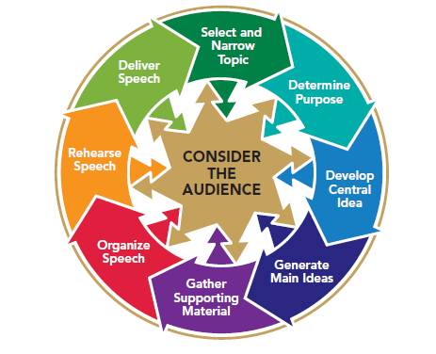
Chapter 2
Speaking With Confidence
This multimedia product and its contents are protected under copyright law. The following are prohibited by law:
any public performance or display, including transmission of any image over a network;
preparation of any derivative work, including the extraction, in whole or in part, of any images;
any rental, lease, or lending of the program.
Notes:
Chapter Overview:
Understand Your Nervousness
Build Your Confidence

Slide 3
The mind is a wonderful
thing. It starts
working the minute
you’re born and never
stops . . . until you
stand up to speak in
public.
~George Jessel
If all my talents and
powers were to be
taken from me by some
inscrutable Providence,
and I had my
choice of keeping but
one, I would unhesitatingly
ask to be
allowed to keep the
Power of Speaking, for
through it, I would
quickly recover all
the rest.
~Daniel Webster
Copyright © 2013, 2008, 2006 Pearson Education, Inc. All Rights Reserved.
Copyright © 2013, 2010, 2007, 2005 Pearson Education, Inc. All Rights Reserved.

Slide 4
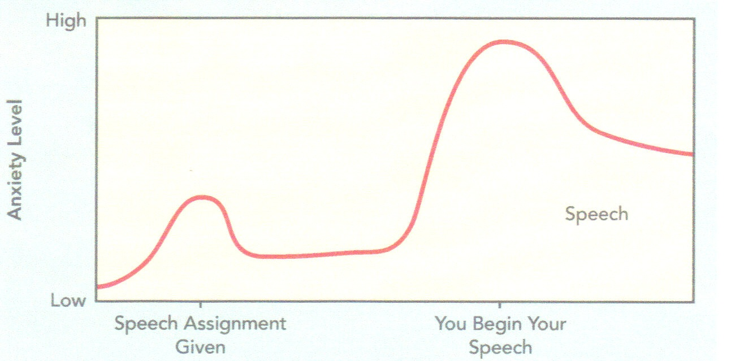
Understand Your Nervousness
Your psychology affects your biology
Your biology affects your psychology
Your apprehension follows a predictable pattern
Figure 2.1
Notes:
NOTES:
Public speaking is number one in highest anxiety.
Eighty percent of people feel anxious when speaking to others.
Your psychology affects your biology: Your view of the speaking assignment, your perception of your speaking skill, and your self-esteem interact to create anxiety. Researchers found that among the causes of anxiety about public speaking were fear of humiliation, concern about not being prepared, worry about one’s looks, pressure to perform, personal insecurity, concern that the audience wouldn’t be interested in the speaker or the speech, lack of experience, fear of making mistakes, and an overall fear of failure.
Your biology affects your psychology: Increasingly, researchers are concluding that communication apprehension may have a
long-term genetic, biological basis. Some people may inherit a tendency to feel anxious about speaking in public. Some researchers have concluded that public-speaking apprehension is both a trait (a characteristic or general tendency that you may have) and a state (anxiety triggered by the specific incidence of giving a speech to an audience).
Your apprehension follows a predictable pattern: Figure 2.1 shows how research suggests that many people feel most nervous right before they are to give their speech. You will feel your second-highest level of anxiety when your instructor explains the speech assignment and you’ll feel the least anxiety when you’re preparing for your speech.

Slide 5
Understand Your Nervousness
Brain triggers body
Communication apprehension (CA) is the fear of speaking
Types of CA:
Average – normal heart rate
Insensitive – lower heart rate
Inflexible – higher heart rate
Confrontational – heart rate levels off in time
Notes:
NOTES:
Understand Your Nervousness
Keep in mind:
• Nervousness is your brain trying to help you.
• Nervousness is predictable.
• You’ll feel more nervous than you look.
• You are not alone.
• It’s normal to be nervous.
• You can re-label and use your feelings to your advantage.
To identify patterns in how people experience communication apprehension, one researcher measured speakers’ heart rates when they were delivering speeches and also asked them several questions about their fear of speaking.16 After studying the results, he identified four styles of communication apprehension:
• Average. With this style, you have a generally positive approach to communicating in public; your overall heart rate when speaking publicly is in the average range. Speakers with this style rated their own speaking performance the highest.
• Insensitive. This is likely to be your style only if you have had previous experience in public speaking. Perhaps because of your experience, you tend to be less sensitive to apprehension when you speak; you have a lower heart rate when speaking, and you rate your performance as moderately successful.
• Inflexible. You have the highest heart rate when speaking publicly. Some people use this high and inflexible level of anxiety to enhance their performance. Their fear motivates them to prepare and be at their best. For others, the anxiety of the inflexible style creates so much tension that their speaking performance is diminished.
• Confrontational. You have a very high heart rate as you begin presenting a speech, and then your heart rate tapers off to more average levels. This style occurred in people who reported a strong emotional or affective response to speaking and was characteristic of more experienced speakers or people with at least some public speaking background.
Remember: Audience cannot see your nervousness; Almost every speaker is nervous; Anxiety can be useful; Think positive.

Slide 6
Build Your Confidence
Know your audience
Don’t procrastinate
Select an appropriate topic
Be prepared
Be organized
Know your introduction & your conclusion
Make practice real
Breathe
Notes:
NOTES:
Build Your Confidence:
Don’t delay in preparing
Learn as much as you can about your audience
Pick a comfortable & familiar topic
Prepare & rehearse
Develop a well structured speech
Other Advice:
Be familiar with introduction & conclusion
Simulate actual speech conditions
Breathe deeply
Think & act calm
Visualize success
Give yourself a mental pep talk

Slide 7
Build Your Confidence
Channel your nervous energy
Visualize your success
Give yourself a mental pep talk
Focus on your message, not your fear
Look for positive support
Focus on your accomplishment, not your fear
Seek speaking opportunities
Notes:
NOTES:
Channel Your Energy
• To release tension, take a leisurely walk once you arrive wherever you will be speaking. A slow, relaxing walk can help to calm you down and use up some of your excess energy.
• When you are seated and waiting to speak, grab the edge of your chair (without calling attention to what you are doing) and gently squeeze the chair to release tension. No one needs to know you’re doing this—just squeeze and relax, squeeze and relax.
• You can also purposely tense and then release the muscles in your legs and arms while you’re seated. You don’t need to look as though you’re going into convulsions; just imperceptibly tense and relax your muscles to burn energy.
• One more tip: Keep both feet on the floor and gently wiggle your toes rather than sitting with your legs crossed. Crossing your legs can sometimes cause one leg or foot to go to sleep. Keeping your feet on the floor and slightly moving your toes can ensure that all of you will be wide awake and ready to go when it’s your turn to speak.
Get and Give Support in Public-Speaking Class
One study found that speakers experienced less apprehension if they had a support group or a small “learning community” that provided positive feedback and reinforcement. This finding has implications for you as a speaker and listener.
• Join a study group. When you have a speaking assignment, work with others to provide support both as you prepare and when you present your speech.
• Listen supportively. When you’re listening to speakers in your communication class, help them by providing eye contact and positive nonverbal support, such as nodding in agreement and maintaining a positive, sincere facial expression.
• Empathize with other students’ anxieties. Providing positive supportive feedback is especially important when you know that a speaker is quite nervous. Try to understand what might make your classmates anxious. For example, one study found that nonnative speakers may feel anxious
and nervous because English is not their native language. You can help your fellow students feel more comfortable as speakers, and they can do the same for you. Watch for their support.

