Slide 1
PowerPoint™ Presentation Prepared by
Diana M. Cooley, Ph.D.
Lone Star College – North Harris
Houston, Texas
Notes:
1

Slide 2
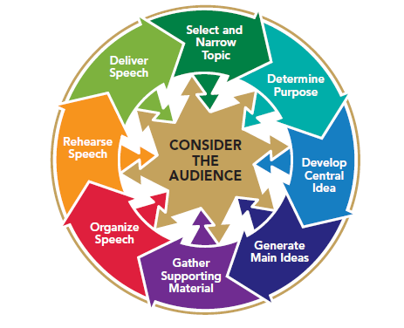
Chapter 16
Understanding Principles
of Persuasive Speaking
This multimedia product and its contents are protected under copyright law. The following are prohibited by law:
any public performance or display, including transmission of any image over a network;
preparation of any derivative work, including the extraction, in whole or in part, of any images;
any rental, lease, or lending of the program.
Notes:
Chapter Overview:
Persuasion Defined
How Persuasion Works
How to Motivate Listeners
How to Develop Your Persuasive Speech

Slide 3
… the power of speech, to stir men’s Blood.
~ William Shakespeare
Copyright © 2013, 2010, 2007, 2005 Pearson Education, Inc. All Rights Reserved.

Slide 4
Persuasion Defined
Persuasion is the process of changing or reinforcing attitudes, beliefs, values, or behavior.
Notes:
NOTES:
Note that when trying to persuade someone, you might not necessarily try to change the person’s point of view or behavior but, instead, aim to reinforce it. Your listeners might already like, believe, or value something, or they might sometimes already do what you would like them to do; in this situation, you are trying to strengthen their current perspective.

Slide 5
Changing or Reinforcing Audience Attitudes, Beliefs, and Values
Attitudes
Our attitudes represent our likes and dislikes.
Beliefs
A belief is what you understand to be true or false.
Values
A value is an enduring concept of right or wrong, good or bad.
Notes:
NOTES:
Since the essence of persuasion is to change or reinforce these three kinds of predispositions, it is very useful to know exactly which one of them you are targeting. Of the three, audience values are the most stable. Figure 16.1 shows, values are the most deeply ingrained of the three predispositions and they change frequently (next slide).

Slide 6
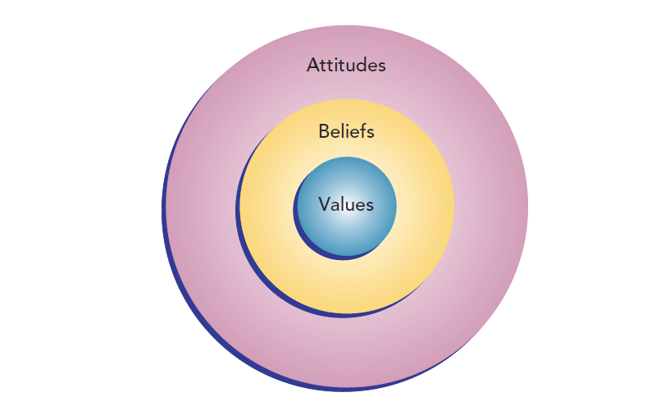
Figure 16.1
Audience Attitudes, Beliefs, and Values
Notes:
NOTES:
The target of your speech affects its chances of successfully persuading your audience. Attitudes form the outer ring of this model because they are easier to change than beliefs or core values. Beliefs can be changed, though not as easily as attitudes. Values are at the core of the model because they are the most deeply ingrained and change the least frequently.
Changing or Reinforcing Audience Behaviors: Persuasive messages often attempt to do more than change or reinforce attitudes, beliefs, or values—they may attempt to change or strengthen behaviors.

Slide 7
How Persuasion Works
Aristotle’s Traditional Approach
Ethos
Logos
Pathos
Notes:
NOTES:
Aristotle, a Greek philosopher and rhetorician who lived and wrote in the fourth century b.c.e., was the source of many ideas about communication in general and persuasion in particular. He defined rhetoric as the process of discovering in any particular case the available means of persuasion. Aristotle identified three general methods (or, using his language, “available means”) to persuade: ethos, logos, and pathos.
Ethos: To use ethos to persuade, an effective communicator presents information that is credible. Aristotle believed that to be credible, a public speaker should be ethical, possess good character, have common sense, and be concerned for the well-being of the audience. The more credible and ethical a speaker is perceived to be, the greater the chances are that a listener will believe in, trust, and positively respond to the of the speaker. To persuade successfully, communicators must present information that can be trusted and therefore must be believable and trustworthy themselves.
Logos: The word logos literally means “the word.” Aristotle used this term to refer to the rational, logical arguments that a speaker uses to persuade someone. A skilled persuader not only reaches a logical conclusion but also supports the message with evidence and reasoning.
Pathos: Aristotle used the term pathos to refer to the use of appeals to emotion. We sometimes hold attitudes, beliefs, and values that are not logical but simply make us feel positive. Likewise, we sometimes do things or buy things to make ourselves feel happy, powerful, or energized.
All three traditional means of persuasion—ethos (ethical credibility), logos (logic), and pathos (emotion)—are ways of motivating a listener to think or behave in certain ways. Motivation is the underlying internal force that drives people to achieve their goals. Our motives explain why we do things. Several factors motivate people to respond to persuasive messages: the need to restore balance to their lives to avoid stress, the need to avoid pain, and the desire to increase pleasure have been documented as motives that influence attitudes, beliefs, values, and behavior.

Slide 8
How Persuasion Works
ELS’s Contemporary Approach
The direct persuasion route
The indirect persuasion route
Notes:
NOTES:
A newer, research-based framework for understanding how persuasion works is called the elaboration likelihood model (ELM) of persuasion. This theory, despite its long name, is a simple idea that offers an explanation of how people are persuaded to do something or to think about something. Rather than prescribing how to craft a persuasive message from the standpoint of the speaker, as Aristotle does, ELM theory describes how audience members interpret persuasive messages. It’s an audience-centered theory about how people make sense out of persuasive communication. The theory suggests that there are two ways in which you can be persuaded: the direct persuasion route, which you follow when you elaborate on a message, and the indirect persuasion route, in which you don’t elaborate and are instead influenced by the more peripheral factors of the message and the messenger.
The direct persuasion route - If you elaborate on a message, you will likely be directly persuaded by the logic, reasoning, arguments, and evidence that are presented to you. When you elaborate, you consider what Aristotle would call the underlying logos, or logic, of the message. You carefully consider the facts and then make a thoughtful decision as to whether to believe or do what the persuader wants.
The indirect persuasion route - A second way in which you can be persuaded, according to ELM theory, is a more indirect, or peripheral, route. If you don’t elaborate (that is, if you don’t use critical thinking skills while listening), you simply draw on an overall impression of what the speaker says and how the speaker says it. The indirect route is a more intuitive process.
Combining Aristotle’s Approach and the ELM: Aristotle’s theory and the ELM both suggest that persuasion is a complex process. Not all of us are persuaded in the same way. Aristotle’s theory emphasizes what a speaker should do to influence an audience. If the speaker discovers the proper application of a credible and ethical message (ethos), logic (logos), and emotion (pathos), then persuasion is likely to occur. ELM theory describes how listeners process the messages they hear. Listeners can be persuaded when they directly elaborate (or actively think about what they hear) and logically ponder how evidence and reasoning make sense. Or, if they do not elaborate, listeners may be persuaded indirectly, on the basis of peripheral factors that don’t require as much thought to process, such as the personal appearance of the speaker or the speaker’s delivery. Both theories give insight into how you can persuade others and how others persuade you. Because you might not know whether your listeners are influenced directly or indirectly by your message (whether they are elaborating or not), you will want to use a balance of ethos, logos, and pathos as you think about how to persuade your listeners, However, it’s your audience members, not you, that ultimately make sense out of what they hear.

Slide 9
How to Motivate Listeners
Use cognitive dissonance
Use listeners’ needs
Use positive motivation
Use negative motivation
Notes:
NOTES:
An audience is more likely to be persuaded if you help members to solve their problems or meet their needs. They can also be motivated if you convince them that good things will happen to them if they follow your advice or that bad things will happen if they don’t. These approaches are summarized in Table 16.1 (next slide).

Slide 10
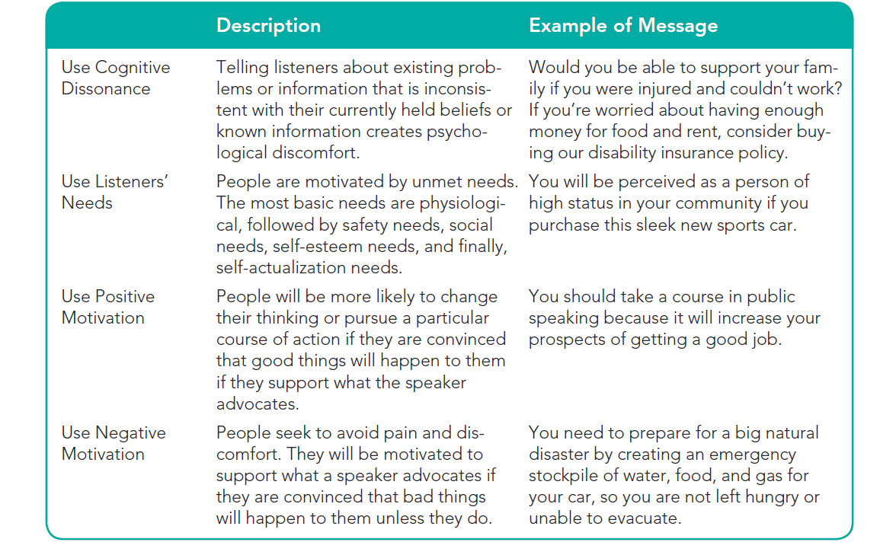
Table 16.1
How to Motivate Listeners
Notes:
NOTES:
Table 16.1 give description and examples of the various methods on how to motivate listeners.

Slide 11
How to Motivate Listeners
Use dissonance:
People seek consistency & balance
If unhappy, people change attitudes, beliefs, values or behaviors
Cognitive dissonance: mental discomfort prompting people to change when new & existing information conflict
Speakers need to be ethical when choosing messages that create dissonance
Notes:
NOTES:
Dissonance theory is based on the principle that people strive to solve problems and manage stress in a way that is consistent with their attitudes, beliefs, and values. According to the theory, when you are presented with information that is inconsistent with your current attitudes, beliefs, values, or behavior, you become aware that you have a problem, and you experience a kind of discomfort called cognitive dissonance. The word cognitive relates to our thoughts. Dissonance means “lack of harmony or agreement.” Cognitive dissonance, then, means that you are experiencing a way of thinking that is nonconsistent and uncomfortable. Most people seek to avoid feelings of dissonance.

Slide 12
How to Motivate Listeners
How listeners’ cope with dissonance:
Discredit the source of the information
Refocus on parts of the message not creating dissonance
Seek new information to prove speaker’s ideas wrong
Stop listening/tune out
Change attitudes, beliefs, values or behaviors to reduce dissonance
Notes:
NOTES:
Effective persuasion requires more than simply creating dissonance and then suggesting a solution. When your listeners confront dissonant information, a number of options are available to them besides following your suggestions. You need to be aware of the various ways in which your audience may react before you can reduce their cognitive dissonance:
Listeners may discredit the source. Instead of believing everything you say, your listeners could choose to discredit you.
Listeners may reinterpret the message. A second way in which your listeners may overcome cognitive dissonance and restore balance is to hear what they want to hear. They may choose to focus on the parts of your message that are consistent with what they already believe and ignore the unfamiliar or controversial parts.
Listeners may seek new information. Your audience members may look for additional information to negate your position and to refute your well-created arguments.
Listeners may stop listening. Most of us do not seek opportunities to hear or read messages that oppose our opinions.
Listeners may change their attitudes, beliefs, values, or behavior. A fifth way in which an audience may respond to dissonant information is to do as the speaker wants them to do: change their attitudes, beliefs, values, or behavior.

Slide 13
How to Motivate Listeners
Use listener needs:
People change attitudes, beliefs, values or actions to restore needs
Maslow: humans are motivated by variety of needs
Persuasion occurs when listeners become convinced that changes will satisfy their needs
Notes:
NOTES:
Need is one of the best motivators. The more you understand your listeners’ needs, the greater are the chances that you can gain and hold their attention and ultimately get them to do what you want. Abraham Maslow developed the classic theory that outlines basic human needs.8 Maslow suggested that there is a hierarchy of needs that motivates everyone’s behavior. Basic physiological needs (for food, water, and air) have to be satisfied before we can be motivated to respond to higher-level needs. Figure 16.2 next slide illustrates Maslow’s five levels of needs, with the most basic at the bottom.

Slide 14
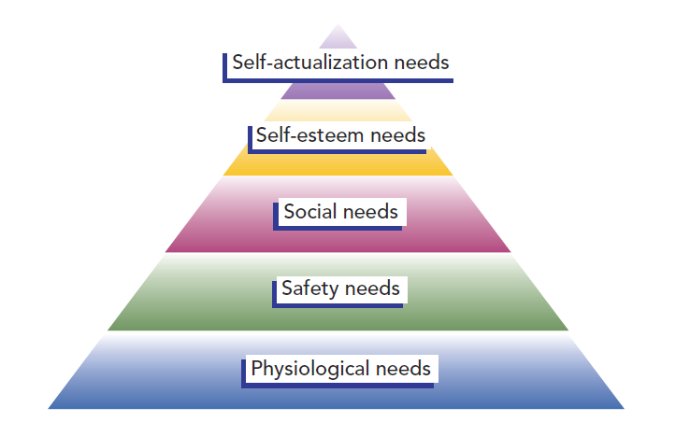
Figure 16.2
Maslow’s Hierarchy of Needs
Notes:
NOTES:
Maslow Hierarchy of Needs: Abraham Maslow developed the classic theory that outlines basic human needs. Maslow suggested that there is a hierarchy of needs that motivates everyone’s behavior. Basic physiological needs (for food, water, and air) have to be satisfied before we can be motivated to respond to higher-level needs. Figure 16.2 illustrates Maslow’s five levels of needs, with the most basic at the bottom. Although the hierarchical nature of Maslow’s needs has not been consistently supported by research (we can be motivated by several needs at the same time), Maslow’s hierarchy of needs provides a useful checklist of needs that can potentially motivate a listener. When attempting to persuade an audience, a public speaker tries to stimulate these needs in order to change or reinforce attitudes, beliefs, values, or behavior.
Levels:
Physiological: comfort, sustenance & survival
Safety: security & protection
Social: contact; feeling loved & valued
Self-esteem: positive self image, and personal satisfaction
Self-actualization: reaching full potential

Slide 15
How to Motivate Listeners
Use Positive Motivation
Emphasize positive values
Emphasize benefits, not just features
Use Negative Motivation
Use fear to persuade:
Use an if then approach
Threaten listeners’ loved ones
Emphasize your credibility
Make the treat real
Make the threat scary
Provide a solution to the fear-inducing problem
Empower your listeners to act
Notes:
NOTES:
Emphasize Positive Values: What do most people value? A comfortable, prosperous life; stimulating, exciting activity; a sense of accomplishment; world, community, and personal peace; and happiness are some of the many things people value. How can you use these values in a persuasive speech? When identifying reasons for your audience to think, feel, or behave as you want them to, review those common values to determine what benefits would accrue to your listeners. Emphasize Benefits, Not Just Features : A benefit is a good result or something that creates a positive feeling for the listener. A feature is simply a characteristic of whatever it is that you’re talking about. A benefit creates a positive emotional sizzle that appeals to the heart. A feature elicits a rational, cognitive reaction—it appeals to the head. The heart usually trumps the head when persuading others.
Use Negative Motivation: One of the oldest methods of trying to change someone’s attitude or behavior, the use of a threat is also one of the most effective. A variety of research studies support the following principles for using fear appeals: Use an if-then approach. Build an argument on the assertion that a need will not be met unless the desired behavior or attitude change occurs: If you don’t do X, then awful things will happen to you. Threaten listeners’ loved ones. A strong threat to a loved one tends to be more successful than a fear appeal directed at the audience members themselves. A speaker using this principle might say, “Unless you see to it that your children wear safety belts, they could easily be injured or killed in an auto accident.” Emphasize your credibility. The more competent, trustworthy, or respected the speaker, the greater the likelihood that an appeal to fear will be successful. A speaker with less credibility will be more successful with moderate threats. Make the threat real. Fear appeals are more successful if you can convince your listeners that the threat is real and will probably occur unless they take the action you are advocating. It is vital to provide evidence to back up your claims of a threat. The speaker who uses fear appeals has an ethical responsibility to be truthful and not exaggerate when trying to arouse listeners’ fear. Make the threat scary. In the past, some researchers and public-speaking textbooks reported that if a speaker creates an excessive amount of fear and anxiety in listeners, the listeners could find the appeal so strong and annoying that they would stop listening. More comprehensive research, however, has concluded that there is a direct link between the intensity or strength of the fear appeal and the likelihood that audience members will be persuaded. Fear appeals work. Strong fear appeals seem to work even better than mild ones. Provide a solution to the fear-inducing problem. You might think the solution is evident, but will your listeners think the same thing? The audience-centered principle again applies. View the solution from your listeners’ point of view, and make sure that you tell them what they can do to reduce the threat. Empower your listeners to act. Fear appeals are more successful if you can convince your listeners that they have the power to make a change that will reduce the fear-causing threat. Don’t stop at presenting a solution to the fear. Also point out how easy it is to take the action that you are suggesting.

Slide 16
How to Develop Your Persuasive Speech
Consider the Audience
Consider audience diversity
Remember your ethical responsibilities as a persuader
Select & narrow your persuasive topic
Determine your persuasive purpose
Develop your central & main ideas
Proposition of fact
Proposition of value
Proposition of policy
Gathering supporting material
Organize your persuasive speech
Rehearse & deliver your speech
Notes:
NOTES: The process of developing a persuasive speech follows the same audience-centered path you would take to develop any speech but uses strategies that are intended to enhance its persuasive appeal to listeners.
One essential aspect of being audience-centered is being sensitive to the culturally diverse nature of most contemporary audiences. In our multicultural society, how persuasion works for one cultural group is different from how it works for others.
As you think about your audience and how to adapt your message to them, we remind you of your ethical responsibilities when persuading others. Fabricating evidence or trying to frighten your listeners with bogus information is unethical. Creating dissonance in the minds of your listeners based on information that you know to be untrue is also unethical. Adapting to your listeners does not mean that you tell people only what they want to hear. It means developing an ethical message to which your audience will listen thoughtfully.
For a persuasive presentation, you can adapt our general advice for picking a speech topic: Consider yourself. What are you passionate about? What issues stir your heart and mind? Consider your audience. The ideal topic speaks to a need, concern, or issue of the audience as well as to your interests and zeal. Know which local, state, national, or international issues interest your listeners. Consider the occasion. Some speech occasions, such as political rallies, may have built-in topics. For others, interpret the term occasion broadly, to refer to the events currently happening around you.
When you persuade others, you don’t always have to strive for dramatic changes in their attitudes, beliefs, values, and behavior. People rarely make major life changes after hearing just one persuasive message. Your speaking goal may be to move listeners a bit closer to your ultimate persuasive objective. Social judgment theory suggests that when listeners are confronted with a persuasive message, their responses fall into one of three categories: A latitude of acceptance, in which they generally agree with the speaker; A latitude of rejection, in which they disagree with the speaker A latitude of non-commitment, in which they are not yet committed either to agree or disagree—they are not sure how to respond.
The overall structure of your speech flows from your central idea and the main ideas that support your central idea. When persuading others, most speakers find it useful to state their central idea in the form of a proposition. A proposition is a statement with which you want your audience to agree. Proposition of fact is a statement that focuses on whether something is true or false. Proposition of value is a statement that either asserts that something is better than something else or presumes what is right or wrong or good or bad. Proposition of policy advocates a specific action—a change in policy, procedure, or behavior.
When gathering supporting material for your persuasive message, you look for the available means of persuasion to support the main ideas that you have developed to achieve your specific purpose.
After identifying and gathering ethical, logical, and appropriate emotional support for your message, you will make final decisions about how to organize your message: Introduction, Body, Conclusion.
To bring your ideas to life, the last two elements of the speechmaking process are to rehearse your message out loud & then, finally, to present your talk to your audience. When your goal is to persuade, you might want to make a special effort to rehearse your speech in front of another person or to run some of your ideas past other people to check the overall clarity and structure of your message.

