Slide 1
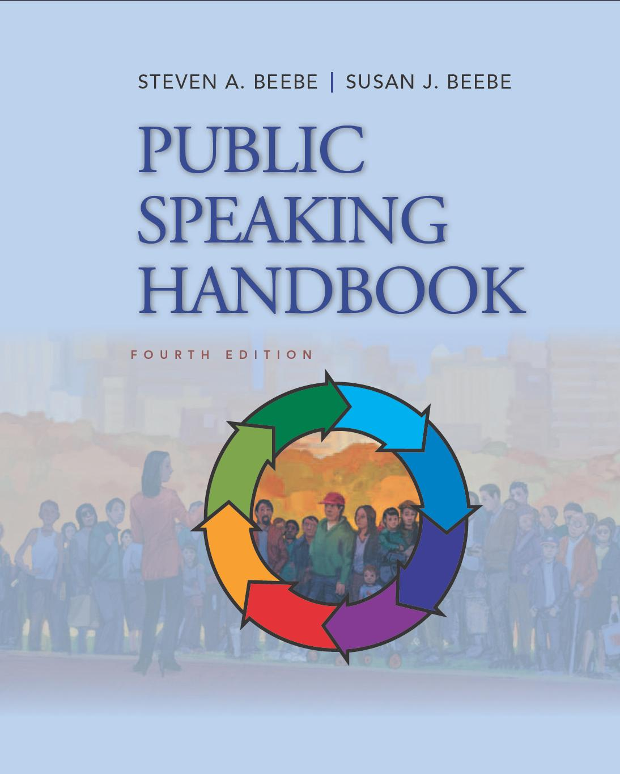
PowerPoint™ Presentation Prepared by
Diana M. Cooley, Ph.D.
Lone Star College – North Harris
Houston, Texas
Notes:
1

Slide 2
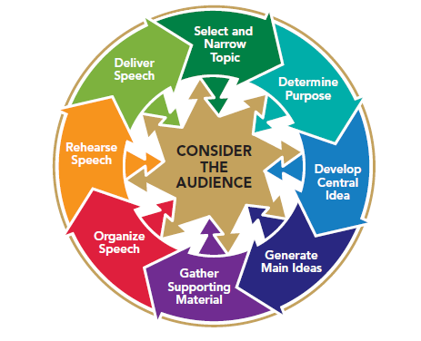
Chapter 15
Speaking to Inform
This multimedia product and its contents are protected under copyright law. The following are prohibited by law:
any public performance or display, including transmission of any image over a network;
preparation of any derivative work, including the extraction, in whole or in part, of any images;
any rental, lease, or lending of the program.
Notes:
Chapter Overview:
Types of Informative Speeches
Strategies to Enhance Audience Understanding
Strategies to Maintain Audience Interest
Strategies to Enhance Audience Recall
Developing an Audience-Centered Informative Speech

Slide 3
Not only is there an art in knowing a thing, but also a certain art in teaching it.
~Cicero
Copyright © 2013, 2010, 2007, 2005 Pearson Education, Inc. All Rights Reserved.

Slide 4
Informative Speaking
A speech to inform shares information with others to enhance their knowledge or understanding of the information, concepts, and ideas you present. When you inform, you typically attempt to achieve three goals:
You speak to enhancing understanding
Your speak to maintain interest
You speak to be remembered
Notes:
NOTES:
Conveying information to others is a useful skill in most walks of life. You may find that informing others will be an important part of your job.

Slide 5
Types of Informative Speeches
Objects
Procedures
People
Events
Ideas
Notes:
NOTES:
Informative speeches can be classified according to the subject areas they cover. In many informative presentations that you will deliver, your topic will be provided for you, or the nature of the specific speaking opportunity will dictate what you talk about.
Objects: A speech about an object might be about anything tangible—anything that you can see or touch. You may or may not show the actual object to your audience while you are talking about it.
Procedures: A speech about a procedure discusses how something works (for example, the human circulatory system) or describes a process that produces a particular outcome (for example, how grapes become wine).
People: A biographical speech could be about someone famous or about someone you know personally. Most of us enjoy hearing about the lives of real people, whether famous or not, living or dead, who had some special quality. The key to presenting an effective biographical speech is to be selective. Don’t try to cover every detail of your subject’s life. Relate the key elements in the person’s career, personality, or other significant life features so that you are building to a particular point rather than just reciting facts about an individual.
Events: Major events punctuate our lives and mark the passage of time. A major event can form the basis of a fascinating informative speech. You can choose to talk about either an event that you have witnessed or one that you have researched. Make the Event Come Alive - your goal is to describe the event in concrete, tangible terms and to bring the experience to life for your audience. Organize for Effect - most speeches that are built around an event follow a chronological arrangement. But a speech about an event might also describe the complex issues or causes behind the event and be organized topically.
Ideas: Speeches about ideas are usually more abstract than the other types of speeches are. Most speeches about ideas are organized topically (by logical subdivisions of the central idea) or according to complexity (from simple ideas to more complex ones).

Slide 6
Strategies to Enhance Audience Understanding
Speak with clarity
Use principles and techniques of adult learning
Provide information that can be used immediately
Actively involve listeners in the learning process
Connect listeners’ life experiences with the new information
Make new information relevant to listeners’ needs
Help listeners to solve their problems
Notes:
NOTES:
The skill of teaching and understanding is obviously important to teachers, but it’s also important to virtually any profession. Whether you’re a college professor, chief executive officer of a Fortune 500 company, or a parent raising a family, you will be called on to teach and explain.
Speak w/clarity: To speak with clarity is to express ideas so that the listener understands the intended message accurately. Speaking clearly is an obvious goal of an informative speaker. What is not so obvious is how to speak clearly. As a speaker, you might think you’re being clear, but only the listener can tell you whether he or she has received your message. Give careful thought to how you will help listeners understand your message. The most effective speakers (those whose message is both understood and appropriately acted on) build in success by consciously developing and presenting ideas with the listener in mind rather than flinging information at listeners and hoping that some of it sticks.
Use principles & techniques of adult learning: Most public-speaking audiences you face will consist of adults. Perhaps you’ve heard of pedagogy, the art and science of teaching children. The word pedagogy is based on the Greek words paid, which means “child,” and agogos, which means “guide.” Thus, pedagogy is the art and science of teaching children. Provide information that can be used immediately. If you present adult listeners with information that they can apply immediately to their “in-baskets,” they are more likely to focus on and understand your message. Actively involve listeners in the learning process. Rather than having your listeners sit passively as you speak, consider asking them questions to think about or, in some cases, to respond to on the spot. Connect listeners’ life experiences with the new information they learn. Adult listeners are more likely to understand your message if you help them to connect the new information with their past experiences. The primary way to do this is to know the kinds of experiences that your listeners have had and then refer to those experiences as you present your ideas. Make new information relevant to listeners’ needs and their busy lives. Most adults are busy—probably, if pressed, most will say they are too busy. So when speaking to an adult audience, realize that any information or ideas that you share will more likely be heard and understood if you relate what you say to their chock-full-of-activity lives. People who are working, going to school, raising families, and involved in their community need to be shown how the ideas you share are relevant to them. Help listeners to solve their problems. Most people have problems and are looking for solutions to them. People will be more likely to pay attention to information that helps them to better understand and solve their problems.

Slide 7
Strategies to Enhance Audience Understanding
Clarify unfamiliar ideas or complex processes
Use analogies
Use vivid description
Use a word picture
Appeal to a variety of learning styles
Auditory learners
Visual print learners
Visual learners
Kinesthetic learners
Notes:
NOTES:
Clarify unfamiliar ideas or complex processes. If you are trying to tell your listeners about a complex process, you will need more than definitions to explain what you mean. Research suggests that you can demystify a complex process if you first provide a simple overview of the process with an analogy, vivid description, or word picture.
An analogy is a comparison between two things. It’s an especially useful technique to describe complex processes because it can help someone to understand. It’s an especially useful technique to describe complex processes because it can help someone to understand something that’s difficult to grasp (the size of the Milky Way) by comparing it to something that the person already understands (the size of a coffee cup).
Use vivid description - When you describe, you provide more detail than you do when just defining something. Using descriptive terms that bring a process to life is especially effective in clarifying something that is complex. Descriptions answer questions about the who, what, where, why, and when of the process. Who is involved in the process? What is the process, idea, or event that you want to describe? Where and when does the process take place? Why does it occur, or why is it important to the audience? (Not all of these questions apply to every description).
Use a word picture - A word picture is a lively description that helps your listeners to form a mental image by appealing to their senses of sight, taste, smell, sound, and touch (see next slide for examples).
Appeal to a variety of learning styles:. Auditory learners - If you would rather listen to a recorded audio book than read a book, you may be an auditory learner, a person who learns best by hearing. Visual print learners - If you learn best by seeing words in print, then you are a visual print learner. Most likely, you would much rather read material than hear it presented orally. Visual learners - Barraged daily with images from TV and the Internet, many people have grown to depend on more than words alone to help them remember ideas and information. They are visual learners who learn best with words and images. Kinesthetic learners - Kinesthetic learners learn best by moving while learning. They would rather try something than hear it, watch it, or read about it. These learners like active learning methods such as writing while listening or, better yet, participating in group activities.

Slide 8
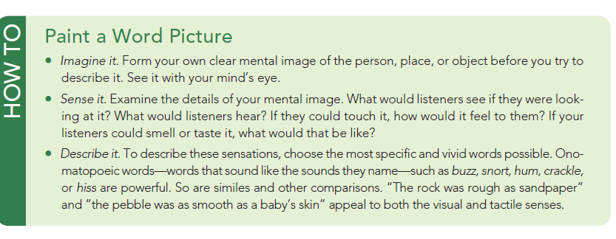
How To
Paint a Word Picture
Notes:
NOTES:
Examples show how to imagine it, sense it and describe it.

Slide 9
Strategies to Maintain Audience Interest
Motivate your audience to listen to you
Tell a story
Present information that relates to your listeners
Use the unexpected
Notes:
NOTES:
Most audiences will probably not be waiting breathlessly for you to talk to them. You will need to motivate them to listen to you. Don’t assume that your listeners will be automatically interested in what you have to say. Pique their interest with a rhetorical question. Tell them a story. Good stories with interesting characters and riveting plots have fascinated listeners for millennia; the words “Once upon a time . . .” are usually surefire attention-getters. A good story is inherently interesting. Stories are also a way of connecting your message to people from a variety of cultural back grounds. The characteristics of a well-told tale are simple yet powerful.
Present Information That Relates to Your Listeners - Being an audience-centered informative speaker means being aware of information that your audience can use. Adapt your message to the people who will be in your audience. With just a little thought about how to make your message less predictable and unexpected, you can add zest and interest to your speeches. Listeners will focus on the unexpected.

Slide 10
Strategies to Enhance Audience Recall
Build in redundancy
Make your key ideas short and simple
Pace your information flow
Reinforce key ideas
Reinforce key ideas verbally
Reinforce key ideas nonverbally
Notes:
NOTES:
When you speak it is useful to repeat key points. Audience members generally cannot stop you if a point in your speech is unclear or if their minds wander. How do you make your message redundant without insulting your listeners’ intelligence? Provide a clear preview at the beginning of your talk and a summary statement in your conclusion. Include internal summaries—short summaries after key points during your speech. Use numeric signposts (numbering key ideas verbally by saying, “My first point is . . . , My second point is . . . , And now here’s my third point: . . . .”). Reinforce key ideas by displaying them in a visual aid. If you really want to ensure that listeners come away from your speech with essential information, consider preparing a handout or an outline of key ideas. (When using a handout, make sure the audience is focusing on you, not on your handout). Make Your Key Ideas Short and Simple: When we say that you should make your messages simple, we don’t mean that you need to give 30-second speeches. Rather, we mean that if you can distill your ideas down to brief and simple phrases, your audience will be more likely to remember what you say. An important speech preparation technique that we’ve suggested is to crystallize the central idea of your message into a one-sentence summary of your speech. To help your audience remember your central-idea statement, make it short enough to fit on a car bumper sticker. Pace Your Information Flow: Organize your speech so that you present an even flow of information, rather than bunching up a number of significant details around one point. If you present too much new information too quickly, you may overwhelm your audience. Listeners’ ability to understand may falter. You should be especially sensitive to the flow of information if your topic is new or unfamiliar to your listeners. Make sure that your audience has time to process any new information you present. Use supporting materials both to help clarify new information and to slow down the pace of your presentation. Again, do not try to see how much detail and content you can cram into a speech. Your job is to present information so that the audience can grasp it, not to show off how much you know. Reinforce Key Ideas Verbally You can verbally reinforce an idea by using such phrases as “This is the most important point” or “Be sure to remember this next point; it’s the most compelling one.” Reinforce Key Ideas Nonverbally: How can you draw attention to key ideas nonverbally? Just the way you deliver an idea can give it special emphasis. Gestures serve the purpose of accenting or emphasizing key phrases. A well-placed pause can provide emphasis to set off and reinforce a point. Pausing just before or just after making an important point will focus attention on your thought. Raising or lowering your voice can also reinforce a key idea.

Slide 11
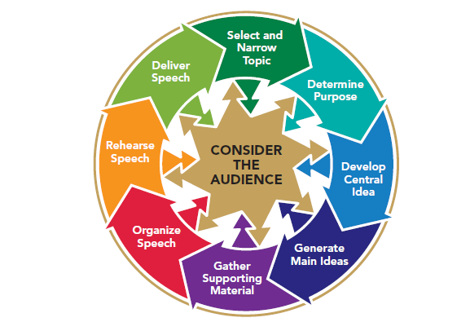
Figure 15.1
Developing an Audience-Centered Informative Speech
Notes:
NOTES: As Figure 15.1 shows, you can rely on the audience-centered speaking model we’ve been following throughout this book to guide you step by step through the process of preparing and presenting an informative speech.
Consider Your Audience: As with any type of speech, an informative talk requires that you consider three general questions of audience analysis: To whom are you speaking? What are their interests, attitudes, beliefs, and values? What do they expect from you?
Select and Narrow Your Informational Topic: during the early stages of preparing your message, ask yourself, and answer, the question “What does my audience already know about my topic?” If you misjudge what an audience already knows about your topic, that misjudgment may hamper your development of an effective and precise specific-purpose statement.
Determine Your Informative Purpose: You already know that your general purpose is to inform. You also need to develop a specific behavioral purpose. That is, you need to identify what you would like the audience to be able to do when your finish your speech.
Develop Your Central Idea: With a clear and precise specific-purpose sentence, you’ll be better prepared to identify your central idea—a one-sentence summary of your message.
Generate Your Main Ideas: If you have developed a specific-purpose sentence and have a well-crafted central-idea sentence, it should be easy to generate your main ideas.
Gather Your Supporting Materials: As you read and research, you look for examples, illustrations, stories, statistics, and other materials that help you to achieve your specific purpose. The type of informative speech you plan to make will often suggest ideas for supporting materials. Biographical details and stories will most likely support a speech about a person. Stories, examples, or statistics may help you to teach your audience about an event or idea. Remember that supporting materials include presentation aids.
Organize Your Speech: As you continue to keep your audience in mind, you now determine what the best sequence of your main points should be. Your topic and purpose can also help to guide you.
Rehearse Your Presentation: For informative speeches, it is especially helpful to rehearse in front of other people, especially people who are similar to your listeners, if possible. Seek their feedback about whether you are effectively teaching them about your topic.
Deliver Your Speech: Effective speakers continually look for ways to adapt and modify their message as they speak. Such adaptation is especially important in informative speaking. As you speak, watch your audience closely for signs—such as puzzled facial expressions—that indicate that your listeners do not understand something. Be alert, too, for signs of wandering attention, such as fidgeting or lack of eye contact. Be prepared to adapt your message, using the strategies discussed earlier in this chapter for enhancing listeners’ understanding and maintaining their attention.

