Slide 1
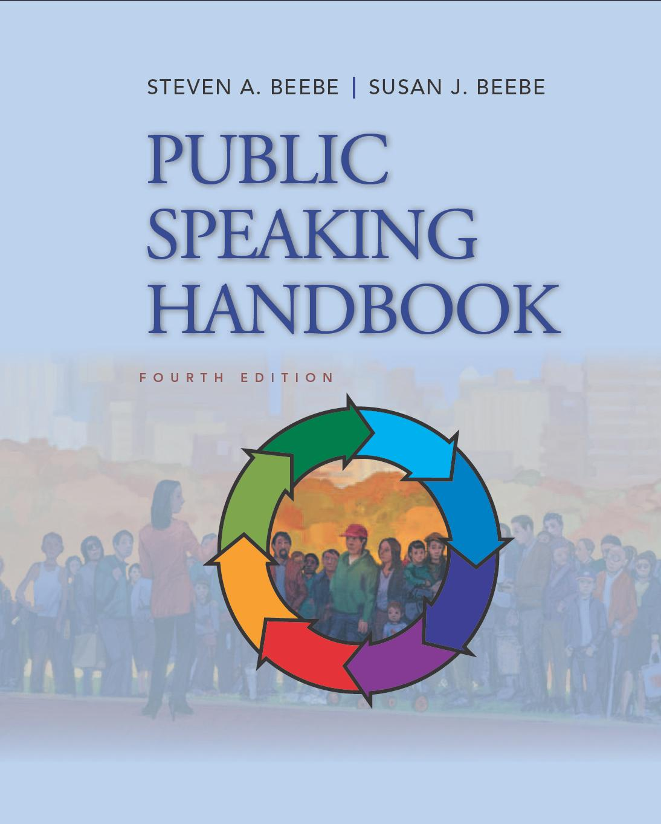
PowerPoint™ Presentation Prepared by
Diana M. Cooley, Ph.D.
Lone Star College – North Harris
Houston, Texas
Notes:
1

Slide 2
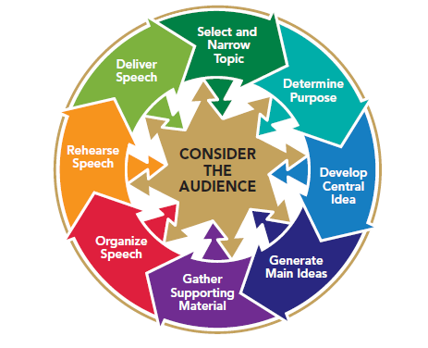
Chapter 12
Using Words Well: Speaker Language and Style
This multimedia product and its contents are protected under copyright law. The following are prohibited by law:
any public performance or display, including transmission of any image over a network;
preparation of any derivative work, including the extraction, in whole or in part, of any images;
any rental, lease, or lending of the program.
Notes:
Chapter Overview:
Differentiating Oral and Written Language Styles
Using Words Effectively
Adapting Your Language Style to Diverse Listeners
Crafting Memorable Word Structures
Using Memorable Word Structures Effectively

Slide 3
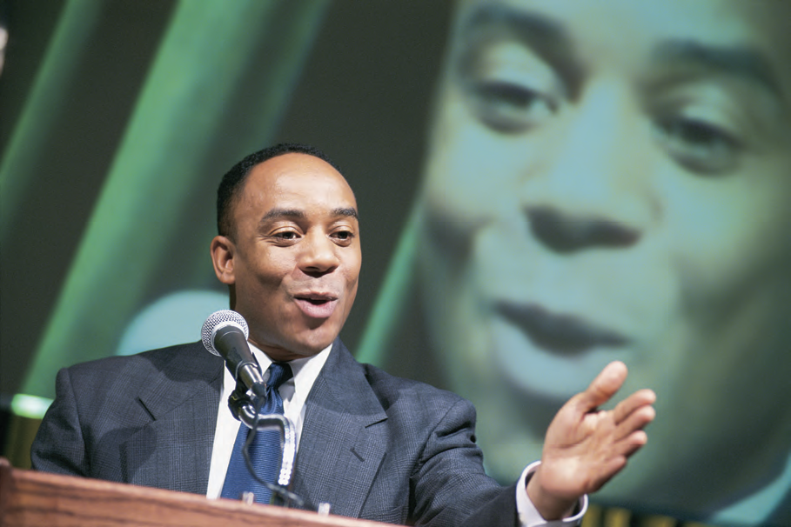
A speech is poetry; cadence, rhythm, imagery, sweep! A speech reminds us that words, like children, have the power to make dance the dullest beanbag of a heart.
~Peggy Noonan
Copyright © 2013, 2010, 2007, 2005 Pearson Education, Inc. All Rights Reserved.

Slide 4
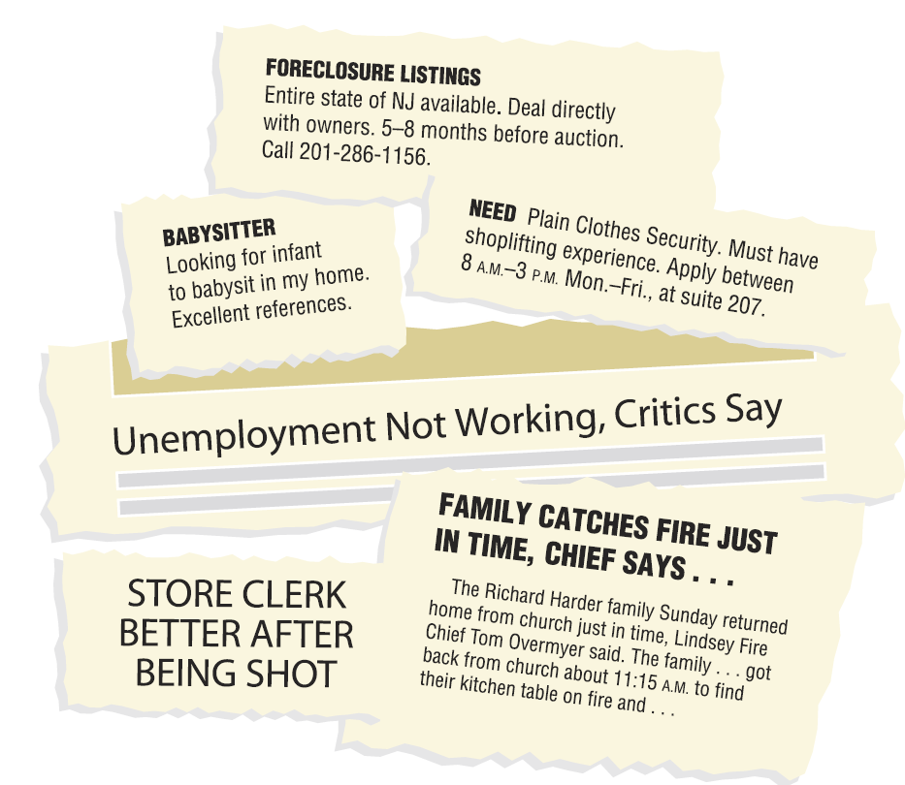
Figure 12.1
Using Language Accurately
Notes:
NOTES: Figure 12.1 Sometimes our word choices are unintentionally amusing.

Slide 5
Differentiating Oral and Written Language Styles
Oral style is more personal than written style
Oral style is less formal than written style
Oral style is more repetitive than written style
Notes:
NOTES: Your instructor has probably told you not to write your speech out word for word. The professor has said this because of the differences between speaking and writing. There are at least three major differences between oral and written language styles:
Oral style is more personal than written style. When speaking, you can look your listeners in the eye and talk to them directly. That personal contact affects your speech and your verbal style.
Oral style is less formal than written style. Memorized speeches usually sound as if they were written, because the words and phrases are longer, more complex, and more formal than those used by most speakers. Spoken communication, by contrast, is usually less formal, characterized by shorter words and phrases and less complex sentence structures.
Oral style is more repetitive than written style. When you don’t understand something that you are reading in a book or an article, you can stop and reread a passage, look up unfamiliar words in the dictionary, or ask someone for help. When you’re listening to a speech, those opportunities usually aren’t available. For this reason, an oral style is and should be more repetitive.

Slide 6
Using Words Effectively
Use specific, concrete words
Use simple words
Use words correctly
Use words concisely
Notes:
NOTES: As a speaker, your challenge is to use words well so that you can communicate your intended message. Ideally, language should be specific and concrete, simple, and correct.
Specific/concrete words: Specific words are often concrete words, which appeal to one of our five senses, whereas general words are often abstract words, which refer to ideas or qualities.
Simple words: The best language is often the simplest. Your words should be immediately understandable to your listeners. Don’t try to impress them with jargon and pompous language.
Using words correctly: A public speech is not the place to demonstrate your lack of familiarity with English vocabulary and grammar. In fact, your effectiveness with your audience depends in part on your ability to use the English language correctly. If you are unsure of the way to apply a grammatical rule, seek assistance from a good English usage handbook. If you are unsure of a word’s pronunciation or meaning, use a dictionary. Language operates on two levels, and perhaps the greatest challenge to using words correctly is remaining aware of connotations as well as denotations. Denotation. The denotation of a word is its literal meaning, the definition that you find in a dictionary. The connotation of a word is not usually found in a dictionary but consists of the meaning we associate with the word, based on our past experiences.
Using words concisely: Eliminate phrases that add no meaning to your message. Keeping your words concise helps your audience to follow your organization and can enhance your credibility. Avoid narrating your speaking technique. Avoid long phrases when a short one will do (see how to slide).

Slide 7
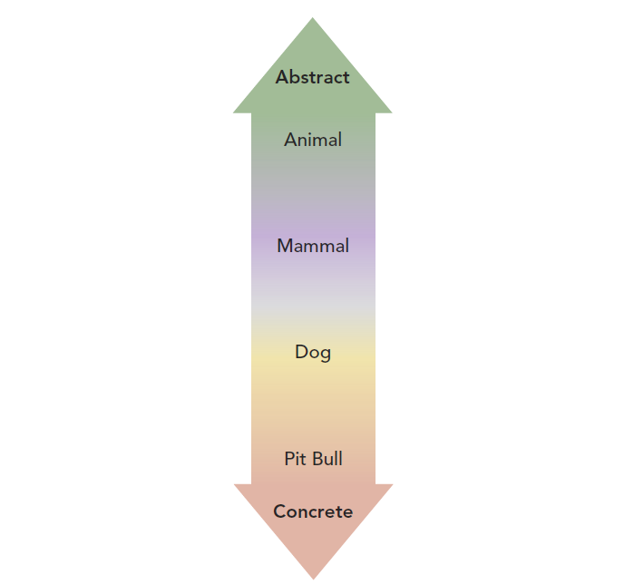
Figure 12.2
Ladder of Abstraction
Notes:
NOTES: Figure 12.2 Semanticists use a “ladder of abstraction” to show how a concept, idea, or thing can be described in either concrete or abstract terms.

Slide 8
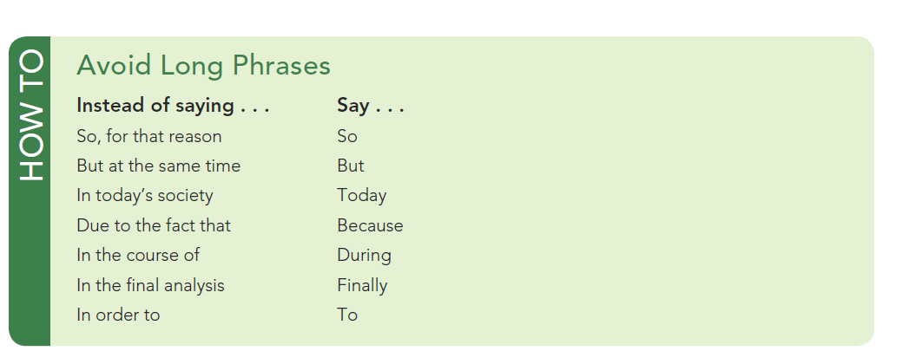
How To
Avoid Long Phrases
Notes:
NOTES:

Slide 9
Adapting Your Language Style to Diverse Listeners
Use language that your audience can understand
Use appropriate language
Use unbiased language
Notes:
NOTES: To communicate successfully with a diverse group of listeners, make sure your language is understandable, appropriate, and unbiased.
Use standard U.S. English. Standard U.S. English is the language taught by schools and used in the media, business, and government in the United States. “Standard” does not imply that standard U.S. English is inherently right and all other forms are wrong, only that it conforms to a standard that most speakers of U.S. English will readily understand, even though they may represent a variety of ethnic, regional, and professional backgrounds.
A speaker whose language defames any subgroup—such as people of particular ethnic, racial, and religious backgrounds or sexual orientations; women; or people with disabilities—or whose language might be otherwise considered offensive or risqué runs a great risk of antagonizing audience members
Even speakers who would never dream of using overtly offensive language may find it difficult to avoid language that more subtly stereotypes or discriminates. Sexist language falls largely into this second category.

Slide 10
Crafting Memorable Word Structures
Creating figurative images
Metaphors and similes
Personification
Creating drama
Use a short sentences
Use omission
Use inversion
Use suspension
Creating Cadence
Repetition
Parallelism
Antithesis
Alliteration
Notes:
NOTES: One way to make your message memorable is to use figures of speech to create arresting images. A figure of speech deviates from the ordinary, expected meanings of words to make a description or comparison unique, vivid, and memorable. Common figures of speech include metaphors, similes, and personification.
A metaphor is an implied comparison of two things or concepts that are similar in some vital way. A simile is a more direct comparison that includes the word like or as.
Personification is the attribution of human qualities to inanimate things or ideas.
Creating Drama - Another way in which you can make phrases and sentences memorable is to use them to create drama in your speech.
Use a short sentence to express a vitally important thought.
Use omission: Leave out a word or phrase that the audience expects to hear.
Use inversion: Reverse the normal word order of a phrase or sentence.
Use suspension: Place a key word or phrase at the end of a sentence rather than at the beginning.
Creating Cadence:
Repetition: repetition of a key word or phrase gives rhythm and power to your message and makes it memorable.
Whereas repetition refers to using identical words, parallelism refers to using different words but the identical grammatical patterns.
The word antithesis means “opposition.” A sentence that uses antithesis has two parts with parallel structures but contrasting meanings.
Alliteration is the repetition of a consonant sound (usually an initial consonant) several times in a phrase, clause, or sentence. Alliteration adds cadence to a thought.

Slide 11
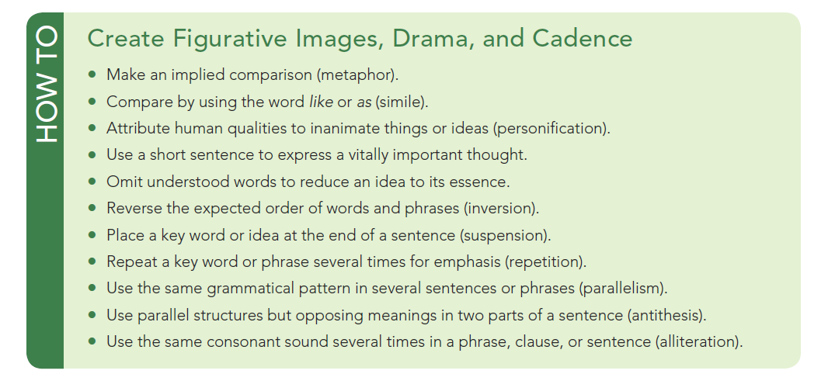
How To
Create Figurative Images, Drama, and Cadence
Notes:
NOTES: How to create figurative images, drama and cadence.

Slide 12
Using Memorable Word Structures Effectively
Use distinctive stylistic devices sparingly
Use stylistic devices at specific points in your speech
Use stylistic devices to economize
Notes:
NOTES: Having reviewed ways to add style and interest to the language of your speech, we must now consider how best to put those techniques into practice.
Use distinctive stylistic devices sparingly. Even though we have made great claims for the value of style, do not overdo it. Including too much highly stylized language can put the focus on your language rather than on your content.
Use stylistic devices at specific points in your speech. Save your use of stylistic devices for times during your speech when you want your audience to remember your key ideas or when you wish to capture their attention. Some kitchen mixers have a “burst of power” switch to help churn through difficult mixing chores with extra force. Think of the stylistic devices that we have reviewed as opportunities to provide a burst of power to your ideas. Use them in your opening sentences, statements of key ideas, and conclusion.
Use stylistic devices to economize. When sentences become too long or complex, try to recast them with antithesis or suspension. Also, consider the possibility of omission.

