Slide 1
PowerPoint™ Presentation Prepared by
Diana M. Cooley, Ph.D.
Lone Star College – North Harris
Houston, Texas
Notes:
1

Slide 2
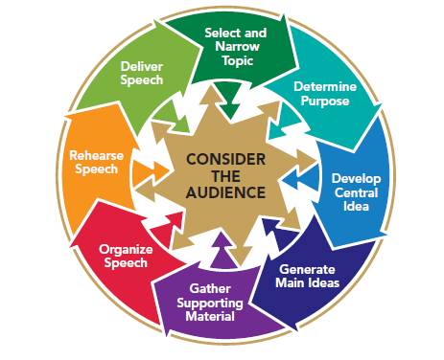
Chapter 9
Introducing Your Speech
This multimedia product and its contents are protected under copyright law. The following are prohibited by law:
any public performance or display, including transmission of any image over a network;
preparation of any derivative work, including the extraction, in whole or in part, of any images;
any rental, lease, or lending of the program.
Notes:
Chapter Overview:
Purposes of Introductions
Effective Introductions

Slide 3
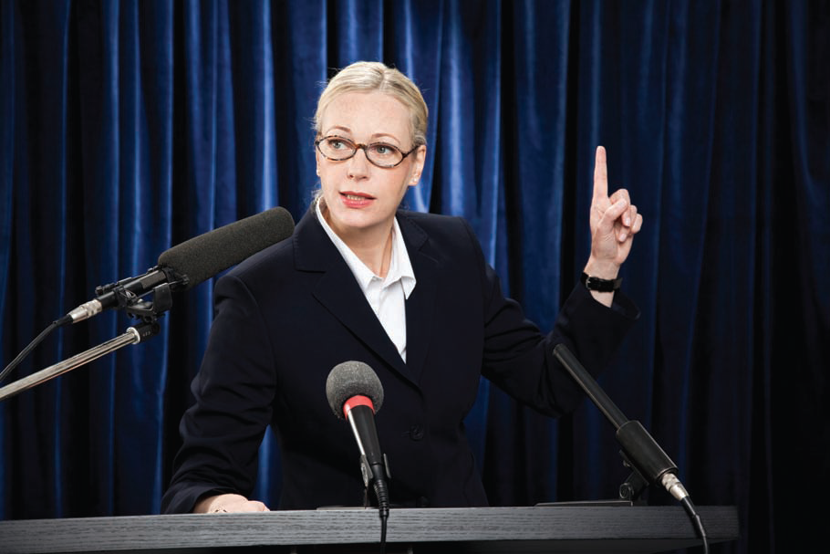
The average man thinks about what he has said; the above average man about what he is going to say.
~Anonymous
Copyright © 2013, 2010, 2007, 2005 Pearson Education, Inc. All Rights Reserved.

Slide 4
Purposes of Introductions
Get the audience’s attention
Give the audience a reason to listen
Introduce the subject
Establish your credibility
Preview your main ideas
Notes:
NOTES:
Within a few seconds of meeting a person, you form a first impression that is often quite lasting. So, too, do you form a first impression of a speaker and his or her message within the opening seconds of a speech. The introduction may convince you to listen carefully because this is a credible speaker presenting a well-prepared speech, or it may send the message that the speaker is ill-prepared and the message is not worth your time.
Get the audience’s attention: A key purpose of the introduction is to gain favorable attention for your speech. Because listeners form their first impressions of the speech quickly, if the introduction does not capture their attention and cast the speech in a favorable light, the rest of the speech may be wasted on them.
Give the audience a reason to listen: Even after you have captured the attention of your audience members, you have to give them some reason to want to listen to the rest of your speech. An unmotivated listener quickly tunes out. You can help to establish listening motivation by showing the members of your audience how the topic affects them directly.
Introduce the subject: Perhaps the most obvious purpose of an introduction is to introduce the subject of a speech. Within a few seconds after you begin your speech, the audience should have a pretty good idea of what you are going to talk about. Do not get so carried away with jokes or illustrations that you forget this basic purpose.
Establish your credibility: A credible speaker is one whom the audience judges to be a believable authority and a competent speaker. A credible speaker is also someone the audience believes they can trust. We stress here that as you begin your speech, you should be mindful of your listeners’ attitudes toward you. Ask yourself, “Why should they listen to me? What is my background with respect to the topic? Am I personally committed to the issues about which I am going to speak?”
Preview your main ideas: A final purpose of the introduction is to preview the main ideas of your speech. The preview statement usually comes near the end of the introduction, included in or immediately following a statement of the central idea. The preview statement allows your listeners to anticipate the main ideas of your speech, which in turn helps to ensure that they will remember those ideas after the speech.

Slide 5
Does your introduction get your audience’s attention?
Quick Check
Does Your Introduction Accomplish Its Purpose
To make sure it does . . .
Use an illustration, a startling fact or statistic, a quotation, humor, a question, a reference to an historical event or to a recent event, a personal reference, a reference to the occasion, or a reference to a preceding speech.

Slide 6
Does your introduction give the audience a reason to listen?
Quick Check
Does Your Introduction Accomplish Its Purpose
To make sure it does…
Tell your listeners how the topic directly affects them.

Slide 7
Does your introduction introduce the subject?
Quick Check
Does Your Introduction Accomplish Its Purpose
To make sure it does…
Present your central idea to your audience.

Slide 8
Does your introduction establish your credibility?
Quick Check
Does Your Introduction Accomplish Its Purpose
To make sure it does…
Offer your credentials. Tell your listeners about your commitment to your topic.

Slide 9
Does your introduction preview your main points?
Quick Check
Does Your Introduction Accomplish Its Purpose
To make sure it does…
Tell your audience what you are going to tell them.

Slide 10
Effective Introductions
Illustrations or anecdotes
Startling facts or statistics
Quotations
Humor
Questions
Reference to historical events
References to recent events
Personal references
References to the occasion
References to preceding speeches
Notes:
NOTES:
An illustration or anecdote, a brief story that is often based on fact, can provide the basis for an effective speech introduction.
Startling an audience with the extent of a situation or problem invariably catches its members’ attention and motivates them to listen further as well as helping them to remember afterward what you had to say.
Quotations - Using an appropriate quotation to introduce a speech is a common practice. Often, another writer or speaker has expressed an opinion on your topic that is more authoritative, comprehensive, or memorable than what you can say.
Humor - Humor, handled well, can be a wonderful attention-getter. It can help to relax your audience and win their goodwill for the rest of the speech.
Questions: To turn questions into an effective introduction, the speaker must do more than just think of good questions to ask. He or she must also deliver the questions effectively.
Reference to historical events: How do you discover anniversaries of historic events? You could consult “This Day in History” (www.history.com/this-day-in-history) or download a “This Day in History” app for the iPhone or iPad.
References to a recent event: a reference to a recent event can be a good way to open your speech. An opening taken from a recent news story can take the form of an illustration, a startling statistic, or even a quotation, giving you the additional advantages discussed under each of those methods of introduction.
Personal references: A reference to yourself can take several forms. You might express appreciation or pleasure at having been asked to speak.
References to the occasion: References to the occasion are often made at weddings, birthday parties, dedication ceremonies, and other such events.
References to preceding speech: If your speech is one of several being presented on the same occasion, such as in a speech class, at a symposium, or as part of a lecture series, you will usually not know until shortly before your own speech what other speakers will say. When this happens, you must decide on the spot whether referring to one of these previous speeches will be better than using the introduction that you originally prepared. It might be wise to refer to a preceding speech when another speaker has spoken on a topic that is so related to your own that you can draw an analogy.

