Slide 1
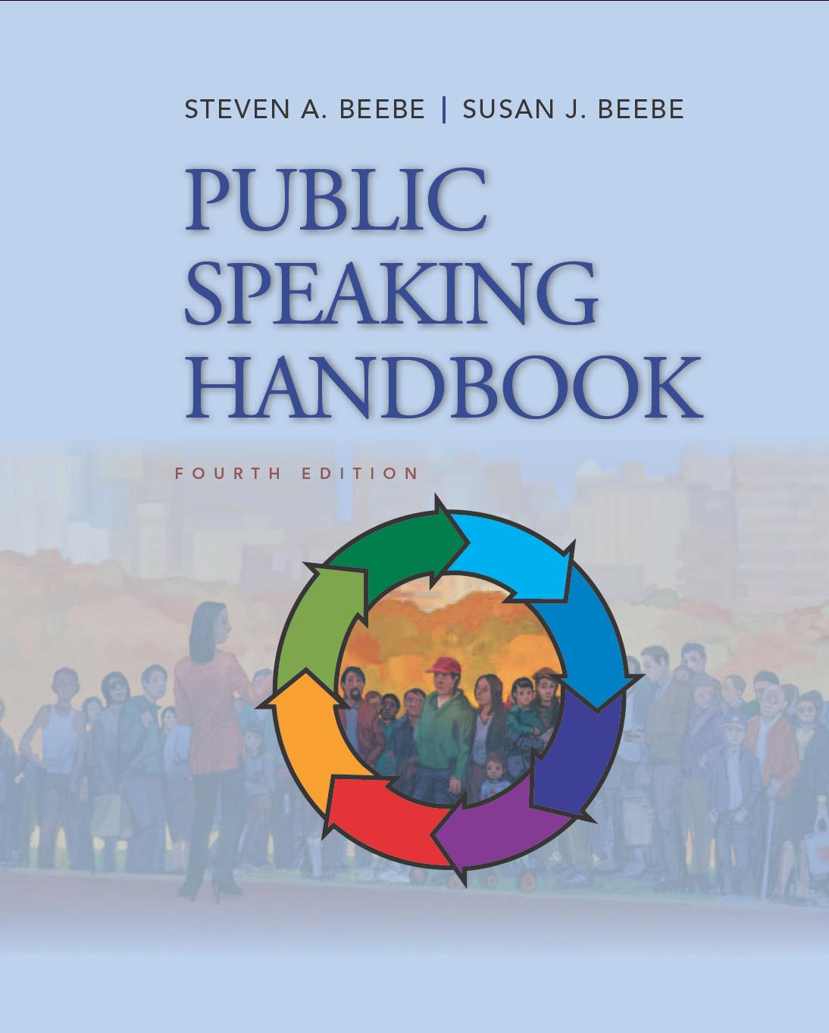
PowerPoint™ Presentation Prepared by
Diana M. Cooley, Ph.D.
Lone Star College – North Harris
Houston, Texas
Notes:
1

Slide 2
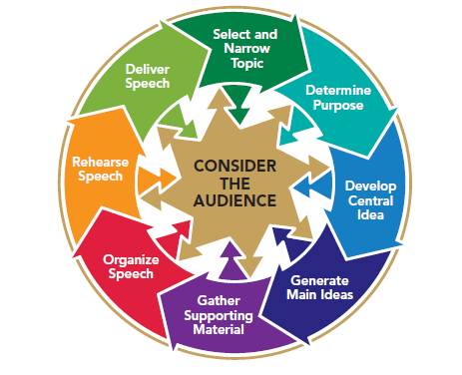
Chapter 7
Gathering Supporting Materials
This multimedia product and its contents are protected under copyright law. The following are prohibited by law:
any public performance or display, including transmission of any image over a network;
preparation of any derivative work, including the extraction, in whole or in part, of any images;
any rental, lease, or lending of the program.
Notes:
Chapter Overview:
Sources of Supporting Material
Research Strategies
Types of Supporting Material
The Best Supporting Material

Slide 3
Learn, compare, collect the facts! …
Always have the courage to say to yourself - I am ignorant.
~ Ivan Petrovich Pavlov
Copyright © 2013, 2010, 2007, 2005 Pearson Education, Inc. All Rights Reserved.

Slide 4
Sources of Supporting Material
Personal knowledge and experience
The Internet
Online databases
Traditional library holdings
Interviews
Notes:
NOTES:
There are various potential sources of supporting material. Remember to go to the best places to get the best ingredients for your speech.

Slide 5
Personal Knowledge
Skills
Hobbies
Personal experience
All of these can boost your credibility
Notes:
NOTES:
Personal knowledge & experience: It is true that most well-researched speeches include some objective material gathered from outside sources. But you may also be able to provide an effective illustration, explanation, definition, or other type of support from your own knowledge and experience. As an audience-centered speaker, you should realize, too, that personal knowledge often has the additional advantage of heightening your credibility in the minds of your listeners. They will accord you more respect as an authority when they realize that you have firsthand knowledge of a topic.

Slide 6
The Internet
Vertical search engine
Boolean search
Internet resources
Notes:
NOTES:
The internet: Understanding the Internet’s primary delivery system—the World Wide Web—the tools for accessing it, and some of the amazing types of information available can help to make your research more productive. vertical search engine, a Web site that indexes World Wide Web information in a specific field, can help you to narrow your search. For example, Google Scholar indexes academic sources, and Indeed indexes job Web sites. Another strategy that can help you to narrow your search is a Boolean search, which allows you to enclose phrases in quotation marks or parentheses so that a search yields only those sites on which all words of the phrase appear in that order, rather than sites that contain the words at random. Boolean searches also permit you to insert “AND” or “+” between words and phrases to indicate that you wish to see results that contain both phrases; similarly, they let you exclude certain words and phrases from your search.
Types of Internet Resources: advocacy sites, commercial sites, entertainment sites, information sties, news sites, and personal sites. Many online databases that began as computerized indexes now provide access to full texts of the resources themselves. Your library may subscribe to several or all of the popular full-text databases:
• ABA/Inform Global. This resource offers many full-text articles in business and trade publications from 1971 to the present.
• Academic Search Complete. This popular database offers many full-text articles from 1865 to the present, covering a wide variety of subjects.
• JSTOR. This is a multi-subject, full-text database of journal articles from the first volume to the present.
LexisNexis Academic. Focusing on business, industry, and law, this database provides many full-text articles from newspapers, magazines, journals, newsletters, and wire services. Dates of coverage vary.

Slide 7
Evaluating Web Resources
Evaluating Internet Resources
Accountability: Who is responsible for the site?
Accuracy: Is the information correct?
Objectivity: Is the site free of bias?
Timeliness: Is the site current?
Usability: Do the layout and design of the site facilitate its use?
Diversity: Is the site inclusive?
Notes:
NOTES:
See Table 7.1 for extended comments for evaluating internet resources

Slide 8
Traditional Library Holdings
Books
Periodicals
Online databases
Newspapers
Reference resources
Government documents
Special services
Notes:
NOTES:
Locating books through the card catalog. You can probably access your library’s computerized card catalog, a file of information about the books in a library, from your own computer before you ever enter the library.
Locating periodicals through periodical indexes. The term periodical refers to both general-interest magazines, such as Newsweek and Consumer Reports, and academic and professional journals, such as Communication Monographs and American Psychologist. Just as a card catalog can help you to find books, a periodical index, a listing of bibliographical data for articles published in a group of magazines and/or journals during a given time period, can help you to locate articles that might be useful.
Locating newspapers through newspaper indexes. Newspaper databases such as Newspaper Source not only index selected articles from newspapers and transcripts from news organizations, but also provide full texts of the articles. As with periodicals, you can use keyword searches to locate newspaper articles. If you know the date on which an event occurred, however, you can simply locate a newspaper from that or the following day and probably find a news story on the event.
Locating reference resources online and through the card catalog. Many encyclopedias, dictionaries, directories, atlases, almanacs, yearbooks, books of quotations, and biographical dictionaries are now available on the Internet.

Slide 9
Interviews
Preparing for the interview
Determine your purpose
Schedule the interview
Plan your questions
Conducting the interview
Dress appropriately
Arrive early
Conduct the interview
Following up the interview
Notes:
NOTES:
When you don’t know the answers to some of the important questions raised by your speech topic but you can think of someone who might, consider interviewing that person to get material for your speech. Consider a word of caution, however, before you decide that an interview is necessary be sure that your questions cannot be answered easily by looking at a Web site or reading a newspaper article or a book. Do some preliminary reading on your subject before you decide to take up someone’s valuable time in an interview. If you decide that only an interview can give you the material you need, you should prepare for it in advance.
Determine your purpose. The first step in preparing for an interview is to establish a purpose or objective for it. Specifically, what do you need to find out? Do you need hard facts that you cannot obtain from other sources? Do you need the interviewee’s expert testimony on your subject? Or do you need an explanation of some of the information that you have found in print sources?
Schedule the interview. Once you have a specific purpose for the interview and have decided whom you need to speak with, arrange a meeting. Telephone the person, explain briefly who you are and why you are calling, and ask for an appointment. Most people are flattered to have their authority and knowledge recognized and willingly grant interviews to serious students if schedules permit. If you are considering making an audio or video recording of the interview, ask for permission.
Plan your questions. Before your interview, prepare questions that take full advantage of the interviewee’s specific knowledge of your subject. You can do this only if you already know a good deal about your subject. It is also helpful to think about how you should combine the two basic types of interview questions: closed-ended and open-ended. Open-ended questions often follow closed-ended questions. If the person you are interviewing answers a closed-ended question with a simple yes or no, you might wish to follow up by asking “Why?”
Following Up the Interview As soon as possible after the interview, read through your notes carefully, and rewrite any portions that may be illegible. If you recorded the interview, label the recording with the date and the interviewee’s name. You will soon want to transfer any significant facts, opinions, or anecdotes from either notes or the recording to index cards or to a word-processing file.

Slide 10
Research Strategies
Develop a preliminary bibliography
Include possible resources to use in your speech
Keep track of your resources
Be consistent with your formatting (APA, MLA, etc)
Choose an appropriate number of resources
Notes:
NOTES:
Well-organized research strategies can make your efforts easier and more efficient. You need to develop a preliminary bibliography, evaluate the usefulness of resources, take notes, and identify possible presentation aids. Figure 7.4 (next slide) illustrates how to transfer information from an electronic-catalog entry to a bibliography card.

Slide 11
Figure 7.4
Creating a Bibliography Card
Transferring information from an electronic-catalog entry to a bibliography card
Notes:
NOTES:
The key to developing a useful bibliography is to establish a consistent format. The two most common formats, or documentation styles, are those developed by the MLA (Modern Language Association) and the APA (American Psychological Association).
MLA style is usually used in the humanities.
APA style in the natural and social sciences. Detailed instructions for formatting bibliography citations can be found in the style guides published by the MLA and APA and on Purdue University’s Online Writing Lab (OWL) at http://owl.english.purdue.edu/.
Check with your instructor about which format he or she prefers. No matter which format you use, you will most likely need the following information about your sources: For a book. You should record the author’s name, the title of the book, the publisher and date of publication, and the library’s call number. Figure 7.4 illustrates how to transfer information from an electronic-catalog entry to a bibliography card.

Slide 12
Research Strategies
Locate resources
Evaluate the usefulness of resources
Take notes
Identify possible presentation aids
Notes:
NOTES:
Locate resources: You should have no trouble obtaining the actual texts of resources from the Web and online databases. For all the other items in your preliminary bibliography, you will need to locate the resources yourself.
Evaluate usefulness: It makes sense to gauge the potential usefulness of your resources before you begin to read more closely and take notes. Think critically about how the various resources you have found are likely to help you achieve your purpose and about how effective they are likely to be with your audience.
Taking Notes: Once you have located, previewed, and ranked your resources, you are ready to begin more careful reading and note-taking. Beginning with the resources that have the greatest potential, record any examples, statistics, opinions, or other supporting material that might be useful to your speech. You can copy them by hand, photocopy them, download them into a computer file, or print them out. Be sure to identify the source.
Presentational aids: In addition to discovering verbal supporting material in your sources, you may also find charts, graphs, photographs, and other potentially valuable visual material. Even if you are not certain at this point that you will even use presentation aids in your speech, it can’t hurt to print out, photocopy, or sketch on a note card any good possibilities, recording those sources of information just as you did for your written materials.

Slide 13
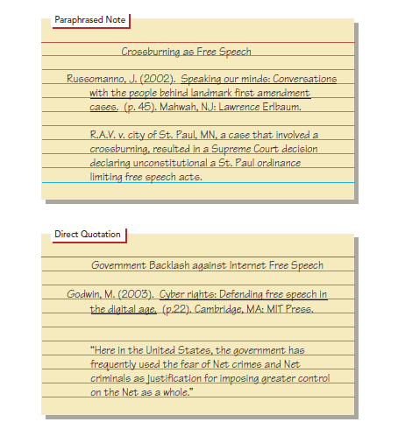
Figure 7.6
Sample Note Cards
Example of a paraphrased note card and a direct quotation note card.
Notes:
NOTES:
Figure 7.6 illustrates two note cards: one with a paraphrased note and one with a direct quotation.

Slide 14
Types of Supporting Material
Illustrations: Relevant stories
Descriptions: Word pictures
Explanations: Statements that make clear how something is done or why it exists in its present form or existed in a past form
Definitions: Concise explanations of a word or concept
Notes:
NOTES:
Illustrations - A story or anecdote—an illustration—almost always guarantees audience interest by appealing to their emotions. Sometimes, a series of brief illustrations can have more impact than either a single brief illustration or a more detailed extended illustration. In addition, although an audience could dismiss a single illustration as an exception, two or more illustrations strongly suggest a trend or norm. The extended illustration resembles a story. It is more vividly descriptive than a brief illustration, and it has a plot—an opening, complications, a climax, and a resolution. Hypothetical illustrations describe situations or events that have not actually occurred. Rather, they are scenarios that might happen. Plausible hypothetical illustrations enable your audience to imagine themselves in a particular situation. Illustrations are almost guaranteed attention getters, as well as a way to support your statements. Descriptions - Probably the most commonly used forms of support are descriptions and explanations. A description, or word picture, provides the details that allow audience members to develop mental images of what a speaker is talking about. An explanation is a statement that makes clear how something is done or why it exists. Explaining How speakers who discuss or demonstrate processes of any kind rely at least in part on explanations of how those processes work. Explaining Why involves giving reasons for or consequences of a policy, principle, or event. When large sections of a speech contain long, nonspecific explanations, audience eyelids are apt to droop. The following suggestions can help you to use descriptions and explanations effectively in your speeches. Keep your descriptions and explanations brief. Too many details may make your listeners say your speech was “everything I never wanted to know about the subject.” Use language that is as specific and concrete as possible. Vivid and specific language helps you to hold the audience’s attention and paint in your listeners’ minds the image you are trying to communicate. Definitions, statements of what terms mean or how they are applied in specific instances, have two justifiable uses in speeches. A definition by classification places a term in the general class, group, or family to which it belongs and differentiates it from all the other members of that class. An operational definition, explaining how something works or what it does.

Slide 15
Types of Supporting Material
Analogies: Comparison between two things
Statistics: Numbers that summarize numbers or examples
Opinions: Testimony or quotations from someone else
Notes:
NOTES:
Analogies: An analogy is a comparison. Like a definition, it increases understanding; unlike a definition, it deals with relationships and comparisons—between the new and the old, the unknown and the known, or any other pairs of ideas or things. Analogies can help your listeners to understand unfamiliar ideas, things, and situations by showing how these matters are similar to something they already know. There are two types of analogies. A literal analogy compares things that are actually similar (two sports, two cities, two events). A figurative analogy may take the form of a simile or a metaphor.
Statistics: Statistics can be expressed as either counts or percentages. Using statistics effectively & correctly: Use reliable sources. Use authoritative sources. No source is an authority on everything; therefore, no source can be credible on all subjects. The most authoritative source is the primary source—the original collector and interpreter of the data. Use unbiased sources. As well as being reputable and authoritative, sources should be as unbiased as possible. Interpret statistics accurately. People are often swayed by statistics that sound good but have, in fact, been wrongly calculated or misinterpreted.
Opinions: Three types of opinions (testimony or quotations that express someone’s attitudes, beliefs, or values) may be used as supporting material in speeches: the testimonies of expert authorities, the testimonies of ordinary (lay) people with firsthand or eyewitness experience, and quotations from literary works. Be certain that any authority you cite is an expert on the subject you are discussing & identify your sources.

