Slide 1
PowerPoint™ Presentation Prepared by
Diana M. Cooley, Ph.D.
Lone Star College – North Harris
Houston, Texas
Notes:
1

Slide 2
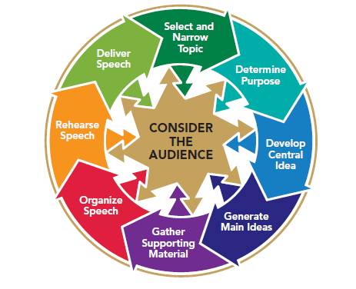
Chapter 5
Analyzing Your Audience
This multimedia product and its contents are protected under copyright law. The following are prohibited by law:
any public performance or display, including transmission of any image over a network;
preparation of any derivative work, including the extraction, in whole or in part, of any images;
any rental, lease, or lending of the program.
Notes:
Chapter Overview:
Becoming an Audience-Centered Speaker
Gathering Information About Your Audience
Analyzing Information About Your Audience
Adapting to Your Audience
Analyzing Your Audience Before You Speak
Adapting to You Audience as You Speak
Analyzing Your Audience After You Speak

Slide 3
For of the three elements in speechmaking - speaker, subject, and person addressed - it is the last one, the hearer, that determines the speech’s end and object. ~Aristotle
Copyright © 2013, 2010, 2007, 2005 Pearson Education, Inc. All Rights Reserved.

Slide 4
Becoming an Audience Centered Speaker
Audience Analysis is Central to the Speechmaking Process
Gather information about
your audience
Analyze the information
that you have gathered
Use your information to
ethically adapt to your
listeners
Figure 5.1
Notes:
NOTES:
Gathering information informally - The simplest way to gather information about your audience members informally is just to observe them and ask questions before you speak. Informal observations can be especially important in helping you to assess obvious demographic characteristics. Demographics are statistical information about characteristics such as age, race, gender, sexual orientation, educational level, and ideological or religious views of a population such as an audience.
Gather information formally - You can use surveys to gather demographic information that is not immediately available through observation.

Slide 5
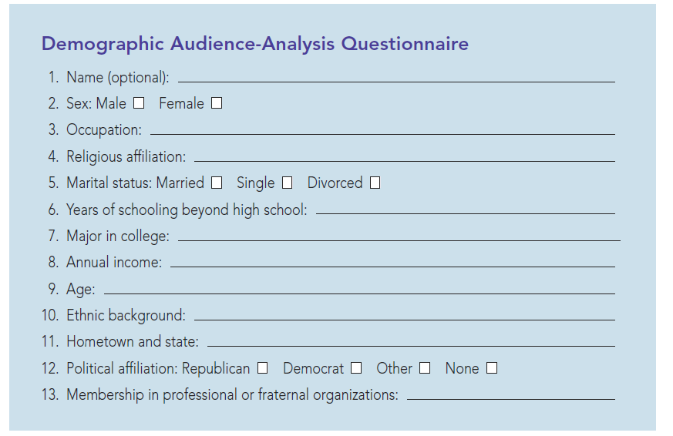
Figure 5.2
Demographic Audience-Analysis Questionnaire
Notes:
NOTES:
Rather than relying only on inferences drawn from casual observation and conversations with others, you may, if time and resources permit, want to conduct a more formal survey of your listeners. You can use surveys to gather demographic information that is not immediately available through observation, such as the questionnaire shown in Figure 5.2.

Slide 6
Analyzing Information About Your Audience
Look for audience member similarities
Look for audience member differences
Establish common ground with your audience
Notes:
NOTES:
Audience analysis is the process of examining information about the listeners who will hear your speech. That analysis helps you to adapt your message so that your listeners will respond as you wish. Precisely what do you look for when analyzing the information that you have
gathered about your audience? Consider answering the following questions:
• How are audience members similar to one another?
• How are audience members different from one another?
• On the basis of their similarities and differences, how can I establish common ground with the audience?

Slide 7
Adapting to Your Audience
Consider your audience
Consider your speech goal
Consider your speech content
Consider your delivery
Notes:
NOTES:
Audience adaptation is the process of ethically using information you’ve gathered when analyzing your audience to help your audience clearly understand your message and to help you achieve your speaking objective. To adapt is to modify your message to enhance its clarity and to enhance the likelihood that you will ethically achieve your goal.
Consider your audience and ask yourself these questions: 1. To whom am I speaking? 2. What does my audience expect from me? 3.What topic would be most suitable for my audience?
Consider Your Speech Goal: 1. What is my objective?
Consider Your Speech Content: 1. What kind of information should I share with my audience? 2.How should I present the information to them? 3.How can I gain and hold their attention? 4. What kind of examples would work best?
Consider Your Delivery: 1. What language or linguistic differences do audience members have? 2. What method of organizing information will be most effective?
Being audience-centered does not mean that you should tell your listeners only what they want to hear or that you should fabricate information simply to please your audience or achieve your goal. If you adapt to your audience by abandoning your own values and sense of truth, then you will become an unethical speaker rather than an audience-centered one.

Slide 8
Analyzing Your Before You Speak
Demographic Audience Analysis
Group Membership
Socioeconomic Status Income Occupation Education
Adapting to diverse listeners
Notes:
NOTES:
Learning about your audience members’ backgrounds and attitudes can help you to select a topic, define a purpose, develop an outline, and carry out virtually all other speech-related activities. You can gather and analyze three primary types of information:
Demographic Audience Analysis - demographics are statistics on population characteristics such as age; gender; sexual orientation; culture, ethnicity, and race; group membership; and socioeconomic status. Now let’s consider how demographic audience analysis can help you to better understand and adapt to your audience.
Group Membership - It’s said that each of us is a member of a gang—it’s just that some gangs are more socially acceptable than others. We are social creatures; we congregate in groups to gain an identity, to help accomplish projects we support, and to have fun. Group membership includes religious groups, political groups, work groups, social groups, service groups.
Socioeconomic Status - Socioeconomic status is a person’s perceived importance and influence based on such factors as income, occupation, and education level. In Europe, Asia, the Middle East, and other parts of the world, centuries-old traditions of acknowledging status differences still are important today. Status differences exist in the United States but are often more subtle.
Adapting to a diverse listener Adapting to Diverse Listeners The most recent U.S. census figures document what you already know from your own life experiences: We all live in an age of diversity.
Focus on a Target Audience A target audience is a specific segment of your audience that you most want to address or influence. You’ve undoubtedly been a target of skilled communicators and might not have been aware that messages had been tailored just for you.
Use Diverse Strategies for a Diverse Audience Another approach you can adopt, either separately or in combination with a target audience focus, is to use a variety of strategies to reflect the diversity of your audience.
Identify Common Values People have debated for a long time whether there are universal human values. Several scholars have made strong arguments that common human values do exist.
Rely on Visual Materials That Transcend Language Differences Pictures and images can communicate universal messages—especially emotional ones. Although there is no universal language, most listeners, regardless of culture and language, can comprehend visible expressions of pain, joy, sorrow, and happiness.

