Slide 1
Apology Speeches
By: Nichole Lee
By: Olivia, Ryan, Naldo John

Slide 2
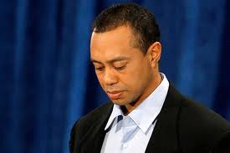
What is an Apology?
Two sides expressed:
Guilty side – understanding of offended
Innocent side – understanding of offender
http://www.thewrap.com/media/ind-column/tiger-woods-apology-scorecard-14428
Scher, Steven J., and John M. Darley. “How Effective are the Things People Say to Apologize? Effects of the Realization of the Apology Speech Act.” Journal of Psycholinguistic Research. 26.1 (1997): 127-140. Springer Standard Collection. Web. 2 June 2011.

Slide 3
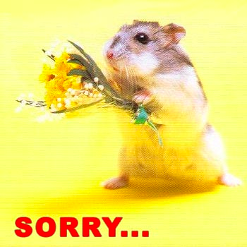
Elements of an Apology
Statement of Regret
http://howardgivner.com/2010/05
Scher, Steven J., and John M. Darley. “How Effective are the Things People Say to Apologize? Effects of the Realization of the Apology Speech Act.” Journal of Psycholinguistic Research. 26.1 (1997): 127-140. Springer Standard Collection. Web. 2 June 2011.

Slide 4
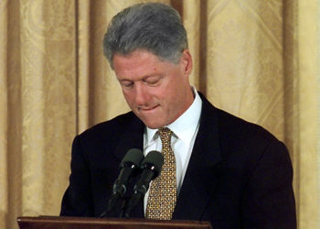
Elements of an Apology
Expression of accountability or responsibility by the offender
http://www.nydailynews.com/gossip/toplists/epic_apologies/epic_apologies.html
Scher, Steven J., and John M. Darley. “How Effective are the Things People Say to Apologize? Effects of the Realization of the Apology Speech Act.” Journal of Psycholinguistic Research. 26.1 (1997): 127-140. Springer Standard Collection. Web. 2 June 2011.

Slide 5
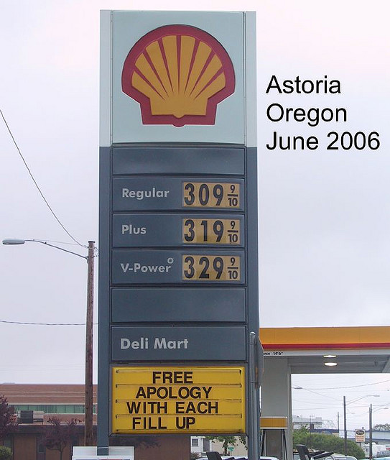
Elements of an Apology
Offer of repair
http://www.flickr.com/photos/whonl/164960839/sizes/z/in/photostream/
Scher, Steven J., and John M. Darley. “How Effective are the Things People Say to Apologize? Effects of the Realization of the Apology Speech Act.” Journal of Psycholinguistic Research. 26.1 (1997): 127-140. Springer Standard Collection. Web. 2 June 2011.

Slide 6
Elements of an Apology
Indication of future intentions
http://www.freeloveletters.org/apology-love-letter
Scher, Steven J., and John M. Darley. “How Effective are the Things People Say to Apologize? Effects of the Realization of the Apology Speech Act.” Journal of Psycholinguistic Research. 26.1 (1997): 127-140. Springer Standard Collection. Web. 2 June 2011.

Slide 7
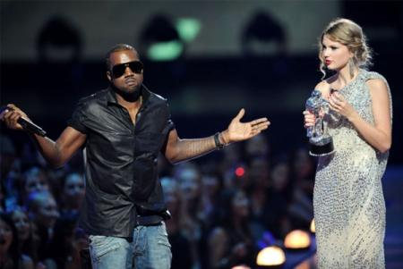
Elements of an Apology
Explanation
http://connect.in.com/kanye-apology/photos-kanye-west-apology-51cf7a5bba78582c.html
Scher, Steven J., and John M. Darley. “How Effective are the Things People Say to Apologize? Effects of the Realization of the Apology Speech Act.” Journal of Psycholinguistic Research. 26.1 (1997): 127-140. Springer Standard Collection. Web. 2 June 2011.

Slide 8
Effectiveness
of Apologies
Increased number of elements
in the apology
=
Increased effectiveness,
Decreased blame
Text and picture: Scher, Steven J., and John M. Darley. “How Effective are the Things People Say to Apologize? Effects of the Realization of the Apology Speech Act.” Journal of Psycholinguistic Research. 26.1 (1997): 127-140. Springer Standard Collection. Web. 2 June 2011.

Slide 9
Demonstration
Our apologies to you, the class and Keena.
This presentation was stolen.

Slide 10
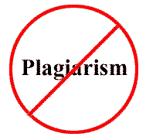
Apology Speeches
By: Nichole Lee
By: Olivia Thomas, Ryan Drendel, Naldo Yepes, John Wierzel
Picture: http://www.shortsaleartisan.com/blog/2010/11/08/cooks-source-and-copyright-violation-plagiarism/

Slide 11
*Disclaimer
This PowerPoint was not actually stolen. All our efforts have been put into this presentation. All information supplied in these pages have been cited to the fullest of our capabilities and to the best of our knowledge. We are consciously aware of the possibility that there may be unintentional errors or omissions. We accept full responsibility for our errors. We will correct them as soon as possible.
Nicole Lee is a fictitious character to the best of our knowledge, and was made up by Olivia Thomas and is not meant to depict any real person.
SCF and Dr. Keena Cowsert do not assume any liability for errors or omissions, or for damages resulting from the use of the information contained herein, and are not responsible for the content of external internet sites. “The information in these pages is provided on the basis that the reader will not rely on it as the sole basis for any action or decision. Readers are advised to contact the stated primary source or the product’s originating institution before acting on any of the information provided.”
Side effects include, possible blurred vision, knowledge gained about apologies, boredom, and, in some severe cases, nausea and vomiting and sometimes death.

